Slide 1
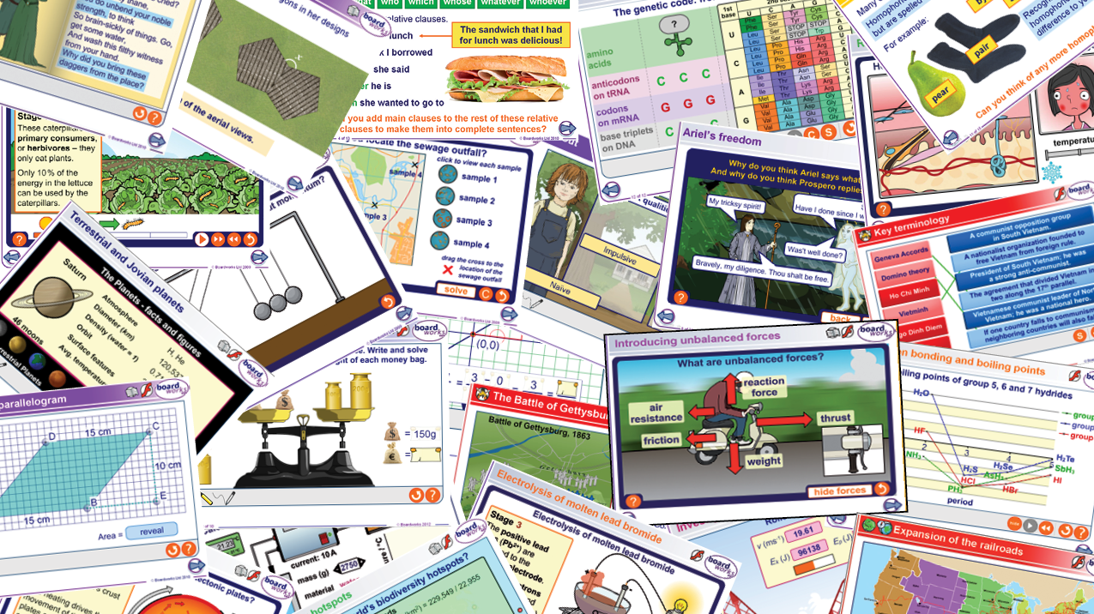
Welcome To Boardworks!
Quick Introduction
& Simple User Guide
for your
Boardworks Resources
Adult Education

Slide 2
Table of Contents
Introduction
All Access
Part 1 - Finding The Right Content
Part 2 – Using Boardworks
Part 3 – Personalizing to Make it Yours!
Part 4 - Common Troubleshooting
Some Images are animated GIFS, view presentation to see animations*

Slide 3
What we do:
Boardworks provides highly interactive and supplemental K-12 resources to enhance teaching and learning
Our goal: Empower every teacher to engage students and improve comprehension across all learning environments

Slide 4
How Boardworks Supports Teachers
Empower Teachers
Engage Students
Enhance Learning
From Anywhere and At Anytime

Slide 5
Boardworks – An Introduction
Who is this guy?
Dave Wilkerson
GA/Southeast Representative
dave.wilkerson@boardworksed.com
Teacher for 9 Years
US History, World History, Government, Geometry, & Health
Football, Wrestling, & Track/Field Coach

Slide 6
Boardworks – Tech Support
Who is this guy?
Andy Flowe – Boardworks Tech Support Expert!
support@boardworksed.com
855-405-7939

Slide 7
What is Boardworks?
Boardworks is a flexible library of content to help teachers continuing teaching no matter what type of modality
Ready-made curriculum-based content designed specifically for interactive whiteboards, student devices, teaching content
Lots of content: interactive games, quizzes, graphs, animations, activities, virtual experiments in science, interactive timelines in history
Customizable so you can differentiate and personalize it

Slide 8
How will Boardworks help make your lessons and your lives as teachers better?
Increased interactivity = increased student engagement
Maximizes use of existing technology
Saves time in lesson prep!
(Bonus: Save $$$!)

Slide 9
Goals for Today
Get you excited about using Boardworks in your lessons!
Show you how to find content & lessons
Explain slide icons for easy use and identification
Show you how to customize & personalize those lessons
Review some of the many way to fully use Boardworks

Slide 10
Every Teacher get All-Access
All Teachers should have access to all resources purchased, no matter your grade level or subject area.
If not, please contact your tech supervisor.
If you need to know what specific resources are available to you, please contact Dave or Andy

Slide 11
Part 1 - Finding The Right Content – Method 1 Download PPT’s Directly (Simplified Method)
Click on the box link provided to your program
Select PowerPoint Folders (for use on PC Version of PowerPoint)
Select Subject Area

Slide 12
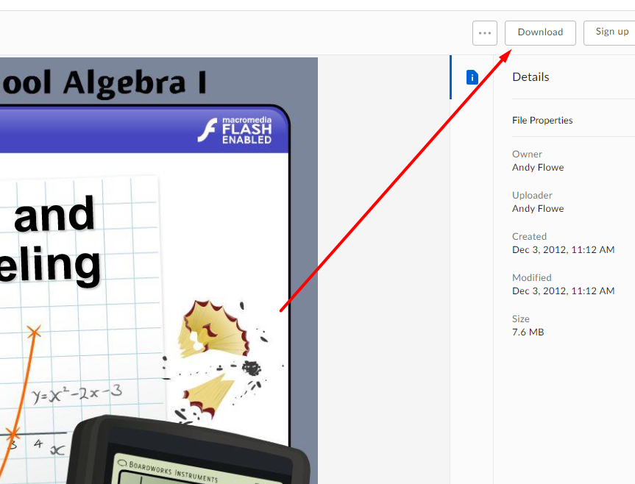
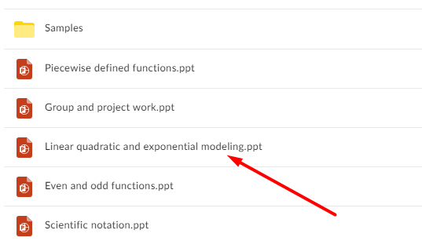
Part 1 - Finding The Right Content – Method 1 Download PPT’s Directly (Simplified Method)
Select desired individual PowerPoint File
Click Download in upper right corner of screen
All Individual Powerpoint file to download fully

Slide 13
Part 1 - Finding The Right Content – Method 2 Through Download Launcher (More Complicated)
Follow the Download Launcher instructions
If using Boardworks on a PC, click here for installation instructions: https://www.boardworkseducation.com/installation-pc/ If using Boardworks on a Mac, click here for installation instructions: https://www.boardworkseducation.com/offline-installation-mac/

Slide 14
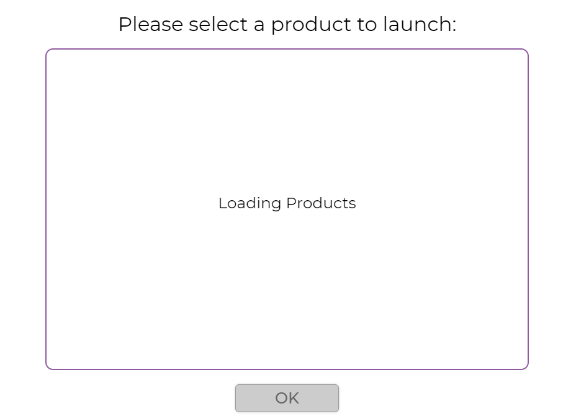
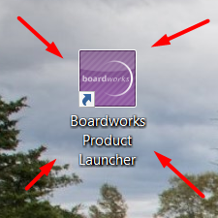
Part 1 - Finding The Right Content – Method 2 Through Download Launcher (More Complicated)
Once Downloaded and installed to your computer, select the “Boardworks Product Launcher” Icon – located on your desktop
Allow resources to load

Slide 15
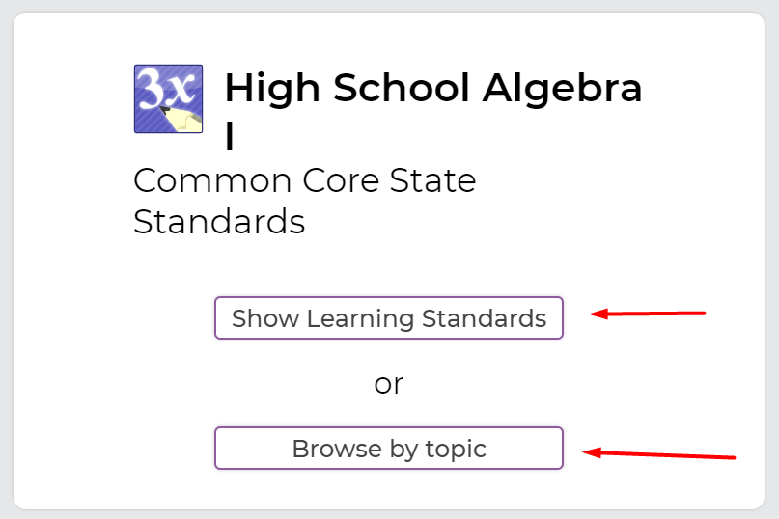
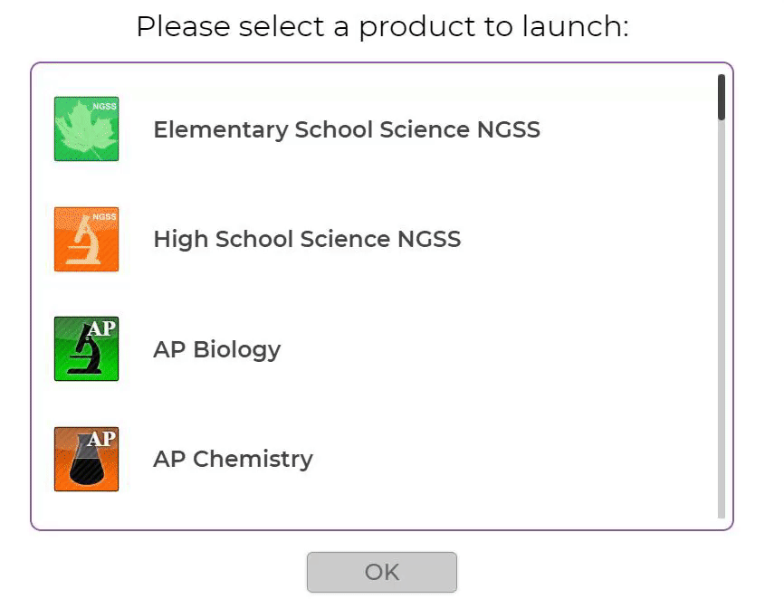
Part 1 - Finding The Right Content – Method 2 Step 2 – Select Level & Subject Area
Boardworks resources are organized alphabetically by subject area & grade level
Click on content and press ok to load presentations
Presentations are organized by standard or by “topic”

Slide 16
Part 1 - Finding The Right Content Step 3 – Filter by Standard or Topic
Browse Presentations through standards or by topic (topic may be quicker)
Presentations are organized alphabetically
Click standard, substandard, or topic to find presentations that cover relevant content to that standard or main topic
Can preview each or click Launch to load Powerpoint

Slide 17
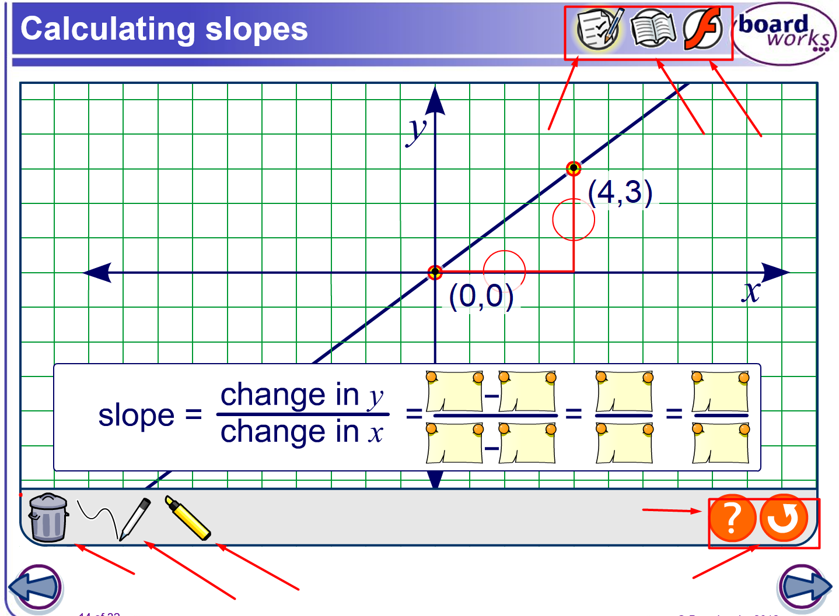
Part 2 – Using Boardworks What do these Icons Means?
The Boardworks presentations have icons to make it as easy as possible to know how to use the slide best
Icons can be found all throughout individual slides in the Boardworks Presentations

Slide 18
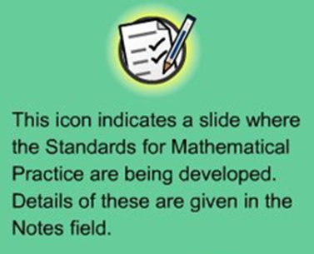
Part 2 – Using the Powerpoint What do these Icons Mean?
This icon indicates the slide contains a virtual experiment

Slide 19
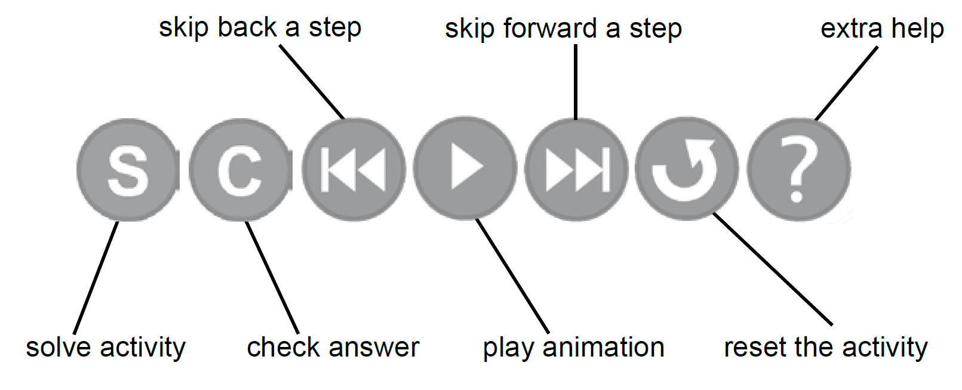
Part 2 – Using the Powerpoint What do these Icons Mean?
Some slides contain multi-stage animations and reviews that can easily be controlled by the icons on the slide
Click the help icon to see how to work the interactive content on that particular slide

Slide 20
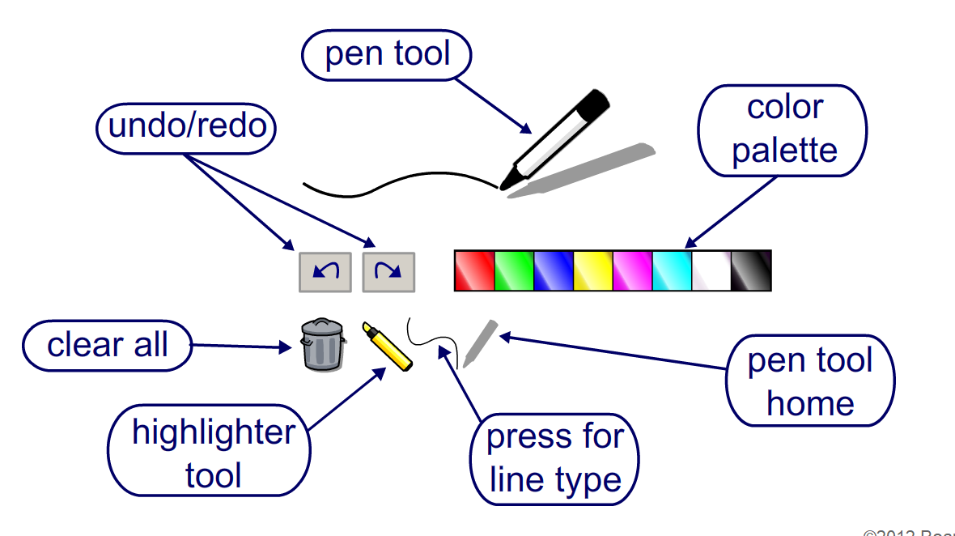
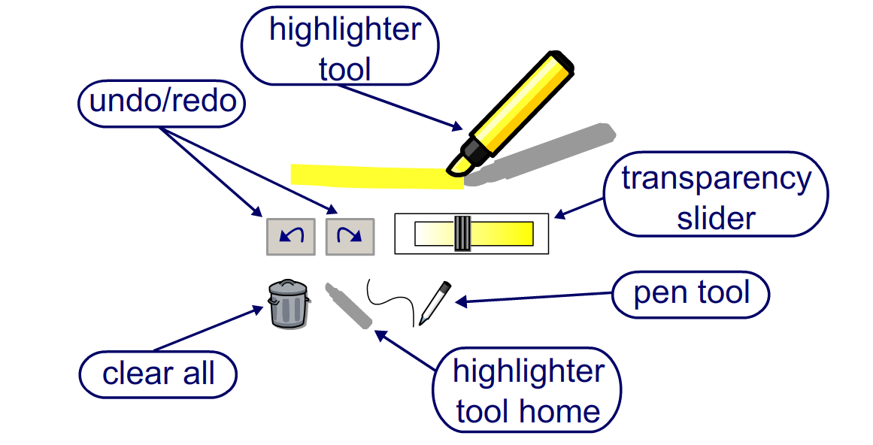
Part 2 – Using the Powerpoint What do these Icons Mean?
Interactive Slides give you access to more tools in the bottom left of screen

Slide 21
Part 3 – Personalizing to Make it Yours!
Each Boardworks Presentation is a complete lesson start to finish
You don’t have to use Boardworks that way though!
You can personalize these slides and presentations to fit your needs and the needs of your students
Edit slides and presentations as you normally would any other PowerPoint presentation
How to Use PowerPoint (Ultimate Tutorial Guide)

Slide 22
Part 3 – Personalizing to Make it Yours! Add, Delete, Rearrange, etc…
Add new text, delete text & pictures, reorder and add slides – you can customize any way you want to!

Slide 23
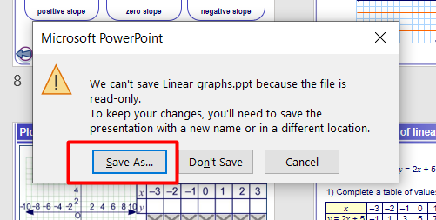
Part 3 – Personalizing to Make it Yours! Don’t worry about losing core presentations
Anytime you make any changes to Boardworks presentation, you can only “Save-As”
You can always go back to the original presentation just like you would to find other presentations

Slide 24
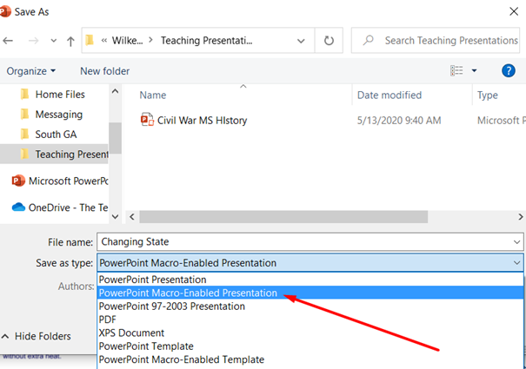
Part 3 – Personalizing to Make it Yours! Save personal presentations anywhere
You can save custom presentations anywhere on your computer, just like a normal PowerPoint – be sure to save as a “Macro-Enabled Presentation” to keep slides interactive

Slide 25
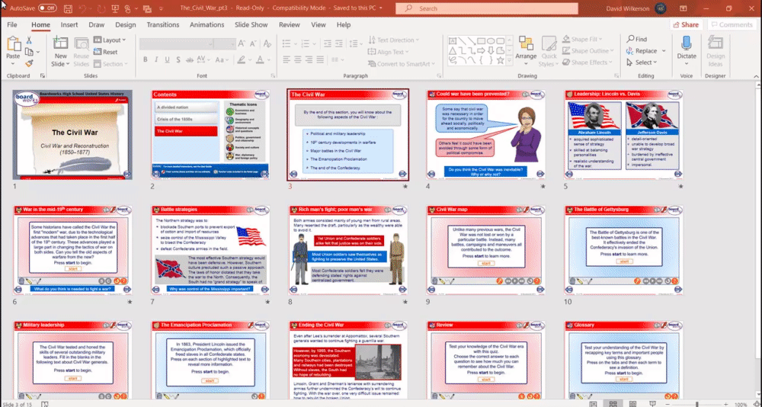
Part 3 – Personalizing to Make it Yours! Add to Boardworks or add Boardworks to Yours
You can add your content to Boardworks lessons if you want
Add a new slide or copy & paste slides into Boardworks lessons
You can add Boardworks Content to your already created PowerPoints (or other Boardworks lessons) and keep the interactive components!
Just Copy and paste slides into your PPT’s
Remember to save as “Macro-Enabled”

Slide 26
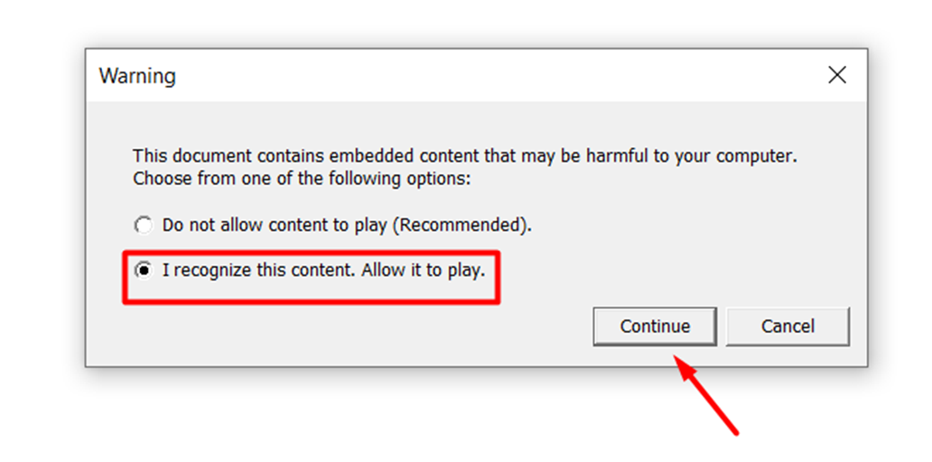
Part 4 - Common Troubleshooting Warning Sign
Sometimes this message occurs when you start a presentation
Boardworks is safe for your computer, just click that your recognize the content and allow it to play – press continue

Slide 27
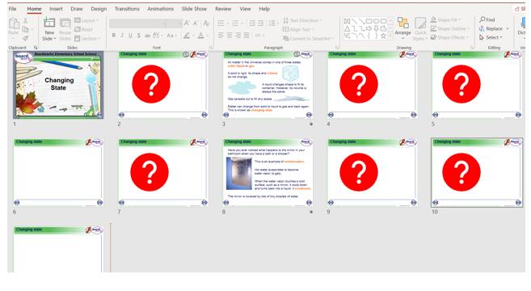
Part 4 - Common Troubleshooting Blank Slides
Sometimes presentations load and slides look blank
Simply view and go through the presentation with the arrows in bottom right to view each slide, whole presentation will then show after last slide

Slide 28
THANK YOU
TO OUR
TEACHERS!

