Slide 1
Earth’s Systems

Slide 2
Information
Developing and Using Models
Analyzing and Interpreting Data
Constructing Explanations and Designing Solutions
Obtaining, Evaluating and Communicating Information
4. Systems and System Models
6. Structure and Function

Slide 3
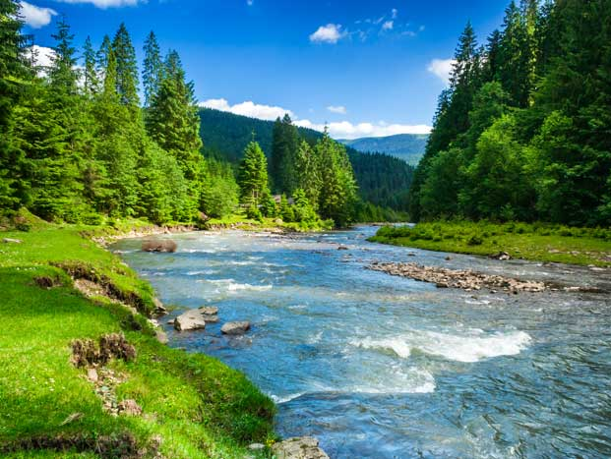
The Earth
Earth is a complex system of interacting rock, water, air and life. It can be divided into four systems:
geosphere
hydrosphere
atmosphere
biosphere.
All of Earth’s processes are the result of energy flowing and matter recycling within and between these systems.
Notes:
Teacher notes
You could remind students that a system is a group of parts working together to perform a function. Make sure students understand the term interacting.
Photo credit: © Mike Pellinni, Shutterstock.com 2018

Slide 4
The structure of the Earth
Notes:
This slide covers the Science and Engineering Practice:
Developing and Using Models: Develop and/or use models to describe and/or predict phenomena.

Slide 5
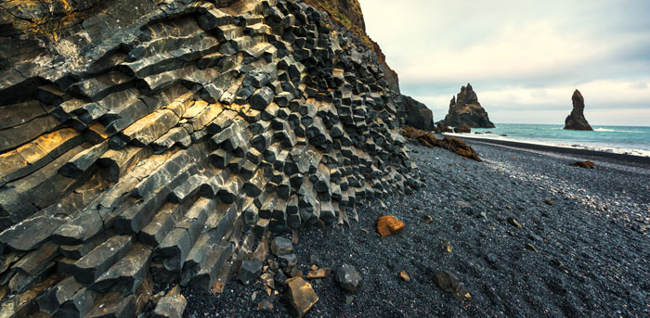
The geosphere (1)
The geosphere is the system that includes the solid parts of the Earth.
This includes all the rocks, minerals and landforms on Earth.
Notes:
Photo credit: © Smit, Shutterstock.com 2018

Slide 6
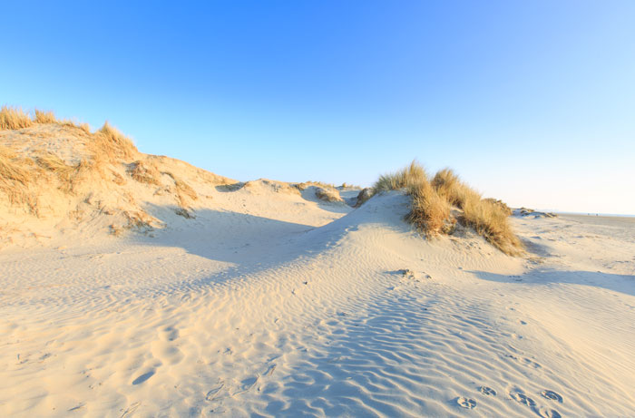
The geosphere (2)
On top of the crust is a layer of soil, which supports life. This is also part of the geosphere.
Sediment is also part of the geosphere. This is small bits of rock, sand or silt.
Notes:
Teacher notes
Students should already begin to spot interactions between spheres. The soil of the geosphere supports life, which is part of the biosphere.
Photo credits: Seedling © 249 Anurak; Dunes © Photodigitaal.nl, both at Shutterstock.com 2018

Slide 7
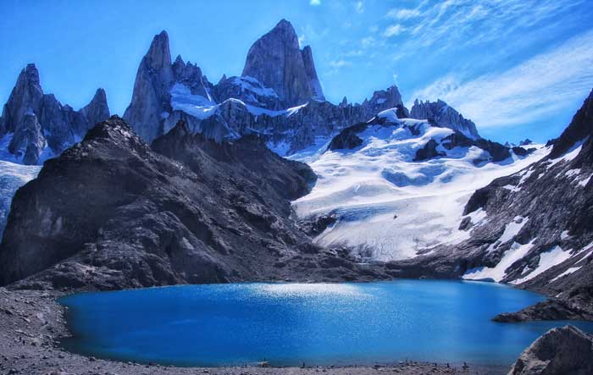
The hydrosphere
The hydrosphere is the system that includes all the water on the planet.
Can you identify the water in this image?
Notes:
Teacher notes
Students should be able to spot the lake, the snow/ice and the water vapor.
This slide covers the Science and Engineering Practice:
Analyzing and Interpreting Data: Analyze and interpret data to make sense of phenomena, using logical reasoning, mathematics, and/or computation.
Photo credit: © bajla marija, Shutterstock.com 2018

Slide 8
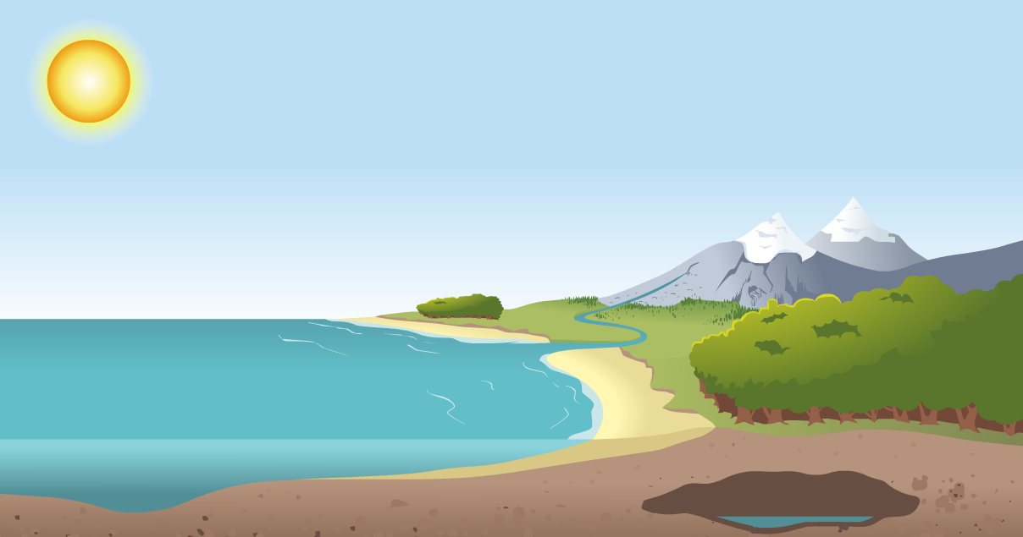
Where is water found?
Water can be found on the surface, underground and in the air. It exists as liquid, vapor and ice.
Water vapor/cloud
Snow
River
Ocean
Ground-water
Water is essential for life, as all organisms need water to survive.
Notes:
Teacher notes
Again, a simple interaction between spheres should be noted here. Water is found in the atmosphere, geosphere and biosphere (organisms contain a large percentage of water).

Slide 9
The water cycle

Slide 10
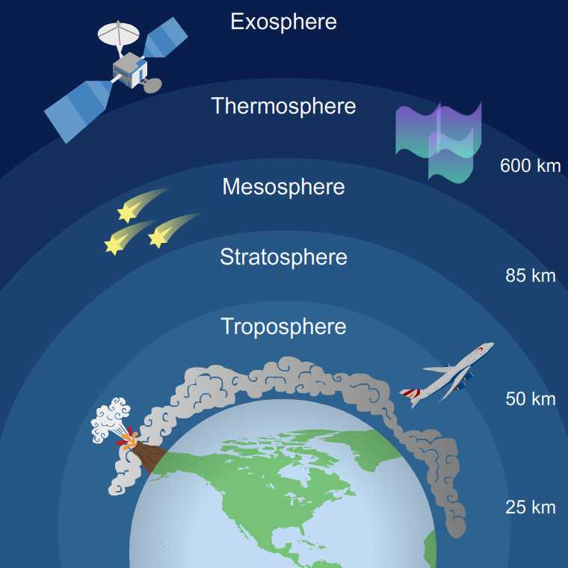
The atmosphere
The atmosphere is an envelope of different gases (air) surrounding the Earth.
Air is made of two main gases: nitrogen and oxygen. These are essential for life.
The atmosphere is divided into layers.
Notes:
Teacher notes
As you go up the layers in the atmosphere, the pressure and temperature decreases.

Slide 11
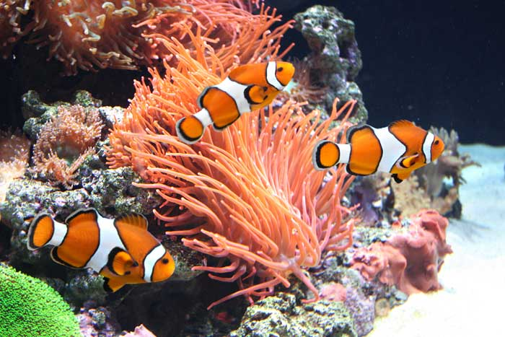
The biosphere
The biosphere is the system that includes all living things.
Living things can be found in a wide range of different locations on Earth, from deep in the ocean to the top of mountains.
Humans are also part of the biosphere.
Organisms rely on resources from other systems to survive. Can you name any of these, and the systems they come from?
Notes:
This slide covers the Science and Engineering Practice:
Obtaining, Evaluating, and Communicating Information: Communicate scientific and/or technical information orally and/or in written formats, including various forms of media and may include tables, diagrams, and charts.
Photo credit: © Lukiyanova Natalia frenta, Shutterstock.com 2018

Slide 12
How do Earth’s systems interact?
The four systems are constantly interacting.
We see this within the ocean.
The water is home to a large range of diverse organisms.
The water interacts with the atmosphere to form weather and affect climate.
The ocean can affect landforms, creating beaches, cliffs and caves.
Can you name the systems described here?
Notes:
This slide covers the Science and Engineering Practice:
Obtaining, Evaluating, and Communicating Information: Communicate scientific and/or technical information orally and/or in written formats, including various forms of media and may include tables, diagrams, and charts.
Photo credit: © Fulcanelli, Shutterstock.com 2018

Slide 13
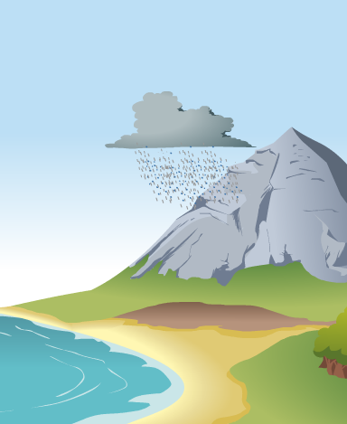
Landforms
Wind and clouds in the atmosphere interact with landforms to determine patterns in weather.
For example, when clouds meet a mountain the air is pushed upwards.
This change in height causes the moisture in the clouds to condense and precipitation occurs.

Slide 14
The rain shadow effect
The other side of the mountain does not get the same amount of rain.
This is known as the rain shadow effect.
Rainfall in turn will affect the distribution of organisms.
How do you think organisms will be affected by the rain shadow effect?
Notes:
Teacher notes
Help students to apply their understanding to answer the question. The rainy side of the mountain may have more plant species, whereas the side in the rain shadow may contain organisms suited for dry conditions.
This slide covers the Science and Engineering Practices:
Constructing Explanations and Designing Solutions: Use evidence (e.g., measurements, observations, patterns) to construct or support an explanation or design a solution to a problem.
Obtaining, Evaluating, and Communicating Information: Communicate scientific and/or technical information orally and/or in written formats, including various forms of media and may include tables, diagrams, and charts.

Slide 15
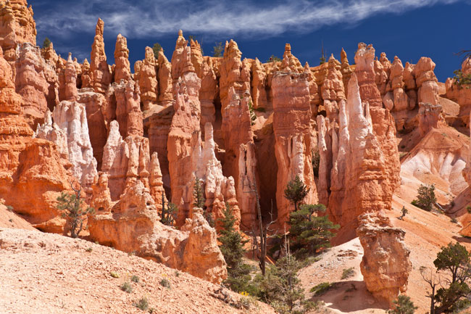
Erosion and deposition
Both wind in the atmosphere and rain in the hydrosphere can shape and change landforms.
This happens through erosion and deposition.
Notes:
Teacher notes
For more information on erosion and deposition, please refer to the Erosion, Transportation and Deposition presentation.
Photo credit: © Berzina, Shutterstock.com 2018

