Slide 1
Erosion, Transportation and Deposition

Slide 2
Information
Asking Questions and Defining Problems
Planning and Carrying Out Investigations
1. Patterns
2. Cause and Effect
7. Stability and Change

Slide 3
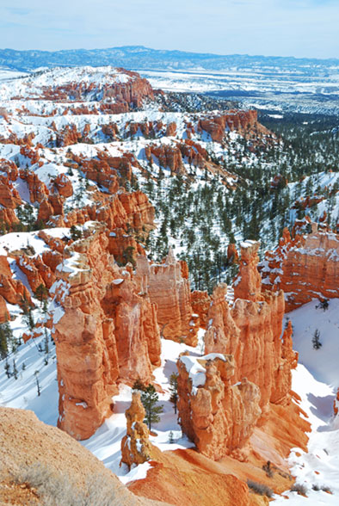
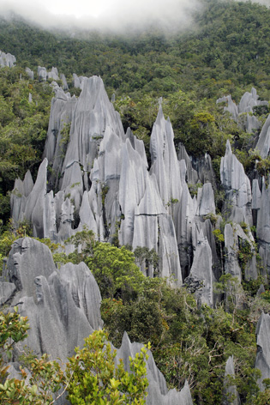
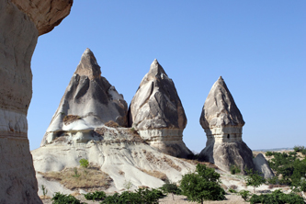
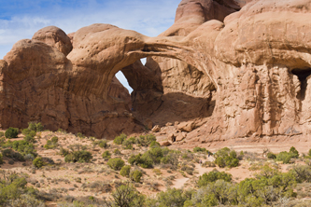
Changing landscapes
Where can we find evidence of landscapes changing?
Notes:
Photo credits: The Pinnacles, Borneo © Dorin Panaitopol; Cappadocia, Turkey © Manamana; Arches National Park, Utah © Irina Moskalev; Bryce Canyon National Park, Utah © Songquan Deng, all at Shutterstock.com 2018

Slide 4
Causes of landscape change
What do you think causes changes in landscapes?
water
ice
wind
gravity
living things.
All of these can change the shape of the land.
They can also work together.

Slide 5
Weathering experiment
Notes:
This slide covers the Science and Engineering Practices:
Asking Questions and Defining Problems: Ask questions that can be investigated and predict reasonable outcomes based on patterns such as cause and effect relationships.
Planning and Carrying Out Investigations: Make observations and/or measurements to produce data to serve as the basis for evidence for an explanation of a phenomenon or to test a design solution.

Slide 6
Freezing temperature and weathering
Notes:
This slide covers the Science and Engineering Practices:
Asking Questions and Defining Problems: Ask questions that can be investigated and predict reasonable outcomes based on patterns such as cause and effect relationships.
Planning and Carrying Out Investigations: Make observations and/or measurements to produce data to serve as the basis for evidence for an explanation of a phenomenon or to test a design solution.

Slide 7
What happens to weathered rocks? (1)

Slide 8
What happens to weathered rocks? (2)

Slide 9
What happens to weathered rocks? (3)

Slide 10
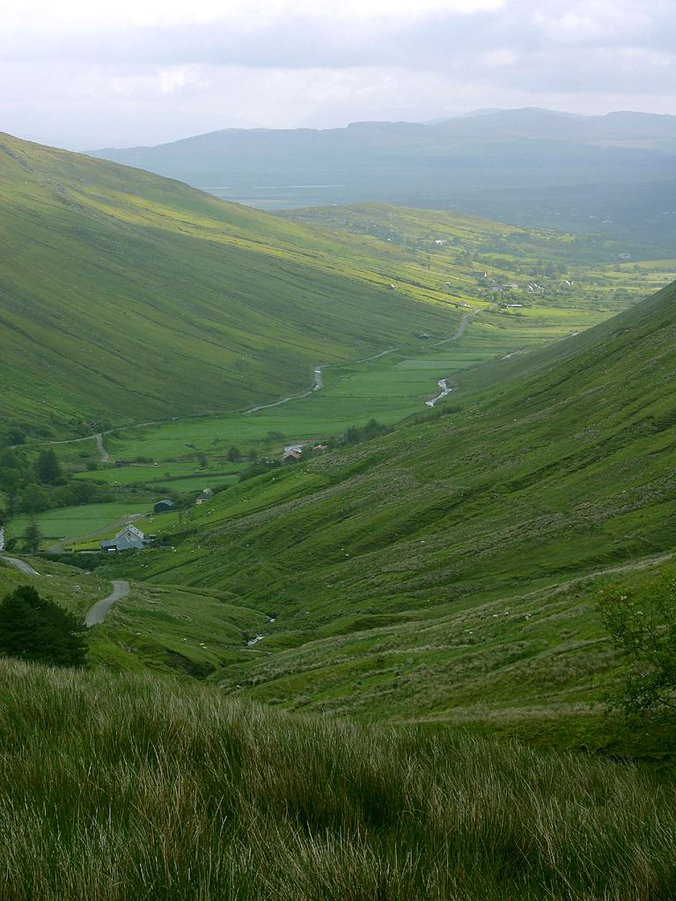
Valleys
Weathering, along with erosion, transportation and deposition by rivers, creates landscape features!
You see V-shaped valleys like this at the start of rivers. The river and the rocks it is carrying slowly erode the river bed, cutting into the land. The valley becomes wider and wider over time.
Notes:
Photo credit: Photo courtesy of PDPhotos.org

Slide 11
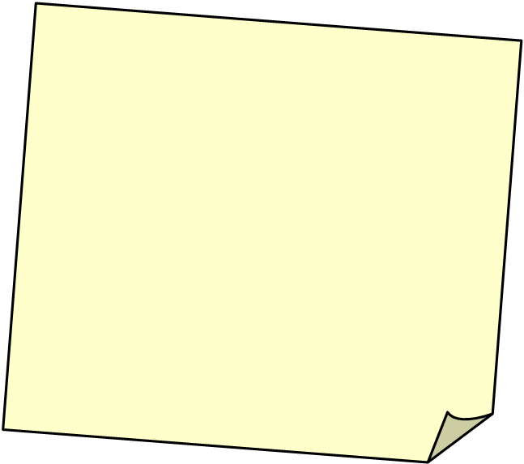
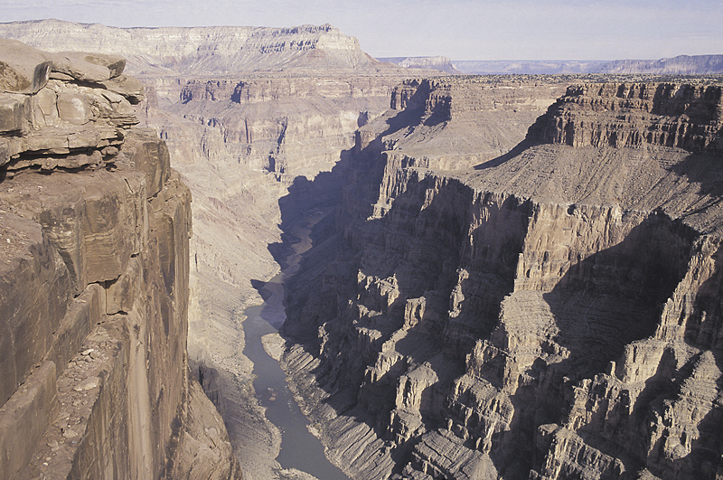
Canyons
This is the Grand Canyon.
A canyon is a very steep valley. Parts of the Grand Canyon are over one kilometers deep! The Canyon was carved out over thousands of years by erosion caused by the Colorado River, as well other forms of weathering.
Colorado River
Notes:
Photo credit: © Jupiterimages Corporation, 2018

Slide 12
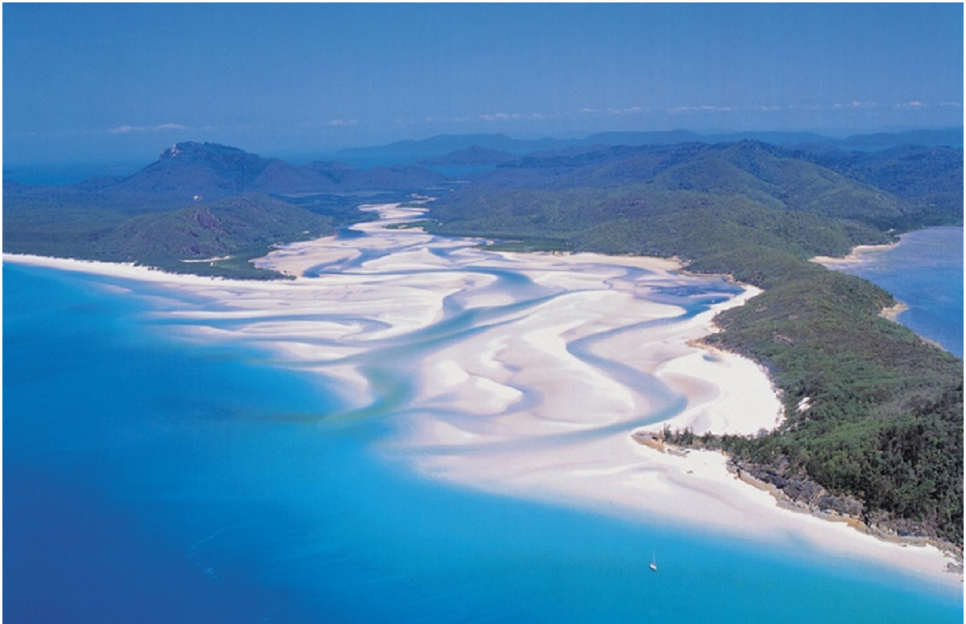
Deltas
Deposition can create new land! As a river enters the ocean, its current is very slow. It deposits all the rock and mud that it can no longer transport.
This causes the river to break up into smaller channels.
The sediment left by the river builds up and turns into new sections of land, called deltas.
delta
Notes:
Photo credit: © Jupiterimages Corporation, 2018

Slide 13
Erosion, transportation and deposition

