Slide 1
Impacts of Human Activity

Slide 2
Information
Constructing Explanations and Designing Solutions
2. Cause and Effect
7. Stability and Change

Slide 3
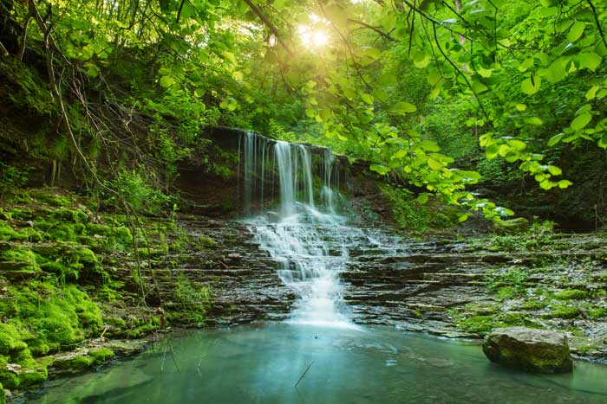
Impacts of human activity
Over 7 billion people live on Earth today.
The activities of all these humans has had a major effect on the environment.
This affects:
land
vegetation
streams
oceans
air.
Notes:
Photo credit: © Roxana Bashyrova, Shutterstock.com 2018

Slide 4
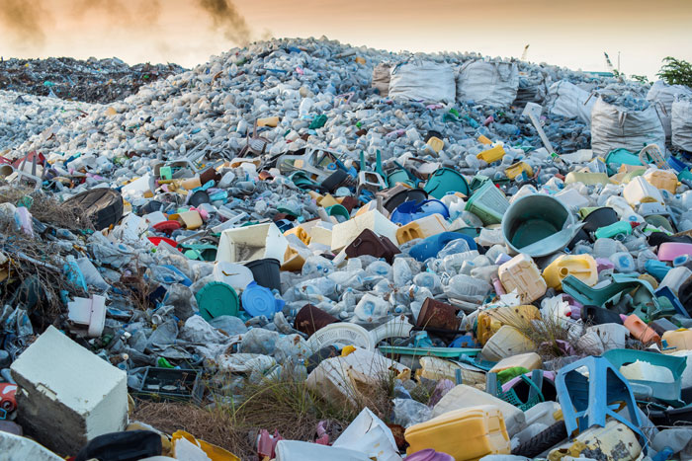
Impacts of human activity
Humans generate a lot of waste products. Landfill sites are areas where garbage is dumped and buried.
This garbage takes a long time to break down. Some materials also release toxic chemicals as they break down, which can enter the soil.
These toxic chemicals can stop plants from growing.
Notes:
Photo credit: © MOHAMED ABDULRAHEEM, Shutterstock.com 2018

Slide 5
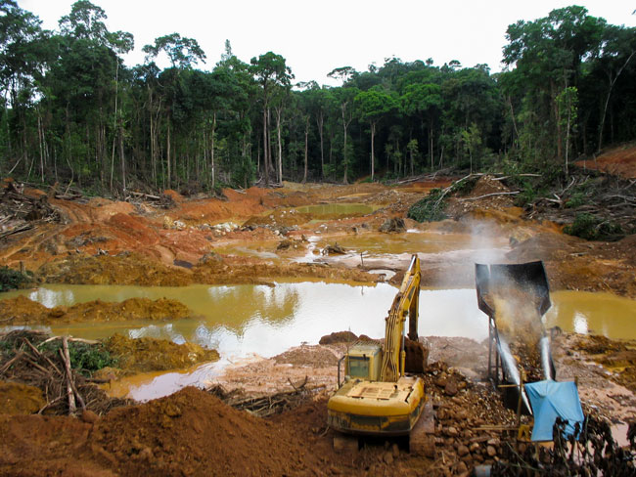
Impacts of human activity
Deforestation is the removal of forests. This is often done to allow human activities, such as agriculture or cattle farming.
This removes habitats for many types of animals and plants, which can affect population numbers.
It may even cause some organisms to become extinct.
Notes:
Photo credit: © kakteen, Shutterstock.com 2018

Slide 6
Impacts of human activity
Notes:
This slide covers the Science and Engineering Practice:
Constructing Explanations and Designing Solutions: Use evidence (e.g., measurements, observations, patterns) to construct or support an explanation or design a solution to a problem.

Slide 7
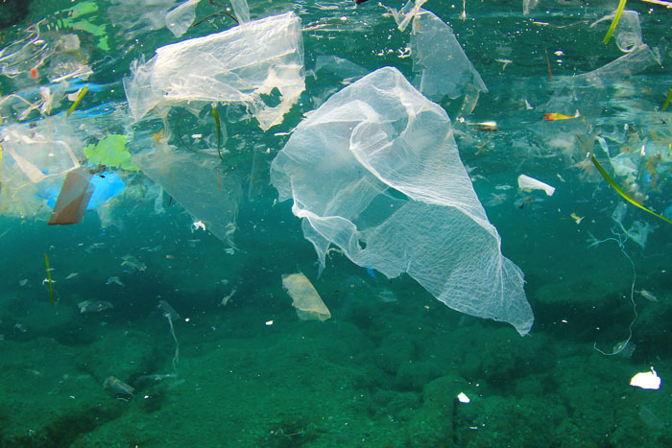
Impacts of human activity
A lot of objects we use and throw away in everyday life are made of plastic. Some of this plastic eventually makes its way into the ocean.
Many marine animals cannot tell the difference between plastic and food, so they can accidentally eat it.
The plastic cannot be broken down, so it fills their stomach and prevents them from eating real food.
Notes:
Teacher notes
Scientists estimate there are 8 million metric tons of plastic being added to the oceans each year. This is equivalent to a garbage truck of plastic every minute.
Ask students if they can guess what turtles often mistake plastic bags for. The right answer is jellyfish.
Photo credit: © Rich Carey, Shutterstock.com 2018

Slide 8
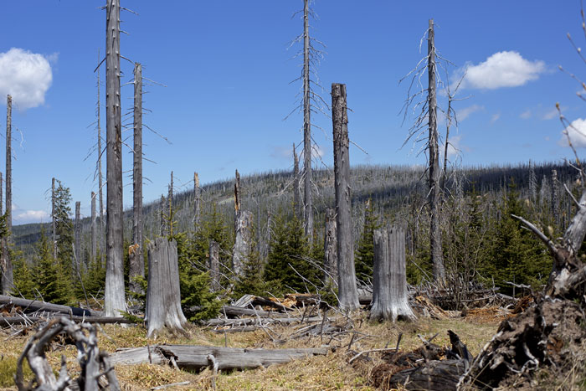
Impacts of human activity
Human activity is causing harmful chemicals and materials to enter the Earth’s atmosphere. For example, smoke from burning fuels and gases from industrial activities.
Acidic gases can dissolve in the water held in clouds, leading to acid rain.
When acid rain falls, it can cause changes to the soil and water in rivers, lakes and streams. This can then affect plant and animals in these areas, causing some to die.
Notes:
Teacher notes
The image shows a forest in Bavaria that has been damaged by acid rain.
Photo credit: © Axel Jung, Shutterstock.com 2018

Slide 9
Impacts of human activity
Notes:
This slide covers the Science and Engineering Practice:
Constructing Explanations and Designing Solutions: Use evidence (e.g., measurements, observations, patterns) to construct or support an explanation or design a solution to a problem.

Slide 10
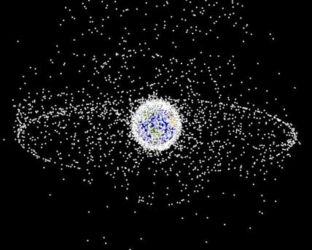
Impacts of human activity
Human activity has not only affected Earth, but also outer space.
There are thought to be more than 500,000 pieces of space debris orbiting the Earth.
This includes human-made objects that are no longer in use, such as satellites, and parts of rockets and space vehicles.
Notes:
Teacher notes
Ask students to think about what impact this could have on future space missions and existing spacecraft with humans on board, such as the International Space Station.
Photo credit: NASA

