Slide 1
Living Things Cause Change

Slide 2
Information
Constructing Explanations and Designing Solutions
Obtaining, Evaluating and Communicating Information
1. Patterns
2. Cause and Effect
7. Stability and Change

Slide 3
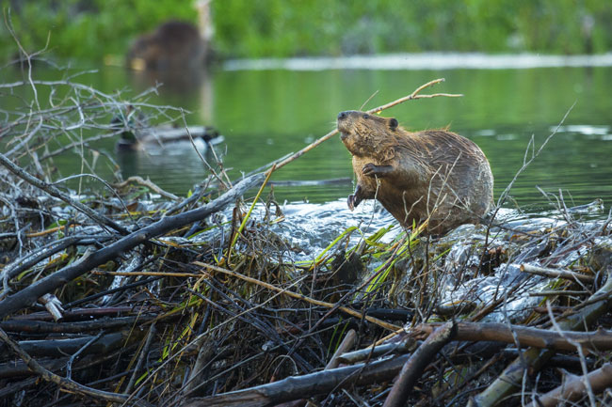
Living things cause change
Plants and animals can change their environment.
This beaver is building a dam for shelter. This will affect the flow and height of the river.
Notes:
Teacher notes
Beavers build dams to deepen the water to enable them to create “lodges” where they can raise young. The deep water helps them to defend the lodges from predators.
Photo credit: © Chase Dekker, Shutterstock.com 2018

Slide 4
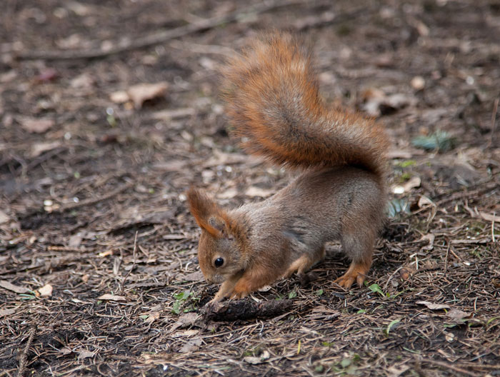
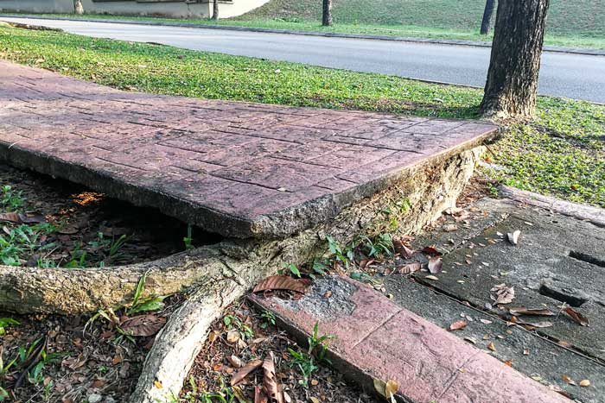
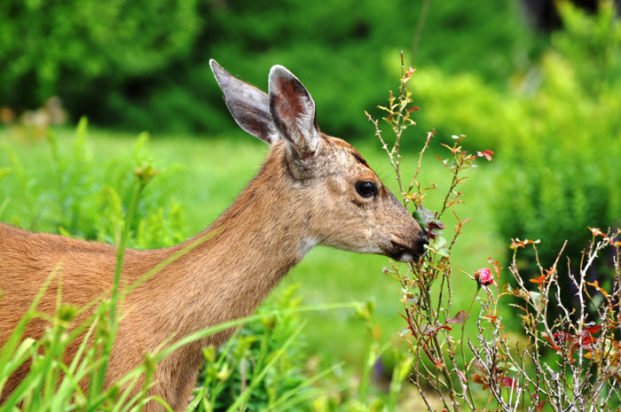
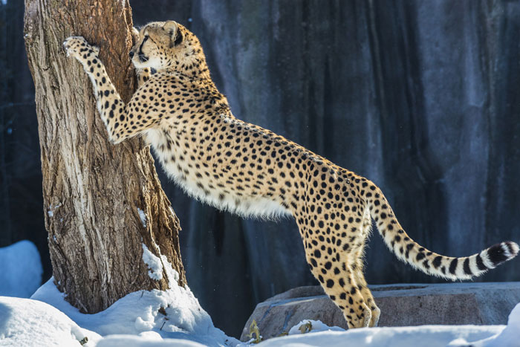
Living things cause change
How are these plants and animals affecting their environment?
What needs are being met by the environment?
Notes:
This slide covers the Science and Engineering Practice:
Constructing Explanations and Designing Solutions: Use information from observations (firsthand and from media) to construct an evidence-based account for natural phenomena.
Photo credits: Squirrel © smallblackcat; Tree roots © ThamKC; Deer © Ms.Karyn; Cheetah © Kris Wiktor, all at Shutterstock.com 2018

Slide 5
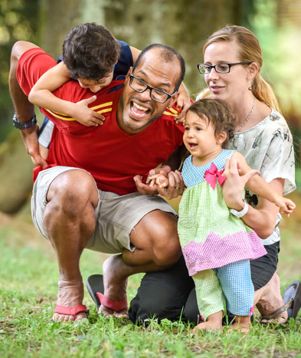
Living things cause change
The actions of humans also change the environment.
Things that people do to live comfortably can affect the world around them.
What things do we do in order to have a comfortable life?
Notes:
Teacher notes
You could ask students to keep a diary of their day-to-day home lives for a couple of days. They could note down what they eat, throw away, buy, how and when they use water, whether they heat or cool their house, how they travel around, etc. This could form the basis for a discussion about how they live and how their actions can affect the environment.
This slide covers the Science and Engineering Practice:
Constructing Explanations and Designing Solutions: Use information from observations (firsthand and from media) to construct an evidence-based account for natural phenomena.
Photo credit: © JGA, Shutterstock.com 2018

Slide 6
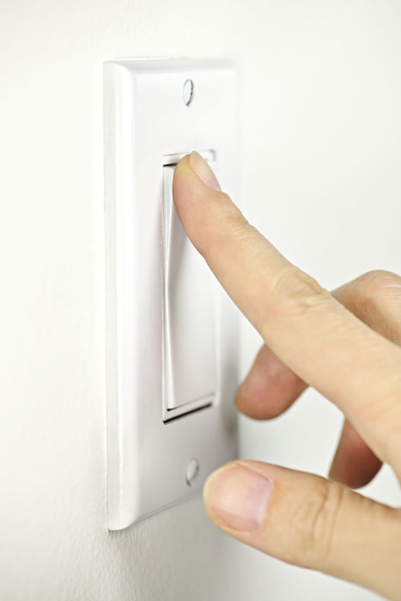
Living things cause change
There are many ways that humans can impact the environment. These are some things that we do in our day-to-day lives:
eat plants and animals
use water for drinking, washing, cooking, etc.
build homes and other structures
use gas and oil in transportation
use electricity in buildings.
Notes:
Photo credit: © Elena Elisseeva, Shutterstock.com 2018

Slide 7
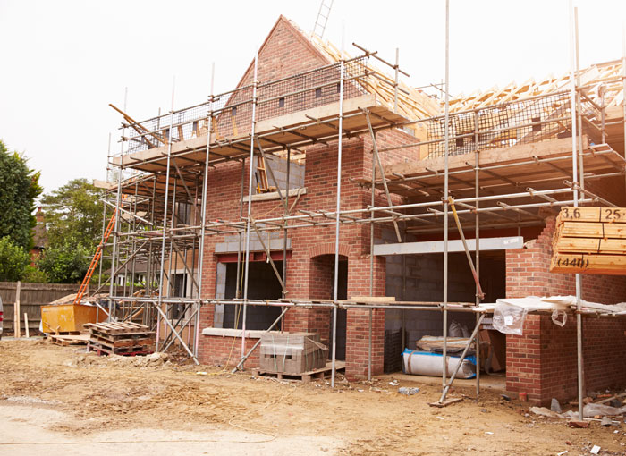
Living things cause change
Building houses uses wood, rock and sand from the environment.
By taking these resources we can affect living things that live in that area.
We also use land to build houses on.
This may reduce the area where other animals and plants can live.
Notes:
Photo credit: © Monkey Business Images, Shutterstock.com 2018

Slide 8
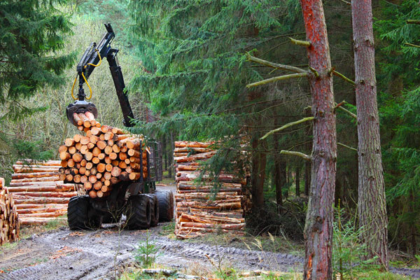
Living things cause change
Some of the natural resources we use can be replaced. These are known as renewable resources.
Wood is a renewable resource.
When we use trees to build houses, we can plant new trees to provide wood in the future.
Notes:
Photo credit: © Kletr, Shutterstock.com 2018

Slide 9
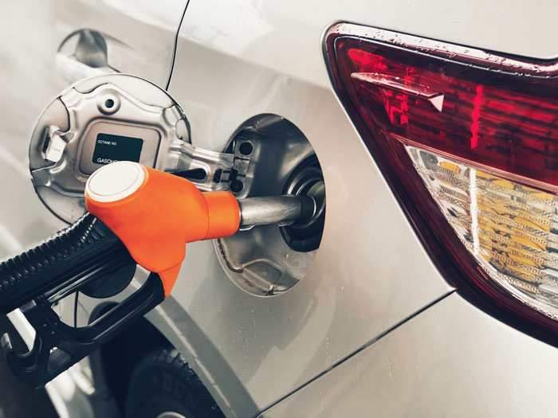
Living things cause change
Some natural resources are non-renewable. They cannot be easily replaced, so they will be used up.
For example, fossil fuels are non-renewable.
We use these to make electricity and to power cars.
It is important that we do not waste this resource or use too much.
Notes:
Photo credit: © Sara_K, Shutterstock.com 2018

Slide 10
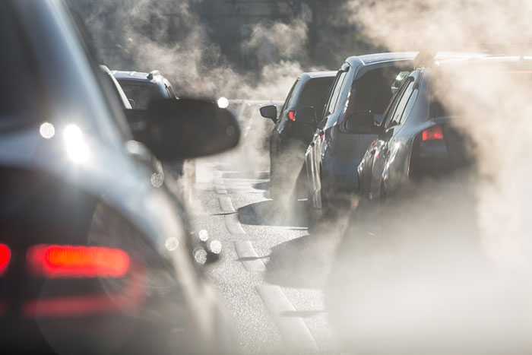
Living things cause change
Burning fossil fuels can also cause pollution.
Pollution is when substances are added to the environment, that can be harmful to animals and plants, as well as other humans.
Land, air and water can all be affected by pollution.
Notes:
Photo credit: © LanaElcova, Shutterstock.com 2018

Slide 11
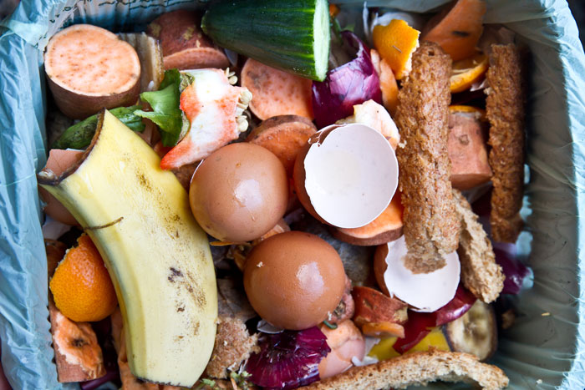
Living things cause change
Humans produce waste – things that we no longer want or need.
Some waste, like fruit and vegetable matter, can easily be broken down.
If this is made into compost it can be returned to the soil, making it richer.
Notes:
Photo credit: © CLICKMANIS, Shutterstock.com 2018

Slide 12
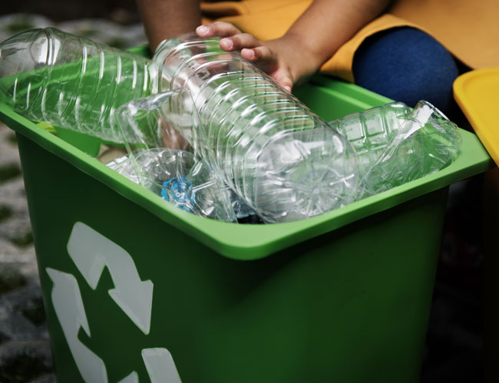
Living things cause change
Other materials, such as plastic and glass, take a long time to break down.
This material can end up in a garbage dump, which can harm the environment.
Glass and some types of plastic can be recycled. This means that it broken down and remade into new useful products.
Notes:
Photo credit: © Rawpixel.com, Shutterstock.com 2018

Slide 13
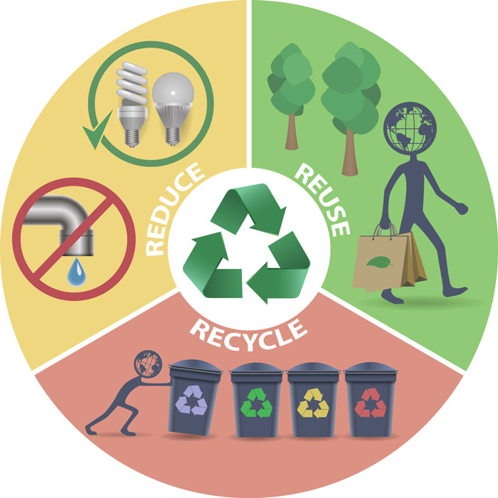
Living things cause change
How can we reduce the impact we have on the environment?
Reduce – we could make less garbage by buying fewer things, that then get thrown away.
Reuse – we could reuse things again, or give them to someone else who could use them.
Recycle – we could turn trash into new products instead of getting rid of them.
Notes:
This slide covers the Science and Engineering Practice:
Obtaining, Evaluating, and Communicating Information: Communicate information or design ideas and/or solutions with others in oral and/or written forms using models, drawings, writing, or numbers that provide detail about scientific ideas, practices, and/or design ideas
Photo credit: © Bellovittorio, Shutterstock.com 2018

