Slide 1
Natural Hazards

Slide 2
Information
Developing and Using Models
Analyzing and Interpreting Data
2. Cause and Effect
5. Energy and Matter
7. Stability and Change

Slide 3
What are natural hazards?
A natural hazard is an extreme event that is a result of a natural process.
lightning
tsunami
landslide
earthquake
volcano
natural hazards
flooding
tornado
avalanche
wildfire
hurricane
thunderstorm
We cannot stop natural hazards from occurring, but we can try to limit the damage they cause and reduce the risk of people being hurt.

Slide 4
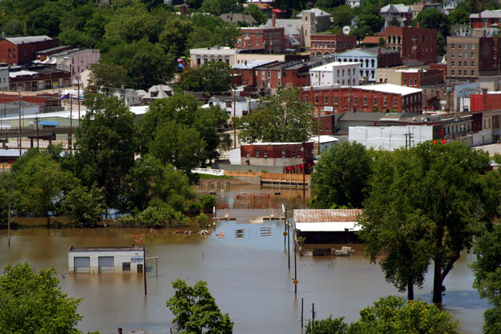
Flooding
If a lot of rain falls in a short amount of time, the ground may become saturated and not be able to absorb it all.
When this happens, water can build up and cause a flood.
The force of the water can cause a lot of damage to buildings and structures and even cause fatalities.
Notes:
Teacher notes
As students will see in the later slides, flooding can also be caused by other natural hazards. Flood waters can also result in permanent damage to homes. The image shows submerged buildings in Missouri.
Photo credit: © Melissa Brandes, Shutterstock.com 2018

Slide 5
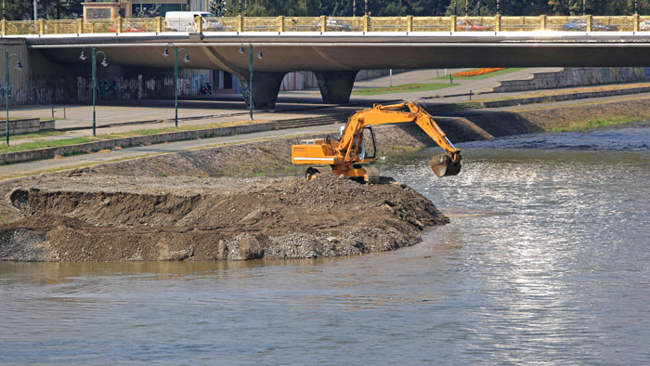
How do you limit flood damage?
We can try to limit the amount of damage done by a flood by directing the water away from areas where people live.
A levee is an embankment that is built to prevent a river from overflowing.
Notes:
Teacher notes
You could ask students to research the advantages and disadvantages of levees. They will find that artificial levees can sometimes increase the risk of flooding further down stream. It can also increase the speed of the water, which increases erosion and reduces plant life. Levees can also fail.
Students could design an experiment to test the suitability of different materials as levees. This investigation could be carried out in the classroom using water. Make sure students understand why it’s important to carry out the same test on each material. Discuss what might happen if they do not.
Photo credit: © Baloncici, Shutterstock.com 2018

Slide 6
How are hurricanes formed? (1)

Slide 7
How are hurricanes formed? (2)

Slide 8
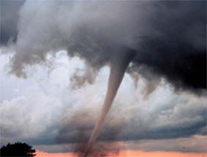
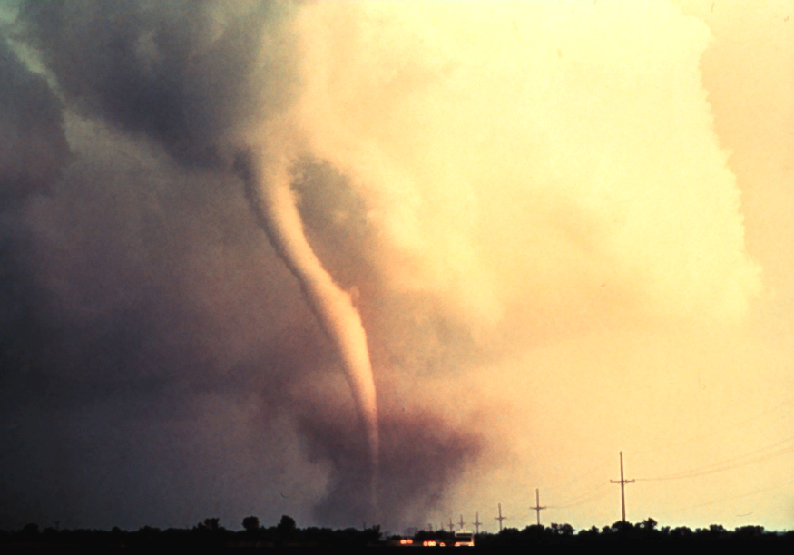
Tornados
Tornados are one of nature’s most powerful forces.
Although hurricanes may be larger in size, the winds inside a tornado are far more concentrated.
Powerful tornados have produced wind speeds of over 500 km/h. This is about double those of Hurricane Katrina, which was the most powerful hurricane in U.S. history.
Notes:
Photo credits: National Oceanic and Atmospheric Administration (NOAA)

Slide 9
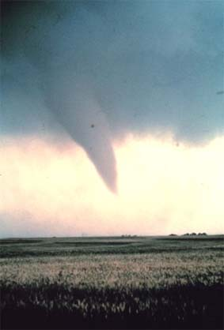
How are tornados formed?
Tornados form where there is warm air rising upwards from the ground.
If this rising, warm air collides with the descending cool air of an oncoming thunderstorm, it can produce a spinning vortex.
If this spinning vortex, known as a funnel cloud, has enough energy, it grows larger until it eventually hits the ground, forming a tornado.
Notes:
Photo credit: National Oceanic and Atmospheric Administration (NOAA)

Slide 10
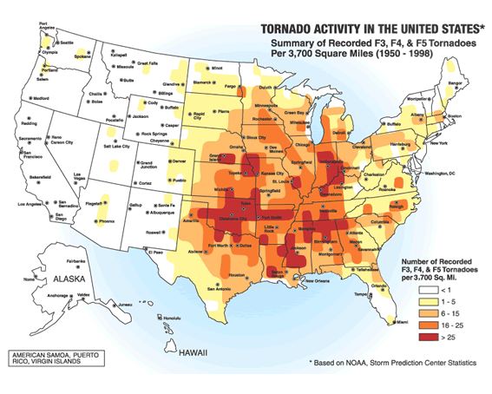
Tornado Alley (1)
Tornados occur all over the world, but a large percentage of them form in an area of the U.S. known as Tornado Alley.
Tornado Alley
Can you identify Tornado Alley on this map?
Notes:
This slide covers the Science and Engineering Practice:
Analyzing and Interpreting Data: Analyze and interpret data to make sense of phenomena, using logical reasoning, mathematics and/or computation.
Photo credit: Image courtesy of the Federal Emergency Management Agency

Slide 11
Tornado Alley (2)
In Tornado Alley, cool, dry air moving southwards from Canada collides with warm, humid tropical air moving northwards from the Gulf of Mexico.
When the cold front and the warm front meet, the combination of warm rising air and cold falling air is exactly right for tornado formation.
The tornado season in the U.S. generally lasts from March until August.
Notes:
Photo credit: © Minerva Studio, Shutterstock.com 2018

Slide 12
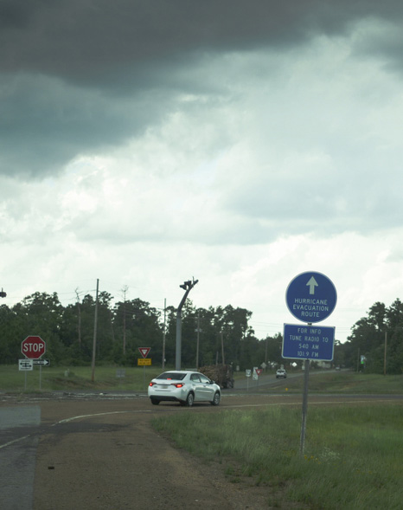
Predicting hurricanes and tornados
We cannot prevent hurricanes and tornados, but we can limit their impact.
Scientists watch weather conditions closely to try to predict when and where extreme events, such as hurricanes and tornados, might happen. People living in the areas within the predicted path can then be evacuated.
We can also try to avoid building homes and businesses in high risk areas, and build with wind resistant materials where possible.
Notes:
Photo credit: © Judy M Darby, Shutterstock.com 2018

Slide 13
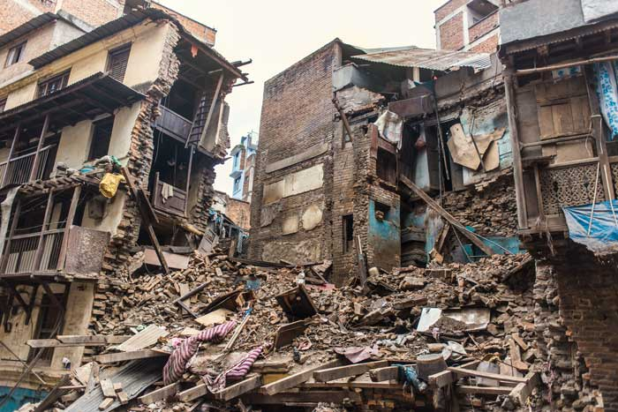
Earthquakes
Earthquakes are vibrations of the Earth’s crust, caused by two tectonic plates moving past each other. This causes the ground to shake suddenly.
Earthquakes can cause huge damage to buildings, causing loss of life.
It can also affect other structures, such as dams and levees, causing flooding.
Notes:
Teacher notes
The image shows buildings in Kathmandu, Nepal, that have been destroyed by an earthquake.
Photo credit: © Julian Frees, Shutterstock.com 2018

Slide 14
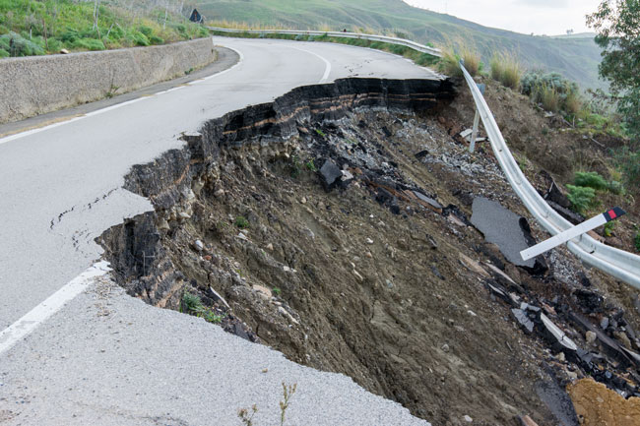
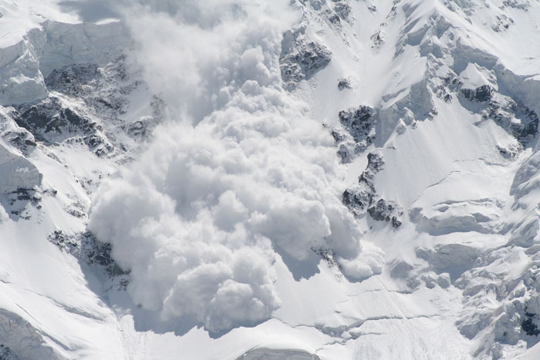
Landslides and avalanches
Sometimes earthquakes can loosen rock, causing a landslide.
In cold climates, earthquakes can loosen packed snow, causing an avalanche.
Notes:
Photo credits: Landslide © Lucky Team Studio; Avalanche © My Good Images, both at Shutterstock.com 2018

Slide 15
Protection from earthquakes (1)

Slide 16
Protection from earthquakes (2)
Engineers often design buildings in earthquake zones to be more stable.
Which building shape would be the most stable in an earthquake?
Notes:
Teacher notes
Students could test these buildings in the classroom, and even try to design their own. The pyramid-shaped building has a wide base, which lowers the center of gravity, helping it to be more stable.
This slide covers the Science and Engineering Practices:
Constructing Explanations and Designing Solutions: Construct an explanation of observed relationships (e.g., the distribution of plants in the back yard).
Constructing Explanations and Designing Solutions: Apply scientific ideas to solve design problems.

Slide 17
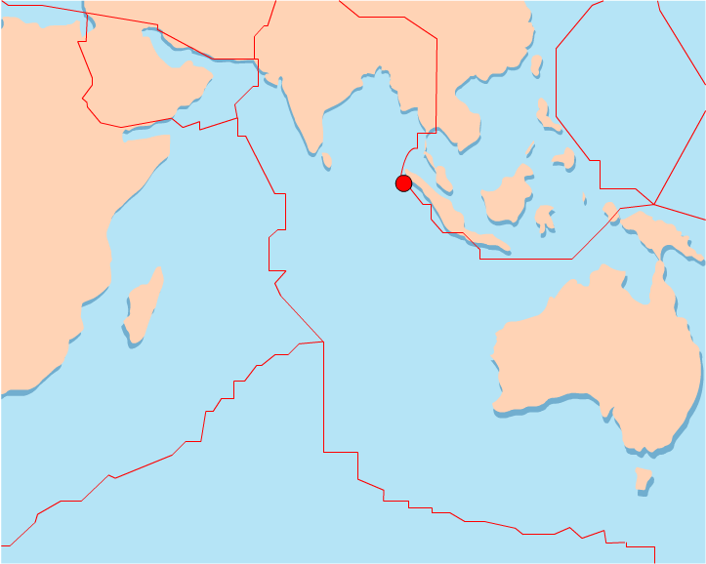
Tsunamis
Tsunamis are tidal waves caused by underwater earthquakes. A tsunami travels at speeds between 600 and 900 km/h.
The tsunami in the Indian Ocean occurred on December 26th, 2004. The earthquake measured 9.0 on the Richter Scale and occurred off the northern tip of Sumatra. Over 226,000 people are presumed to have died in the disaster.
Earthquake epicenter
The tsunami spread across the Indian Ocean, affecting coastal areas of 14 countries including Indonesia, Sri Lanka, India, Bangladesh, Myanmar, The Maldives and Malaysia.

Slide 18
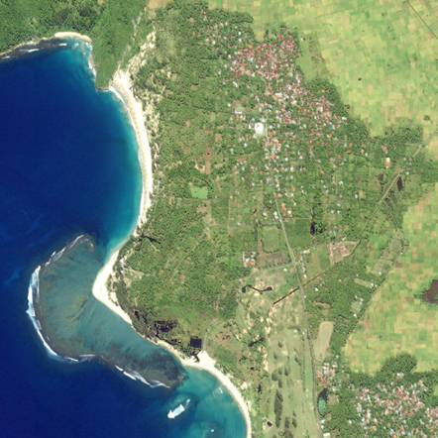
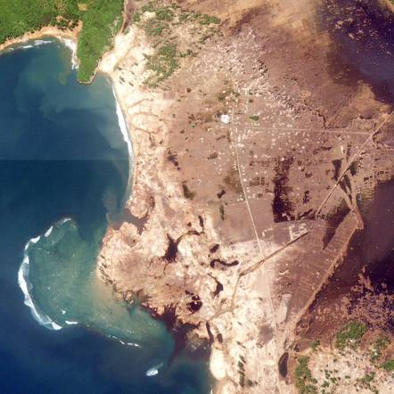
The 2004 Indonesian tsunami
What do you think these satellite images show?
before the tsunami
after the tsunami
January 10th, 2003
December 29th, 2004
Notes:
Teacher notes
The image shows an area affected by the 2004 tsunami in Lhoknga, Indonesia. The area of brown in the right-hand photo indicates land that has been scoured by the wave of the tsunami. In some places, water traveled inland as far as 5km from the coast.
This slide covers the Science and Engineering Practice:
Analyzing and Interpreting Data: Analyze and interpret data to make sense of phenomena, using logical reasoning, mathematics and/or computation.
Photo credit: NASA/Ikonos Images copyright, Center for Remote Imaging, Sensing and Processing, National University of Singapore and Space Imaging.

Slide 19
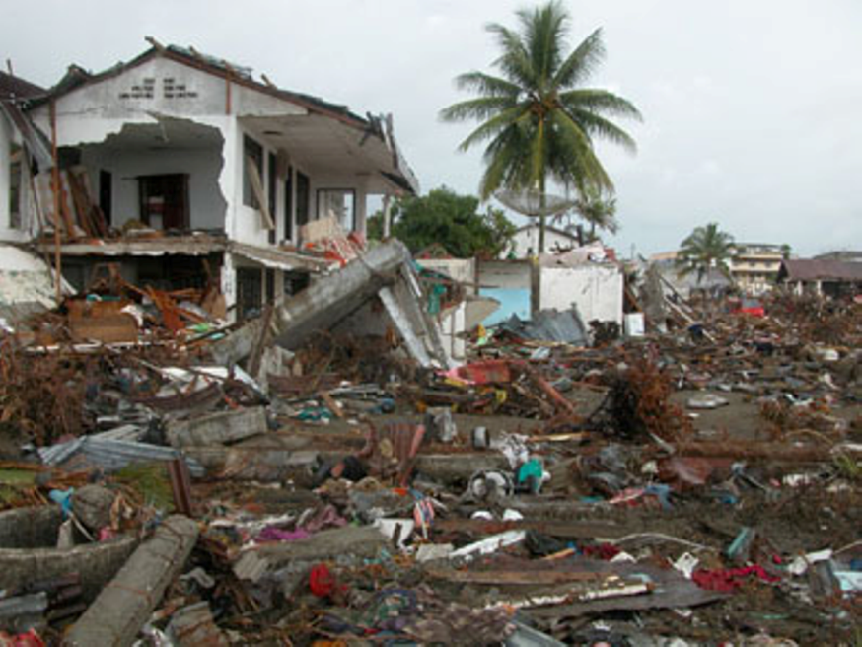
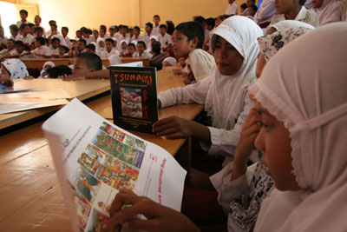
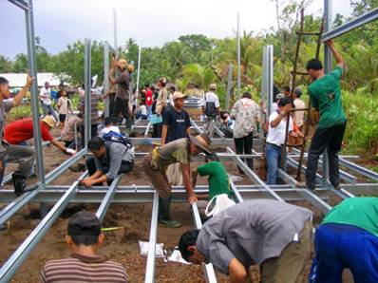
The impact of the tsunami
The tsunami brought devastation to the Indonesian province of Banda Aceh, but, with aid and community action, people are rebuilding their lives.
Notes:
Teacher notes
In Indonesia, 128,645 people lost their lives, 37,063 remain unaccounted for and are presumed dead. Over 500,000 were displaced throughout Aceh Province and on Nias Island. The International Red Cross and Red Crescent (IFRC) has spent CHF 614 million (US $610 million) between 2005 and 2010 in Indonesia.
The IFRC’s main activities in Indonesia include:
Distribution of food and shelter to over 345,000 people.
A transitional shelter construction program.
150,000 people have been provided with water and sanitation services. On average, 1.5 million liters of clean drinking water were produced daily during the emergency phase.
Basic health care was provided to 100,000 people.
200 Red Cross volunteers and 1,000 community members trained to provide psychological support to communities.
Providing family links service for nearly 31,000 people with assistance from the International Committee of the Red Cross (ICRC).
Future programs will include:
Over 550,000 registered recipients will continue to receive supplementary food and other humanitarian assistance.
Reconstruction projects to rebuild or repair nearly 35,000 permanent homes, 89 schools, 43 health centers, 4 orphanages and 20 Red Cross branch offices.
113,000 people will continue to be supported with water and sanitation services including the production of 1,000,000 liters of clean water each day.
Community-based action teams will be formed as part of a risk reduction initiative to benefit 480,000 people across 200 communities. The program includes community early warning systems, awareness raising, training for teachers and school children and more than 100 “safe havens” – designated structures and areas for communities to gather in times of emergency.
Community-based disaster preparedness training and disaster response training for at least 2,850 Red Cross volunteers.
Photo credit: destruction, Ian Woolverton/International Federation of Red Cross and Red Crescent Societies; tsunami education, Amalia Soemantri/International Federation of Red Cross and Red Crescent Societies; rebuilding, International Federation of Red Cross and Red Crescent Societies.

Slide 20
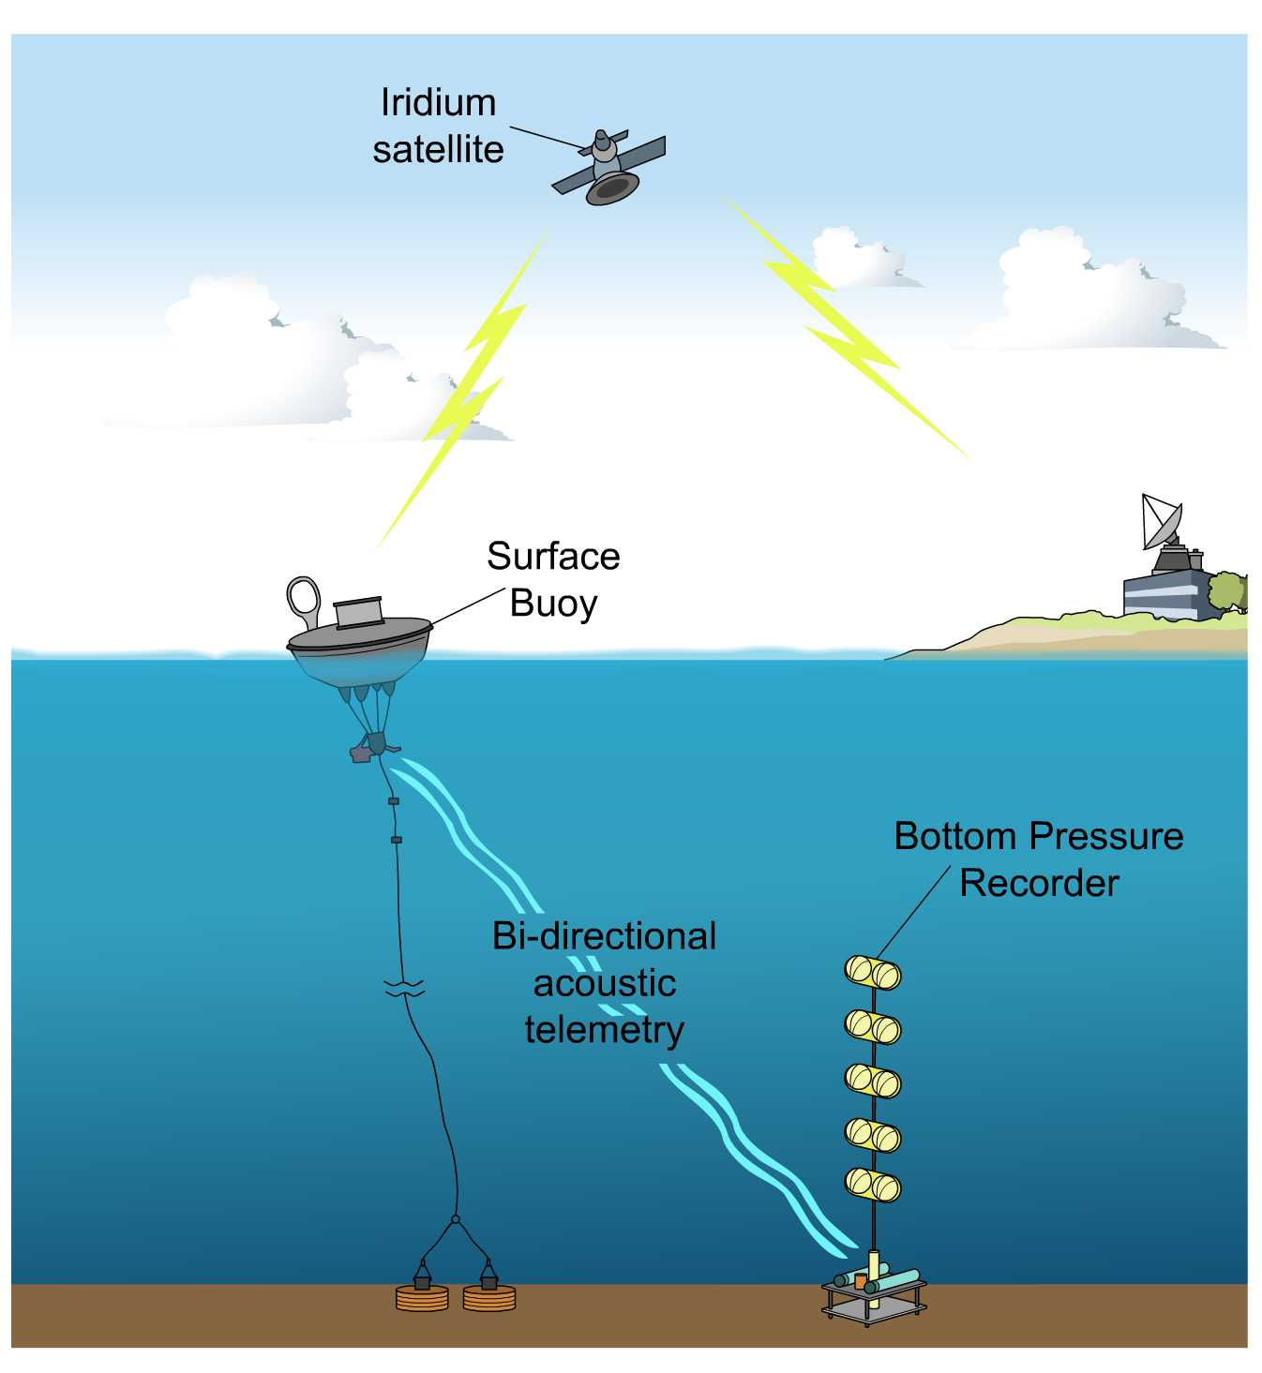
Predicting tsunamis
In the U.S., the National Oceanic and Atmospheric Administration (NOAA) have a system that tries to improve tsunami prediction.
This is a network of buoys located throughout the oceans.
The bottom pressure recorder detects seismic activity and the surface buoy monitors changes in sea surface level.
A satellite is used to send the information to land, where it is analyzed.
Notes:
Teacher notes
You can view a map of the locations of the buoys and view the most recent data received from each on the NOAA website: https://www.ndbc.noaa.gov/dart.shtml
This weblink was working at the time of publication. Boardworks is not responsible for the content of third party sites.
This slide covers the Science and Engineering Practice:
Developing and Using Models: Develop and/or use models to describe and/or predict phenomena.

