Slide 1
Natural Resources

Slide 2
Information
Analyzing and Interpreting Data
Using Mathematics and Computational Thinking
Engaging in Argument from Evidence
Obtaining, Evaluating and Communicating Information
1. Patterns
3. Scale, Proportion, and Quantity
5. Energy and Matter

Slide 3
What are energy resources?
An energy resource is anything humans can use to generate power. Energy resources comes from natural sources.
Can you think of any natural sources of energy?
The Sun
(solar)
petroleum
plants
(biomass)
sources of energy from the environment
natural gas
coal
waves
water
(hydroelectric)
heat from the Earth (geothermal)
Notes:
Teacher notes
If students are unsure about the use of the term “natural” in this context, you could explain that it means that it comes from somewhere in the environment on Earth. This does not mean from ‘nature’.

Slide 4
Energy from natural resources
Notes:
This slide covers the Science and Engineering Practices:
Analyzing and Interpreting Data: Represent data in tables and/or various graphical displays (bar graphs, pictographs and/or pie charts) to reveal patterns that indicate relationships.
Using Mathematics and Computational Thinking: Describe, measure, estimate and/or graph quantities such as area, volume, weight and time to address scientific and engineering questions and problems.

Slide 5
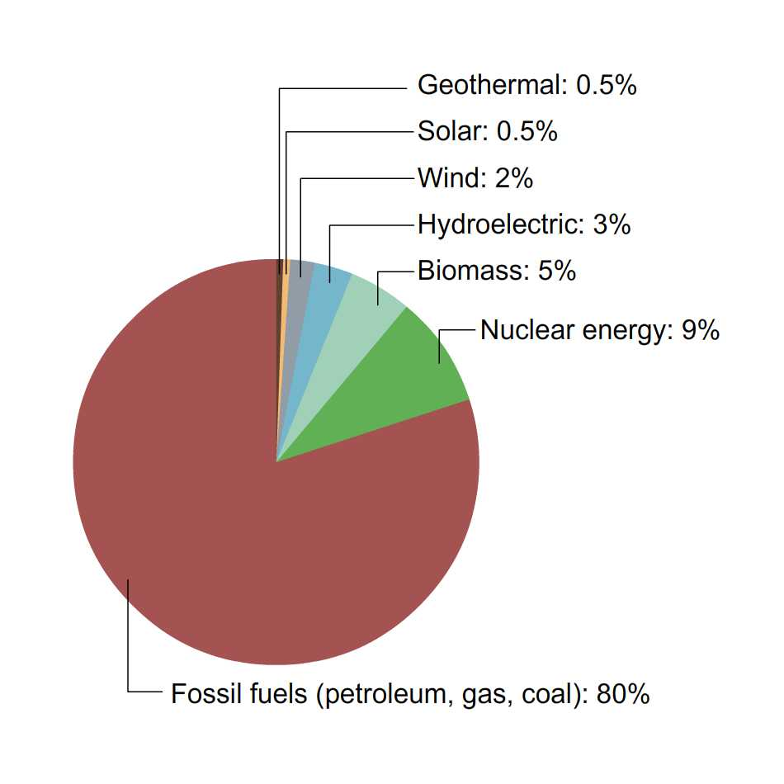
Energy use
This pie chart shows how much of the energy used, over the last twelve months, in the U.S. came from each energy source.
Does this match your prediction?
How is it the same, and how is it different?
Notes:
Teacher notes
This might be a good opportunity to remind students that even though we often say that we “produce energy” from different sources, energy cannot be created or destroyed. What we mean by this is that energy is converted from one form to another, or transferred from one place to another.
This slide covers the Science and Engineering Practices:
Analyzing and Interpreting Data: Analyze and interpret data to make sense of phenomena, using logical reasoning, mathematics, and/or computation.
Using Mathematics and Computational Thinking: Describe, measure, estimate and/or graph quantities such as area, volume, weight and time to address scientific and engineering questions and problems.

Slide 6
Renewable and non-renewable energy (1)
Energy resources can be divided into two categories:
Renewable resources are resources that are replaced quickly by a natural process. Solar energy is renewable.
Non-renewable resources are resources that will run out or not be replaced in our lifetimes, or in many lifetimes. Petroleum is a non-renewable energy resource.
Notes:
Photo credits: Solar panel © Diyana Dimitrova, gasoline pump © Nithid Memanee; both at Shutterstock.com 2018

Slide 7
Renewable and non-renewable energy (2)
Notes:
7
Teacher notes
Appropriately coloured voting cards could be used with this classification activity to increase class participation.
Nuclear energy is usually considered non-renewable. Nuclear energy itself is a renewable energy source. However, the rare type of uranium used in power plants is not. The plutonium waste can be reused to generate electricity; however, even with intensive recycling, nuclear fuel will eventually run out.

Slide 8
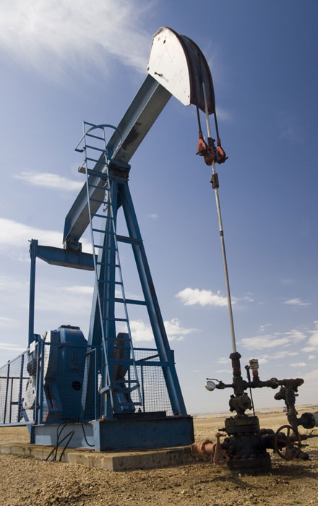
Fossil fuels
Fossil fuels, such as coal, petroleum and natural gas are non-renewable.
They were formed from biological deposits over the course of millions of years.
These are now extracted from the Earth and burned to produce useful energy.
These fuels cannot be renewed, meaning that they will run out before more is produced.
Notes:
Photo credit: © Geoff Hardy, Shutterstock.com 2018

Slide 9
How is coal formed?

Slide 10
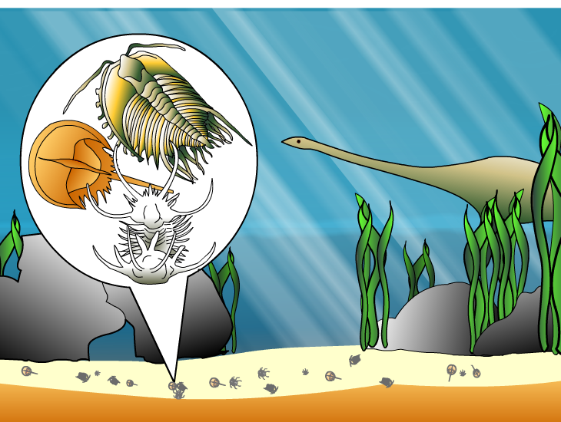
How are petroleum and natural gas made?
Petroleum and natural gas are also biological in origin.
Millions of years ago, tiny animals that lived in the sea died and fell to the sea floor, but did not rot away.
Over time, they were buried deeper by the mud and sand.
They were heated and squashed by the Earth’s forces. This changed them into petroleum and natural gas.

Slide 11
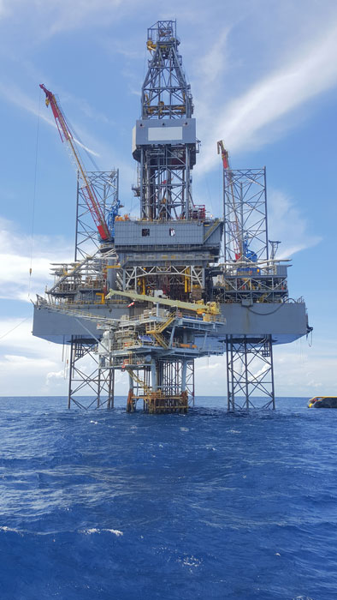
Deep sea drilling
Petroleum and natural gas are found underground.
They can be extracted by drilling deep down into the ground, or under the seabed.
Petroleum can be converted into useful fuels, such as gasoline.
Natural gas is used for heating and cooking.
Notes:
Photo credit: © laimonholy, Shutterstock.com 2018

Slide 12
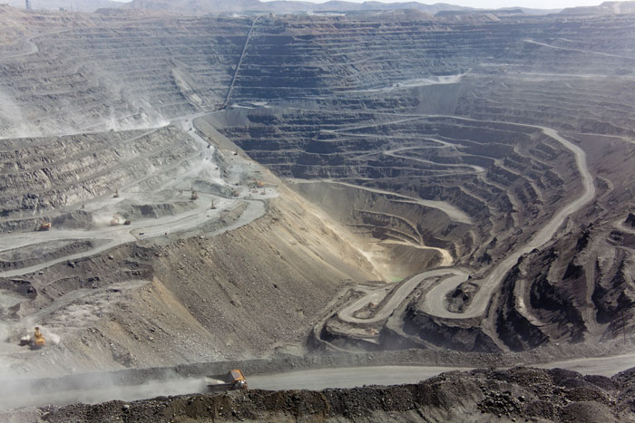
How do fossil fuels impact the environment? (1)
Obtaining fossils fuels often has an impact on the environment.
Sometimes, during the mining process, plants need to be removed from the area. This results in natural habitat being lost.
Some of the waste products from mining can pollute the soil and water nearby.
Notes:
Photo credit: © Andrey N Bannov, Shutterstock.com 2018

Slide 13
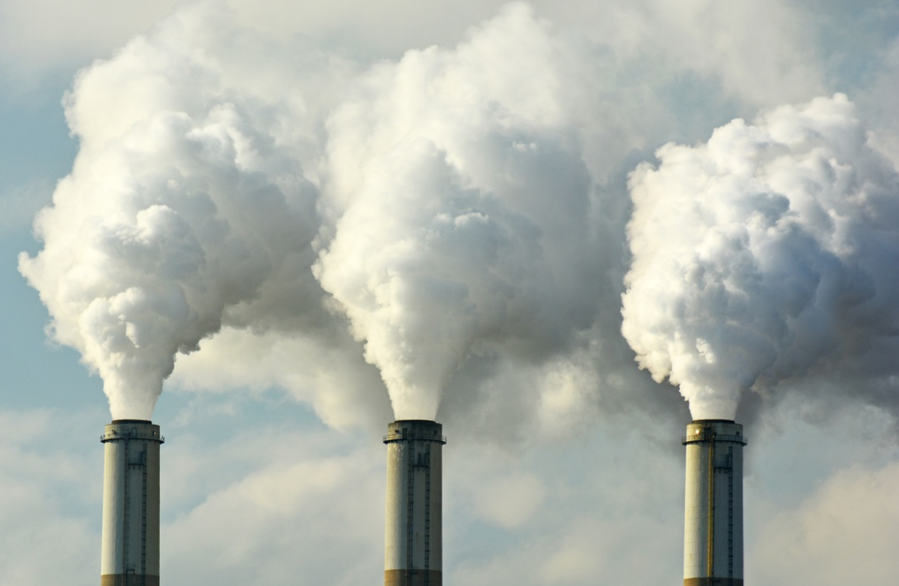
How do fossil fuels impact the environment? (2)
Burning fossils fuels causes air pollution.
Fossil fuels produce carbon dioxide, which is released into the atmosphere when they are burned.
Carbon dioxide is a greenhouse gas. This can contribute to the greenhouse effect.
Some fossil fuels also create chemicals like sulfur dioxide, which causes acid rain.
Notes:
Teacher notes
For more information on the impacts of humans on the environment, please refer to the Impacts of Human Activity presentation.
Photo credit: © Jeff Zehnder, Shutterstock 2018

Slide 14
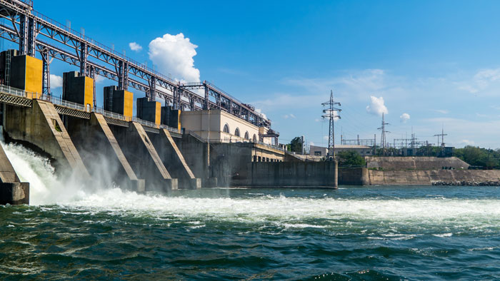
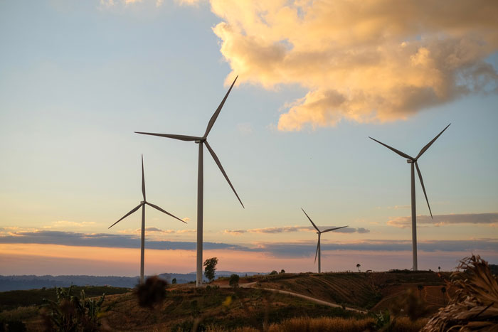
Renewable energy
Renewable energy resources will not run out because they can easily be generated.
Renewable energy resources include:
hydroelectric power
solar power
wind power
biomass
geothermal.
Notes:
Photo credits: Hydroelectric power plant © Maxim Burkovskiy; Windmills © mimiscape, both at Shutterstock.com 2018

Slide 15
Wind turbines

Slide 16
Solar power
The energy from the Sun also can be used to produce electricity.
This can be done by using photovoltaic cells, also known as solar panels.
These convert solar energy to electricity that can be used in homes and businesses.
Notes:
Photo credit: © Diyana Dimitrova, Shutterstock.com 2018

Slide 17
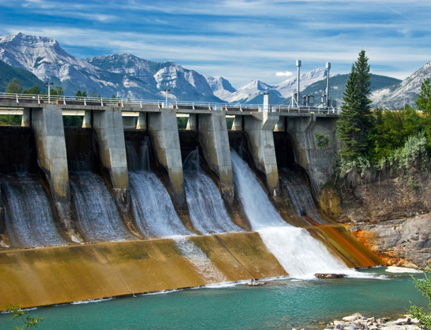
Hydroelectric power
Hydroelectric power is made by using the gravitational force of falling or fast-flowing water.
The water is held behind a dam. When it is released, it moves through a giant turbine, causing the blades to turn.
This kinetic energy is then converted into electricity by a generator.
Notes:
Photo credit: © Constantine Androsoff, Shutterstock.com 2018

Slide 18
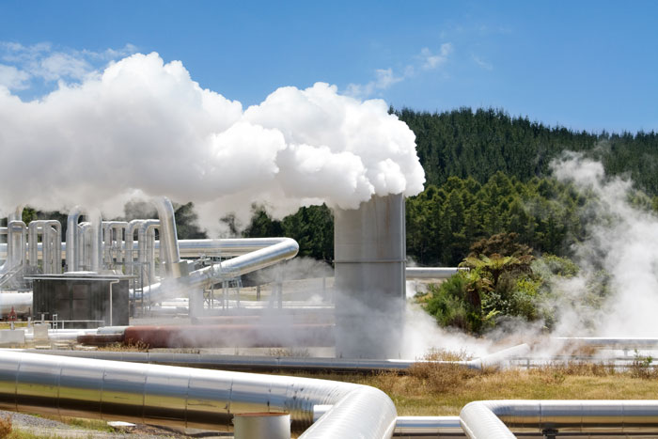
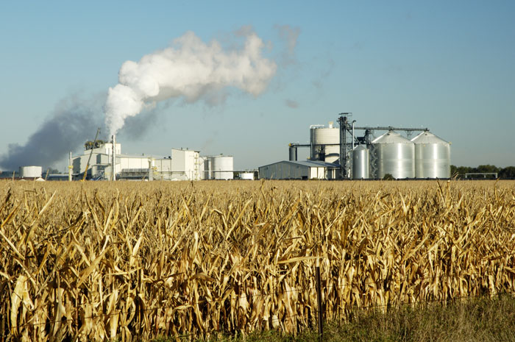
Geothermal and Biomass energy
Geothermal energy uses heat stored beneath the Earth’s surface to create steam. This is used to power turbines.
Biomass fuels are made of processed plant remains and are used in the same way as fossil fuels. More crops are grown to replace those used.
Notes:
Photo credits: Geothermal power station © N. Minton; Bioethanol production plant © Jim Parkin, both at Shutterstock.com 2018

Slide 19
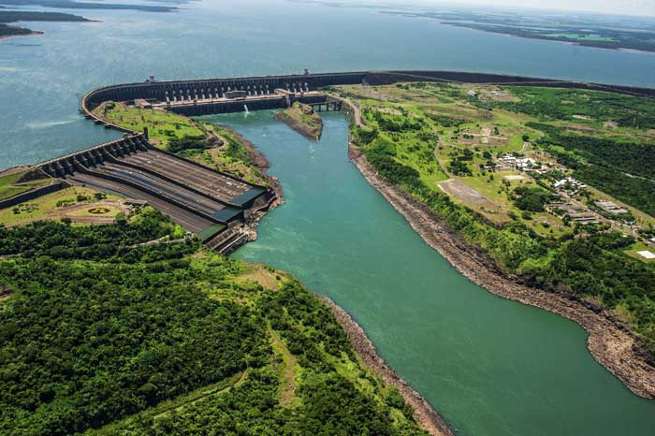
Environmental impact of renewable energy
It is not only fossil fuels that impact the environment. Renewable energy can also have a negative effect.
For example, building a dam can have these impacts:
affecting the flow and temperature of the water.
blocking the movement of some organisms.
submerging areas that were previously land.
Can you explain how a dam might affect organisms living in the local area?
Notes:
Teacher notes
Dams can also prevent natural flooding, which can result in habitat loss for some species. Help students apply their knowledge of life sciences to answer the question. For example, some types of fish depend on migration for parts of their life cycles.
This slide covers the Science and Engineering Practices:
Engaging in Argument from Evidence: Construct and/or support an argument with evidence, data, and/or a model.
Obtaining, Evaluating, and Communicating Information: Communicate scientific and/or technical information orally and/or in written formats, including various forms of media which may include tables, diagrams and charts.
Photo credit: © Mykola Gomeniuk, Shutterstock.com 2018

