Slide 1
Outside Earth

Slide 2
Information
Asking Questions and Defining Problems
Constructing Explanations and Designing Solutions
Obtaining, Evaluating and Communicating Information
1. Patterns
3. Scale, Proportion, and Quantity
4. Systems and System Models
6. Structure and Function

Slide 3
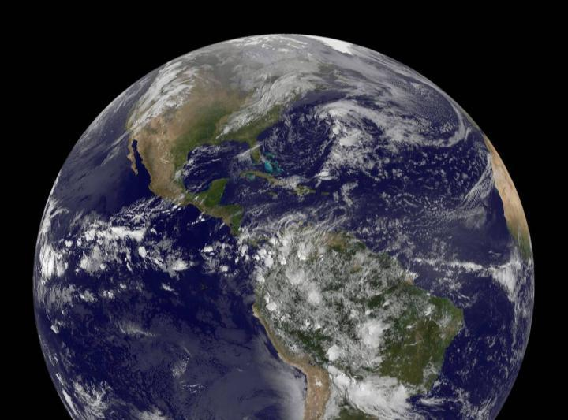
Outside Earth
What is beyond the Earth?
Notes:
Teacher notes
Ask students for their ideas to answer the question.
This slide covers the Science and Engineering Practice:
Asking Questions and Defining Problems: Ask questions that can be investigated and predict reasonable outcomes based on patterns such as cause and effect relationships.
Photo credit: NASA/NOAA/GOES Project

Slide 4
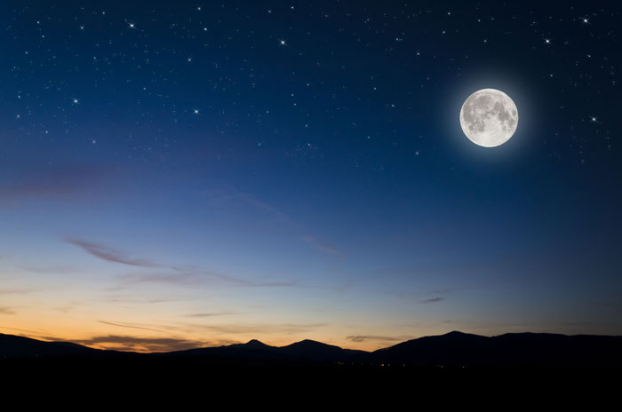
Outside Earth
We can see some of the things that are beyond our planet by looking up at the sky. What can you see here?
Notes:
Teacher notes
Students should be able to identify the Moon and stars. You may want to point out that some objects that appear to be stars are actually other planets in our solar system. Students may also identify the clouds shown above the mountains. You may want to explain the difference between objects that are not on Earth’s surface but are still considered to be part of Earth, and those that are outside of Earth.
Photo credit: © Klagyivik Viktor, Shutterstock.com 2018

Slide 5
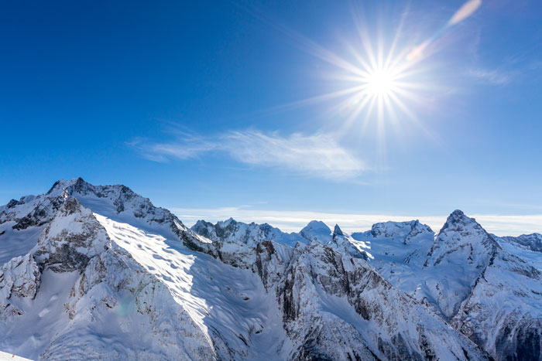
Outside Earth
What can you see here?
What can’t you see, compared to at night?
Can you explain the difference?
Notes:
Teacher notes
Students should be able to identify the Sun and describe that they can no longer see the Moon and stars. Encourage them to explain that the Sun is the brightest object in the sky. When it appears during the day, we usually cannot see objects that are less bright such as the Moon and stars.
This slide covers the Science and Engineering Practices:
Constructing Explanations and Designing Solutions: Construct an explanation of observed relationships.
Obtaining, Evaluating, and Communicating Information: Communicate scientific and/or technical information orally and/or in written formats, including various forms of media and may include tables, diagrams, and charts.
Photo credit: © Roman Safonov, Shutterstock.com 2018

Slide 6
Outside Earth
The Sun is a star.
We can see other stars in the sky at night, but the Sun looks very different.
That’s because it is much closer to us than any other star.
Stars are balls of very hot gases. Inside them, reactions are happening all the time.
The reactions release lots of heat and make stars glow very brightly!

Slide 7
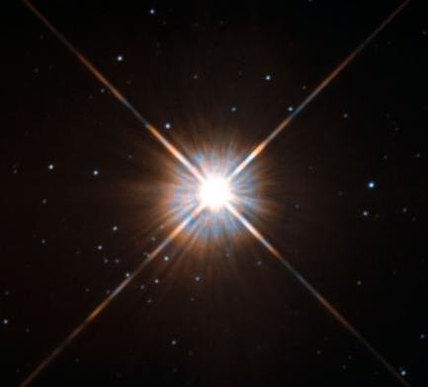
Outside Earth
The other stars that you can see in the night sky are also glowing very brightly, like the Sun.
However, they are very far away.
After the Sun, our next nearest star is called Proxima Centauri.
It is about 40,000,000,000,000 kilometers from Earth!
Notes:
Photo credit: ESA/Hubble & NASA

Slide 8
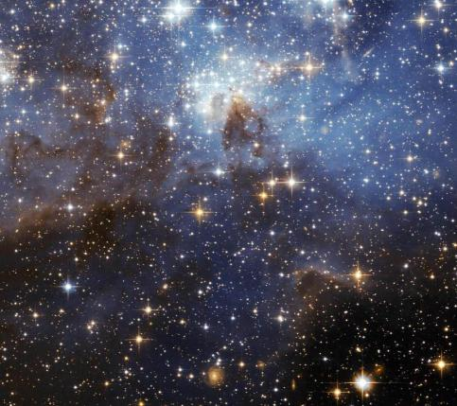
Outside Earth
Stars vary greatly in their distance from Earth.
Some of them are so far away that it takes billions of years for their light to reach us!
Stars that look close together in the night sky are actually very far apart from each other.
Notes:
Photo credit: NASA

Slide 9
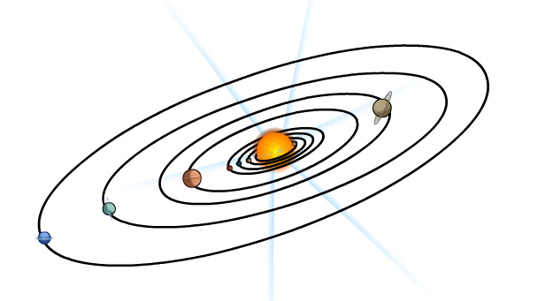
Outside Earth
Our closest star, the Sun, is orbited by many objects, including Earth.
The Sun and the objects that orbit it are called the Solar System.

Slide 10
Outside Earth
Notes:
Teacher notes
Use the zoom buttons (+ or –) to optimize the use of this interactive animation. This will give students a sense of scale. Emphasize that stars are much larger than planets.
Suitable prompts could include:
What is the largest object in our solar system?
What might other solar systems look like?
Are there more stars in the Universe or more planets?

Slide 11
Outside Earth
Notes:
Teacher notes
You could also highlight the asteroid belt between Mars and Jupiter. Point out that these rocks orbit the Sun in the same way as the planets, but they are much smaller.

Slide 12
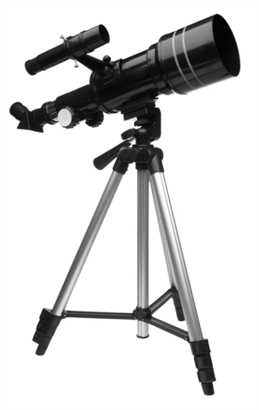
Outside Earth
Objects in the sky often seem very small to us. How do you think we can see them in more detail?
We can use a piece of equipment called a telescope to view objects outside of Earth in more detail.
A telescope magnifies the objects in the sky, so they
appear larger to our eyes.
Much of what we know about objects outside Earth comes from our use of telescopes.
Notes:
Photo credit: © Kayros Studio “Be Happy!”, Shutterstock.com 2018

