Slide 1
What is Weather?

Slide 2
Information
Planning and Carrying Out Investigations
Analyzing and Interpreting Data
Obtaining, Evaluating and Communicating Information
1. Patterns
2. Cause and Effect

Slide 3
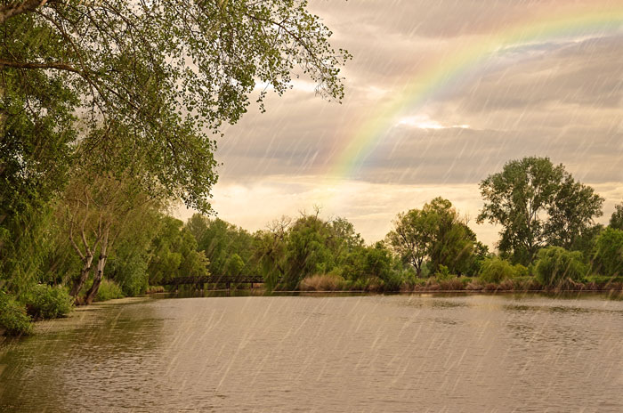
What is weather?
Weather is a description of what it is like outside today.
What things happening outside are weather events?
Temperature
Wind
Rain
Clouds
Snow
Sunlight
Notes:
Teacher notes
You could talk to students about how we respond to different types of weather. Students could also look at the cause and effect relationship between the day’s weather and the clothing that they wear.
This slide covers the Science and Engineering Practice:
Obtaining, Evaluating, and Communicating Information: Communicate information or design ideas and/or solutions with others in oral and/or written forms using models, drawings, writing, or numbers that provide detail about scientific ideas, practices, and/or design ideas
Photo credit: © SasaStock, Shutterstock.com 2018

Slide 4
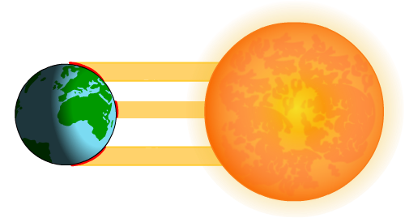
The Sun and weather
The Sun affects our weather. This is because sunlight warms the Earth’s surface.
On a cloudy day some of this sunlight is blocked, which can reduce the temperature.
On a sunny day less sunlight is blocked, causing the Earth’s surface to heat up.

Slide 5
Temperature
We can use instruments to measure weather.
Temperature is a measure of how warm or cold it is.
Temperature is measured using a thermometer.
The units of temperature are degrees Fahrenheit (°F) or degrees Celsius (°C).
Notes:
Teacher notes
Temperatures are measured in the shade, so the Sun’s rays do not heat up the instrument.
Photo credit: © txking, Shutterstock.com 2018

Slide 6
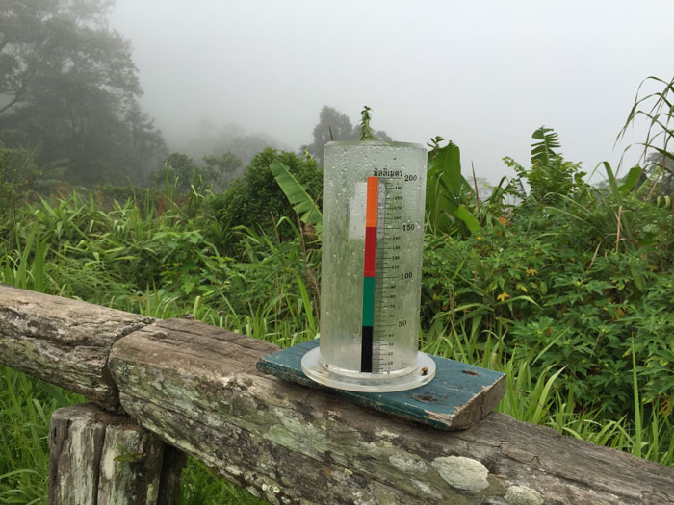
What is a rain gauge?
We can measure the water that falls from the sky. The water could be in the following forms:
rain
sleet
hail
snow.
We can measure these with a rain gauge.
Notes:
Photo credit: © dotini, Shutterstock.com 2018

Slide 7
Making a rain gauge
Notes:
This slide covers the Science and Engineering Practices:
Planning and Carrying Out Investigations: With guidance, plan and conduct an investigation in collaboration with peers.
Planning and Carrying Out Investigations: Make observations (firsthand or from media) to collect data that can be used to make comparisons.

Slide 8
Weather forecast symbols
We can use symbols to help record the weather each day.
Sunny
Cloudy
Overcast
Sunny intervals
Heavy rain shower
Light rain
Heavy rain
Heavy snow
Sleet
Hail
Thunder
Notes:
Teacher notes
Before revealing the symbols you could ask students to draw their own.

Slide 9
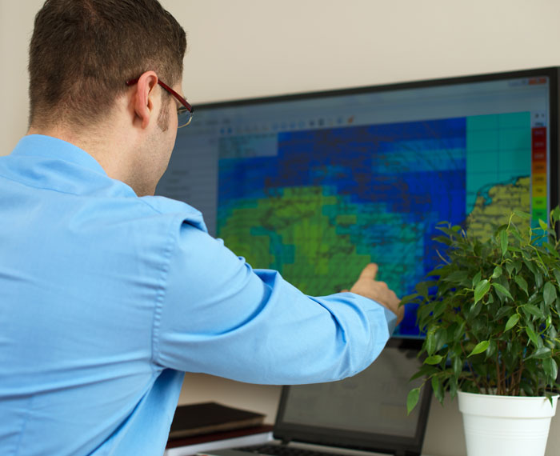
What are meteorologists?
Why do we record weather?
Scientists called meteorologists record weather.
Meteorologists use the information they record to look for patterns in weather over time.
This helps them to predict what type of weather might happen next.
Notes:
Photo credit: © Dmitri Ma, Shutterstock.com 2018

Slide 10
Using weather data
Have there been more cloudy days or sunny days?
What day was the hottest?
Which week was the sunniest?
Make sure you give evidence for your answers.
Notes:
Teacher notes
This is an example set of weather data from two weeks in July in St Louis, Missouri. You could expand this to run a related practical exercise that measures and records local weather. You could do this as part of the classroom routine throughout the year. This would allow you to see some weather patterns that are not obvious unless the students collect data over long periods of time. Also, during some periods, the weather data could be recorded in the morning and then again in the afternoon. This allows students to observe patterns in temperature through the course of the day.
Students can spot patterns such as:
Snow and colder temperatures generally occur in the winter.
Clouds may bring rain or snow.
Rain occurs more often in the spring.
Warmer/hotter temperatures occur in the summer.
It is generally cooler in the morning and warmer in the afternoon.
This slide covers the Science and Engineering Practices:
Analyzing and Interpreting Data: Use and share pictures, drawings, and/or writings of observations.
Analyzing and Interpreting Data: Use observations (firsthand or from media) to describe patterns and/or relationships in the natural and designed world(s) in order to answer scientific questions and solve problems.

Slide 11
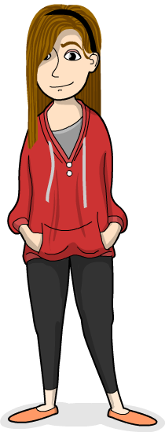
Predicting severe weather
Meteorologists can use recorded weather information to help them predict severe weather.
This can include:
lightning
hurricanes
thunderstorms
snowstorms
flooding
tornadoes.
What type of severe weather do you get in your area?
Notes:
This slide covers the Science and Engineering Practice:
Obtaining, Evaluating, and Communicating Information: Communicate information or design ideas and/or solutions with others in oral and/or written forms using models, drawings, writing, or numbers that provide detail about scientific ideas, practices, and/or design ideas.

Slide 12
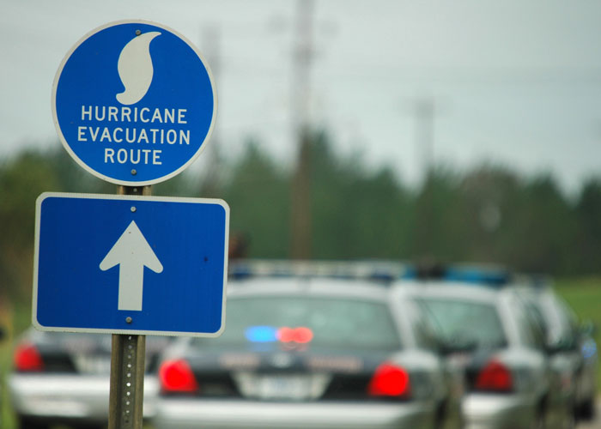
Preparing for severe weather
By predicting weather, meteorologists can warn people of severe weather that may be coming.
This can help people to prepare for and respond to this weather.
In some cases, people may be asked to leave an area or take shelter in a safe place.
Warning people about severe weather can save many lives.
Notes:
Teacher notes
Talk to students about what they do to prepare for severe weather in their area. Encourage them to ask questions about what might happen and how it would work. Get them thinking about if there are any tools they might use (e.g. sandbags, salt, shovels, shelters, umbrellas, etc.) and what the authorities might need to do keep people safe (evacuations, emergency workers, early warnings, stockpiling food, providing shelter, etc.). Students might also ask questions about what will happen if the severe weather causes damage to buildings, power lines, houses, etc.
Photo credit: © Tad Denson, Shutterstock.com 2018

