Slide 1
Animal and Plant Parts

Slide 2
Information
Asking Questions and Defining Problems
Developing and Using Models
1. Patterns
4. Systems and System Models
6. Structure and Function

Slide 3
Sorting animals into groups (1)
Notes:
This slide covers the Science and Engineering Practice:
Developing and Using Models: Develop and/or use a model to represent amounts, relationships, relative scales (bigger, smaller), and/or patterns in the natural and designed world(s).

Slide 4
Sorting animals into groups (2)
Sort the animals into two groups of your own!
Write the name of each animal into the correct box for the groups you have chosen.
........................................
........................................
butterfly
snail
spider
bee
frog
blackbird
Notes:
Teacher notes
Ask: “What other ways can you think of grouping these animals?” Students can experiment with ways of grouping the animals. They could challenge their classmates to guess the names of the groups. There are several possibilities, e.g. animals with wings / no wings; animals with more / fewer than four legs; animals with beaks; animals that make / do not make a noise.
This slide covers the Science and Engineering Practice:
Developing and Using Models: Develop and/or use a model to represent amounts, relationships, relative scales (bigger, smaller), and/or patterns in the natural and designed world(s).

Slide 5
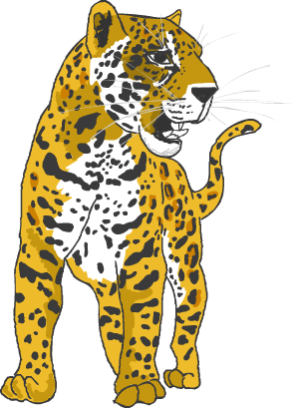
Different parts of animals
All living things have different parts that help them survive.
What sort of parts does this animal have?
Eyes
Ears
Mouth
Teeth
Nose
Tail
Legs
Feet
How do you think these parts help this animal to survive?
Notes:
Teacher notes
You could ask students to help you point to each part on the image when its name appears.
This slide covers the Science and Engineering Practice:
Asking Questions and Defining Problems: Ask questions based on observations to find more information about the natural and/or designed world(s).

Slide 6
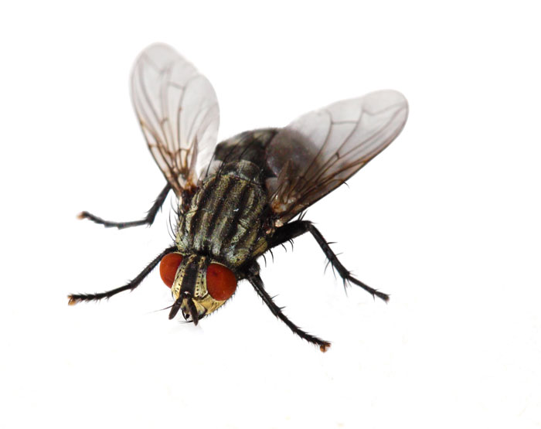
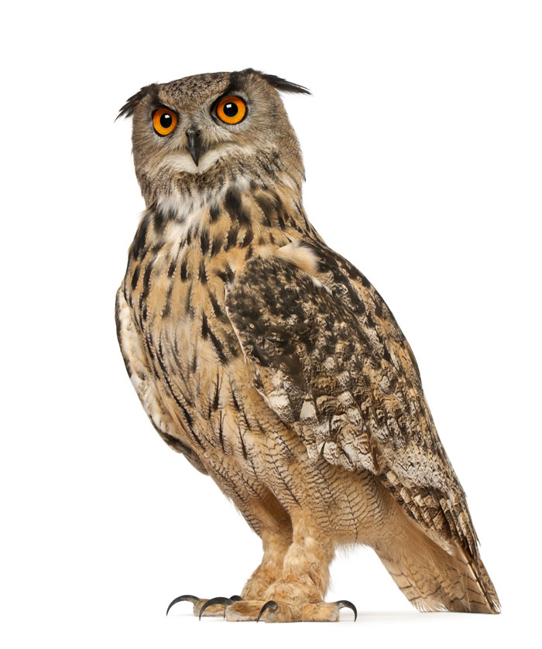
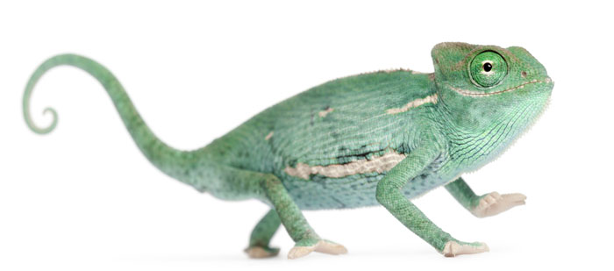
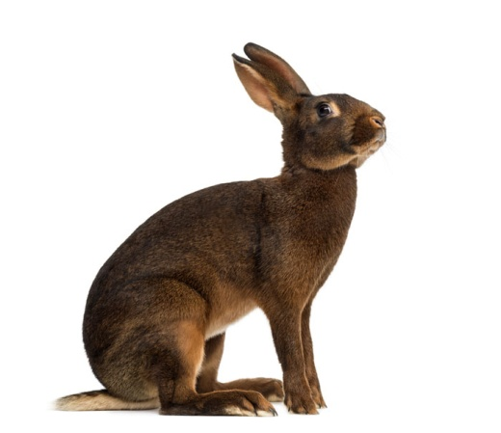
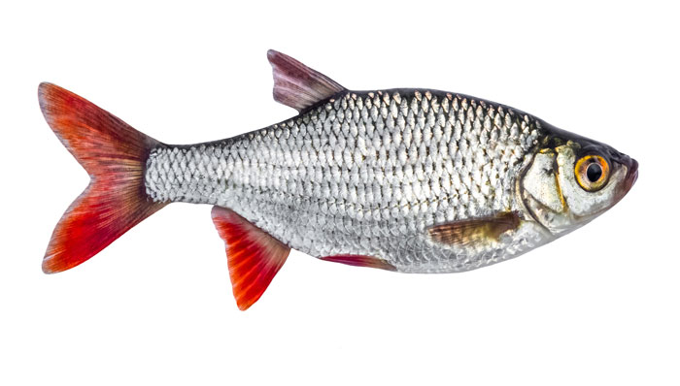
Animal parts and what they do (1)
Animals use their parts do different jobs, such as seeing, hearing or moving.
Which parts do these animals use for seeing?
Do the parts look the same or different?
Notes:
This slide covers the Science and Engineering Practice:
Asking Questions and Defining Problems: Ask questions based on observations to find more information about the natural and/or designed world(s).
Photo credits: Chameleon © Eric Isselee; Fly © Le Do; Hare © Eric Isselee; Fish © Nosyrevy; Eagle-Owl: © Eric Isselee, all at Shutterstock.com 2018

Slide 7
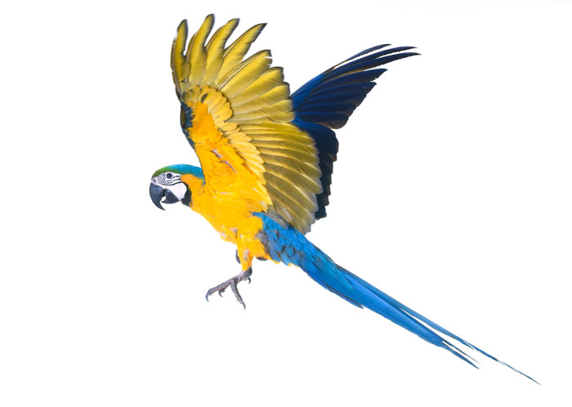
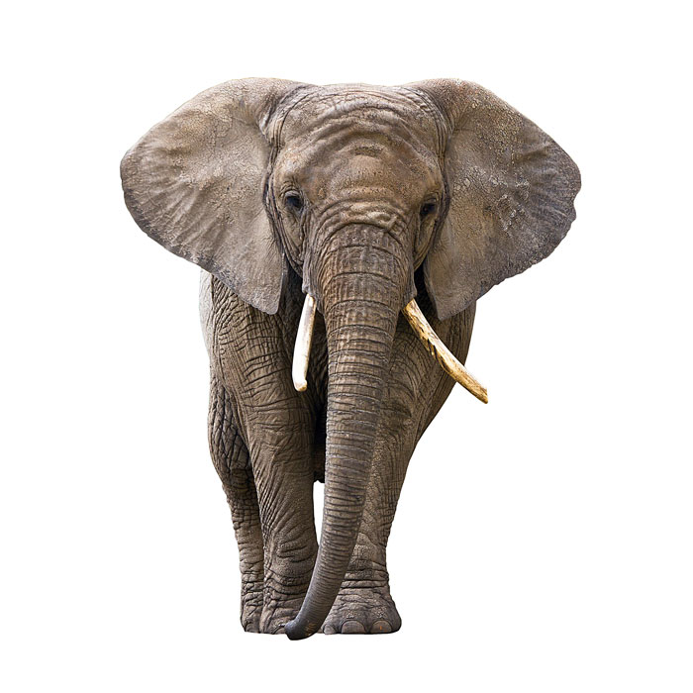
Animal parts and what they do (2)
Which parts do these animals use for moving from place to place?
Do the parts look the same or different?
Notes:
This slide covers the Science and Engineering Practice:
Asking Questions and Defining Problems: Ask questions based on observations to find more information about the natural and/or designed world(s).
Photo credits: Macaw © cynoclub; Elephant © Patryk Kosminder; Chameleon © Eric Isselee; Fly © Le Do; Hare © Eric Isselee; Fish © Nosyrevy, all at Shutterstock.com 2018

Slide 8
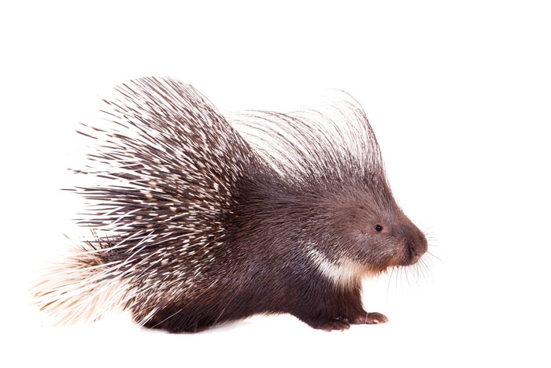
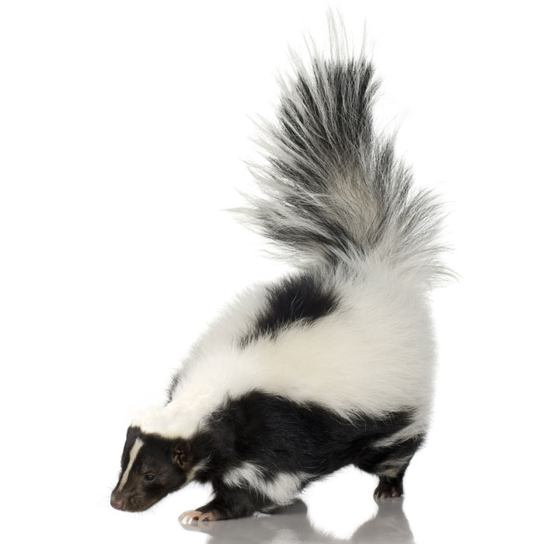
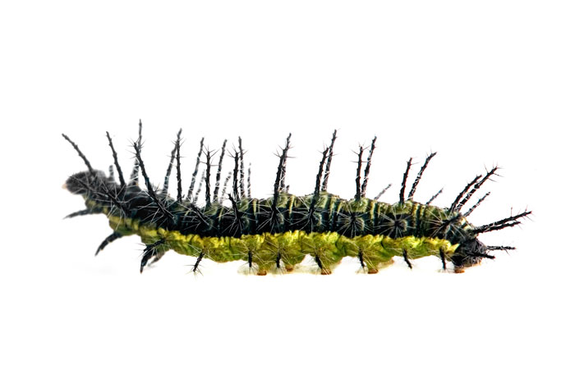
Animal parts and what they do (3)
Which parts do these animals use for protecting themselves from danger?
Do the parts look the same or different?
Notes:
This slide covers the Science and Engineering Practice:
Asking Questions and Defining Problems: Ask questions based on observations to find more information about the natural and/or designed world(s).
Photo credits: Indian crested porcupine © Rosa Jay; Striped skunk © Eric Isselee; Caterpillar © hagit berkovich, all at Shutterstock.com 2018

Slide 9
Different parts of plants
Notes:
Teacher notes
Students could label plants around the school orally or by using sticky notes. If possible, help them to identify the visible roots of a nearby tree.

Slide 10
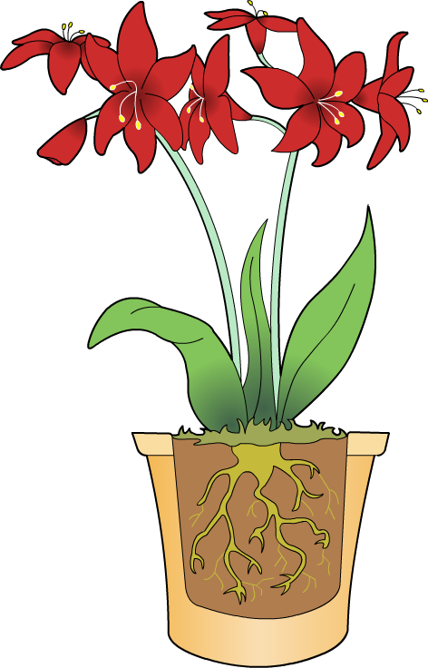
Plant parts and what they do (1)
Like animals, plants use their parts to do different jobs.
Flowers help the plant to attract insects and make seeds.
The stem supports the plant and helps it to grow tall.
Leaves help the plant to capture light from the Sun.
Roots help the plant to take up water from the soil.

Slide 11
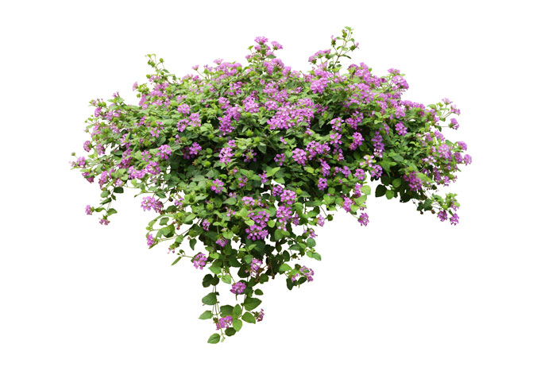
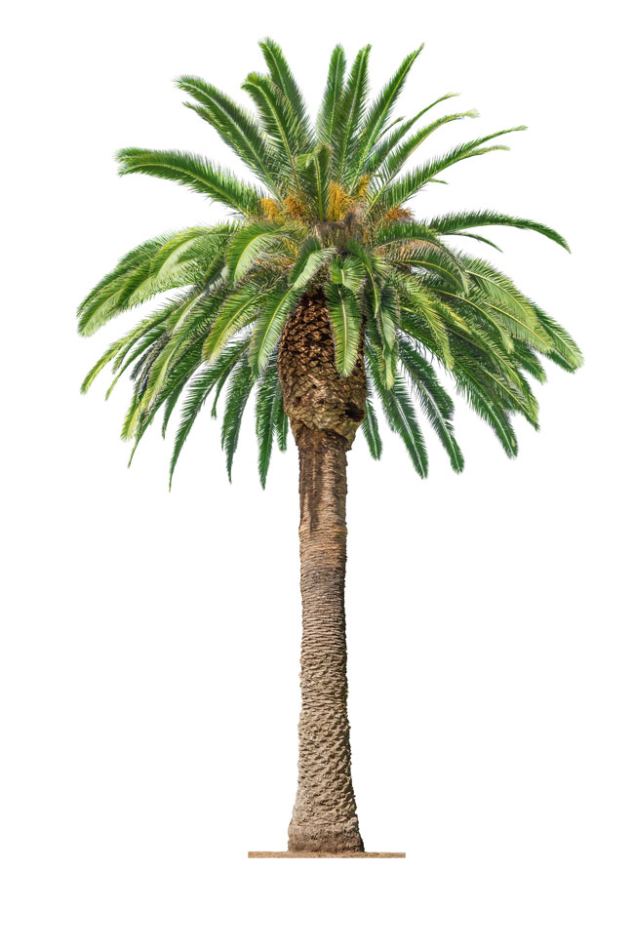
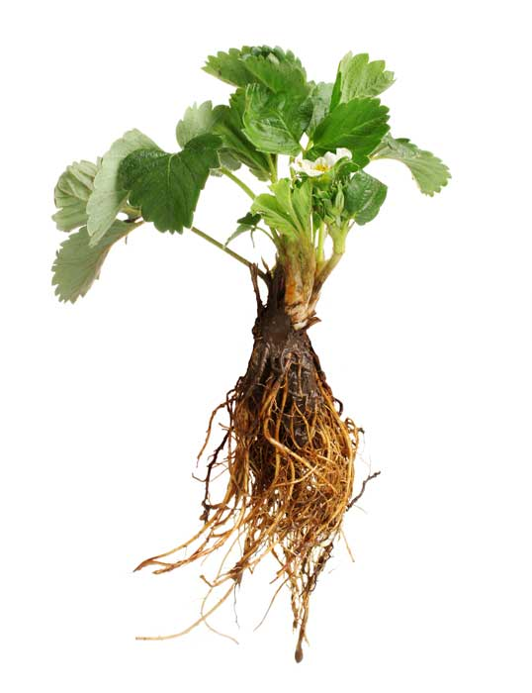
Plant parts and what they do (2)
Can you recognize any plant parts in the plants below?
Do the parts look the same or different?
Notes:
This slide covers the Science and Engineering Practice:
Asking Questions and Defining Problems: Ask questions based on observations to find more information about the natural and/or designed world(s).
Photo credits: Strawberry plant © Africa Studio; Spreading plant © sakdam; Primrose plant © Labrador Photo Video; Palm tree © Lev Kroptov, all at Shutterstock.com 2018

