Slide 1
Ecosystems

Slide 2
Information
Engaging in Argument from Evidence
Obtaining, Evaluating and Communicating Information
2. Cause and Effect
6. Structure and Function
7. Stability and Change

Slide 3
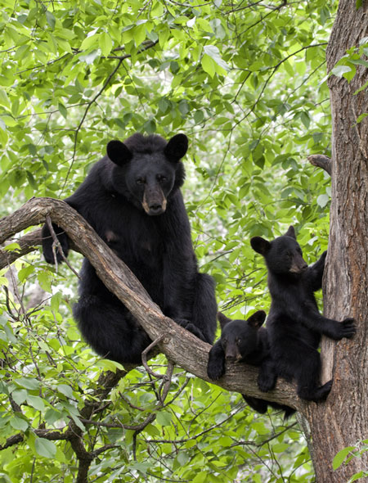
What are ecosystems?
The environment is made up of many different ecosystems, such as seashores, forest, lakes and deserts.
An ecosystem includes both the living organisms and the non-living components in the area, such as water.
Organisms can only survive in an ecosystem that meets their exact needs.
For example, providing the right food, water, temperature and shelter.
Notes:
Photo credit: © Debbie Steinhausser, Shutterstock.com 2018
3

Slide 4
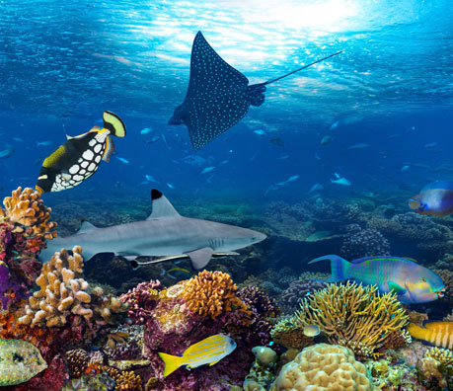
Healthy ecosystems
A healthy ecosystem is one that can support lots of different species.
The more species that are supported within the ecosystem, the less likely it is to be disrupted by a small change.
This creates a relatively stable web of life.
Notes:
Photo credit: © stockphoto-graf, Shutterstock.com 2018

Slide 5
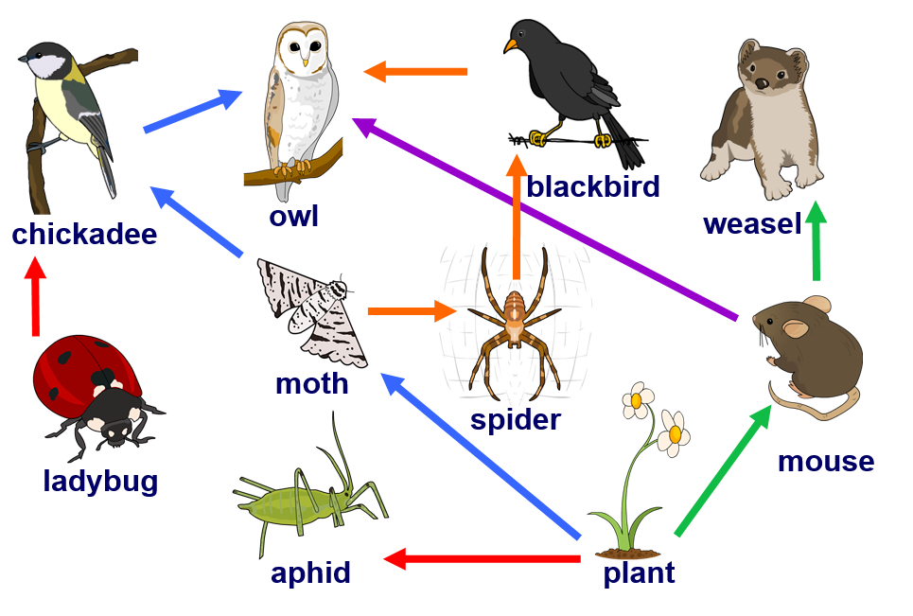
Food webs
This food web shows some of the interactions in one ecosystem.
What would happen to owls if the population of chickadees was to die out?
The owl would still have sources of food from the blackbird and mouse.
Do you think this food web shows a healthy ecosystem?
Notes:
Teacher notes
For more information on food webs, please refer to the Food Webs presentation.
This slide covers the Science and Engineering Practices:
Engaging in Argument from Evidence: Construct and/or support an argument with evidence, data, and/or a model.
Obtaining, Evaluating, and Communicating Information: Communicate scientific and/or technical information orally and/or in written formats, including various forms of media and may include tables, diagrams and charts.

Slide 6
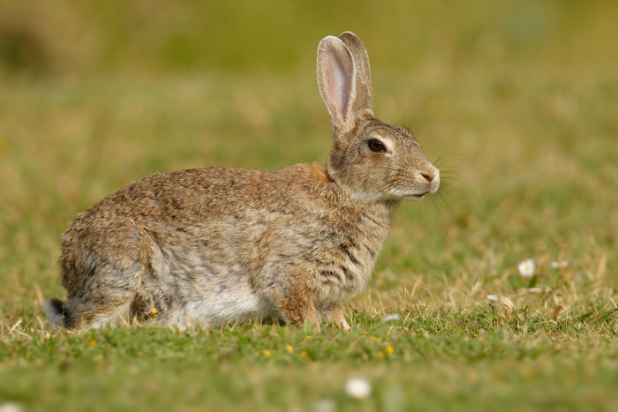
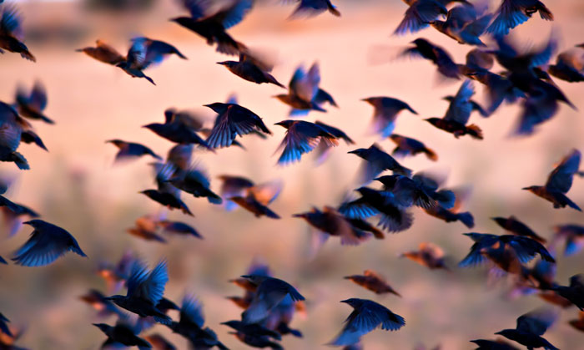
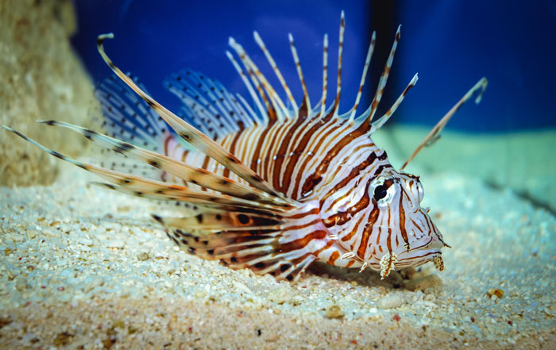
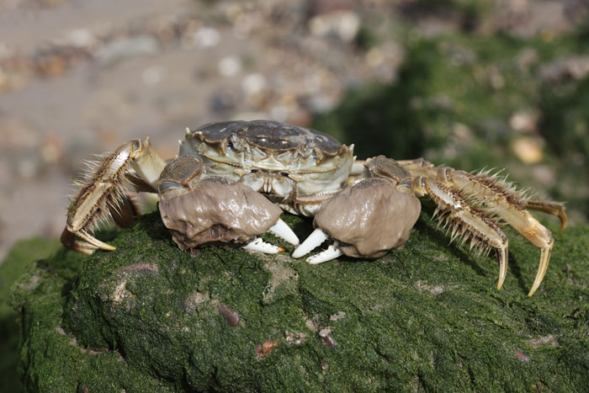
What are invasive species? (1)
An invasive species is one that is not native to an area, and therefore has been introduced.
These can have a very disruptive effect on the stability of an ecosystem.
Notes:
Teacher notes
Photos show four examples of invasive species.
Rabbit, in Australia
Starlings, in the US
Lionfish, in Atlantic coral reefs
Chinese mitten crab, in waterways of Northern Europe and North America (San Francisco Bay and Hudson River)
Photo credits: European Rabbit © Martin Pelanek; Birds © Nature Bird Photography; Red lionfish © Fotokon; Chinese mitten crab © Erni, all at Shutterstock.com 2018

Slide 7
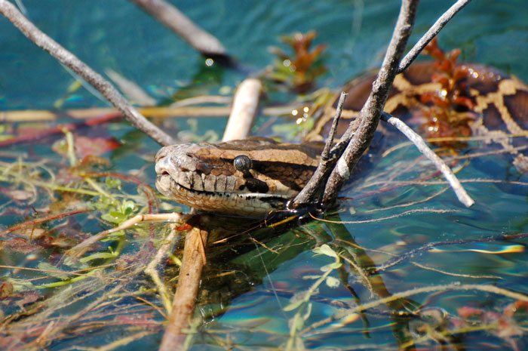
What are invasive species? (2)
One example of an invasive species is a large snake, the Burmese python.
It is native to Southeast Asia. However, it is now also found in the Everglades. It is thought that they were released into the wild accidently.
These snakes eat mammals. This has caused a large reduction in the native alligator, deer, raccoon, rabbit and possum populations.
Notes:
Teacher notes
Students could research what is being done to reduce the numbers of Burmese python in the Everglades.
Photo credit: Burmese Python © Heiko Kiera, Shutterstock.com 2018

Slide 8
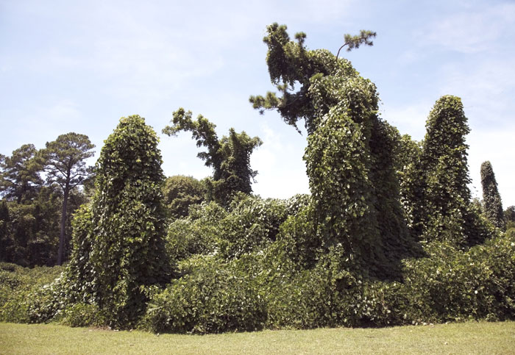
What are invasive species? (3)
Plants can also be invasive species. Kudzu was introduced into North America from Asia in the late 1800s. It was planted widely to help with erosion control.
The plant grows very rapidly over trees and shrubs. This prevents light from reaching them, causing them to die.
The reduction of native plants in this way has a huge effect on the rest of the ecosystem.
Notes:
Teacher notes
Ask students to comment on how and why this has effected the rest of the ecosystem.
Photo credit: Kudzu © vincent noel, Shutterstock.com 2018

