Slide 1
Environmental Change

Slide 2
Information
Planning and Carrying Out Investigations
Constructing Explanations and Designing Solutions
Engaging in Argument from Evidence
Obtaining, Evaluating and Communicating Information
1. Patterns
2. Cause and Effect
6. Structure and Function
7. Stability and Change

Slide 3
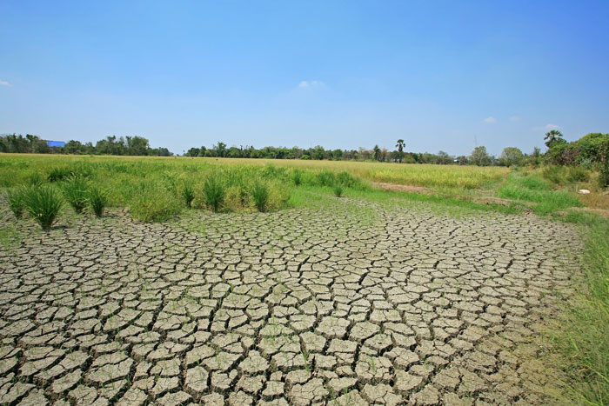
Environmental change
A change in the environment can affect the animals and plants that live there.
This includes changes to:
temperature
land characteristics
water distribution
food availability.
Human activity can often cause these environmental changes.
Notes:
Photo credit: © Blanscape, Shutterstock.com 2018

Slide 4
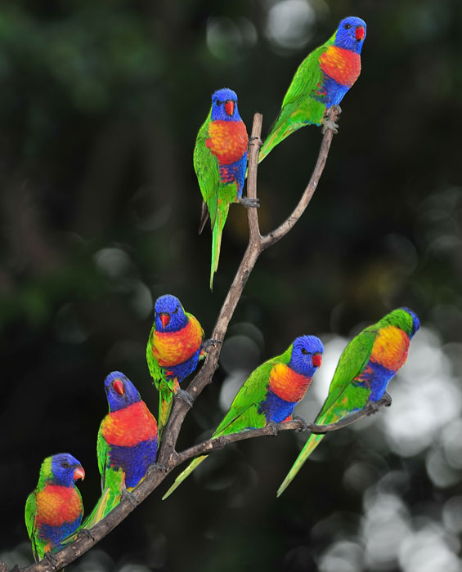
Adaptions in populations (1)
What happens to populations when the environment changes?
Some populations are able to adapt to the changes.
Some individuals in a population may have characteristics that make them more suitable for the changed environment.
These individuals may survive and reproduce.
Notes:
Photo credit: © worldswildlifewonders, Shutterstock.com 2018

Slide 5
Adaptions in populations (2)
Notes:
This slide covers the Science and Engineering Practice:
Constructing Explanations and Designing Solutions: Construct an explanation of observed relationships (e.g., the distribution of plants in the back yard).

Slide 6
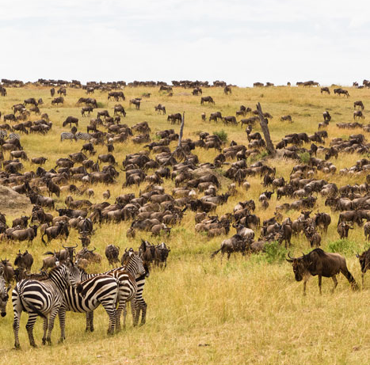
Migration
Some animals may move to another, more suitable environment.
Other organisms that can tolerate the changed environment might move in.
If a population is unable to move or adapt it may die out.
Notes:
Photo credit: © Victor Lapaev, Shutterstock.com 2018

Slide 7
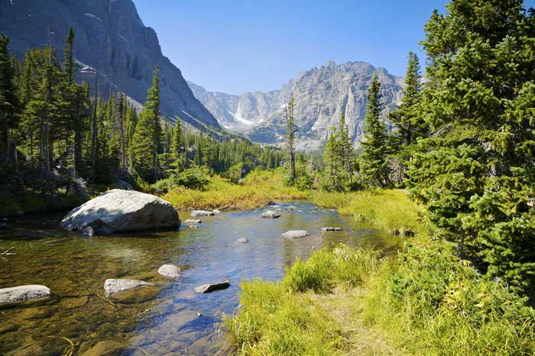
The effect of environmental change (1)
Let’s look at an example. If this river dried up, what effect would this have on the organisms that live there?
Notes:
Teacher notes
You could ask students to identify a change in the environment (or give them some to choose from) and research how this change is affecting the organisms in the environment.
This slide covers the Science and Engineering Practice:
Constructing Explanations and Designing Solutions: Construct an explanation of observed relationships (e.g., the distribution of plants in the back yard).
Photo credit: © RIRF Stock, Shutterstock.com 2018

Slide 8
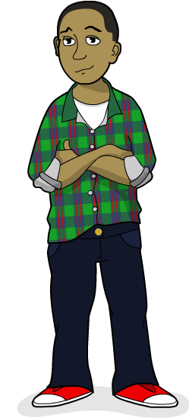
The effect of environmental change (2)
Grasses and other plants that live near the river might not grow as large as before.
Some animals that use the river may move to another area.
Some populations of aquatic organisms, such as fish, may die out completely.
Other animals and plants that require less water may move into the environment and thrive.
Did you think of any others?

Slide 9
Habitats
Notes:
Teacher notes
Help students to list the things that each organism needs from its environment. For example, the plants need space to grow, water and nutrients from the soil, sunlight and air. In the next slide, students will need to examine the park after it has changed and decide whether or not each organism can survive in its changed environment.
For more information on habitats, please refer to the Habitats presentation.
This slide covers the Science and Engineering Practices:
Planning and Carrying Out Investigations: Make observations and/or measurements to produce data to serve as the basis for evidence for an explanation of a phenomenon or test a design solution.
Constructing Explanations and Designing Solutions: Construct an explanation of observed relationships (e.g., the distribution of plants in the back yard).

Slide 10
Changing habitats
Notes:
Teacher notes
Help students to notice changes in the park. Examples include: litter in the flowerbed and removal of the oak tree, bushes, pond plants and vegetables. The pond has been drained and the grass has been reduced. Students should be able to explain the effect of these changes on the organisms they identified in the previous slide. Help them to identify that some organisms will move to other areas, some will die, and some will continue to survive in their changed habitat. Some new organisms may move into the changed habitats. For example, removing the oak tree reduces the amount of shade below it, which may make the habitat suitable for different plants and animals.
This slide covers the Science and Engineering Practices:
Engaging in Argument from Evidence: Construct and/or support an argument with evidence, data, and/or a model.
Obtaining, Evaluating, and Communicating Information: Communicate scientific and/or technical information orally and/or in written formats, including various forms of media and may include tables, diagrams, and charts.

