Slide 1
Food Webs

Slide 2
Information
Developing and Using Models
Analyzing and Interpreting Data
Constructing Explanations and Designing Solutions
Engaging in Argument from Evidence
1. Patterns
2. Cause and Effect
4. Systems and System Models
7. Stability and Change

Slide 3
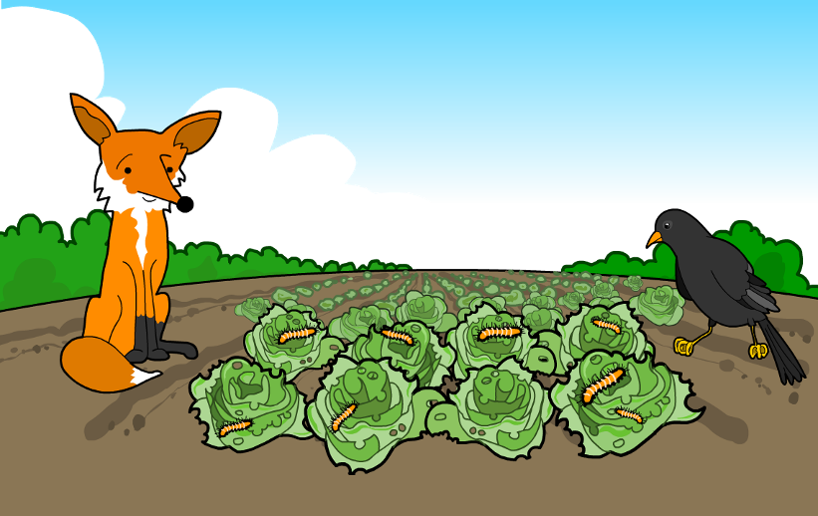
A garden habitat
Look carefully at the organisms in this garden habitat.
Can you identify who might eat who
or what in this picture?
Notes:
Teacher notes
Students should be comfortable with the information in the presentation Habitats before viewing this presentation.

Slide 4
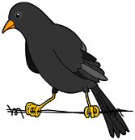
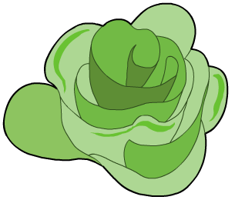
Food chains
In every habitat, some animals eat plants and some animals eat other animals.
lettuce
caterpillar
bird
fox
In this garden, lettuce is eaten by a caterpillar, which is then eaten by a bird, which is then eaten by a fox.
This is an example of a food chain.

Slide 5
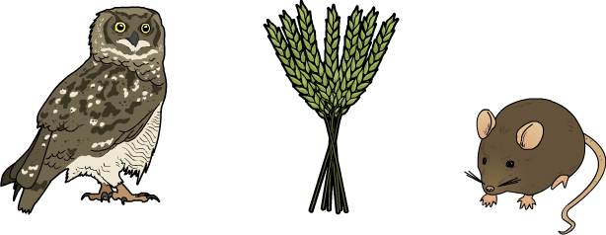
What are food chains?
A food chain describes the feeding relationships in a group of organisms. It shows what eats what in the group!
All organisms are linked together by food chains. They depend on each other to survive.
Can you make a food chain for these organisms?
Notes:
Teacher notes
For the organisms shown, the food chain would be: Wheat → Mouse → Owl.

Slide 6
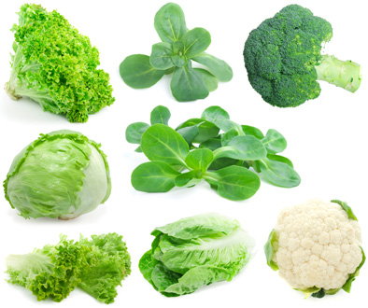
Producers
Most food chains start with a green plant.
Green plants are producers. They produce food for other living things.
Producers make their own food using energy from the Sun.
Most producers need sunlight, water and carbon dioxide to make food.
Notes:
Teacher notes
It may be helpful to explain the term “producer” as an organism that “produces” food for other organisms, and “consumer” as an organism that “consumes,” or eats, other organisms.
Photo credit: © motorolka, Shutterstock.com 2018

Slide 7
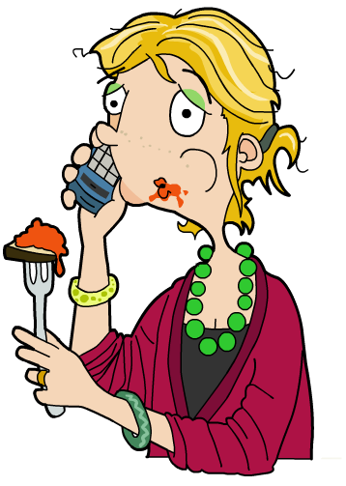
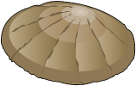
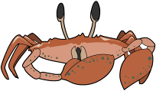
Consumers
Other organisms eat producers to get the energy they need to live and grow.
Organisms that consume other organisms are called consumers.
seaweed
limpet
crab
human
producer
consumer
consumer
consumer

Slide 8
Examples of food chains
Notes:
Teacher notes
Challenge students further by asking them which organisms are found in a specific habitat. Ask them to identify the food of specific animals, some of which eat plants and some of which eat animals.
Food chains that can be made in the activity include (but are not limited to):
beetle → chicken → fox
berries → beetle → chicken
beetle → chicken → human
corn → beetle → chicken
berries → beetle → finch
berries → finch → fox
Note that the arrows in a food chain are always drawn from left to right to indicate “is eaten by.”
This slide covers the Science and Engineering Practice:
Developing and Using Models: Develop and/or use models to describe and/or predict phenomena.

Slide 9
What are food webs?
Animals usually eat many different things and are involved in lots of different food chains.
plants
aphid
ladybug
chickadee
owl
plants
moth
chickadee
owl
plants
mouse
weasel
plants
mouse
owl
These food chains can be put together in a food web,
which shows how the food chains are connected.
What would the food web for these food chains look like?
Notes:
Teacher notes
You could ask students why it is important for an organism to have different sources of food. Reliance on only one source of food would make an organism vulnerable to variations in the availability of this food. Also, many food sources are not available all year round, so alternative sources of nutrition are needed.

Slide 10
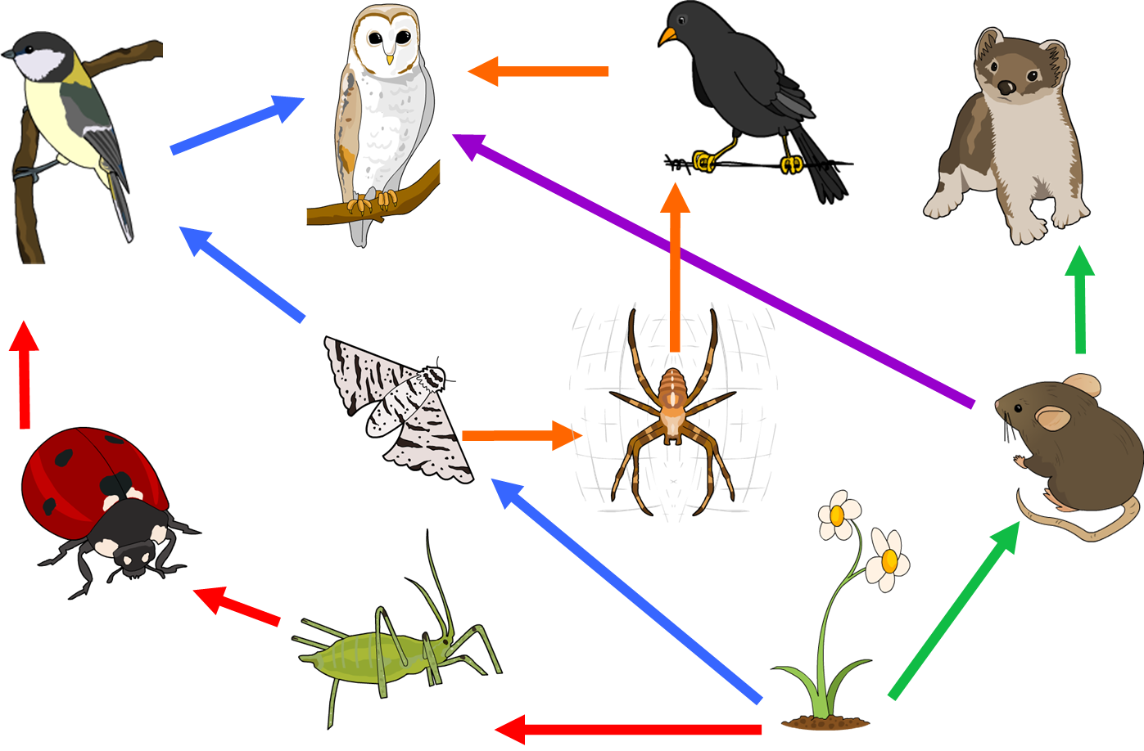
A food web
blackbird
owl
weasel
chickadee
moth
spider
mouse
ladybug
aphid
plant

Slide 11
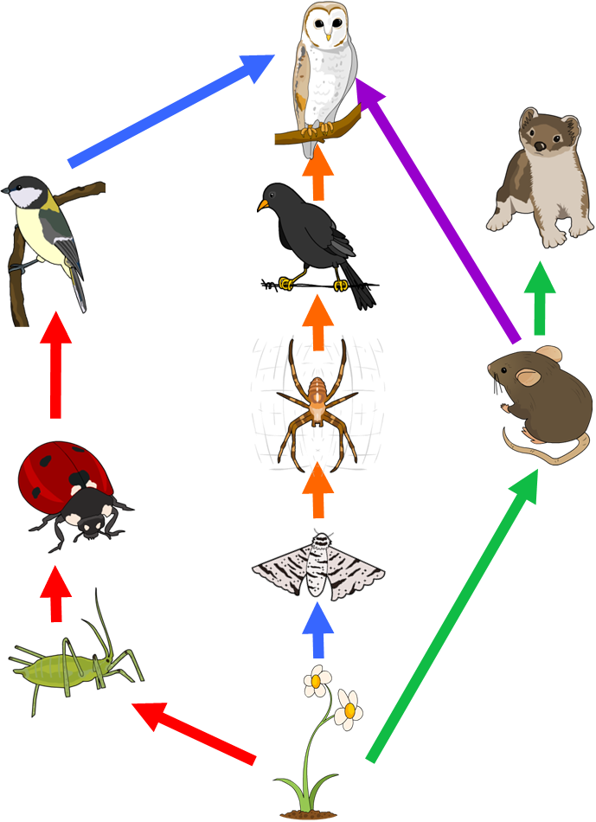
Understanding food webs
1. Who is the producer in this food web?
2. Who are the two herbivores in this food web?
3. Who are the two carnivores in this food web?
4. How many consumers are in this food web?
5. Which food chains include the moth?
Notes:
Teacher notes
1. Daisy (flower/plant)
2. Mouse, aphid and moth (Adult moths usually don’t eat, but their larvae do. While mice in urban environments often become omnivorous, they are natural herbivores.)
3. Weasel, ladybug, spider and owl
4. Nine (all of the organisms except the daisy are consumers)
5. Daisy, moth, chickadee, owl
Daisy, moth, spider, blackbird, owl

Slide 12
Building a food web
Notes:
This slide covers the Science and Engineering Practice:
Developing and Using Models: Develop and/or use models to describe and/or predict phenomena.
Analyzing and Interpreting Data: Analyze and interpret data to make sense of phenomena, using logical reasoning, mathematics, and/or computation.

Slide 13
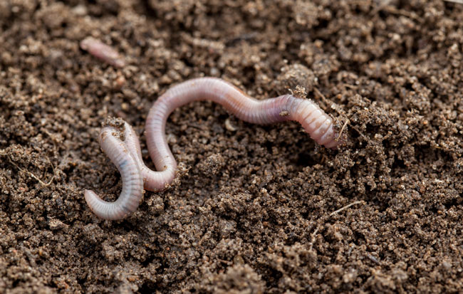
What are decomposers? (1)
When organisms die, they are eaten by other types of organisms.
These organisms are called decomposers.
Decomposers include some types of animals, such as earthworms.
Fungi and some types of bacteria are also decomposers.
Notes:
Photo credit: © Maryna Pleshkun, Shutterstock.com 2018

Slide 14
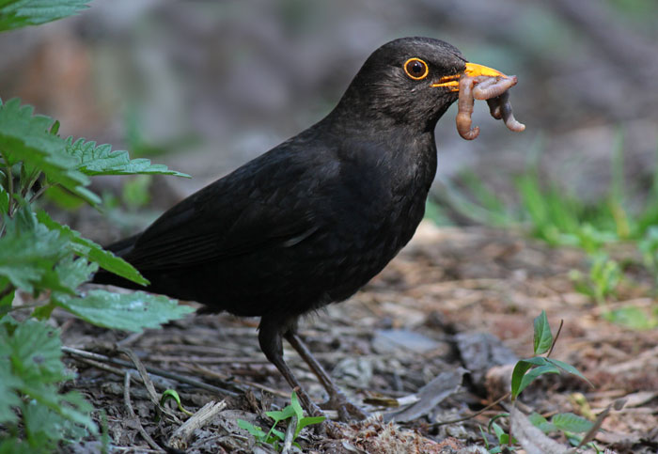
What are decomposers? (2)
Decomposers grow and survive by eating dead organisms and waste matter such as dung.
Decomposers are eaten by other living organisms.
This means that decomposers have a very important role in food webs.
Can you explain why?
Notes:
Teacher notes
Encourage students to explain that decomposers recycle matter in food webs, returning the useful parts of dead matter and waste materials back into the food web for other organisms to use.
This slide covers the Science and Engineering Practices:
Constructing Explanations and Designing Solutions: Construct an explanation of observed relationships.
Engaging in Argument from Evidence: Construct and/or support an argument with evidence, data, and/or a model.
Photo credit: © Olha Insight, Shutterstock.com 2018

Slide 15
Interdependence

