Slide 1
Fossils

Slide 2
Information
Constructing Explanations and Designing Solutions
Engaging in Argument from Evidence
Obtaining, Evaluating and Communicating Information
1. Patterns
2. Cause and Effect
7. Stability and Change

Slide 3
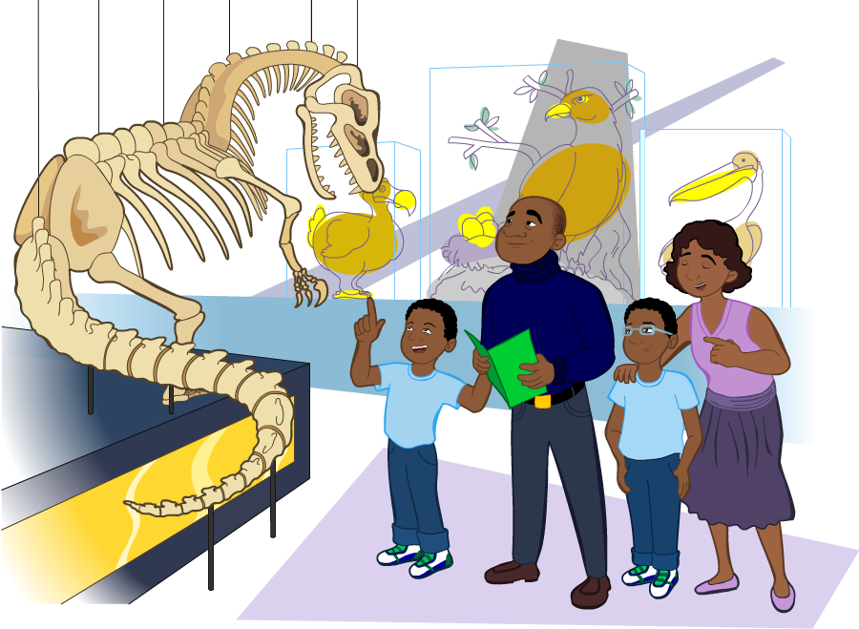
The Earth before humans
Life on Earth has not always looked like it does today.
Many years ago, other kinds of plants and animals lived on Earth.
Some of them looked very different to the living things we see today!
Can you think of any examples?

Slide 4
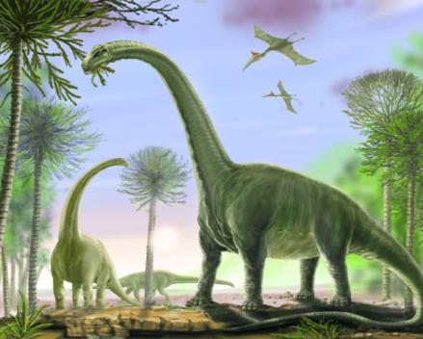
What are dinosaurs?
Dinosaurs are examples of living things that existed on Earth millions of years ago.
Dinosaurs no longer live on Earth.
Many types of plants and animals that once lived on Earth are no longer found anywhere.
So how do we know they existed?
Notes:
Photo credit: © David Roland, Shutterstock.com 2018

Slide 5
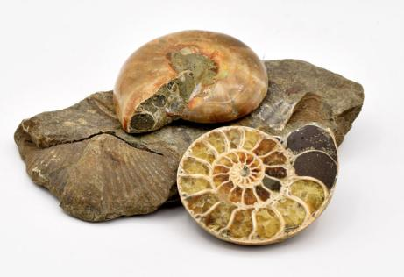
What are fossils?
We can use fossils to show us what ancient plants and animals may have looked like.
Fossils are the remains of plants and animals that lived on Earth a long time ago.
There are many different types of fossils. That’s because there are many different types of once-living things!
Notes:
Photo credit: © Paul Juser, Shutterstock.com 2018

Slide 6
How were fossils formed?
Notes:
Teacher notes
This six-stage interactive animation shows how animal fossils were formed at sea, and how they are found within sedimentary rock formations on land. Suitable prompts could include:
Would you expect many organisms to make it all the way through this process?
What might stop an organism from becoming a fossil?
Are fossils made from bones?
How can you tell that some fossils are older than others?
How do fossils formed deep underwater end up on the side of cliffs?

Slide 7
Using fossils
Notes:
This slide covers the Science and Engineering Practices:
Constructing Explanations and Designing Solutions: Use evidence (e.g., measurements, observations, patterns) to construct or support an explanation or design a solution to a problem.
Engaging in Argument from Evidence: Construct and/or support an argument with evidence, data, and/or a model.
Photo credits: T-Rex © fusebulb; ammonites © sarkao; fish © markrhiggins; plant © alice-photo, all at Shutterstock.com 2018

Slide 8
Learning from fossils
Notes:
Teacher notes
This fill in the blanks activity could be used as a review exercise on fossils. Students could be asked to write down the missing words in their notebooks and the activity could be concluded by completion onscreen.

