Slide 1
Growing Up

Slide 2
Information
Constructing Explanations and Designing Solutions
Obtaining, Evaluating and Communicating Information
1. Patterns

Slide 3
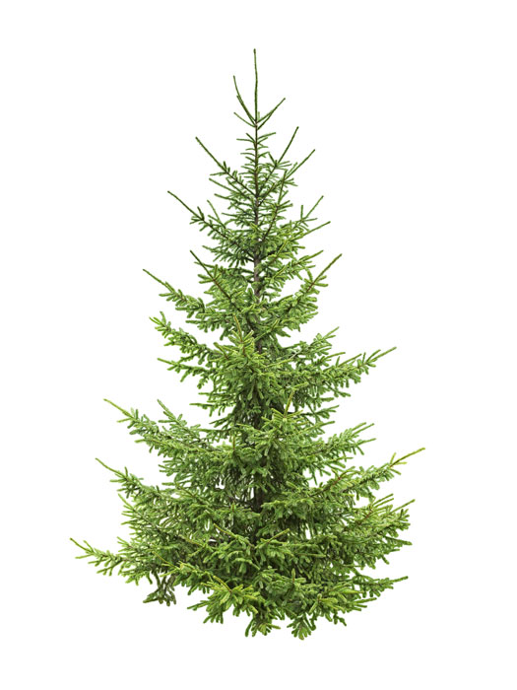
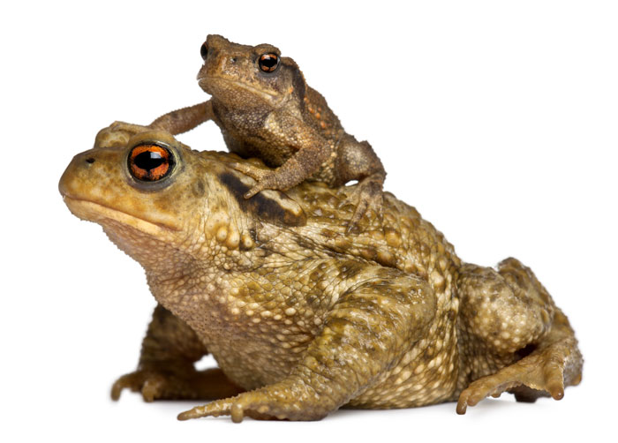
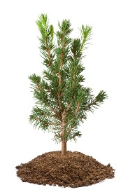
Parents and offspring
Adult plants and animals can have young.
These are also known as offspring.
Notes:
Photo credits: Mother common toad and her baby © Eric Isselee; Young spruce sapling © Fotofermer; Spruce tree © Irina Rogova, all at Shutterstock.com 2018
3

Slide 4
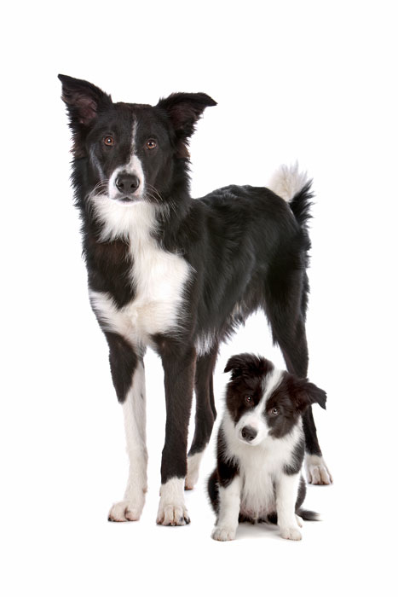
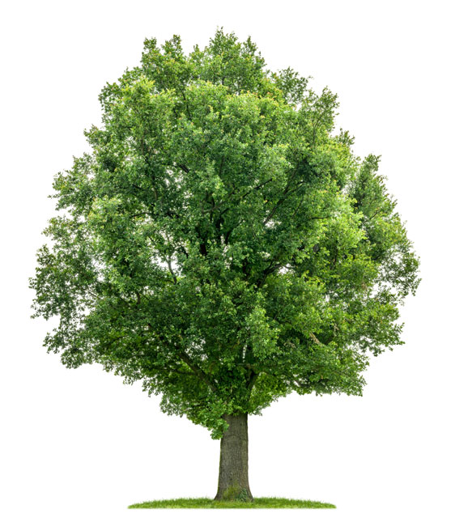
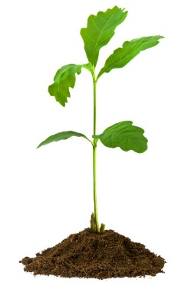
The same or different?
Many of the offspring’s characteristics are inherited from their parents.
But are the offspring exactly
the same as their parents?
Notes:
Teacher notes
Prompt students to give their opinion. Then ask students to identify two ways in which the offspring are different from the parent and two ways they are the same, for both the dogs and the oak.
Photo credits: 1-month seedling oak © Fotofermer; Oak tree © Zerbor; Border collie adult and puppy © Erik Lam, all at Shutterstock.com 2018

Slide 5
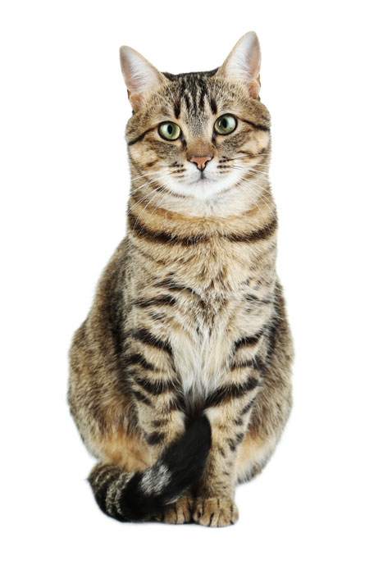
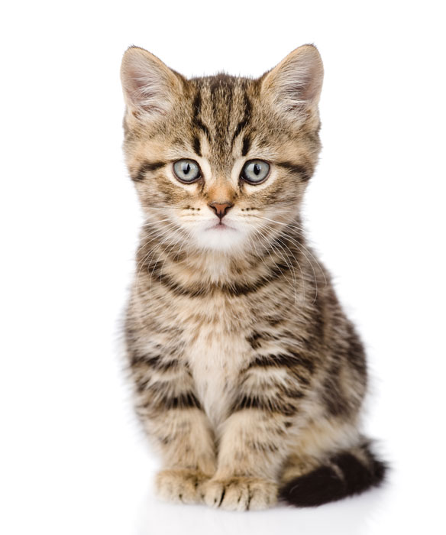
Common characteristics
Offspring are very much, but not exactly, like their parents.
We can see this when comparing this cat and its kitten.
Parent
Offspring
green eyes
striped fur
blue eyes
large
black tail tip
small
Notes:
Teacher notes
Give students an example of another parent and its offspring and ask them to compare them in the same way, using a Venn diagram. If appropriate, students could compare themselves to one of their own parents.
Photo credits: Cat © 5 second Studio; Kitten © Ermolaev Alexander, both at Shutterstock.com 2018

Slide 6
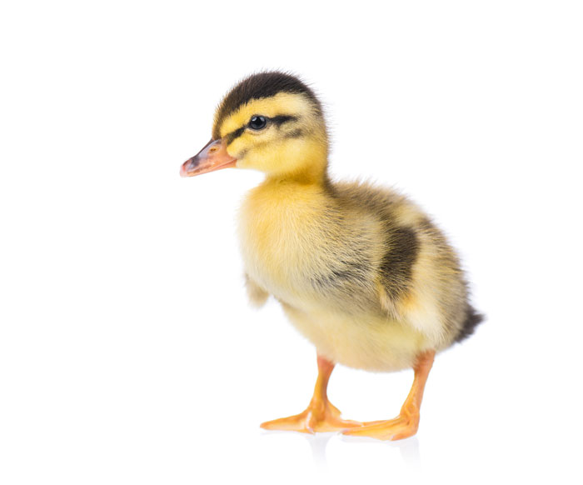
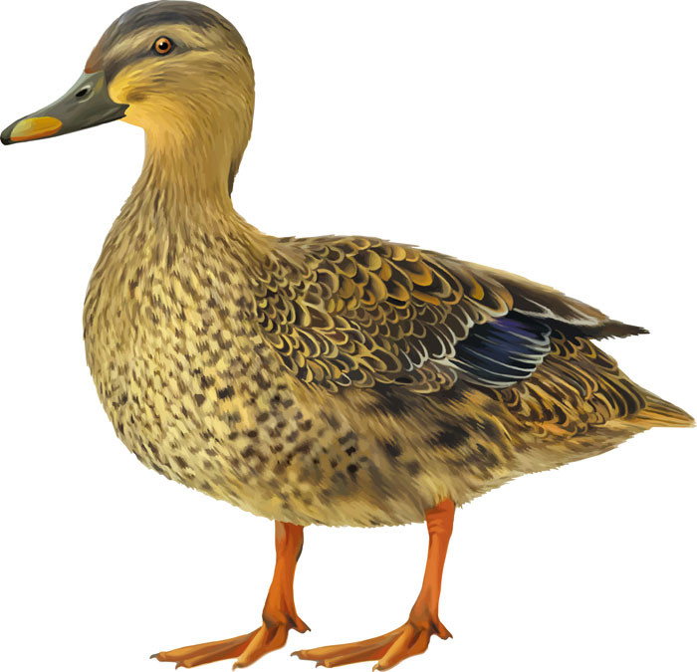
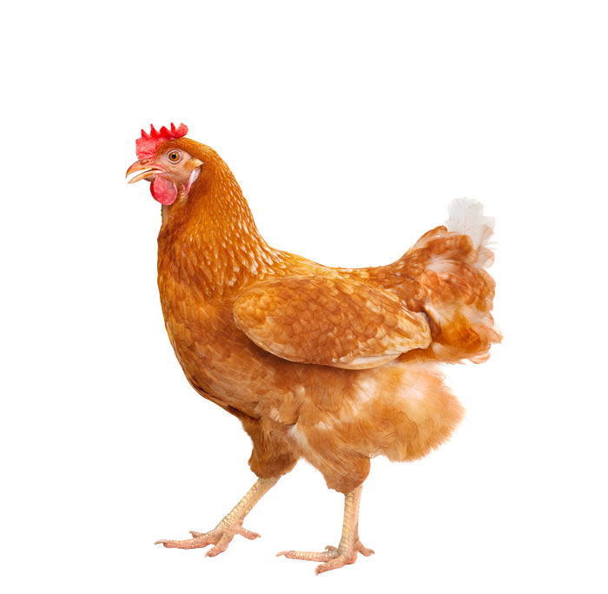
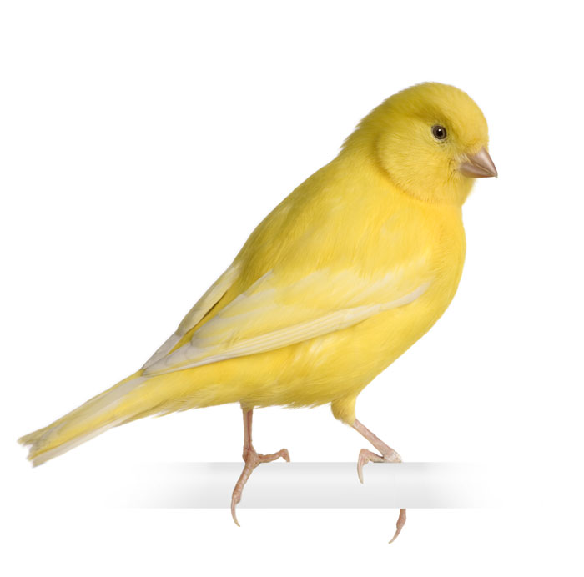
Find the right parent
This baby bird has fallen out of its nest.
Can you use its characteristics to identify the correct parent?
Notes:
Teacher notes
Ask students to give specific evidence to back up their decision. They should be able to identify that the baby bird has webbed feet, a duck bill and stripes on its head.
The birds shown are a mallard duck, a chicken and a yellow canary. The correct parent is the mallard duck.
Photo credits: Female mallard duck © Nature Art; full body of brown chicken © stockphoto mania; Yellow canary © Eric Isselee; Newborn duckling © DenisNata, all at Shutterstock.com 2018

Slide 7
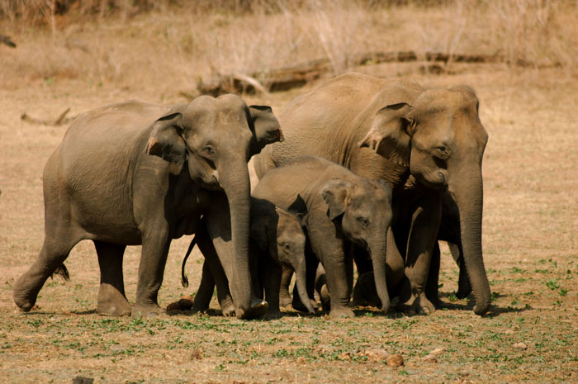
Behavior in parents
With some animals, the parents look after their young.
They behave in certain ways in order to help the offspring to survive, including:
feeding
comforting
providing protection.
Notes:
Teacher notes
Ask students what they think is happening in this photo, and what type behavior this may be an example of.
The image shows two elephants walking either side of their young in order to protect them.
Photo credit: Herd of Asian Elephants © Julian W, Shutterstock.com 2018

Slide 8
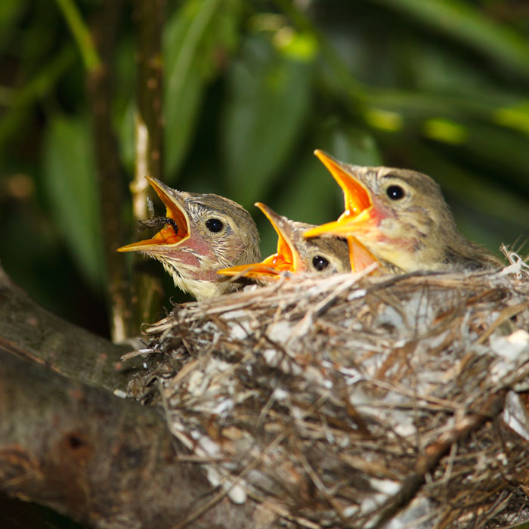
Behavior in offspring
Offspring also use special behavior to help them to survive.
Some young make signals, such as crying, cheeping or other noises. This alerts their parents when they are hungry or in danger.
Notes:
Teacher notes
Ask the students if they can identify what the baby birds are doing in the photo, and why, before revealing the answer.
This slide contains audio.
Photo credit: Icterine Warbler © Vishnevskiy Vasily, Shutterstock.com 2018
Sound credit: Chicks chirping - This work is licensed under the Creative Commons 0 License.

