Slide 1
Habitats

Slide 2
Information
Asking Questions and Defining Problems
Planning and Carrying Out Investigations
Constructing Explanations and Designing Solutions
Engaging in Argument from Evidence
Obtaining, Evaluating and Communicating Information
1. Patterns
2. Cause and Effect
6. Structure and Function
7. Stability and Change

Slide 3
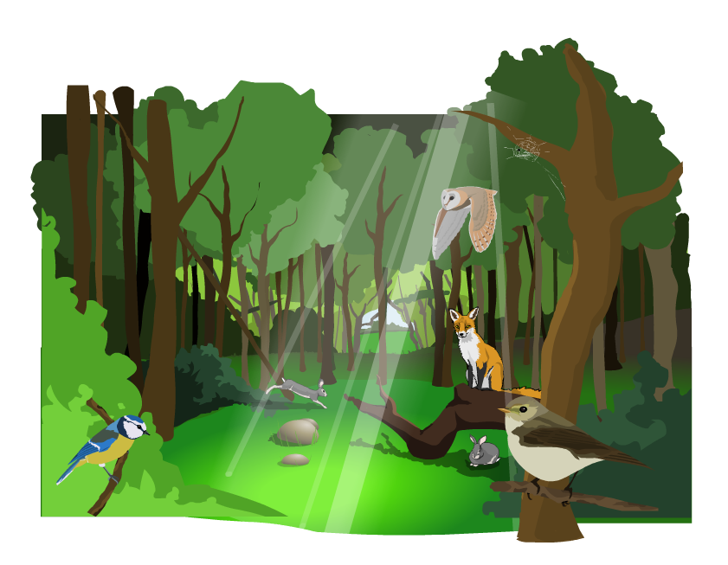
Living in habitats
Plants and animals live together in habitats. A habitat is the natural home or environment of an organism.
A habitat includes everything that a living thing needs to survive.
Plants and animals living together in different habitats form an ecosystem.

Slide 4
Different types of habitats
Notes:
Teacher notes
Emphasize that the park itself is a habitat, and also that lots of smaller habitats are contained within it. Discuss the idea of a habitats, mini-habitats and micro-habitats.
Habitat: The park
Mini-habitat: tree, bushes, flower bed, lawn
Micro-habitat: under a leaf, under a stone.
Explain that organisms have features that help them to survive in their habitats.
This slide covers the Science and Engineering Practices:
Planning and Carrying Out Investigations: Make observations and/or measurements to produce data to serve as the basis for evidence for an explanation of a phenomenon or test a design solution.
Constructing Explanations and Designing Solutions: Construct an explanation of observed relationships (e.g., the distribution of plants in the back yard).

Slide 5
Conditions within habitats
Notes:
Teacher notes
Some organisms look for a home that allows them to hide or to keep cool. Others need a home that provides lots of sunshine. Have students research common organisms in your local or state environment and ask them to consider what features make these organisms suited to their habitat.
This slide covers the Science and Engineering Practice:
Asking Questions and Defining Problems: Ask questions that can be investigated and predict reasonable outcomes based on patterns such as cause and effect relationships.

Slide 6
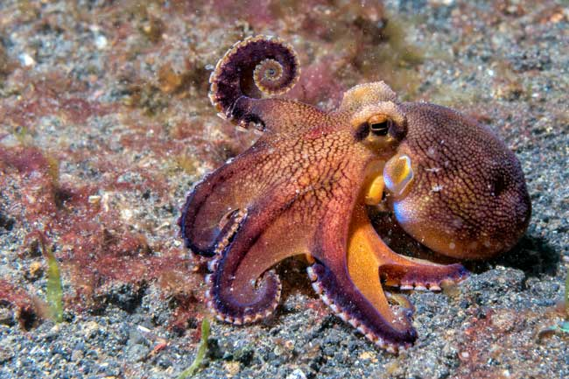
Animals and their habitats
This octopus lives in the sea next to Indonesia, where the water is warm.
The octopus is suited to live in its own habitat.
This means that it needs warm, salty water to survive.
What would happen if you moved it to a river habitat instead?
Notes:
Teacher notes
Help students to explain that a river habitat is a cool, freshwater environment that would not meet the needs of the octopus. If it was moved to this environment, the octopus would not have the ability to survive and would most likely die.
This slide covers the Science and Engineering Practice:
Asking Questions and Defining Problems: Ask questions that can be investigated and predict reasonable outcomes based on patterns such as cause and effect relationships.

Slide 7
Matching animals with habitats
Notes:
This slide covers the Science and Engineering Practices:
Constructing Explanations and Designing Solutions: Use evidence (e.g., measurements, observations, patterns) to construct or support an explanation or design a solution to a problem.
Engaging in Argument from Evidence: Construct and/or support an argument with evidence, data, and/or a model.
Obtaining, Evaluating, and Communicating Information: Communicate scientific and/or technical information orally and/or in written formats, including various forms of media and may include tables, diagrams, and charts.

Slide 8
Protection and pollution
Notes:
Teacher notes
Explain that organisms only flourish in a healthy environment where there is enough food. Ask students to think about the ways in which organisms are affected by changing conditions such as: the draining of a pond, the removal of weeds from a pond, the removal of shade, or pollution.
Ask students to describe examples of human impacts on the environment that have brought about beneficial changes and examples that have detrimental effects.
For more information on environmental changes, please refer to the Environmental Change presentation.
This slide covers the Science and Engineering Practices:
Asking Questions and Defining Problems: Ask questions that can be investigated and predict reasonable outcomes based on patterns such as cause and effect relationships.
Obtaining, Evaluating, and Communicating Information: Communicate scientific and/or technical information orally and/or in written formats, including various forms of media and may include tables, diagrams, and charts.

