Slide 1
Life Cycles

Slide 2
Information
Developing and Using Models
Analyzing and Interpreting Data
Constructing Explanations and Designing Solutions
1. Patterns
7. Stability and change

Slide 3
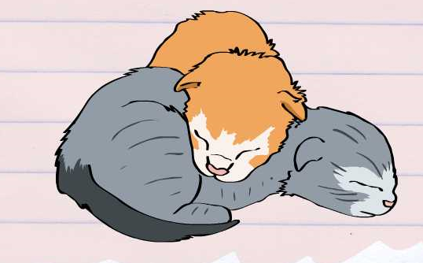
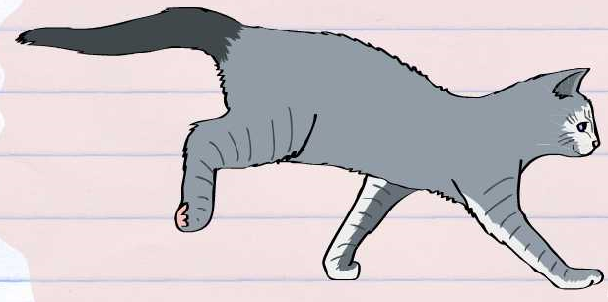
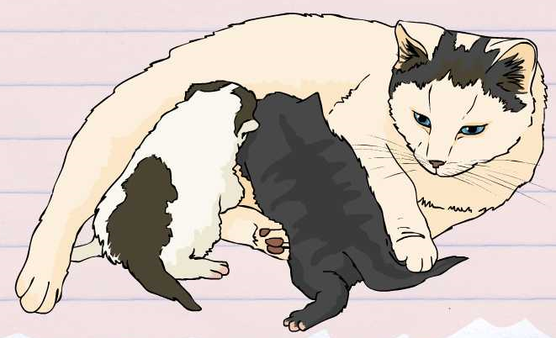
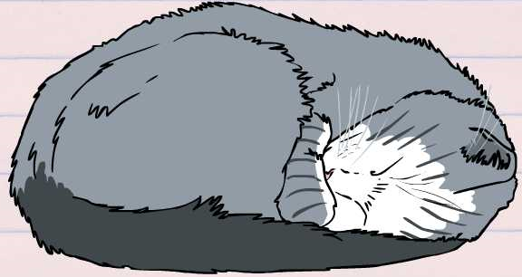
Life cycles
All plants and animals have their own unique life cycle.
This is the series of changes that occur during the life of an organism, including reproduction.
Can you describe any stages in the life cycle of a cat?
They are born.
They grow.
They have kittens.
They die.
Notes:
Teacher notes
You could carry out a practical investigation into an organism’s life cycle by studying a species in the classroom or school environment.

Slide 4
Cat life cycle

Slide 5
Butterfly life cycle

Slide 6
Ordering the butterfly life cycle

Slide 7
Frog life cycle

Slide 8
Ordering the frog life cycle

Slide 9
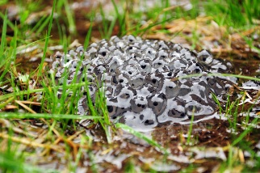
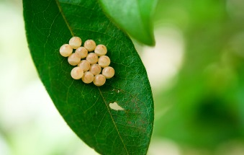
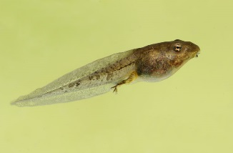
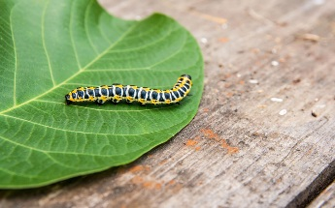
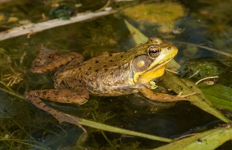
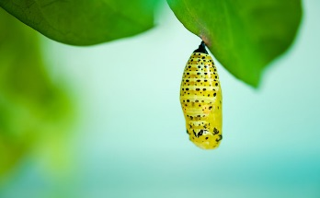
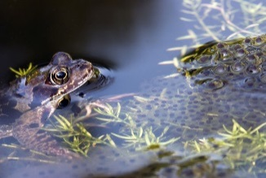
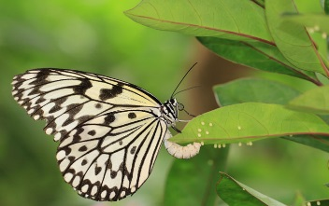
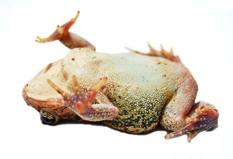
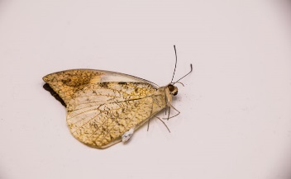
Comparing life cycles
Look at these two life cycles.
Frog
Butterfly
What differences are there?
What similarities are there?
Can you name four processes that they have in common?
Notes:
Teacher notes
What differences are there? Students could identify the differences between the changes that each species go through, or where these occur.
What similarities are there? They both start with an egg, the adults lay eggs, they both die, the both get bigger.
Can you name four processes that they have in common? Birth, growth, reproduction, death.
Once you have named the four processes, ask students to identify where these occur. Perhaps going back to the animations too.
This slide covers the Science and Engineering Practices:
Analyzing and Interpreting Data: Analyze and interpret data to make sense of phenomena, using logical reasoning, mathematics, and/or computation.
Constructing Explanations and Designing Solutions: Use evidence (e.g., measurements, observations, patterns) to construct or support an explanation or design a solution to a problem.
Photo credits:
Frog spawn © Joanna K-V; Wood Frog Tadpole © Steve Byland; An adult Green Frog © Gerald A. DeBoer; Brown frog and frog spawn © Gertjan Hooijer; Toad playing dead © eduard Ionescu; butterfly eggs © Thammanoon Khamchalee; Beautiful caterpillar © Kostiantyn Kravchenko; Chrysalis of Butterfly © Hendra Xu; Large Tree Nymphs butterfly and eggs © happykamill; Dead butterfly © Alohapatty, all at Shutterstock.com 2018

Slide 10
Plant life cycle

Slide 11
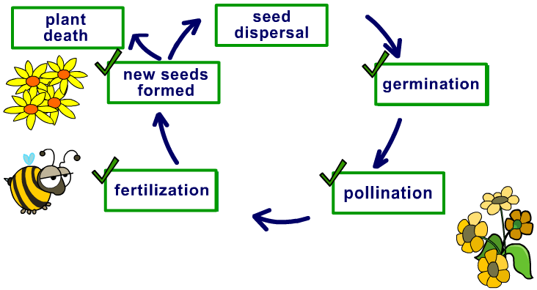
Using the model
We know that all life cycles involve birth, growth, reproduction and death.
Can you apply this model to plant reproduction?
Death
Birth
Growth
Reproduction
Notes:
This slide covers the Science and Engineering Practice:
Developing and Using Models: Develop and/or use models to describe and/or predict phenomena.

Slide 12
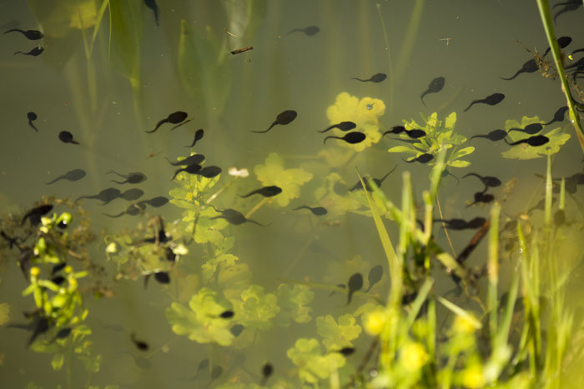
Disrupted life cycles
What will happen if an organism does not complete its life cycle?
It will not reproduce, which may affect population numbers.
Reproduction is essential for the continued existence of every kind of organism.
Notes:
Teacher notes
Students could be given population data for a declining species and background information about a change in the environment of a species. Ask them to identify what has happened to the population numbers by analyzing the data. They could also give a reasoned explanation of why this might have happened and identify which part of the life cycle has been affected.
Photo credit: © Edvard Mizsei, Shutterstock.com 2018

