Slide 1
Living Things

Slide 2
Information
Constructing Explanations and Designing Solutions
Engaging in Argument from Evidence
1. Patterns
2. Cause and Effect
5. Energy and Matter
6. Structure and Function

Slide 3
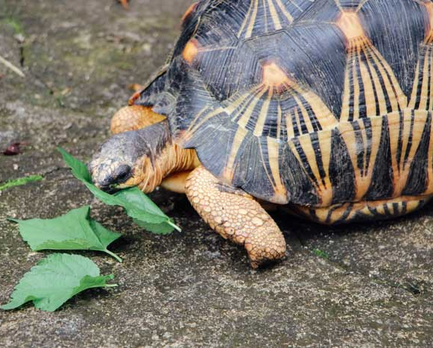
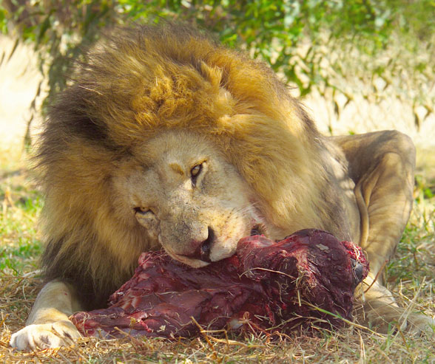
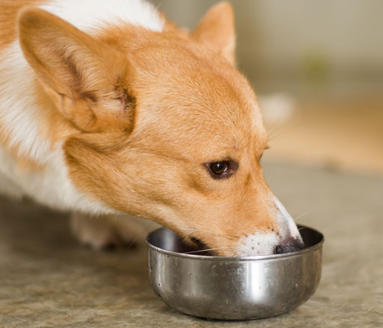
Eating
Let’s look at these animals. What are they all doing?
They are eating food.
This food is made from plants or other animals.
It provides energy to help the animal live and grow.
Notes:
Teacher notes
Before revealing each sentence, you could ask students what they think. For example, “What is this food made from?” and “What does the food provide?”
If possible, give the students an opportunity to observe real animals and make observations on what they eat and drink.
This slide covers the Science and Engineering Practice:
Constructing Explanations and Designing Solutions: Use information from observations (firsthand and from media) to construct an evidence-based account for natural phenomena.
Photo credit: Tortoise © seasoning_17; Lion © Diane Diederich; Dog © Paul's Lady, all at Shutterstock.com 2018
3

Slide 4
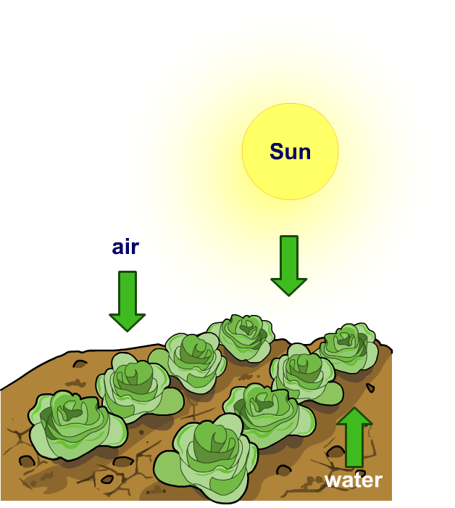
Plants and food
Do plants need to eat food?
No. Plants make their own food.
To do this they need:
light from the Sun
water from the soil
air.
Notes:
Teacher notes
Before revealing each sentence, you could ask students what they think. For example, “What do plants need?”
You could test whether plants need water or light by carrying out a simple experiment. For example, putting one plant into a dark room or covering with a box, while living the other in natural light. Students could predict what they think will happen. You could also talk about how to make this a fair test – keeping other variables, such as water the same for both. After a week or so students could make observations and come to a conclusion.

Slide 5
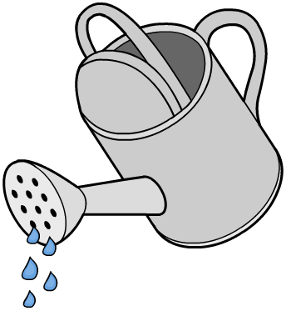
Plants and water (1)
What will happen if you only water one of these plants?
A
B
Notes:
Teacher notes
Before moving to the next slide, ask: “What do you think will happen to plants A and B? What will we see?” Students could draw pictures of how they think the two plants will end up and display them around the board.

Slide 6
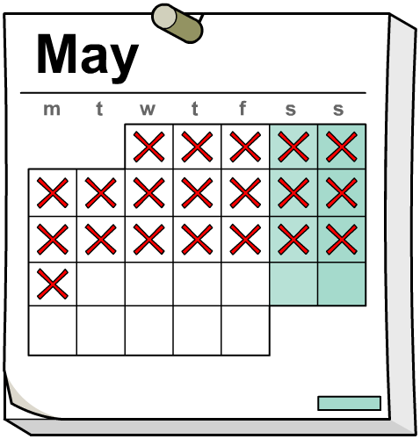
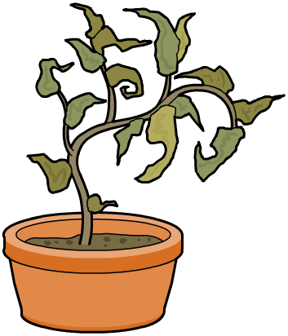
Plants and water (2)
What has happened to the plants after twenty days?
A
B
Notes:
This slide covers the Science and Engineering Practice:
Analyzing and Interpreting Data: Use observations (firsthand or from media) to describe patterns and/or relationships in the natural and designed world(s) in order to answer scientific questions and solve problems.

Slide 7
Plants and water (3)
Plant
What does the plant look like?
yellow
wrinkly leaves
dry
A (no water)
tall
fallen leaves
droopy stem
green
tall
straight stem
solid
B (water)
lots of leaves
flowers
juicy
Can you think of your own words to describe the plants?
Notes:
Teacher notes
Can students find examples in the local area of plants like the ones described in the table? Ask: “Are all plants watered by people, or do some plants get water another way?”
This slide covers the Science and Engineering Practice:
Analyzing and Interpreting Data: Use observations (firsthand or from media) to describe patterns and/or relationships in the natural and designed world(s) in order to answer scientific questions and solve problems.

Slide 8
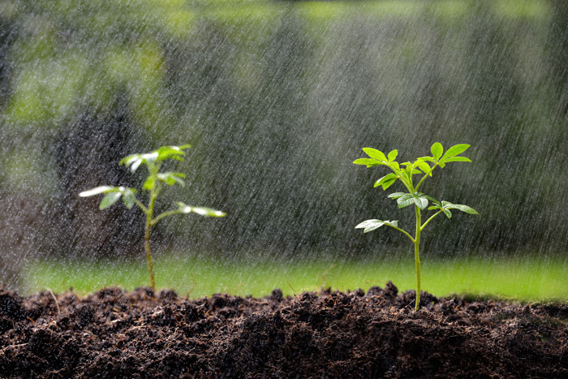
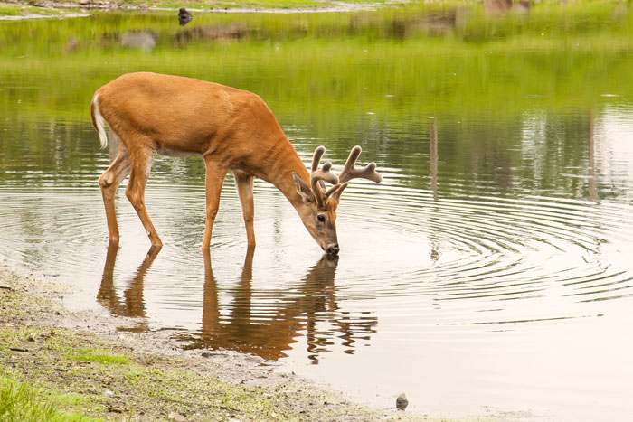
Animals and water
Do animals need water?
Yes. Both plants and animals need water.
They also need air to survive.
Notes:
Photo credits: Seedling © amenic181; Deer © Kevin McKeever, both at Shutterstock.com 2018

Slide 9
What do plants and animals need to survive?

Slide 10
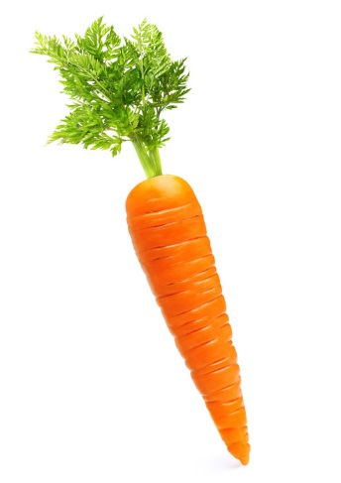
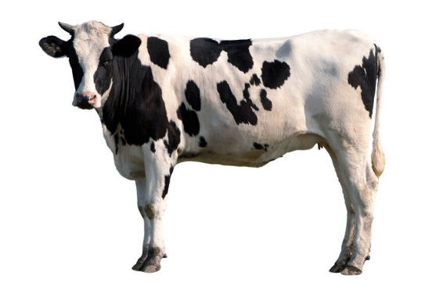
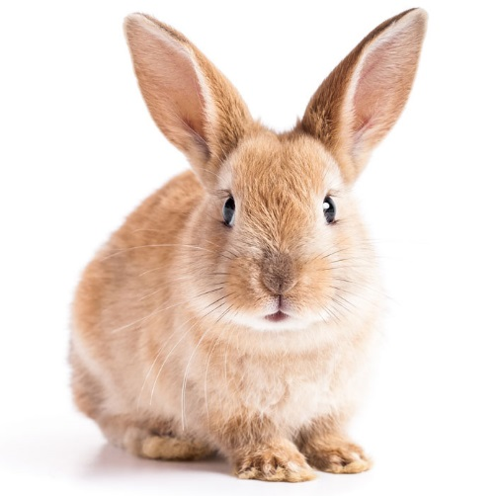
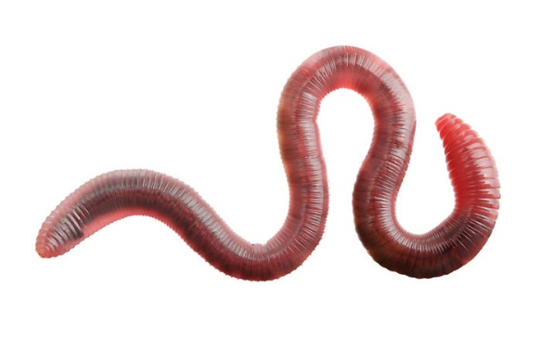
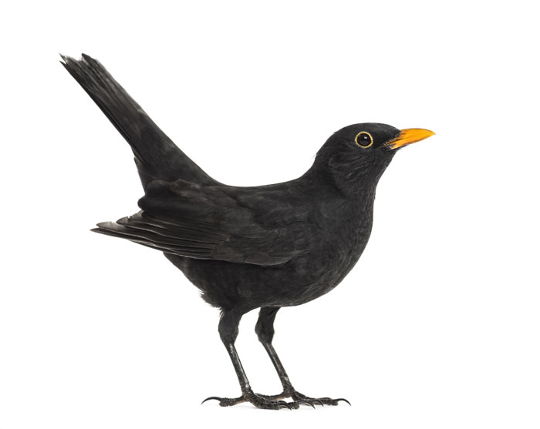
What do animals eat?
Do all animals eat the same thing?
No, they eat different things.
Match these animals with the food they eat.
Notes:
This slide covers the Science and Engineering Practices:
Constructing Explanations and Designing Solutions: Use information from observations (firsthand and from media) to construct an evidence-based account for natural phenomena.
Engaging in Argument from Evidence: Construct an argument with evidence to support a claim.
Photo credits: Cow © VanderWolf Images; Blackbird © Eric Isselee; Rabbit © effective stock photos; Grass © bnamfa; Earth worm © Valentina Razumova; Carrot © Valentina Razumova, all at Shutterstock.com 2018

Slide 11
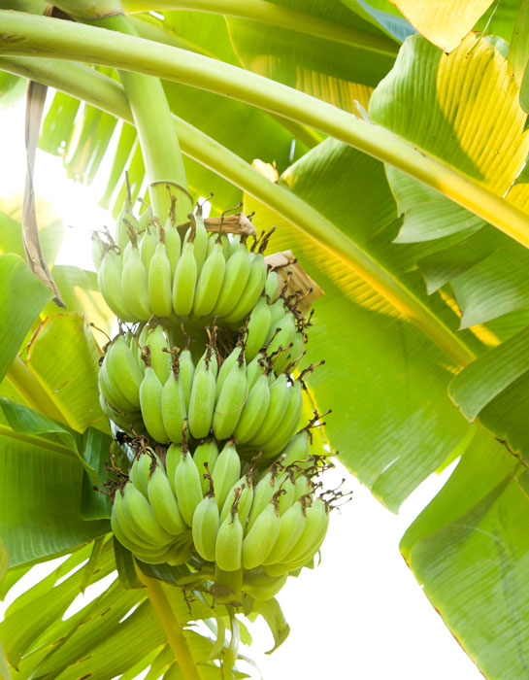
Animals, food and habitats
Why do animals live in different places around the world?
They live in places where they can get the things they need.
Why do banana trees live in a tropical rainforest?
Why do monkeys live here too?
Notes:
This slide covers the Science and Engineering Practices:
Constructing Explanations and Designing Solutions: Use information from observations (firsthand and from media) to construct an evidence-based account for natural phenomena.
Engaging in Argument from Evidence: Construct an argument with evidence to support a claim.
Photo credit: © Boonrod, Shutterstock.com 2018

