Slide 1
Needs of Plants

Slide 2
Information
Planning and Carrying Out Investigations
Analyzing and Interpreting Data
Constructing Explanations and Designing Solutions
Engaging in Argument from Evidence
1. Patterns
2. Cause and Effect
7. Stability and Change

Slide 3
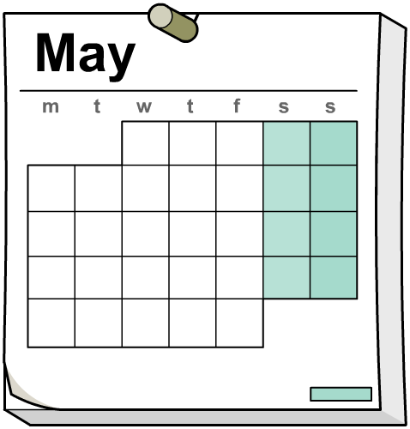
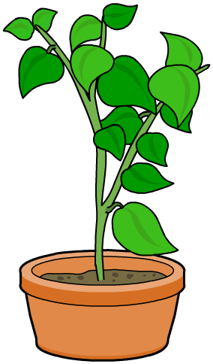
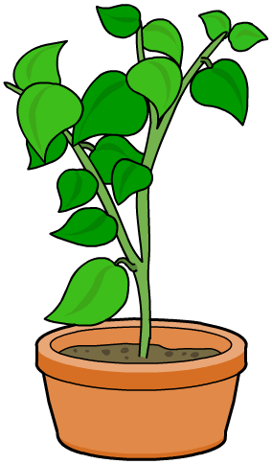
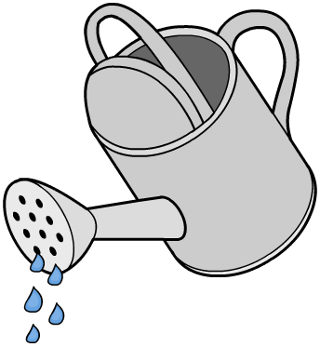
Plants and water (1)
What will happen if you only water one of these plants?
A
B
Notes:
Teacher notes
Before moving to the next slide, ask: “What do you think will happen to plants A and B? What will we see?” Students could draw pictures of how they think the two plants will end up and display them around the board.

Slide 4
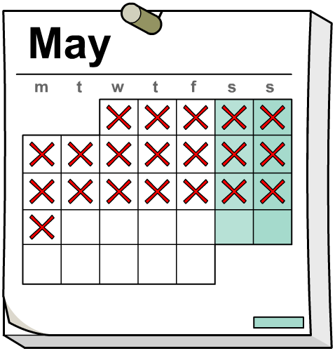
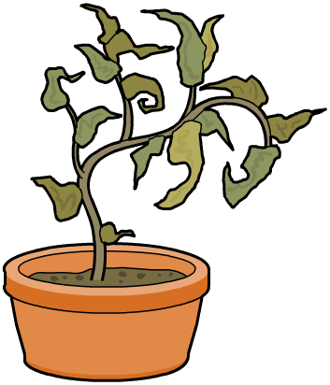
Plants and water (2)
What has happened to the plants after twenty days?
A
B
Notes:
This slide covers the Science and Engineering Practice:
Analyzing and Interpreting Data: Use observations (firsthand or from media) to describe patterns and/or relationships in the natural and designed world(s) in order to answer scientific questions and solve problems.

Slide 5
Plants and water (3)
Plant
What does the plant look like?
yellow
wrinkly leaves
dry
A (no water)
tall
fallen leaves
droopy stem
green
tall
straight stem
solid
B (water)
lots of leaves
flowers
juicy
Can you think of your own words to describe the plants?
Notes:
Teacher notes
Can students find examples in the local area of plants like the ones described in the table? Ask: “Are all plants watered by people, or do some plants get water another way?”
This slide covers the Science and Engineering Practice:
Analyzing and Interpreting Data: Use observations (firsthand or from media) to describe patterns and/or relationships in the natural and designed world(s) in order to answer scientific questions and solve problems.

Slide 6
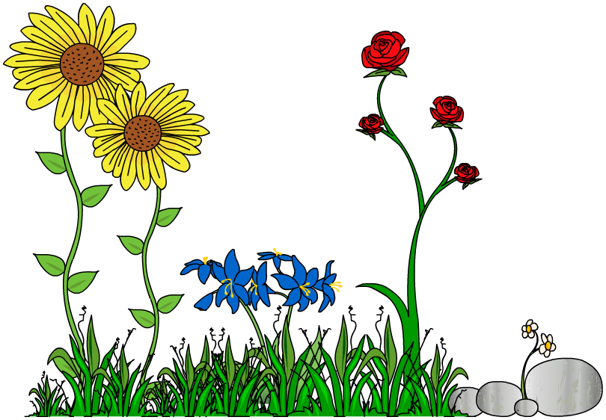
Plants and light
We know that plants need water.
But how do we know that they need light too?
We can do a test to find out if plants need light!
Notes:
Teacher notes
Ask: “Do you think green plants need sunshine? How do you know?” Collect students’ responses.

Slide 7
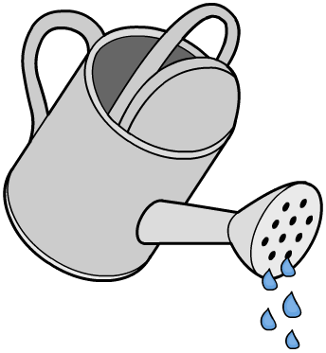
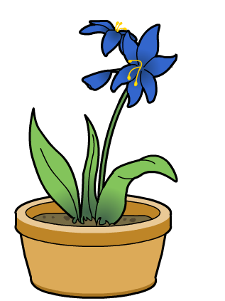
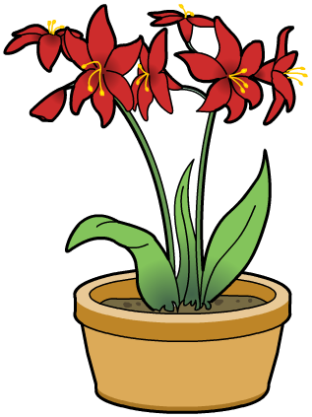
Why do plants need light? (1)
Day 1: Both plants are watered.
The red plant is covered with a cardboard box.
Notes:
Teacher notes
As the animated test unfolds, encourage students to describe what they see happening. Ask: “Why is only one plant covered by a box?” and “Why is it important to water both plants?”
This slide covers the Science and Engineering Practice:
Planning and Carrying Out Investigations: Plan and conduct an investigation collaboratively to produce data to serve as the basis for evidence to answer a question.

Slide 8
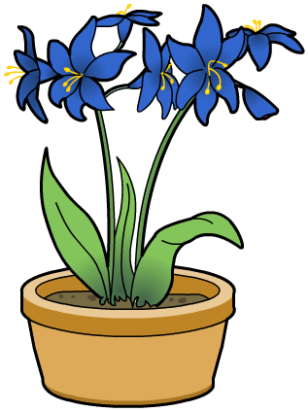
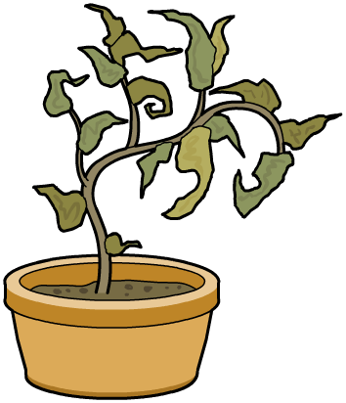
Why do plants need light? (2)
Day 14: The blue plant has grown big and strong, but the red plant has become yellow and floppy.
Why?
Notes:
This slide covers the Science and Engineering Practice:
Analyzing and Interpreting Data: Use observations (firsthand or from media) to describe patterns and/or relationships in the natural and designed world(s) in order to answer scientific questions and solve problems.

Slide 9
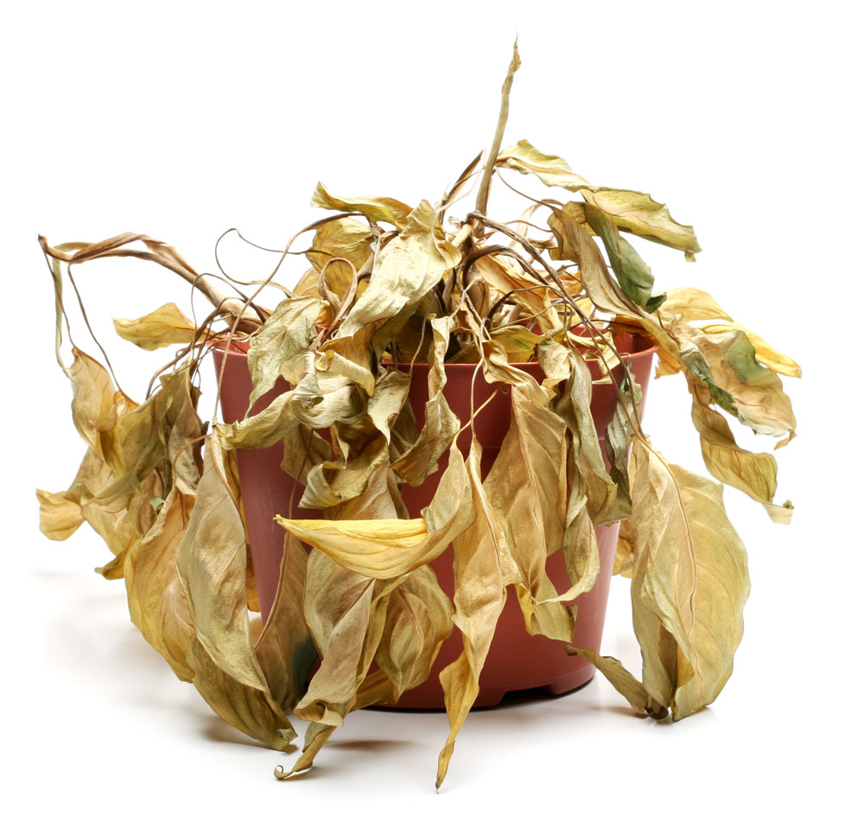
Why do plants need light? (3)
Plants get yellow and floppy if they don’t get light.
Plants need light to stay green and grow well.
Notes:
Photo credit: © Sascha Burkard, Shutterstock.com 2018

Slide 10
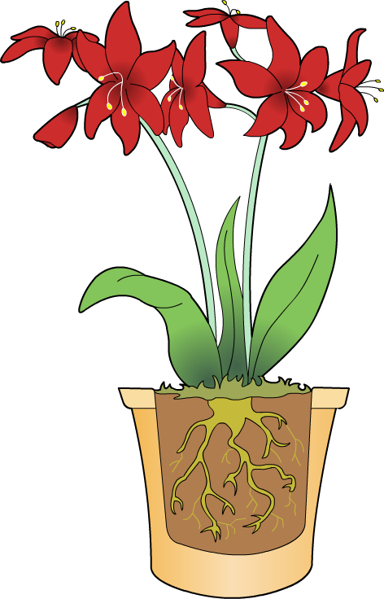
The different parts of plants
A plant is a living organism. It has different parts, such as
the leaf, flower, stem and root.
The different parts work together to keep the plant alive.
Each part performs its own function or job.
What can we learn about the function of leaves and how they make a plant grow well?
Notes:
Teacher notes
It may be helpful to use an analogy to explain this concept. For example, all the parts of a bicycle (wheels, chain, brakes) need to work together correctly if someone is to ride it.

Slide 11
Plants, leaves and growth
Notes:
Teacher notes
Discuss what students are going to measure and observe, specifically: the height from soil level to the tip of the shoot, color and number of leaves.
This slide covers the Science and Engineering Practice:
Planning and Carrying Out Investigations: Plan and conduct an investigation collaboratively to produce data to serve as the basis for evidence to answer a question.

Slide 12
Conducting the experiment (1)
Notes:
This slide covers the Science and Engineering Practice:
Planning and Carrying Out Investigations: Make predictions based on prior experiences.

Slide 13
Conducting the experiment (2)
Notes:
Teacher notes
Ask students to describe the plants in Group A after the two weeks. Encourage them to describe the physical characteristics of plants, e.g. yellow, pale, thin and spindly.
This slide covers the Science and Engineering Practices:
Planning and Carrying Out Investigations: Plan and conduct an investigation collaboratively to produce data to serve as the basis for evidence to answer a question.
Analyzing and Interpreting Data: Record information (observations, thoughts, and ideas).

Slide 14
The conclusion to the experiment
Notes:
Teacher notes
If necessary, remind students that plants in Group A had only one leaf, while plants in Group B kept all of their leaves.
This slide covers the Science and Engineering Practices:
Constructing Explanations and Designing Solutions: Use information from observations (firsthand and from media) to construct an evidence-based account for natural phenomena.
Engaging in Argument from Evidence: Construct an argument with evidence to support a claim.

Slide 15
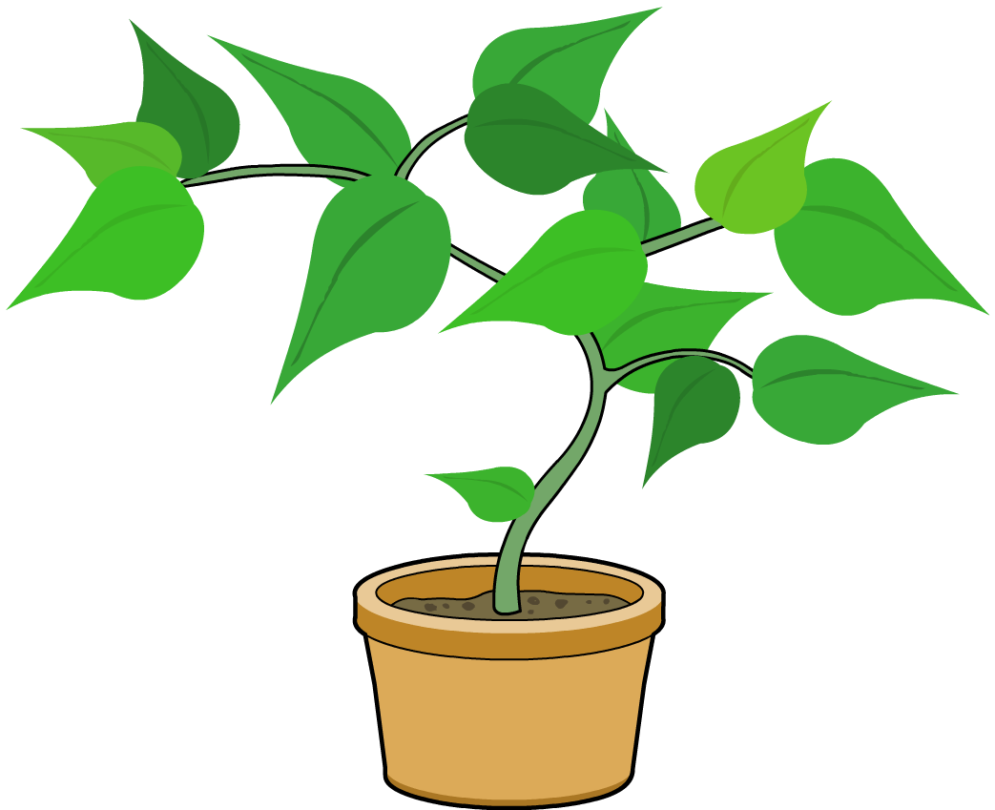
Why do plants grow with more leaves?
Can you explain why plants grow better with more leaves?
Leaves are a very important plant part.
Part of their job is to capture light from the Sun. They are often broad and flat to help them do this.
Remember, plants need light to grow.
Without leaves, plants cannot get the things they need to survive.

Slide 16
Working together
Notes:
Teacher notes
Explain that plants need nutrients to thrive, but that nutrients do not provide energy for the plant. Plants make their own “food” in their leaves that provides energy for the plant to grow.

