Slide 1
Senses

Slide 2
Information
Asking Questions and Defining Problems
Analyzing and Interpreting Data
Constructing Explanations and Designing Solutions
Engaging in Argument from Evidence
1. Patterns
4. Systems and System Models
6. Structure and Function

Slide 3
Picking up information
What body parts do we have that can pick up information from our environment?
eyes
ears
nose
tongue
skin
Each body part picks up different information from the environment.

Slide 4
What are senses?
The different ways in which we pick up information from our environment are called senses.
eyes: vision
ears: hearing
nose: smell
tongue: taste
skin: touch
How are these people using their senses?
Notes:
This slide covers the Science and Engineering Practice:
Engaging in Argument from Evidence: Construct an argument with evidence to support a claim.
Photo credit: © fizkes, Shutterstock.com 2018

Slide 5
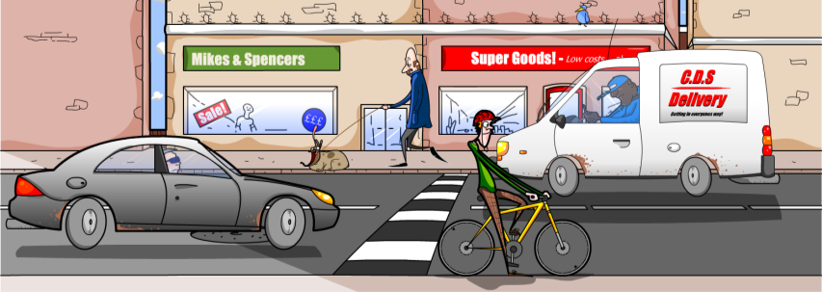
How do we use our senses?
Our senses allow us to pick up important information from the environment.
We can use this to understand what’s going on around us.
Can you think of any examples where it’s important to know what’s going on around us?
Notes:
Teacher notes
Appropriate examples might include approaching traffic, or an alarm. Ask students to explain why their choice of sound is important.

Slide 6
Animal senses
Other living things also have senses.
Like us, they have body parts that help them to understand their environment.
What senses do you think this animal has?
eyes: vision
tongue: taste
ears: hearing
skin: touch
nose: smell
It has the same senses as us!
Notes:
Teacher notes
You may need to explain that the leopard has skin underneath its fur.

Slide 7
Can animal senses be different from ours?
Fuzz the dog has body parts that allow him to see, hear, smell, taste and feel.
Do you think he senses his environment in exactly the same way as us?
What things might be different?
Fuzz has a very strong sense of smell. It is much stronger than ours.
His sight is also different. He cannot see as many colors as us.

Slide 8
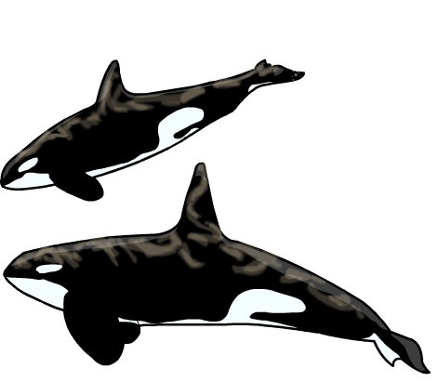
Different senses in animals (1)
Some animals have very different senses to us.
Some whales and dolphins can use sound in a special way that allows them to judge distances.
This is called echolocation.
They have special body parts that help them to do this.
Notes:
Teacher notes
Other animals also use echolocation, including bats.

Slide 9
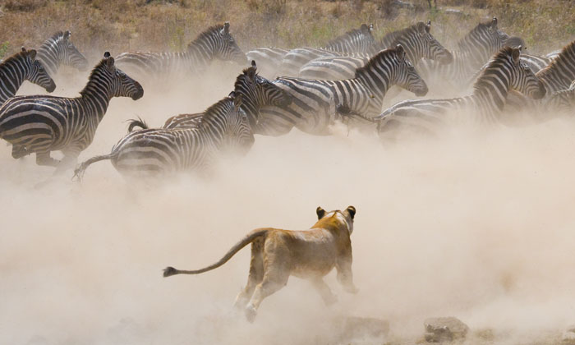
Different senses in animals (2)
How do you think these animals are using their senses?
Notes:
Teacher notes
The lion uses its sight and smell to identify and locate its prey, the zebra. The zebras use their sight to identify the lion as a threat, which informs their decision to run away.
This slide covers the Science and Engineering Practice:
Engaging in Argument from Evidence: Construct an argument with evidence to support a claim.
Photo credit: © GUDKOV ANDREY, Shutterstock.com 2018

Slide 10
Do plants have senses? (1)
Do you think plants can sense information from their environment?
Yes, they can!
Like animals, plants can sense their environment, and they can respond to important information from it.
This helps them to stay alive in their environment.

Slide 11
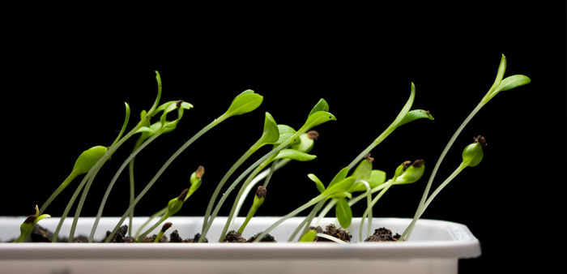
Do plants have senses? (2)
How do you think these plants are using information from their environment?
Notes:
Teacher notes
Plants are able to detect differences in brightness, and can respond by directing their growth towards the light source.
This slide covers the Science and Engineering Practices:
Constructing Explanations and Designing Solutions: Use information from observations (firsthand and from media) to construct an evidence-based account for natural phenomena.
Engaging in Argument from Evidence: Construct an argument with evidence to support a claim.
Photo credit: © Anest, Shutterstock.com 2018

