Slide 1
Structures for Survival

Slide 2
Information
Developing and Using Models
Analyzing and Interpreting Data
4. Systems and System Models
6. Structure and Function

Slide 3
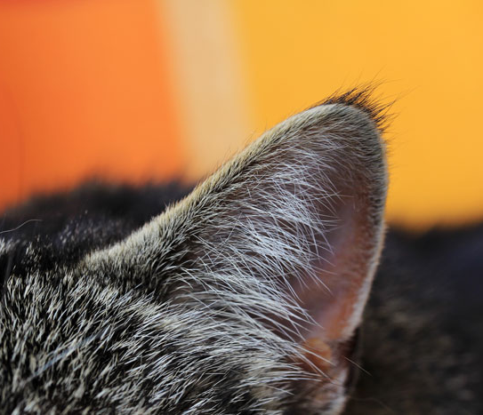
Structure and function (1)
Plants and animals have structures that help them to function.
What is the difference between structure and function?
The structure is the thing we can see.
The function is the job that it does.
For example, this structure is an ear. Its function is hearing.
Notes:
Photo credit: © Astrid Gast, Shutterstock.com 2018

Slide 4
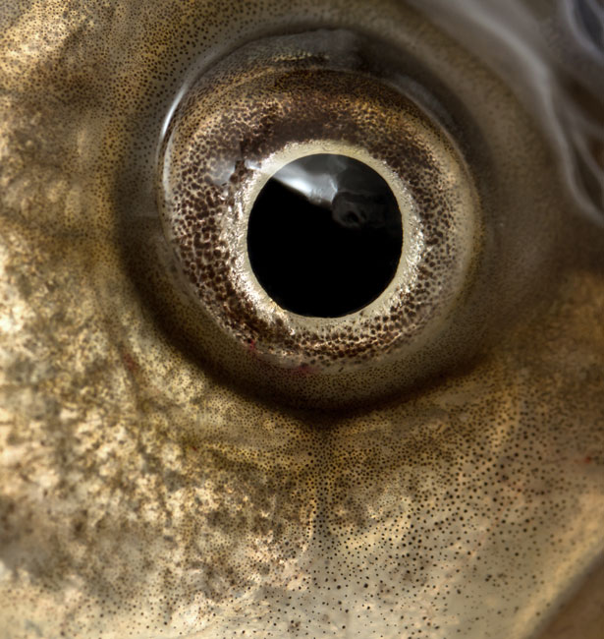
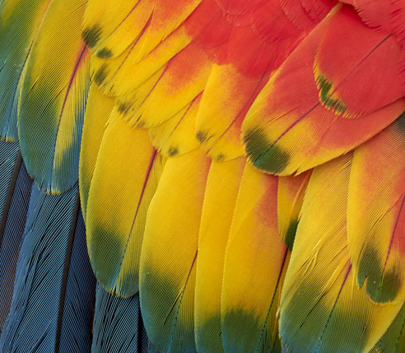
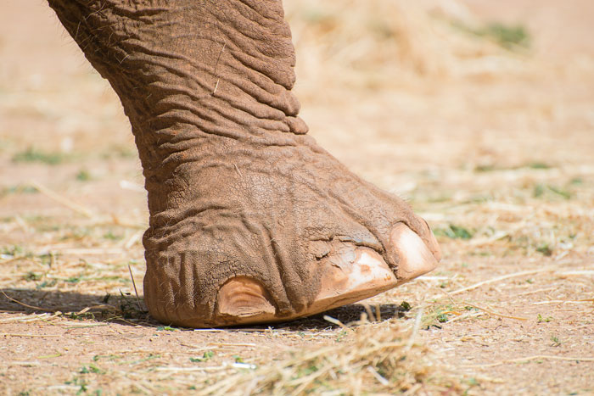
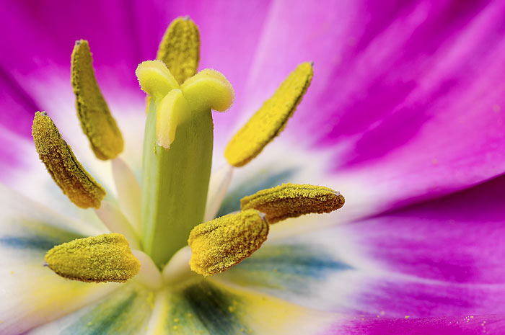
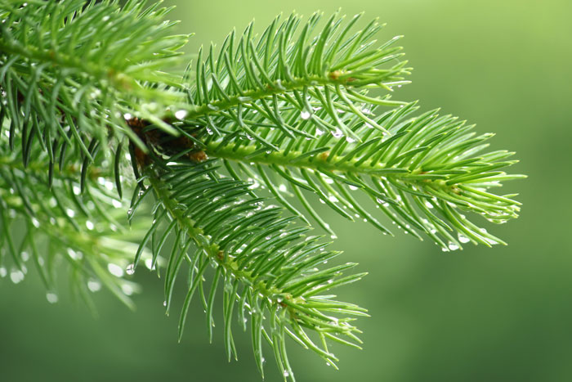
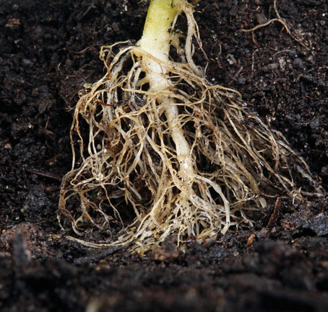
Structure and function (2)
What are these structures and their functions?
Notes:
Teacher notes
You could ask students whether the structures only have one function.
This slide covers the Science and Engineering Practice:
Analyzing and Interpreting Data: Analyze and interpret data to make sense of phenomena, using logical reasoning, mathematics, and/or computation.
Photo credits: Fish eye close up © kzww; Feathers © Tramont_ana; Elephant’© Dmitri Ma; Tulip © Costin Constantinescu; Conifer © ArTDi101; Root s © Filipe B. Varela, all at Shutterstock.com 2018

Slide 5
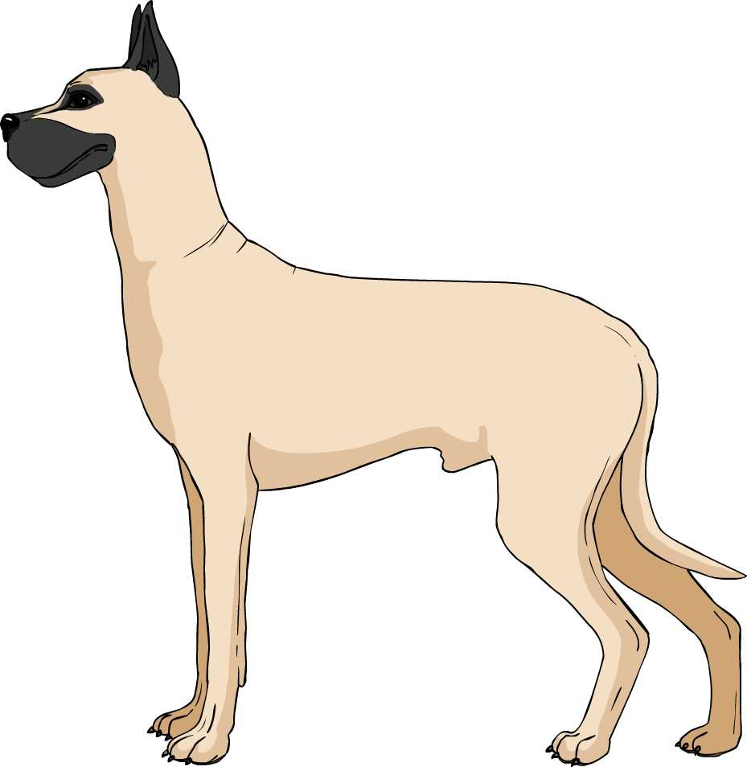
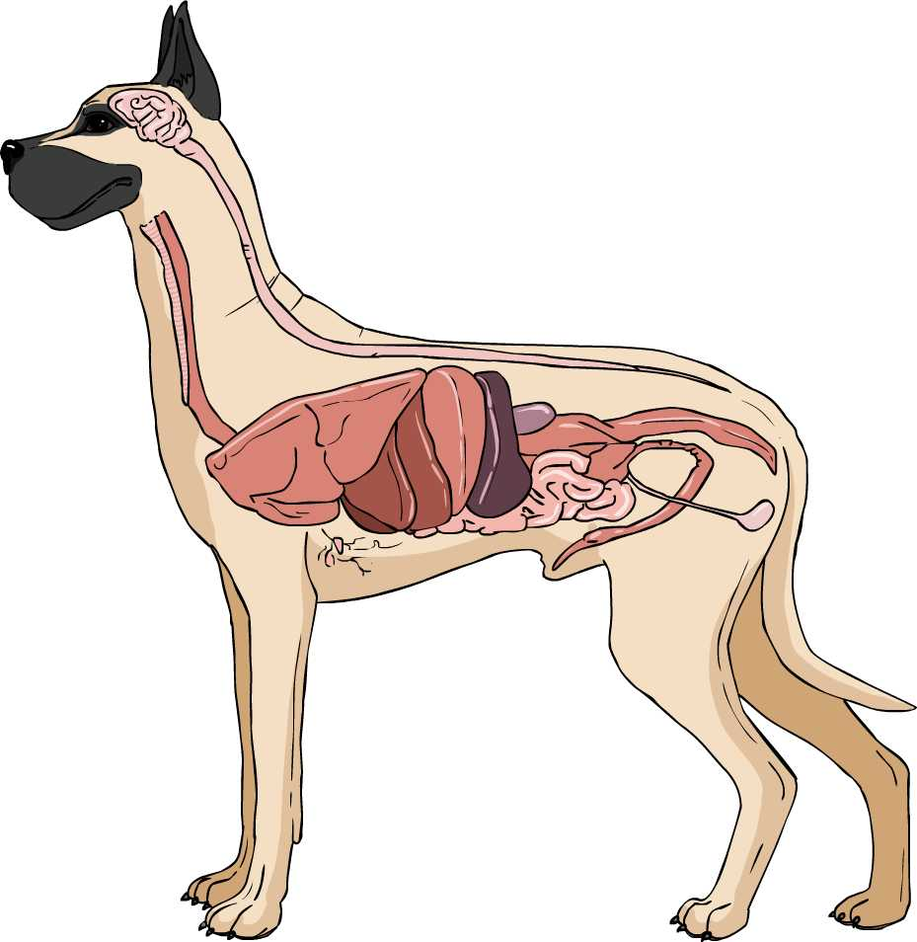
Internal and external structures of animals
Animals have both internal and external structures that serve various functions.
We can classify functions as helping with growth, survival, behavior, and reproduction.
The Brain – behavior
Fur – survival
Reproductive parts – reproduction
Stomach – growth

Slide 6
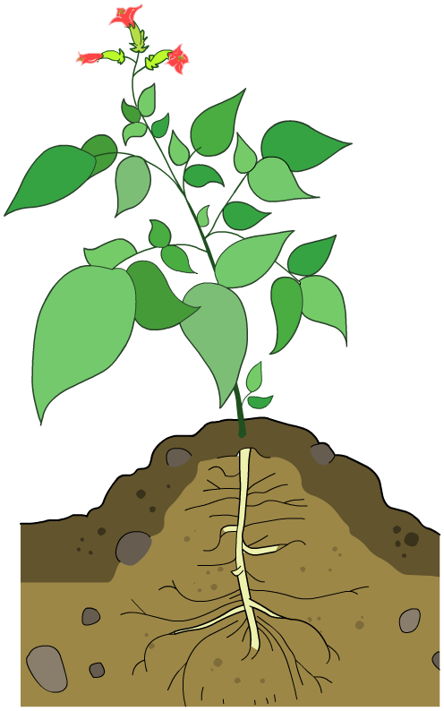
Internal and external structures of plants
Animals have both internal and external structures that serve various functions.
We can classify functions as helping with growth, survival, behavior, and reproduction.
Flowers – reproduction
Stem – behavior
Leaves – growth
Roots – survival

Slide 7
Body systems
Notes:
Teacher notes
Ask students to say whether each system function is growth, survival, behavior or reproduction.

Slide 8
Receiving information
Animals and plants have structures that help them to receive, process, store and respond to information from the environment.
What type of information might organisms receive from the environment?
Light
Sound
Touch
Temperature
Taste
Notes:
Photo credit: © ESB Professional, Shutterstock.com 2018

Slide 9
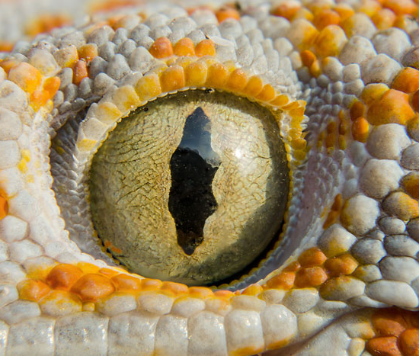
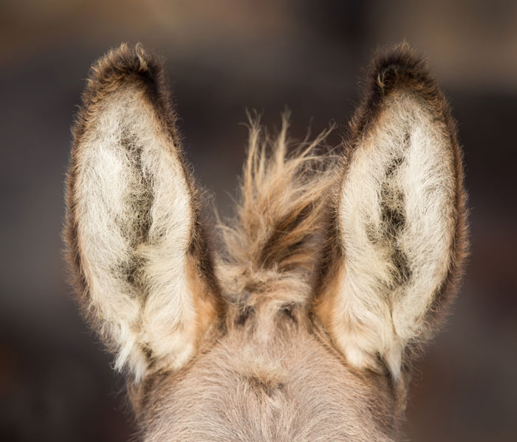
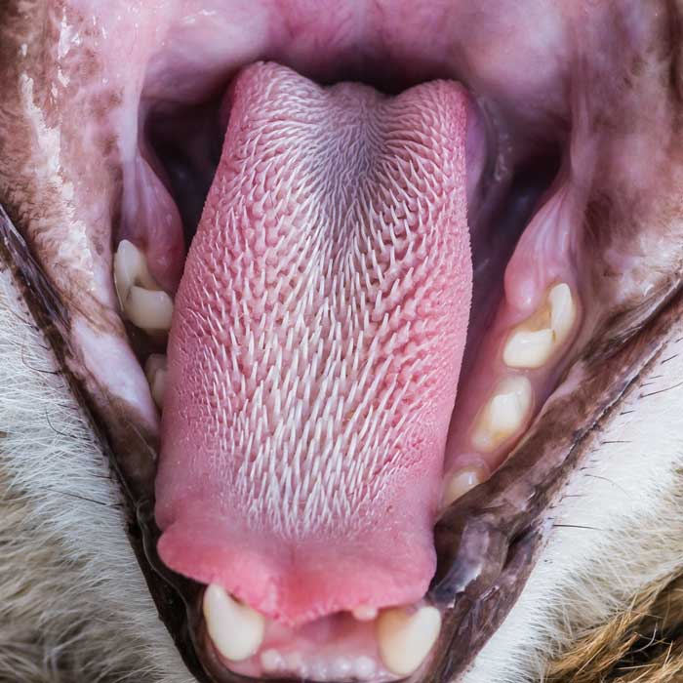
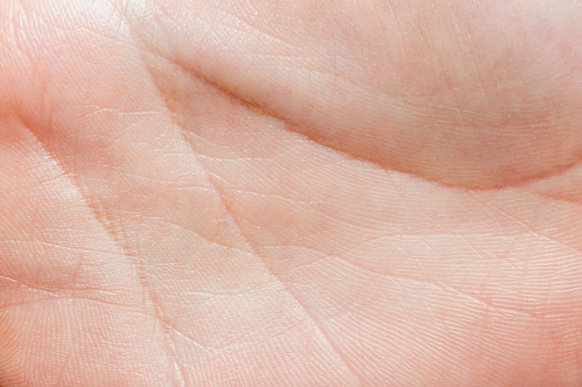
Sensory organs
Can you name any structures that help organisms to receive information?
These are called sense organs.
Notes:
Photo credits: Donkey's ears © Budimir Jevtic; Gecko © Aedka Studio; Cat’s tongue © Ian Grainger; Human palm © effective stock photos, all at Shutterstock.com 2018

Slide 10
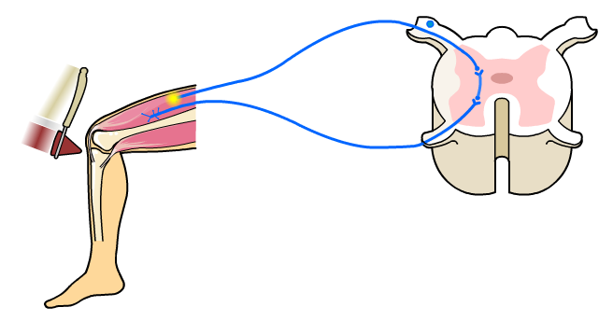
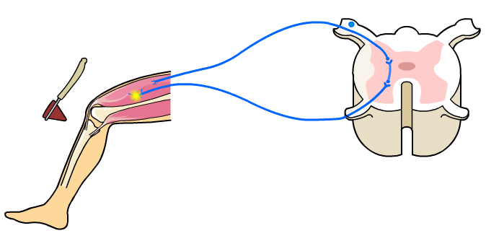
Signals in the nervous system
Sense organs send nervous signals to the brain, where they are processed.
The brain processes the information. It can then send signal for action back to the body.
However, sometimes a reaction happens very quickly.
For example, if a person’s knee is tapped the sensory receptors in the thigh send a signal to the spinal cord.
The spinal cord sends a signal back that causes the leg to straighten.
Notes:
Teacher notes
You could talk about the fact that the example given is a reflex action, and happens very quickly as the brain does not take time to process it. Unlike some other actions, like typing.

Slide 11
Processing and responding to information
We can present the process of receiving, processing and responding to information as a model.
Sense Organ:
Rabbit’s eyes look for a fox
Brain Process: A fox is dangerous
Yes
Information:
Is a fox close by?
No
Brain Process: There is no danger
Animal action:
Run back to the burrow
Animal action: Begin looking for food
Notes:
Teacher notes
Before revealing the model, see if students can develop their own model using the information from the previous slides.
This slide covers the Science and Engineering Practice:
Developing and Using Models: Develop and/or use models to describe and/or predict phenomena.

Slide 12
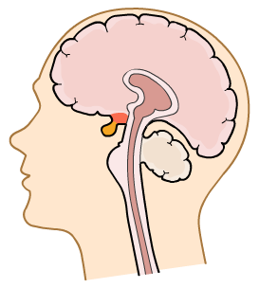
Memory
The information received by the brain can also be stored as retrievable information, known as memory.
Brain
Memory storage
Brain Stem
This allows the animal to use these memories to guide future actions. For example, if you previously burned yourself you might remember to avoid touching hot pans in future.

