Slide 1
Who Lives There?

Slide 2
Information
Analyzing and Interpreting Data
1. Patterns

Slide 3
Animals and plants in the park
Notes:
Teacher notes
As different animals and plants are revealed onscreen, ask: “Do you know anywhere nearby where we can see an animal or plant like that?” List students’ suggestions.
Photo credits: tadpoles © rubiphoto; ladybug © Rechitan Sorin, both at Shutterstock.com 2018; all others © Jupiterimages Corporation 2018

Slide 4
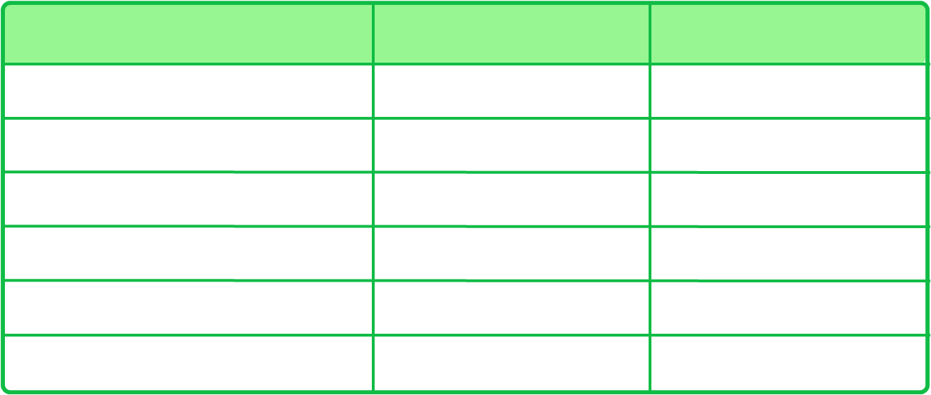
Who was found there?
Can you remember what was found where?
Place
Plant
Animal
leaf pile
lichen
spider
flowerbed
flowers
ladybug
log
fungus
earwig
pond
water lily
tadpoles
vegetable patch
lettuce
caterpillar
tree
oak tree
birds
How many did you remember?
Notes:
Teacher notes
Students could complete a similar table for an area near to their classroom.

Slide 5
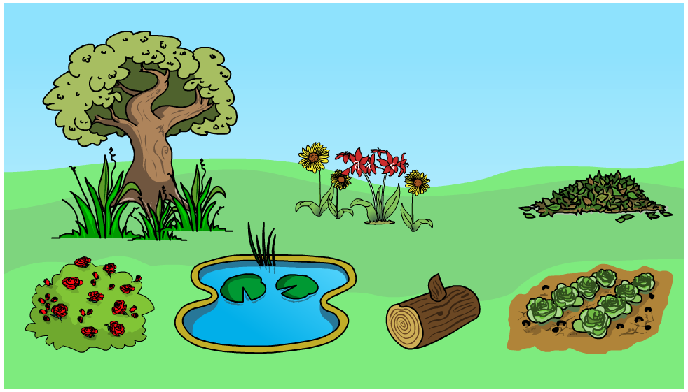
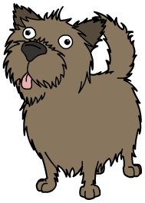
Finding animals and plants
If you go looking for animals and plants…
treat them with care
leave things the way you found them
wash your hands afterwards.
Good luck!
Notes:
Teacher notes
Ask: “Why do you think you should follow these rules?” Encourage students to note that living things should be left unharmed and that after handling soil, hand-washing can prevent illness.

Slide 6
Different habitats

Slide 7
What do animals and plants need to live?

Slide 8
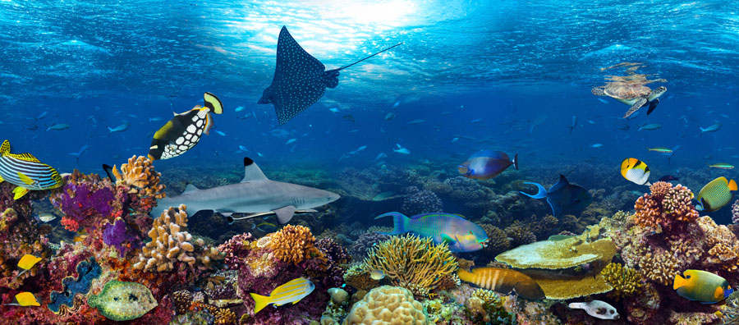
Different habitats around the Earth
Different types of living things can be found almost anywhere on Earth.
Which living things can you see here?
Notes:
Teacher notes
Living things in the example image include coral, reef fish (various species), spotted eagle ray, sea turtle and black tipped reef shark. You could ask students to suggest where this image might have been taken. Coral reefs are most commonly found at shallow depths in tropical waters.
This slide covers the Science and Engineering Practice:
Analyzing and Interpreting Data: Use observations (firsthand or from media) to describe patterns and/or relationships in the natural and designed world(s) in order to answer scientific questions and solve problems.
Photo credit: © stockphoto-graf, Shutterstock.com 2018

Slide 9
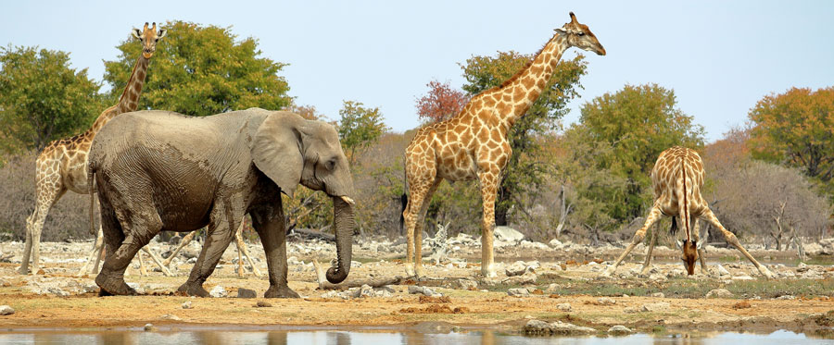
Changing environments
When the environment changes, the type of living things that we find changes too.
Which living things can you see here?
Notes:
Teacher notes
You could ask students to suggest where this image might have been taken. It shows part of a national park in Namibia. Students could discuss other living things that they might expect to find in this environment, as well as ones that they wouldn’t expect to find.
This slide covers the Science and Engineering Practice:
Analyzing and Interpreting Data: Use observations (firsthand or from media) to describe patterns and/or relationships in the natural and designed world(s) in order to answer scientific questions and solve problems.
Photo credit: © giannimarchetti, Shutterstock.com 2018

