Slide 1
Changing State

Slide 2
Information
Asking Questions and Defining Problems
Planning and Carrying Out Investigations
1. Patterns
2. Cause and Effect
5. Energy and Matter
6. Structure and Function
7. Stability and Change

Slide 3
Changing between states
Notes:
Teacher notes
At each stage of the animation, ask students what words they would use to describe what is happening. Appropriate words could include: solid, liquid, gas, melt, freeze, change, cool, warm, flow, change shape, volume, powder, vapor, condensation.
Explain the difference between degrees Celsius and degrees Fahrenheit. Celsius is the metric scale for temperature. Although most countries use Celsius for all temperature measurement, people in the United States usually only use Celsius in scientific contexts. Ask students to give examples of situations in which they might use Celsius or Fahrenheit (in a science classroom, when talking about the weather, etc.).

Slide 4
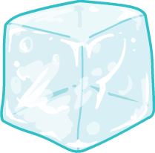
Solid, liquid or gas
Matter in the Universe comes in different states. These are: solid, liquid or gas.
A solid is rigid. Its shape and volume do not change.
A liquid changes shape to fit its container. However, its volume is always the same.
Gas spreads out to fill any space.
Matter can change from solid to liquid to gas and back again. This is known as changing state.
Notes:
Teacher notes
You may need to define volume as “the amount of space something takes up.”

Slide 5
How are solids, liquids and gases different?

Slide 6
Heating water
Notes:
This slide covers the Science and Engineering Practice:
Asking Questions and Defining Problems: Ask questions that can be investigated and predict reasonable outcomes based on patterns such as cause and effect relationships.

Slide 7
Evaporation
Notes:
This slide covers the Science and Engineering Practices:
Asking Questions and Defining Problems: Ask questions that can be investigated and predict reasonable outcomes based on patterns such as cause and effect relationships.
Planning and Carrying Out Investigations: Make observations and/or measurements to produce data to serve as the basis for evidence for an explanation of a phenomenon or test a design solution.

Slide 8
Ice at room temperature
Notes:
This slide covers the Science and Engineering Practice:
Asking Questions and Defining Problems: Ask questions that can be investigated and predict reasonable outcomes based on patterns such as cause and effect relationships.

Slide 9
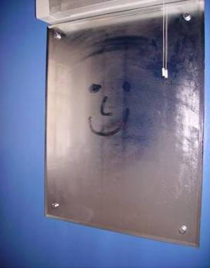
Condensation
Have you ever noticed what happens to the mirror in your bathroom when you have a bath or a shower?
This is an example of condensation.
Hot water evaporates to become
water vapor (a gas).
When the water vapor touches a cold
surface, such as a mirror, it cools down and turns back into a liquid. It condenses.
The mirror is covered by lots of tiny droplets of water.
Notes:
Photo credit: Photo courtesy of Kathryn Kendall.

Slide 10
The changing states of water

Slide 11
The states of water and their temperatures

Slide 12
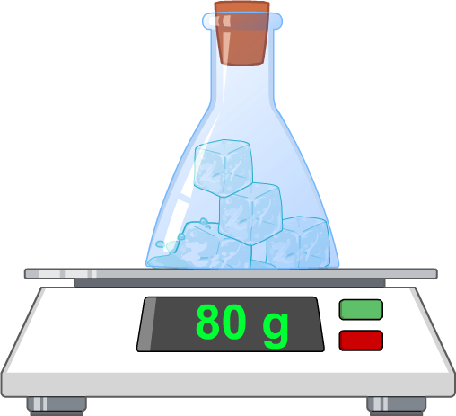
Mass and changing of state
What will the mass of this flask be when the ice has melted?
It will be 80 g.
The amount of matter always stays the same when it changes state.
This means that its mass will not change.

Slide 13
Changing state summary

