Slide 1
Communication

Slide 2
Information
Planning and Carrying Out Investigations
Analyzing and Interpreting Data
Constructing Explanations and Designing Solutions
2. Cause and Effect
6. Structure and Function

Slide 3
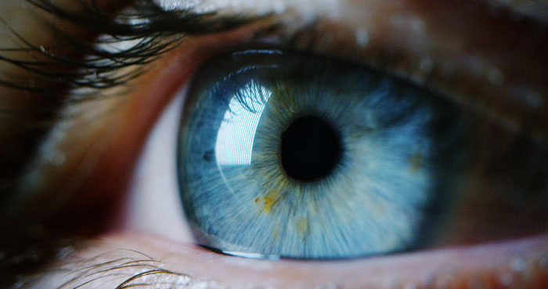
How do we use our senses?
We use our senses to find out about the world around us.
Our eyes detect light.
Our ears detect sound.
Using touch we can feel vibrations.
We can also use technology to help us send and receive information over long distances.
Notes:
Photo credit: Blue eye © Hquality, Shutterstock.com 2018
3

Slide 4
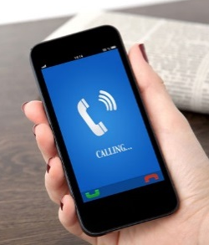
Examples of communication
Can you give any examples of how we communicate over long distances?
Sending letters
Email
Phone call
Communication
Social media
Text message
Morse code
Notes:
Teacher notes
You could ask students for their ideas before revealing the spider diagram. Discuss with the class which senses they use for each type of communication.
Photo credits: Email menu © kpatyhka; Envelope © Suradech Prapairat; Hand holding a phone © Denys Prykhodov; Smartphone © guteksk7; Morse code key © Jason Salmon; Hands holding smartphone with social media © Robert Kneschke, all at Shutterstock.com 2018

Slide 5
Designing a communication device
Alexis and James have designed a communication device.
Cup
String
When Alexis talks into the cup James can hear her.
Notes:
Teacher notes
You could ask students how they think James can hear Alexis, then explain that sound vibrations travel along the string.
This slide covers the Science and Engineering Practice:
Constructing Explanations and Designing Solutions: Use tools and/or materials to design and/or build a device that solves a specific problem or a solution to a specific problem.

Slide 6
A communication device experiment (1)
Notes:
This slide covers the Science and Engineering Practice:
Planning and Carrying Out Investigations: Plan and conduct an investigation collaboratively to produce data to serve as the basis for evidence, using fair tests in which variables are controlled and the number of trials considered.

Slide 7
A communication device experiment (2)
Notes:
This slide covers the Science and Engineering Practice:
Planning and Carrying Out Investigations: Make predictions about what would happen if a variable changes.

Slide 8
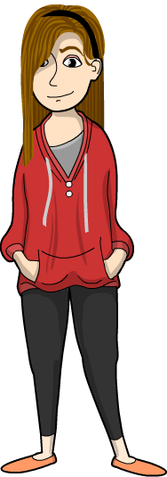
The results of the experiment
Alexis and James carried out the test. Here is what they found out:
When James talked into the device with the long string the sound was quiet and not very clear.
When James talked into the device with the short string the sound was loud and I could hear him clearly.

Slide 9
What can we conclude?
Notes:
This slide covers the Science and Engineering Practices:
Analyzing and Interpreting Data: Compare predictions (based on prior experiences) to what occurred (observable events).
Constructing Explanations and Designing Solutions: Use evidence (e.g., measurements, observations, patterns) to construct or support an explanation or design a solution to a problem.

