Slide 1
Electrical Circuits

Slide 2
Information
Asking Questions and Defining Problems
Developing and Using Models
Analyzing and Interpreting Data
Obtaining, Evaluating and Communicating Information
1. Patterns
2. Cause and Effect
3. Scale, Proportion, and Quantity
4. Systems and System Models
5. Energy and Matter
6. Structure and Function

Slide 3
What uses electricity?
Notes:
Teacher notes
Important: Safety warning. Explain that students must never touch any part of live wire from a circuit. They could get a serious electric shock, which could be fatal.
Explain that the batteries used in the classroom are safe to touch, but larger batteries are not safe, e.g. car batteries.

Slide 4
The transfer of electrical energy
Electrical currents transfer energy from place to place.
An electrical current flows in electrical circuits.
A circuit is made of a power source, wire and components that use electricity.
Components in the circuit transform the electrical energy from the circuit into other useful forms of energy, such as light.

Slide 5
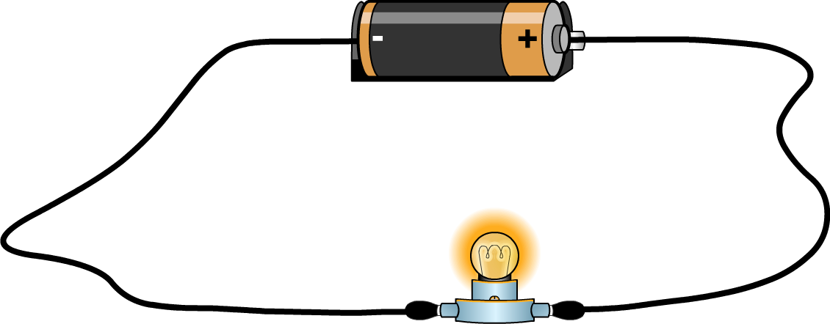
Complete circuits
A complete circuit allows an electrical current to run from the power source, through the components, and back to the power source.
power source (battery)
flow of electricity
wires completing the circuit
component that uses electricity
Notes:
Teacher notes
The power source generates the electrical current and the circuit conducts the electrical current through wires so that it lights the bulb and then flows back again.
If appropriate, explain that an electric current is a flow of negatively charged particles called electrons. Electrons flow through wires and carry electrical energy to the components. The negative terminal of the battery pushes the electrons along the wire and the positive terminal of the battery attracts the negative electrons along the wire. It may be helpful to review students’ understanding of magnets and how like poles repel each other (hence the negative electrons are pushed away from the negative terminal of the battery) and how unlike poles attract each other (hence the positive terminal of the battery attracts the negative electrons). The electrical current therefore flows from the negative terminal of the battery, through the bulb, to the positive terminal.

Slide 6
Drawing a complete circuit
Draw a complete circuit. Label each part of your drawing and describe the purpose of each part.
All complete circuits must include:
a power source
a device that requires electricity
wires joining all the components or parts of the circuit.
Notes:
This slide covers the Science and Engineering Practices:
Developing and Using Models: Develop a model using an analogy, example, or abstract representation to describe a scientific principle or design solution.
Obtaining, Evaluating, and Communicating Information: Communicate scientific and/or technical information orally and/or in written formats, including various forms of media and may include tables, diagrams, and charts.

Slide 7
Adding batteries to circuits
Notes:
This slide covers the Science and Engineering Practices:
Asking Questions and Defining Problems: Ask questions that can be investigated and predict reasonable outcomes based on patterns such as cause and effect relationships.

Slide 8
Adding a bulb to the circuit
Notes:
This slide covers the Science and Engineering Practices:
Asking Questions and Defining Problems: Ask questions that can be investigated and predict reasonable outcomes based on patterns such as cause and effect relationships.
Analyzing and Interpreting Data: Represent data in tables and/or various graphical displays (bar graphs, pictographs, and/or pie charts) to reveal patterns that indicate relationships.

Slide 9
Unbroken electrical currents
Notes:
This slide covers the Science and Engineering Practices:
Asking Questions and Defining Problems: Ask questions that can be investigated and predict reasonable outcomes based on patterns such as cause and effect relationships.

Slide 10
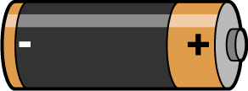
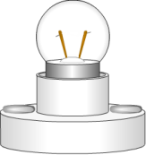
Voltage in a circuit
The power source and the electrical device in a circuit need to be of the same voltage in order to work correctly.
1.5V battery
+
1.5V light bulb
=
circuit working correctly
If we add more light bulbs to a circuit that is working correctly, the brightness of the bulbs will dim because the battery has to share its power between the bulbs.
If we add more batteries to a circuit that is working correctly, the bulb will burn brighter because there is more electrical power flowing to the light bulb.
Notes:
Teacher notes
Explain that every battery, or cell, has a plus sign (+) at one end and a minus sign (-) at the other. If more than one battery is used in a circuit, the positive end of one battery must be connected to the negative end of the other.

