Slide 1
Electromagnets

Slide 2
Information
Developing and Using Models
Constructing Explanations and Designing Solutions
2. Cause and Effect
4. Systems and System Models
6. Structure and Function

Slide 3
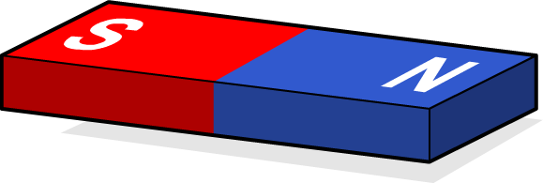
What are magnets?
What do you know about magnets?
Magnets attract objects containing steel or iron.
Magnets have two opposite poles. Like poles repel each other and opposite poles attract each other.
Most magnets you see are permanent magnets.
It is possible to create a temporary magnet by running an electric current through a wire.
A magnet created by electricity is called an electromagnet.

Slide 4
Electricity and magnetic fields
Notes:
Teacher Notes
During Stage 2 of the activity, you could hide the field lines and ask students to draw the field based on compass direction.
This slide covers the Science and Engineering Practices:
Developing and Using Models: Develop and/or use models to describe and/or predict phenomena.

Slide 5
How do you create strong electromagnets?

Slide 6
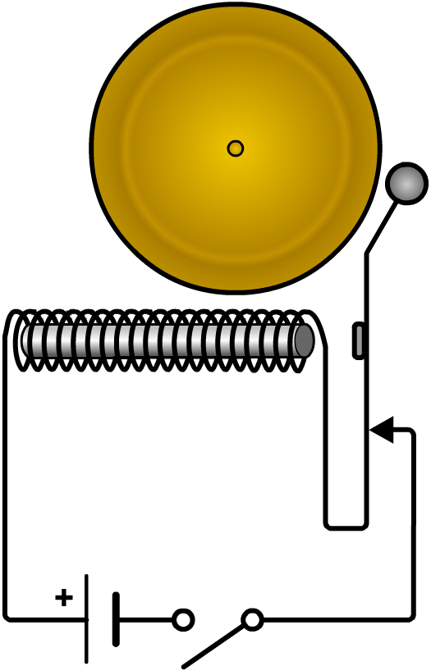
Electromagnets in use (1)
The circuit for a door bell includes an electromagnet.
bell
When the circuit is closed, the electromagnet attracts the armature, causing the hammer to strike the bell.
hammer
armature
electromagnet
This movement breaks the circuit, and the hammer returns to its original position.
battery

Slide 7
Electromagnets in use (2)
Notes:
This slide covers the Science and Engineering Practices:
Constructing Explanations and Designing Solutions: Construct an explanation of observed relationships.
7

