Slide 1
Energy

Slide 2
Information
Developing and Using Models
Constructing Explanations and Designing Solutions
Engaging in Argument from Evidence
1. Patterns
2. Cause and Effect
5. Energy and Matter

Slide 3
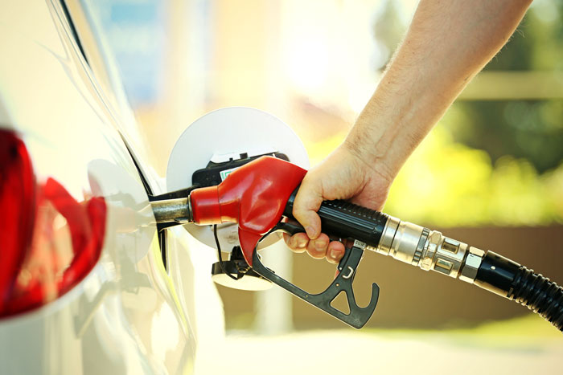
Energy
What do all of these things have in common?
eating food
filling a car with gasoline
plugging in a TV
These are all to do with energy.
Notes:
Teacher notes
You could ask students to expand on this, giving their own examples.
Photo credits: Food © Syda Productions; Car © Pavel Kubarkov; Plugs © Trum Ronnarong, all at Shutterstock.com 2018

Slide 4
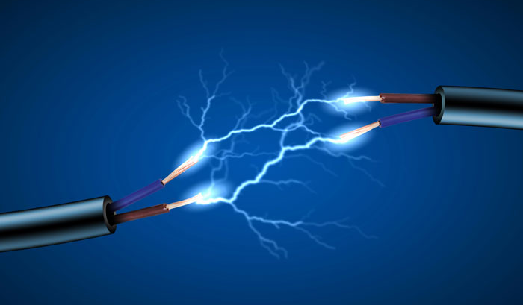
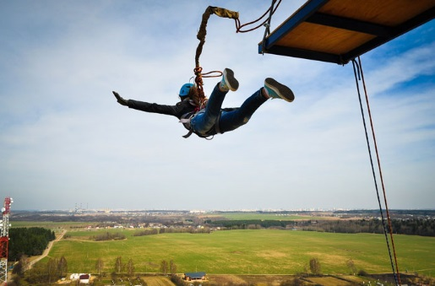
Where do you find energy?
light
sound
moving objects
electricity
magnetism
Energy is present whenever there is:
objects at a height
heat
Notes:
Teacher notes
It’s important to avoid terms such as sound energy and heat energy, as these aren’t actually forms of energy, but they have an ability to transfer energy.
Photo credits: Sun © ESB Professional; instruments © Brian Goodman; Soccer ball © Alexander Mak; Magnet © revers; Bonfire © yuratosno3; Ropejumping © Stas Vulkanov; Electricity © ESB Professional, all at Shutterstock.com 2018
4

Slide 5
Kinetic energy
Energy is the ability to do work, or the ability to cause change.
There are different types of energy. Energy that exists due to motion is called kinetic energy.
Moving objects have kinetic energy.
For example, this moving car has kinetic energy.
Notes:
Photo credit: © Pozdeyev Vitaly, Shutterstock.com 2018
5

Slide 6
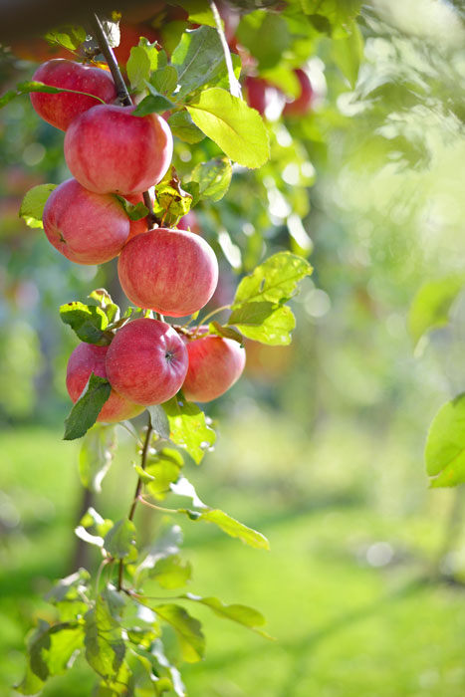
Potential energy
Some objects will have potential energy due to their position.
This is stored energy, which has a potential to cause movement.
Even though an object is not moving, it has the potential to move.
For example, an apple in a tree has potential energy.
Notes:
Teacher notes
You could mention that this potential energy will be converted into kinetic energy if the apple was to fall. Energy transfers are also covered in more detail later in the presentation
Photo credit: © KayaMe, Shutterstock.com 2018

Slide 7
Faster and slower objects (1)
Objects that are moving have energy.
Faster objects have more energy.
Ball 1
Ball 2
Ball 3
Which ball has the most energy?
Notes:
Teacher notes
Ask the students which ball would hurt the most if it hit you? The fastest one. This helps to demonstrate that the fastest ball has the most energy.
This slide covers the Science and Engineering Practices:
Constructing Explanations and Designing Solutions: Construct an explanation of observed relationships (e.g., the distribution of plants in the back yard).
Engaging in Argument from Evidence: Construct and/or support an argument with evidence, data, and/or a model.
7

Slide 8
Faster and slower objects (2)

Slide 9
Why is energy transferred?
Energy cannot be created or destroyed. It can only be transferred from one place to another, or changed from one form to another.
Sound transfers energy from one place to another. For example, from a speaker to an ear.
Light also transfers energy. For example from a TV to eyes.
Notes:
Teacher notes
You could ask students to apply the scientific ideas they’ve learnt here to design, test, and refine a device that converts energy from one form to another.
Photo credit: © Concept Photo, Shutterstock.com 2018

Slide 10
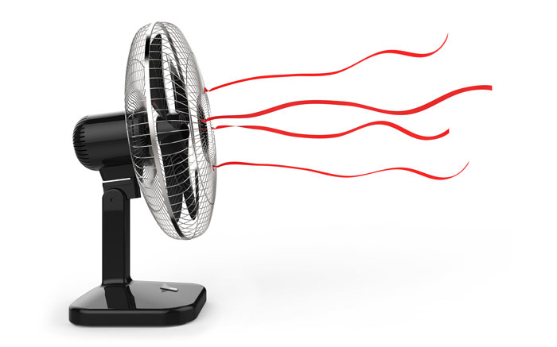
How is energy converted?
Energy can be transferred from place to place by electric currents. The energy can then be converted to produce sound, light, heat or motion.
For example, a electric current transfers energy to the blades of a fan. The energy is then converted into motion.
Some energy might also be converted into sound and heat.
Notes:
Teacher notes
Students need to make observations to provide evidence that energy can be transferred from place to place by sound, light, heat, and electric currents. You could set up a device in the classroom or draw a diagram that shows energy being converting from one form into another. Ask students to make observations and write an explanation for what is happening.
Photo credit: © Thomas Soellner, Shutterstock.com 2018

Slide 11
Energy in devices

Slide 12
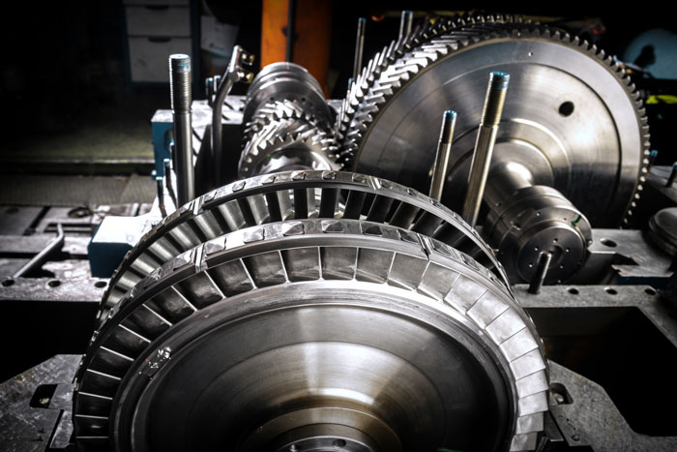
Turbines
How are electric currents produced?
Electric currents can be produced by converting the energy of motion into electrical energy.
For example, the heat energy from burning fuel can be used to make steam. The movement of the steam spins a big fan wheel called a turbine.
Using magnets the energy from this motion is converted into an electric current.
Notes:
Teacher notes
Discuss other ways that electric currents can be produced – using solar, wind, etc.
Photo credit: © Anton Mikhmel StudioNW, Shutterstock.com 2018

Slide 13
Stored energy
When we talk about ‘producing energy’ we are not making energy, as it cannot be created.
This term simply means converting stored energy into a useful form of energy.
For example, we might say that a battery ‘produces’ energy. However, when we use a battery it converts stored chemical energy into electric currents, that can be used to power devices.
Notes:
Photo credit: © mariva2017, Shutterstock.com 2018

Slide 14
Potential and kinetic energy
Notes:
This slide covers the Science and Engineering Practices:
Developing and Using Models: Develop and/or use models to describe and/or predict phenomena.

Slide 15
Energy in collisions (1)
Another way that energy can be transferred is through collisions.
When two objects collide the contact forces transfer energy. This results in a change to the objects’ motion.
For example, if this white moving ball hits the red stationary ball it will transfer some of its energy. This causes the red ball to move and the white ball to slow down.
Notes:
Photo credit: © nirajkedar, Shutterstock.com 2018

Slide 16
Energy in collisions (2)
How else is energy released when two objects collide?
Some energy is transferred to the surrounding air.
As a result, heat might be produced or a sound might be heard when the objects collide.

