Slide 1
Friction

Slide 2
Information
Asking Questions and Defining Problems
Planning and Carrying Out Investigations
Analyzing and Interpreting Data
Constructing Explanations and Designing Solutions
1. Patterns
2. Cause and Effect
6. Structure and Function

Slide 3
What is friction?

Slide 4
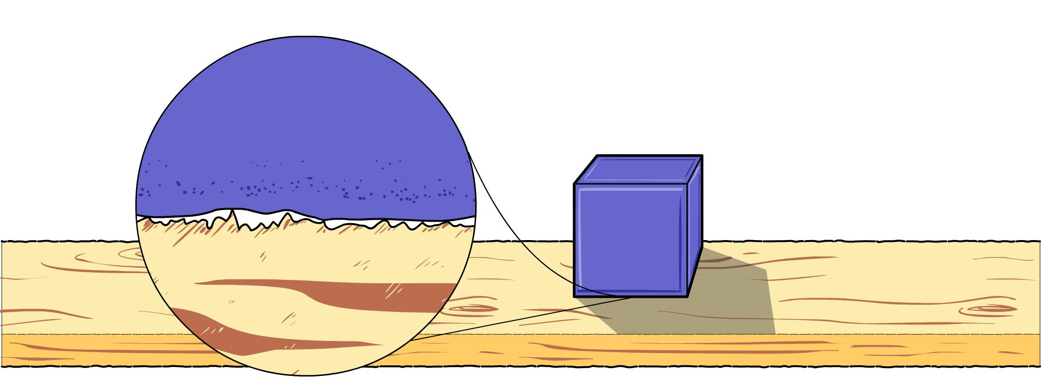
Resisting forces
The ‘hills and valleys’ of the two surfaces snag as the objects rub against each other. The resisting force caused by the snagging of the surfaces is called friction.
If the two surfaces are very rough, they will cause a large amount of friction. If the two surfaces are smoother, they will cause only a small amount of friction.

Slide 5
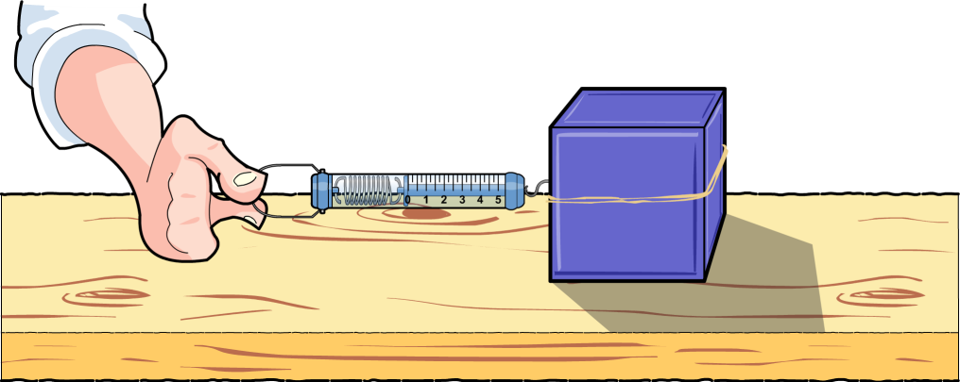
Stationary friction
Two surfaces don’t have to slide over each other to create friction. Friction occurs between an object and a surface even when the object is stationary.
An object will only move when the force applied to it is greater than the friction between the object and the surface on which it is sitting.
Would it be more difficult to move an object on a smooth or a rough surface?
How could we find out?
Notes:
Teacher notes
Explain that the frictional resistance force of a stationary object may prevent the object from moving.
There are two components of frictional resistance: the coefficient of friction and the weight of the object being moved. You may wish to discuss the component of weight and what affect this has on surface friction in more detail.

Slide 6
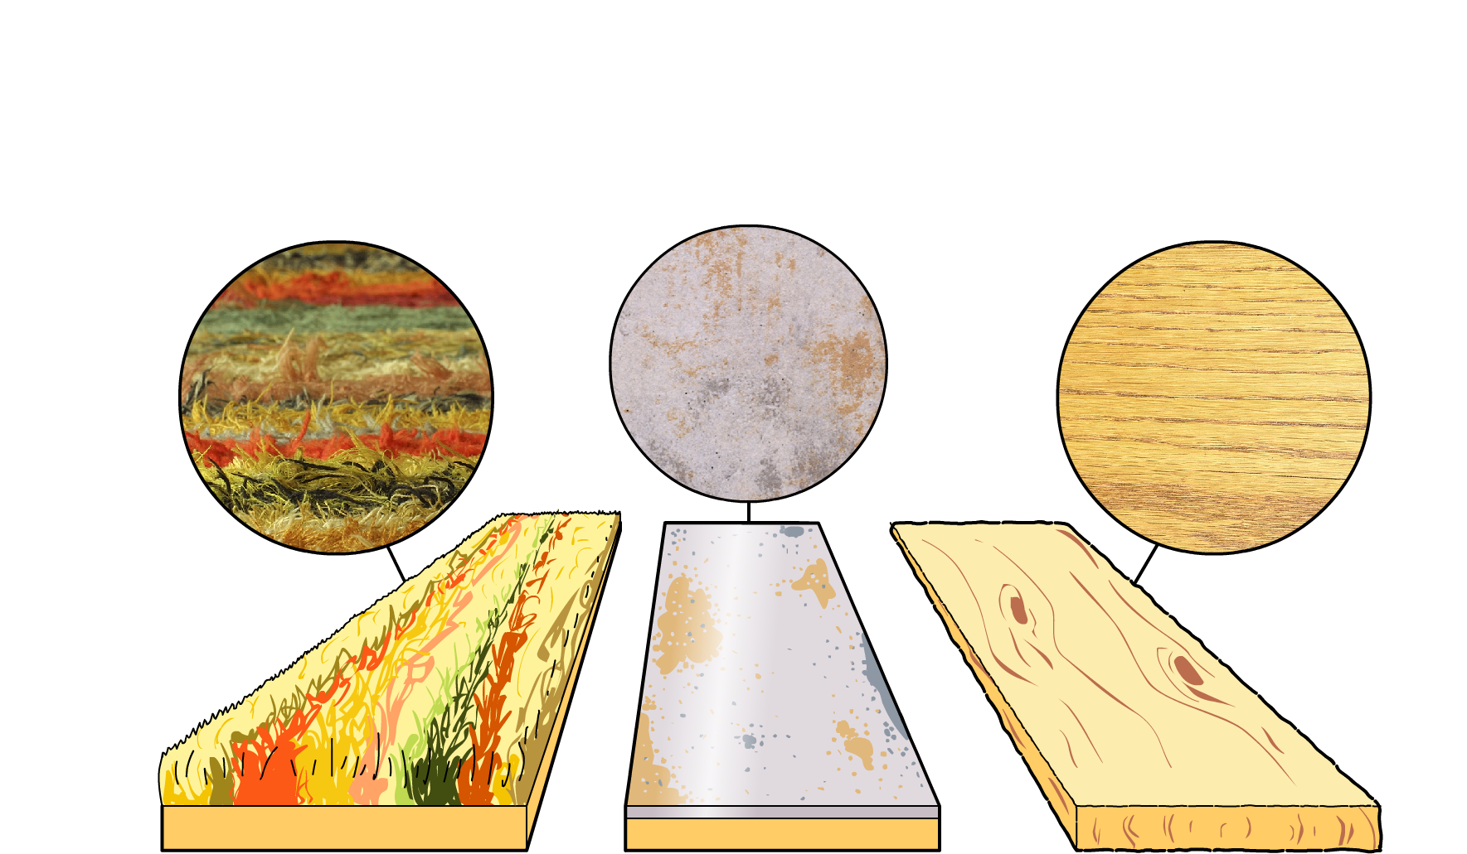
Different surface frictions
Which surface do you think will need the largest force in order to make an object start moving?
Which surface will produce the largest friction?
Which surface will produce the smallest friction?
These are the surfaces we will test.
carpet
vinyl
wood
Notes:
This slide covers the Science and Engineering Practices:
Asking Questions and Defining Problems: Ask questions that can be investigated and predict reasonable outcomes based on patterns such as cause-effect relationships.

Slide 7
Friction experiment (1)
Notes:
This slide covers the Science and Engineering Practices:
Planning and Carrying Out Investigations: Make observations and/or measurements to produce data to serve as the basis for evidence for an explanation of a phenomenon or to test a design solution.

Slide 8
Friction experiment (2)
Notes:
This slide covers the Science and Engineering Practices:
Analyzing and Interpreting Data: Represent data in tables and/or various graphical displays (bar graphs, pictographs and/or pie charts) to reveal patterns that indicate relationships.

Slide 9
Friction experiment (3)
Notes:
This slide covers the Science and Engineering Practices:
Analyzing and Interpreting Data: Analyze and interpret data to make sense of phenomena, using logical reasoning, mathematics, and/or computation.
Constructing Explanations and Designing Solutions: Construct an explanation of observed relationships (e.g., the distribution of plants in the back yard).

Slide 10
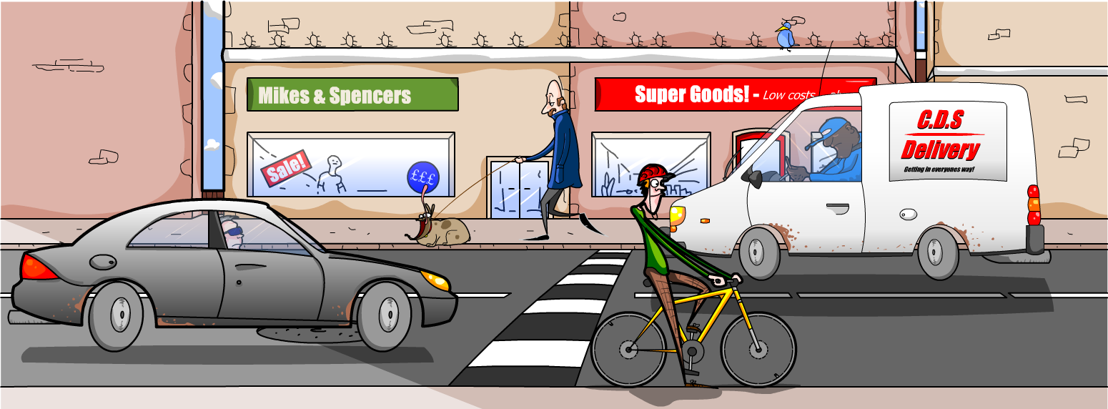
Road surfaces
What type of road surface is needed to keep cars and bicycles from skidding?
Make a list of examples where high or low friction occurs. Describe surfaces that cause high and low friction.
Notes:
Teacher notes
Road surfaces must be rough to create friction between tires and the road so that vehicles don’t skid. Discuss what happens when roads are covered in snow and ice. Why do people put sand and salt on icy roads to make them safer?
Ask students to think of other scenarios in which friction is useful. Friction between our shoes and the floor stops us from slipping. Friction between brakes and wheels helps bikes and cars slow down.
Friction can also be unhelpful. If you don't lubricate your bike regularly with oil, the friction in the chain and axles increases. Your bike will be noisy and difficult to pedal. When there is a lot of friction between moving parts, energy is lost as heat. Think of what happens when you rub your hands together quickly.

