Slide 1
Insulators and Conductors

Slide 2
Information
Planning and Carrying Out Investigations
Analyzing and Interpreting Data
1. Patterns
2. Cause and Effect
5. Energy and Matter
6. Structure and Function

Slide 3
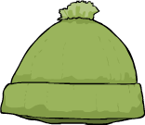
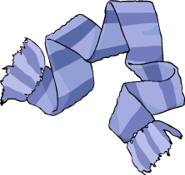
What are thermal insulators?
Materials that are good at keeping things hot or cold are called thermal insulators.
Thermal insulators trap the air around an object. If the object is hot, the thermal insulation prevents heat from escaping from the object, keeping it warm.
If the object is cold, the thermal insulation prevents outside heat from mixing with the object, keeping it cool.
During the winter, we wear fabrics that are thermal insulators to trap the heat around our bodies and stop it from escaping!
Notes:
Teacher notes
Students may find it difficult to accept that the same types of material help keep cold objects cold and warm objects warm. Explain how the hat and scarf could also help to keep something cold.

Slide 4
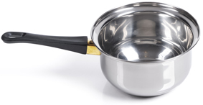
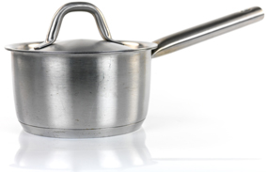
What are thermal conductors?
Think about the materials used to make a cooking pan. How are the properties of the materials used to make it good for cooking?
Materials that are thermal insulators, such as wood and plastic, are often used on the handles of cooking pans.
Because heat cannot easily travel through wood or plastic, the handles of these pans do not get too hot when the pan is on the stove.
Other materials are good at allowing heat to pass through them.
These materials are called thermal conductors. Metal is an example of a thermal conductor.
Notes:
Photo credits:
Pot with plastic handle: © Igor Kovalchuk, Shutterstock.com 2018
Pot with metal handle: © Kitch Bain, Shutterstock.com 2018

Slide 5
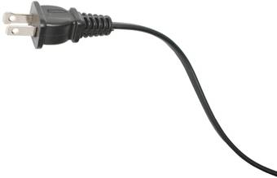
What are electrical conductors?
Materials that are thermal conductors are often good electrical conductors.
A conductor allows energy to move easily, just like a train conductor keeps a train moving.
Metal is also a good electrical conductor. It is used for the pins and wires in this cord so that electricity can flow through it to operate an appliance.
Notes:
Photo credits:
Plug: © liubomir, Shutterstock.com 2018

Slide 6
Testing electrical conductors
Notes:
This slide covers the Science and Engineering Practices:
Planning and Carrying Out Investigations: Make observations and/or measurements to produce data to serve as the basis for evidence for an explanation of a phenomenon or test a design solution.

Slide 7
What can we conclude?
Notes:
This slide covers the Science and Engineering Practices:
Analyzing and Interpreting Data: Analyze and interpret data to make sense of phenomena, using logical reasoning, mathematics, and/or computation.

Slide 8
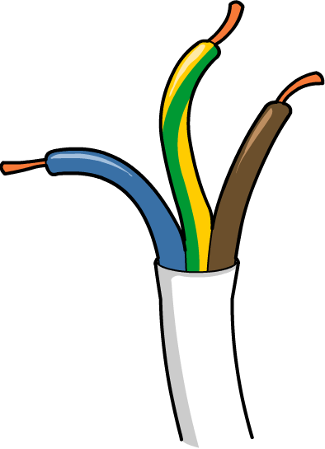
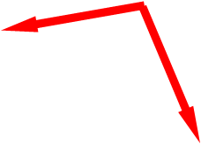
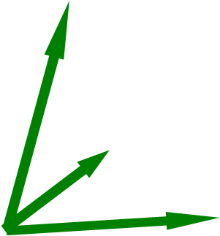
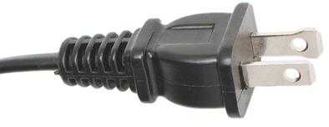
Electrical insulators
Plastics are electrical insulators, which is why they are used to cover wires, plugs and switches.
conductors
insulators
Notes:
Photo credits: © liubomir, Shutterstock.com 2018

Slide 9
Insulators and conductors in your area
Look around the room and building.
List materials that are being used as insulators
(thermal or electrical).
List materials that are being used as conductors
(thermal or electrical).
Notes:
Teacher notes
Ask students to include a brief explanation of their examples. Possible examples include metal radiators (so that the heat is transmitted to the rest of the room) and the base of an iron (the entire base conducts heat so that it can be rolled over the clothes to smooth them).
This slide covers the Science and Engineering Practices:
Planning and Carrying Out Investigations: Make observations and/or measurements to produce data to serve as the basis for evidence for an explanation of a phenomenon or test a design solution.

