Slide 1
Introducing Waves

Slide 2
Information
Developing and Using Models
2. Cause and Effect
4. Systems and System Models
5. Energy and Matter

Slide 3
What are waves?
Waves are regular patterns of motion. They transfer energy without transferring matter.
We can see an example of a wave by using water.
When an object hits the surface of water, waves move across the surface.
Waves move up and down across the surface of the water away from the point of contact.
Notes:
Teacher notes
Waves in water are an example of transverse waves.
Photo credit: © WhiteJack, Shutterstock.com 2018
3

Slide 4
The movement of waves (1)
As the water wave moves through the water, particles in the water move up and down.
The particles do not travel with the wave. They move about a fixed position.
Water wave
Down
Water particles
Up
Direction of Wave
Notes:
Photo credit: © Willyam Bradberry, Shuttertock.com 2018

Slide 5
The movement of waves (2)
The movement of a wave can be shown by the behavior of a duck floating on a water surface.
As a wave moves through the water below the duck, the water, and therefore the duck, moves up and down.
The duck and the water do not travel. Only the wave travels.
Notes:
Photo credit: © Leonid Eremeychuk, Shutterstock.com 2018

Slide 6
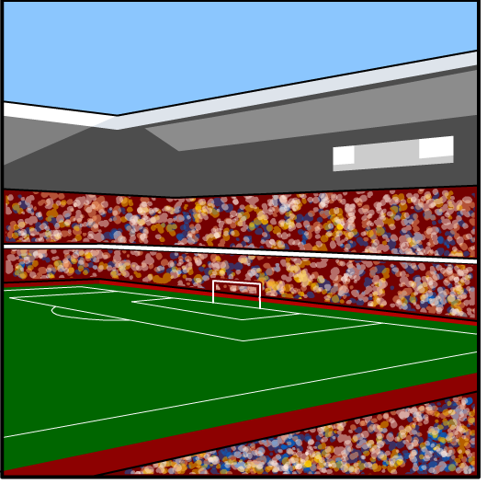
The movement of waves (3)
The movement of waves can also be demonstrated by looking at a crowd doing 'The Wave' in a stadium.
This is started by one group of people moving up and down.
Energy is involved as the people move up and down.
The people do not leave their seat, but the wave travels around the stadium.
Notes:
Teacher notes
You could do this with your students in the classroom to demonstrate.
This slide covers the Science and Engineering Practices:
Developing and Using Models: Develop a model using an analogy, example, or abstract representation to describe a scientific principle or design solution.

Slide 7
Wave particles
Notes:
This slide covers the Science and Engineering Practices:
Developing and Using Models: Develop a model using an analogy, example, or abstract representation to describe a scientific principle or design solution.

