Slide 1
Light and Reflection

Slide 2
Information
Planning and Carrying Out Investigations
1. Patterns
2. Cause and Effect
5. Energy and Matter

Slide 3
Redirection of light
Notes:
Teacher notes
The light beam reflects off the mirror and changes direction.
This slide covers the Science and Engineering Practices:
Planning and Carrying Out Investigations: Make observations and/or measurements to produce data to serve as the basis for evidence for an explanation of a phenomenon or test a design solution.

Slide 4
The angle of reflection
Notes:
This slide covers the Science and Engineering Practices:
Planning and Carrying Out Investigations: Make observations and/or measurements to produce data to serve as the basis for evidence for an explanation of a phenomenon or test a design solution.

Slide 5
Dull and shiny surfaces
Notes:
Teacher notes
Ask students to predict which objects will be the most reflective.
This slide covers the Science and Engineering Practices:
Planning and Carrying Out Investigations: Plan and conduct an investigation collaboratively to produce data to serve as the basis for evidence, using fair tests in which variables are controlled and the number of trials considered.
Planning and Carrying Out Investigations: Make observations and/or measurements to produce data to serve as the basis for evidence for an explanation of a phenomenon or test a design solution.

Slide 6
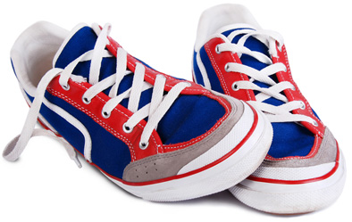
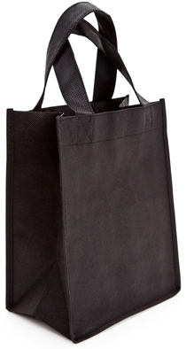
Surfaces and reflection
You can see yourself clearly in a mirror because
its shiny surface reflects the light.
Normal surfaces scatter light in all directions. Some of these scattered beams reach our eyes and we see the objects.
Black surfaces absorb all the light.
Notes:
Photo credits:
Pencil © Ruslan Ivantsov, Shutterstock.com 2018
Shoes © Solovyova Lyudmyla, Shutterstock.com 2018
Bag © Feng Yu, Shutterstock.com 2018

Slide 7
How do we see objects?
Notes:
This slide covers the Science and Engineering Practices:
Planning and Carrying Out Investigations: Make observations and/or measurements to produce data to serve as the basis for evidence for an explanation of a phenomenon or test a design solution.

Slide 8
What have you learned about reflection?

