Slide 1
Mirrors

Slide 2
Information
Analyzing and Interpreting Data
Constructing Explanations and Designing Solutions
1. Patterns
2. Cause and Effect

Slide 3
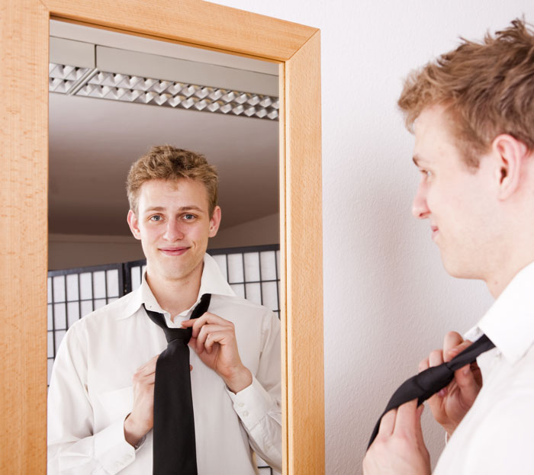
What are mirrors?
A mirror is a reflective surface.
The image we see in a mirror is a reflection of the original.
Mirrors are very useful in everyday life. They can help us see ourselves, and other objects out of view.
Notes:
Photo credit: © Ulrich Willmunder, Shutterstock.com 2018

Slide 4
Light and mirrors
Notes:
Teacher notes
The light beam bounces off the mirror and changes direction.
You could do this as a practical exercise in the classroom, even given students two mirrors to see what effects they can produce.
This slide covers the Science and Engineering Practices:
Analyzing and Interpreting Data: Use observations (firsthand or from media) to describe patterns and/or relationships in the natural and designed world(s) in order to answer scientific questions and solve problems.
Constructing Explanations and Designing Solutions: Use information from observations (firsthand and from media) to construct an evidence-based account for natural phenomena.

Slide 5
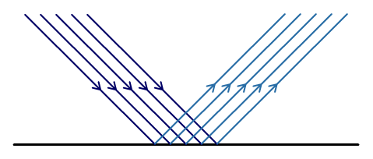
Reflection
Light that hits a mirror bounces off it again. This is called reflection.
We can represent this in a diagram, like this:
Some of the reflected light travels into our eyes, allowing us to see it.
Light
Mirror

Slide 6
Reflective surfaces
Notes:
This slide covers the Science and Engineering Practices:
Analyzing and Interpreting Data: Use observations (firsthand or from media) to describe patterns and/or relationships in the natural and designed world(s) in order to answer scientific questions and solve problems.
Constructing Explanations and Designing Solutions: Use information from observations (firsthand and from media) to construct an evidence-based account for natural phenomena.

