Slide 1
Separating Mixtures

Slide 2
Information
Asking Questions and Defining Problems
Planning and Carrying Out Investigations
Analyzing and Interpreting Data
1. Patterns
2. Cause and Effect
5. Energy and Matter
6. Structure and Function

Slide 3
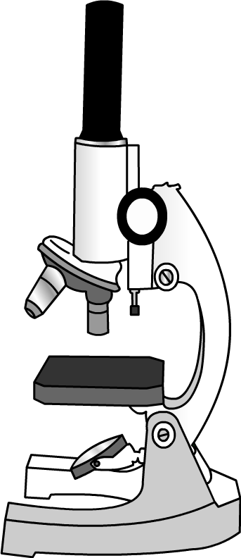
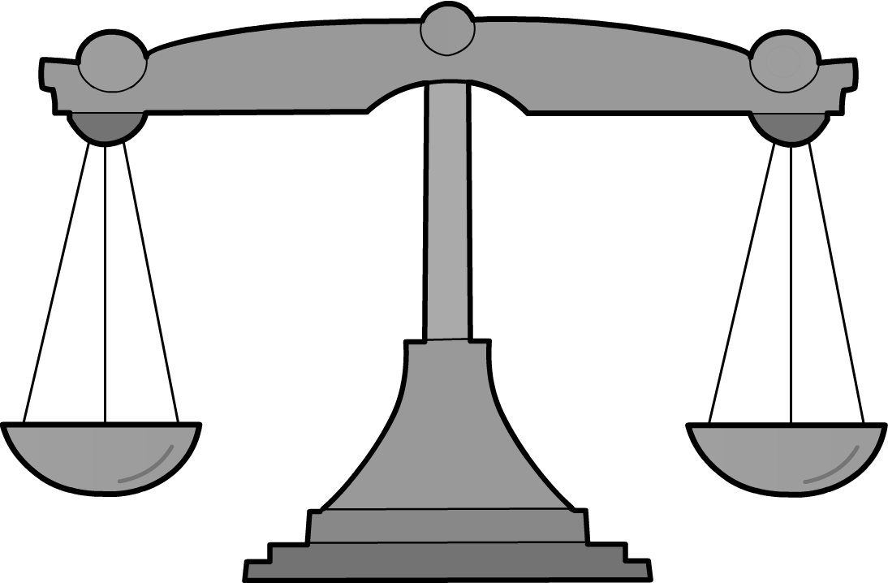
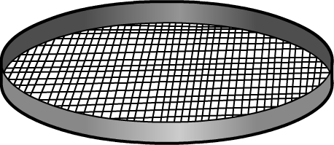
What is a mixture?
A mixture is two or more substances mixed together.
Solid substances that are mixed together can often be easily separated again. Which tool would you use to separate a mixture of solids?
scale?
sieve?
microscope?
A sieve can be used to separate a mixture of solids.
Notes:
Teacher notes
A sieve is made up of wire or plastic mesh held in a frame. A sieve is the best apparatus to use when separating solids, or liquids from solids, where the substances have particles of different sizes.
This slide covers the Science and Engineering Practices:
Planning and Carrying Out Investigations: Evaluate appropriate methods and/or tools for collecting data.

Slide 4
Using sieves
Notes:
This slide covers the Science and Engineering Practices:
Planning and Carrying Out Investigations: Make observations and/or measurements to produce data to serve as the basis for evidence for an explanation of a phenomenon or test a design solution.

Slide 5
Mixing solids with liquids (1)
Notes:
Teacher notes
Older students may be ready to discuss the difference between physical and chemical changes. Use this activity to help students recognize the difference between a physical change (e.g., mixing water and sand) and a chemical change (e.g. mixing water and instant coffee powder to make a new substance: coffee).
This slide covers the Science and Engineering Practices:
Planning and Carrying Out Investigations: Make observations and/or measurements to produce data to serve as the basis for evidence for an explanation of a phenomenon or test a design solution.

Slide 6
Mixing solids with liquids (2)
Notes:
This slide covers the Science and Engineering Practices:
Planning and Carrying Out Investigations: Make observations and/or measurements to produce data to serve as the basis for evidence for an explanation of a phenomenon or test a design solution.

Slide 7
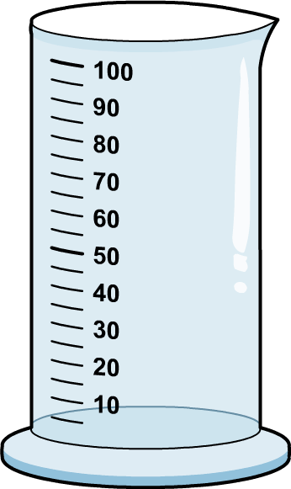
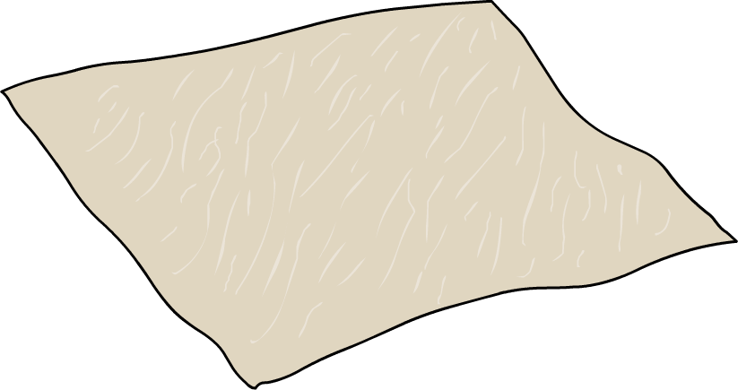
Separating solids from a liquid
Some of the solids dissolved in the water to form a solution. Other solids reacted with the water to form a new substance.
The solids that did not dissolve or react with the water can be easily separated. What should we use to separate a solid that did not dissolve or react from a liquid?
measuring
cylinder?
filter paper?
sieve?
Filter paper can be used to separate a solid, such as sand or chalk, from a liquid.
Notes:
Teacher notes
Discuss the difference between dissolving and melting. Melting is what happens to some solids when you heat them.
Ask students to look closely at the mixtures in which the solid did not dissolve or react. They should be able to see the small pieces of the solid collected on the bottom of the container.
Explain that sieves will separate marbles from water but not sand or chalk as the holes in even the smallest sieve are too big. Discuss how filters are like sieves but with very small holes that the small pieces of sand and chalk cannot go through.
This slide covers the Science and Engineering Practices:
Planning and Carrying Out Investigations: Evaluate appropriate methods and/or tools for collecting data.

Slide 8
Using filter paper (1)
Notes:
This slide covers the Science and Engineering Practices:
Asking Questions and Defining Problems: Ask questions that can be investigated and predict reasonable outcomes based on patterns such as cause and effect relationships.
Analyzing and Interpreting Data: Represent data in tables and/or various graphical displays (bar graphs, pictographs, and/or pie charts) to reveal patterns that indicate relationships.

Slide 9
Using filter paper (2)
Notes:
This slide covers the Science and Engineering Practices:
Planning and Carrying Out Investigations: Make observations and/or measurements to produce data to serve as the basis for evidence for an explanation of a phenomenon or test a design solution.

Slide 10
What conclusions can we draw?
Notes:
This slide covers the Science and Engineering Practices:
Analyzing and Interpreting Data: Analyze and interpret data to make sense of phenomena, using logical reasoning, mathematics, and/or computation.

Slide 11
Separating mixtures by evaporation

