Slide 1
Sound Waves

Slide 2
Information
Asking Questions and Defining Problems
Planning and Carrying Out Investigations
Constructing Explanations and Designing Solutions
1. Patterns
2. Cause and Effect
3. Scale, Proportion, and Quantity
5. Energy and Matter

Slide 3
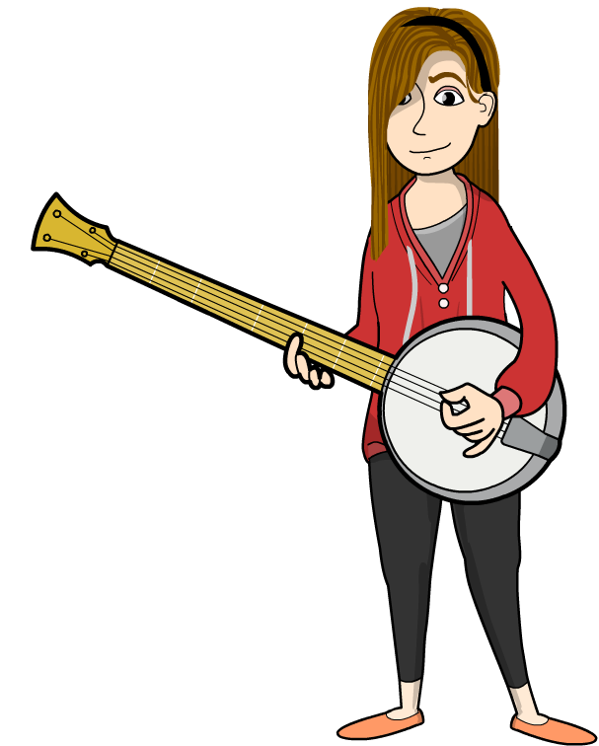
What is sound?
Sound is a type of wave. Remember, a wave is a regular pattern of motion.
When you pluck a banjo string, it causes the string to move quickly backward and forward.
This movement is called a vibration.
The vibrations repeat in a regular pattern, creating a sound wave.

Slide 4
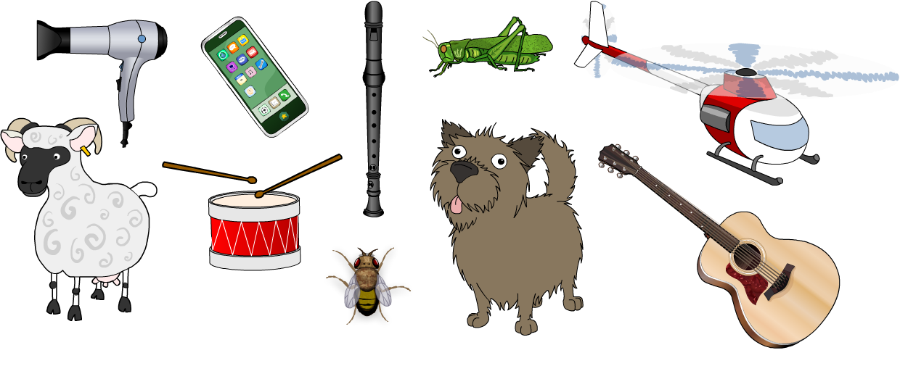
Different types of sounds
There are many different types of sounds.
How many can you think of, and what makes them different from each other?
Each different sound has its own sound wave. Sound waves can be very different from each other!

Slide 5
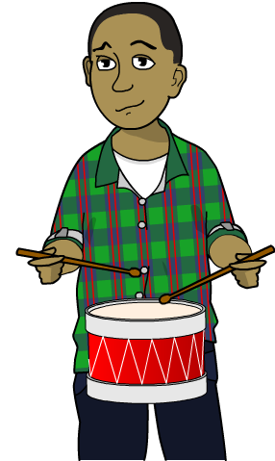
Vibrations and amplitude
Sounds can be loud, soft, or anywhere in between!
For a loud sound, the vibrations in the sound wave are large.
This means that the particles in the wave move backwards and forwards a long way.
Another way of describing this is to say that the wave has a large amplitude.
Vibrations with a large amplitude make a loud sound.

Slide 6
Loud and soft sounds

Slide 7
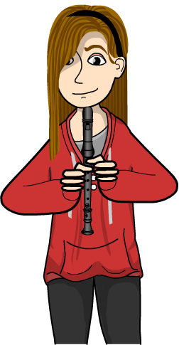
Pitch and frequency
The pitch of a sound wave is how high or low it sounds when we hear it.
Pitch is affected by how quickly vibrations happen in the wave.
Vibrations that happen quickly make a sound with a high pitch.
Another way of describing this is to say that the wave has a high frequency.
High frequency vibrations make a sound with a high pitch.

Slide 8
High or low pitch

Slide 9
How is pitch created?
Notes:
Teacher notes
The size of the drum also affects the sound it makes. Small drums make high-pitched sounds and large drums make low-pitched sounds.

Slide 10
Understanding pitch (1)
Notes:
Teacher notes
Students could also try tapping the bottles to hear the difference in pitch between when they are blown and when they are tapped. A bottle with lots of water produces a high-pitched sound when blown over but a low-pitched sound when tapped. This is because when the bottle is tapped, it is the water (not the air) that vibrates, and the column of water is longer than the column of air.
This slide covers the Science and Engineering Practices:
Asking Questions and Defining Problems: Ask questions that can be investigated and predict reasonable outcomes based on patterns such as cause and effect relationships.
Planning and Carrying Out Investigations: Make observations and/or measurements to produce data to serve as the basis for evidence for an explanation of a phenomenon or test a design solution.

Slide 11
Understanding pitch (2)
Notes:
Teacher notes
Help students apply the results of the water bottle experiment to other instruments. (For example, the pitch of a wind instrument is changed by altering the length of the air column vibrating.)
This slide covers the Science and Engineering Practices:
Constructing Explanations and Designing Solutions: Construct an explanation of observed relationships (e.g., the distribution of plants in the back yard).

