Slide 1
Sounds

Slide 2
Information
Planning and Carrying Out Investigations
Analyzing and Interpreting Data
Using Mathematics and Computational Thinking
Constructing Explanations and Designing Solutions
Engaging in Argument from Evidence
1. Patterns
2. Cause and Effect

Slide 3
How do sounds travel?
Notes:
Teacher notes
Ask students to draw a picture that shows how they think James can hear Fuzz barking. Their pictures could be displayed around the board. Ensure students understand that to travel means to move.

Slide 4
Sounds at different distances (1)

Slide 5
Sounds at different distances (2)

Slide 6
Investigating distance and sound
Notes:
Teacher notes
After watching the animation, students could re-enact the test using a quiet sound such as a ticking clock or wristwatch. Ask: “How can we make our test fair?” (e.g. by all starting at the same distance from the sound).
This slide covers the Science and Engineering Practice:
Planning and Carrying Out Investigations: Plan and conduct an investigation collaboratively to produce data to serve as the basis for evidence to answer a question.

Slide 7
Plotting a graph
Notes:
Teacher notes
Draw students’ attention to the labels on the axes of the bar graph. Ask: “Was everyone the same distance away from Fuzz when they heard him panting?” , “If Fuzz was barking instead, do you think the kids would need to get this close to hear him?” and “How far away can you hear a dog barking?” Let students discuss the questions, then ask: “Do loud sounds travel further?”
Ask students questions that require them to interpret the bar graph, such as “Who had to get closest to Fuzz in order to hear him?” (Jo).
This slide covers the Science and Engineering Practices:
Analyzing and Interpreting Data: Use and share pictures, drawings, and/or writings of observations.
Analyzing and Interpreting Data: Use observations (firsthand or from media) to describe patterns and/or relationships in the natural and designed world(s) in order to answer scientific questions and solve problems.
Using Mathematics and Computational Thinking: Describe, measure, and/or compare quantitative attributes of different objects and display the data using simple graphs.

Slide 8
How do we hear sounds?

Slide 9
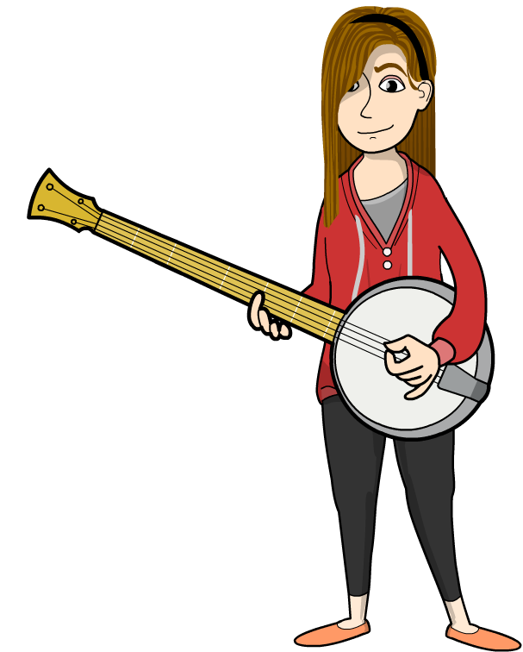
Vibrations
When you pluck a banjo string, it causes the string to move quickly backward and forward.
This movement is called a vibration.
When vibrations happen, sound is made.
The same happens when you hit a drum.
That’s because all sound
is made by vibrations.

Slide 10
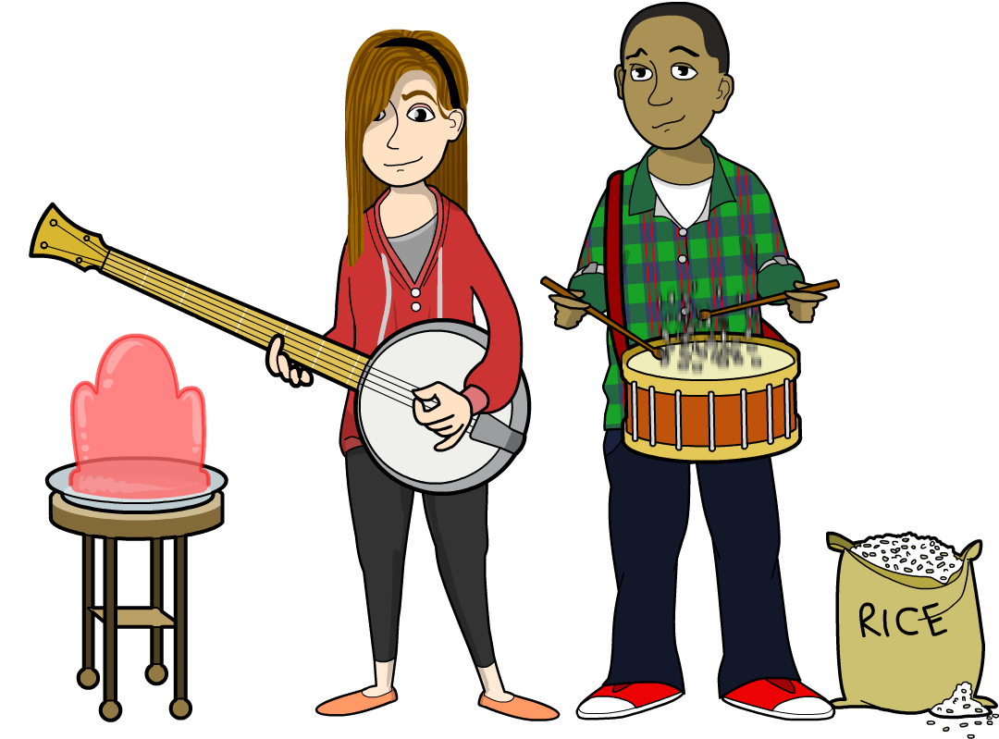
Can vibrations travel? (1)
Vibrations can spread from one object to another.
When James hits the drum, the rice moves too.
Vibrations can also spread to the air and
then to another object.
Can you explain what happens when Alexis plucks the banjo string?
Notes:
Teacher notes
Collect students’ ideas about what happens when Alexis plucks the banjo string before moving to the next slide. Encourage students to explain their ideas using evidence.
This slide covers the Science and Engineering Practices:
Constructing Explanations and Designing Solutions: Use information from observations (firsthand and from media) to construct an evidence-based account for natural phenomena.
Engaging in Argument from Evidence: Construct an argument with evidence to support a claim.

Slide 11
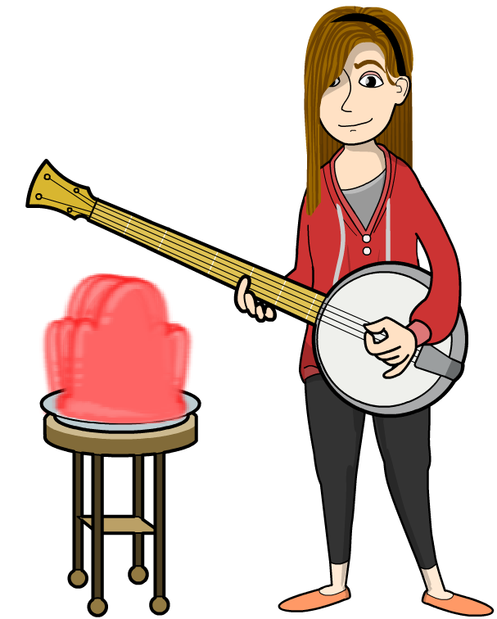
Can vibrations travel? (2)
When Alexis plucks the banjo string, the vibrations cause the air to move too!
The vibrations travel through the air and into to the gelatin. This causes the gelatin to move.
The vibrating air can also reach
the inside of our ears. This
causes them to vibrate too.
That’s how we hear sounds!

Slide 12
Hearing sounds

Slide 13
How do our ears hear sounds?
Notes:
This slide covers the Science and Engineering Practice:
Constructing Explanations and Designing Solutions: Use information from observations (firsthand and from media) to construct an evidence-based account for natural phenomena.

