Slide 1
Astronomical Distances

Slide 2
Information
Using Mathematics and Computational Thinking
3. Scale, Proportion, and Quantity

Slide 3
The evolving Universe

Slide 4
Astronomical distances
Planets, stars and galaxies, and the distances between them, are huge when compared with everyday measurements:
the distance from Earth to the Sun: 149,598,000,000 m
the distance from the Sun to the center of our galaxy: 2.5 × 10²⁰ m.
To make these distances easier to use, physicists and astronomers use much larger, non-SI units to describe them:
1 astronomical unit (AU)
= mean distance from Earth to the Sun
= 1.5 × 10¹¹ m
1 light year (ly) = distance light travels in a year
= 9.5 × 10¹⁵ m
Notes:
This slide covers the Science and Engineering Practice:
Using Mathematics and Computational Thinking: Apply ratios, rates, percentages, and unit conversions in the context of complicated measurement problems involving quantities with derived or compound units (such as mg/mL, kg/m³, acre-feet, etc.).

Slide 5
Parallax
Notes:
Teacher notes
Pause the second animation and use the ruler tool to project the nearby star onto the background of stars, and compare its position with the view through the telescope on the right. The view through the telescope represents what might be seen if that same patch of sky were observed over a long period of time (one year per revolution).

Slide 6
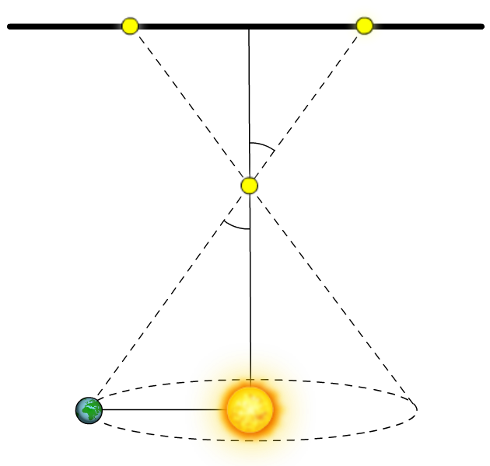
Using parallax to measure distance
The closer a star is to the Earth, the more parallax it shows as the Earth orbits the Sun. How can parallax be used to measure this distance?
The parallax angle, p, is defined as half the angle that the near star appears to move through:
apparent motion
The distance from the Earth to the Sun, r, is 1 AU, so using trigonometry:
p
r
near star
tan p =
d
p
But p is a very small angle, so tan p ≈ p:
d
r
r
r
p =
so
d =
d
p
Notes:
This slide covers the Science and Engineering Practice:
Using Mathematics and Computational Thinking: Apply ratios, rates, percentages, and unit conversions in the context of complicated measurement problems involving quantities with derived or compound units (such as mg/mL, kg/m³, acre-feet, etc.).

Slide 7
What is a parsec?
The word parsec is a shortening of “parallax of one arcsecond.” An arcsecond is a small division of a degree, which is a useful measurement in astronomy because the night sky is so vast. An arcminute is a 60th of a degree, and an arcsecond is a 60th of an arcminute, or one 3,600th of a degree.
A parsec is the distance away an object must be to have a parallax of one arcsecond when observed from Earth.
1 parsec (pc) = 1 astronomical unit / 1 arcsecond
[1 AU = 1.5 × 10¹¹ m]
[1 arcsecond = 2π/(360 × 3,600) rad]
1 pc = 3.1 × 10¹⁶ m
How does this compare to a lightyear?
1 pc = 3.3 ly
…and an astronomical unit?
1 pc = 2.1 × 10⁵ AU
Notes:
Teacher notes
A good question for more able students would be, “is the parsec a useful unit of measurement?”
Possible answers:
The parsec is close in size to the light year, which makes it no more useful for measuring greater distances.
Unlike the light year, the parsec is based on a simple ratio of other units, which makes it more useful for avoiding complicated scaling factors in astronomical calculations.
This slide covers the Science and Engineering Practice:
Using Mathematics and Computational Thinking: Apply ratios, rates, percentages, and unit conversions in the context of complicated measurement problems involving quantities with derived or compound units (such as mg/mL, kg/m³, acre-feet, etc.).

Slide 8
Converting units
Notes:
This slide covers the Science and Engineering Practice:
Using Mathematics and Computational Thinking: Apply ratios, rates, percentages, and unit conversions in the context of complicated measurement problems involving quantities with derived or compound units (such as mg/mL, kg/m³, acre-feet, etc.).

