Slide 1
Biogeology

Slide 2
Information
Asking Questions and Defining Problems
Developing and Using Models
Engaging in Argument from Evidence
1. Patterns
2. Cause and Effect
3. Scale, Proportion, and Quantity
4. Systems and System Models
7. Stability and Change

Slide 3
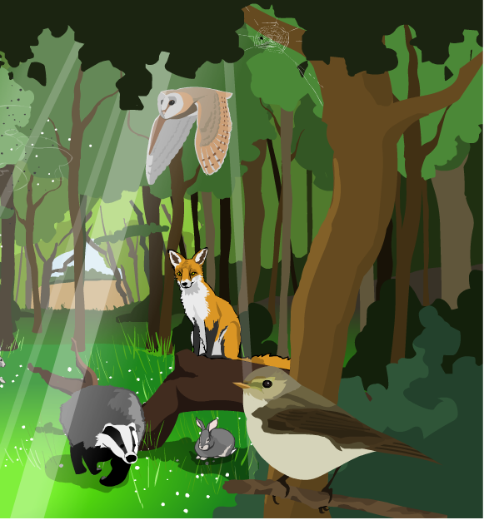
What is the biosphere?
The parts of the Earth where living organisms can be found are known as the biosphere. These include:
oceans
swamps and wetlands
coasts
forests
plains and grasslands
rivers.
These are all examples of habitats: environments in which plants and animals coexist. A community of animal and plant populations within a habitat makes up an ecosystem.
Different parts of the biosphere are interdependent – meaning they depend on each other to survive.

Slide 4
The history of the atmosphere
Notes:
Teacher notes
Students may need reminding that 4,500 million years is the same as 4.5 billion years.
For more detailed information on the composition and history of the Earth’s atmosphere, see the Earth’s Atmosphere presentation.
This slide covers the Science and Engineering Practice:
Developing and Using Models: Develop, revise, and/or use a model based on evidence to illustrate and/or predict the relationships between systems or between components of a system.

Slide 5
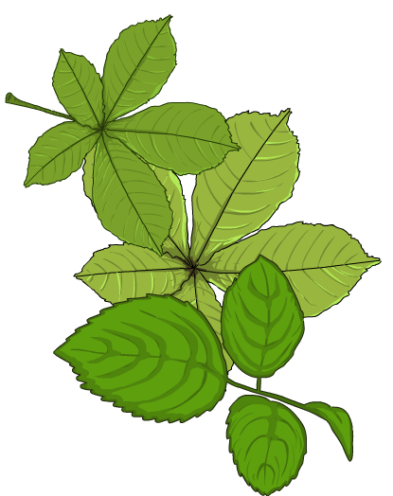
What is photosynthesis?
Plants absorb carbon dioxide (CO₂) from the atmosphere and use it to produce glucose and oxygen (O₂).
6CO₂ + 6H₂O → C₆H₁₂O₆ + 6O₂
carbon dioxide
water
glucose
oxygen
This process is known as photosynthesis.
Trees, plants and algae photosynthesize to produce glucose molecules. Glucose is a sugar and a source of energy. The oxygen produced during photosynthesis is released by the plants back into the atmosphere.

Slide 6
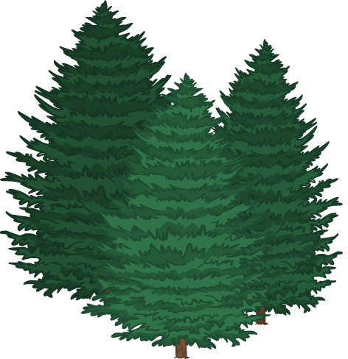
The Great Oxygenation Event
About 3 billion years ago, the Earth’s atmosphere was completely different: it contained very little oxygen.
Photosynthetic organisms (lifeforms that photosynthesize) release oxygen as a byproduct. The first photosynthetic organisms were bacteria that lived in the ocean about 2.1 billion years ago.
These bacteria produced oxygen, which eventually began to escape into the atmosphere.
Over the next billion years, the amount of oxygen in the Earth’s atmosphere increased. This process is known as the Great Oxygenation Event.
Notes:
Teacher notes
As before, students may need reminding that 3 billion years is equal to 3,000 million. Encourage them to compare the evolution of plants and trees with the timeline of the atmosphere on slide 4.

Slide 7
How important is oxygen?
So what was the impact of all this new oxygen that had been added into the atmosphere?
The extra oxygen eventually transformed life on Earth.
It allowed for more types of weathering to take place, including oxidization of surface minerals.
It led to the evolution of aerobic lifeforms that breathe oxygenated air, such as birds, reptiles and humans.
If photosynthesis had never evolved, humans would not exist.
Notes:
Teacher notes
The importance of weathering is covered on the next slides.
This slide covers the Science and Engineering Practice:
Asking Questions and Defining Problems: Ask questions that arise from examining models or a theory, to clarify and/or seek additional information and relationships.

Slide 8
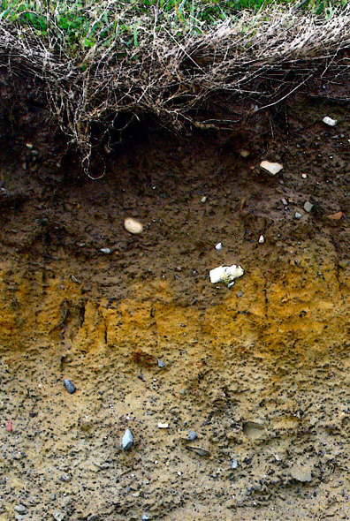
How does weathering form soils?
Weathering is the breakdown of rocks over time. It can be categorized as chemical or mechanical.
Chemical weathering involves chemical changes, such as acid rain dissolving soft rocks. Mechanical weathering breaks rocks into smaller pieces via
physical processes such as abrasion.
When rocks break up into tiny pieces, they form soil. Elements found in soil are either:
organic (living)
or inorganic (non-living).
What examples of organic or inorganic
soil elements can you think of?
Notes:
Teacher notes
For more information on the different types of weathering, including abrasion, see the Weathering presentation.
Photo credit: Soil layers in Ireland image has been released into the public domain by its author, HolgerK, and is reproduced free from any known copyright restrictions.

Slide 9
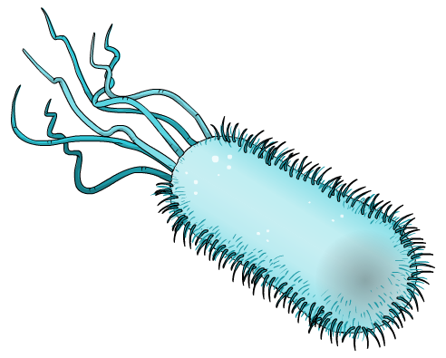
Soil fertility
Soil that is mainly inorganic is not very fertile.
For example, soil in a hot desert is composed of sand: inorganic rock grains. Few plants are able to grow there.
Organic soil materials include decaying plant matter and microorganisms. These elements increase soil fertility.
Evidence of weathering from
ancient rocks suggests that
photosynthetic microorganisms
were living on land about 1.2 billion
years ago. As these microorganisms
developed, they gradually colonized the early land, creating fertile soils.

Slide 10
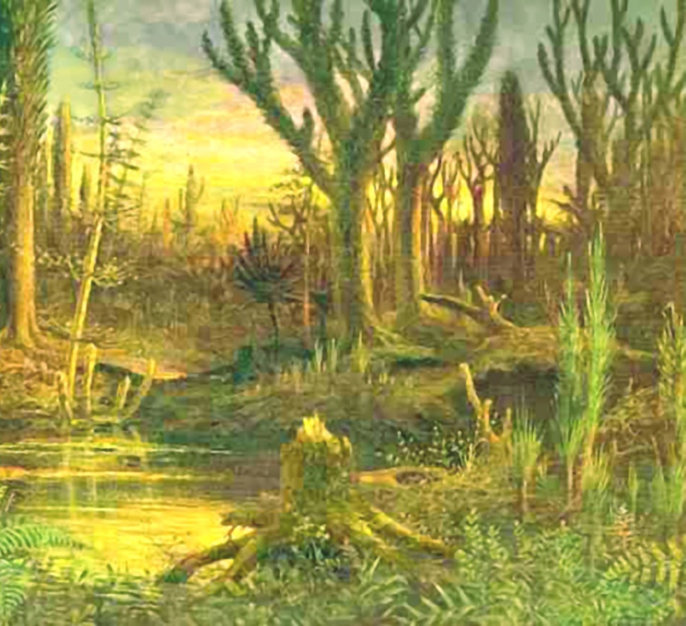
Plants on land
Scientists are not sure exactly when land plants evolved.
The earliest fossil evidence dates to about 420 million years ago, but it is possible they existed before then.
Land plants could not have evolved without two key factors:
the evolution of photosynthesis
the increase in soil fertility.
Which of these two factors do you think was the most important?
Can you construct an argument to back up your point of view?
Notes:
Teacher notes
Students may pick one side or the other: the important factor is whether they are able to back up their arguments. They may also decide that both factors were equally important, since land plants could not have evolved as we know them without both factors occurring.
This slide covers the Science and Engineering Practice:
Engaging in Argument from Evidence: Construct, use, and/or present an oral and written argument or counter-arguments based on data and evidence.
Photo credit: Artist’s impression of early land plants, by Eduard Riou (1872) is in the public domain and is reproduced free from any known copyright restrictions.

Slide 11
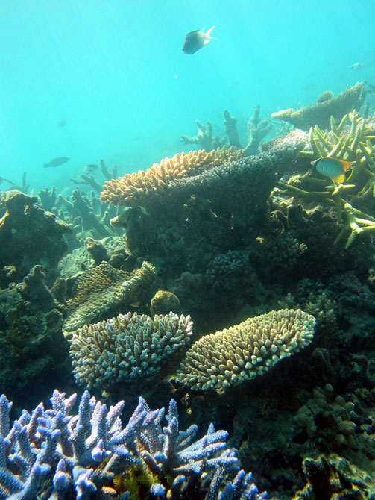
Coral reefs
Coral reefs are an example of an ocean ecosystem. While corals look like plants, they are actually a type of sessile animal. Sessile animals are not able to move themselves.
Several corals naturally secrete material made of calcium as part of their life cycle. These calcium deposits eventually build up into a rocky formation: a coral reef.
Coral reefs are an important part of the Earth’s biodiversity. They provide habitats for a diverse range of oceanic lifeforms.
Notes:
Photo credit: Coral reef © Terry Hughes, 2006, reproduced under the terms of the Creative Commons Attribution 2.5 Generic license.

Slide 12
How do coral reefs form?
Fringing reef
Corals typically form in shallow ocean waters around islands. They attach to the ocean floor and, as coral deposits build up, form a reef.
Barrier reef
When a volcanic island is worn down and subsides (sinks) underwater over millions of years, coral reefs around it are left behind. These circular reefs are known as atolls.
Atoll
How do you think coral reefs affect nearby coastlines?
Notes:
Teacher notes
The answer to this question is covered in detail on the next slide.

Slide 13
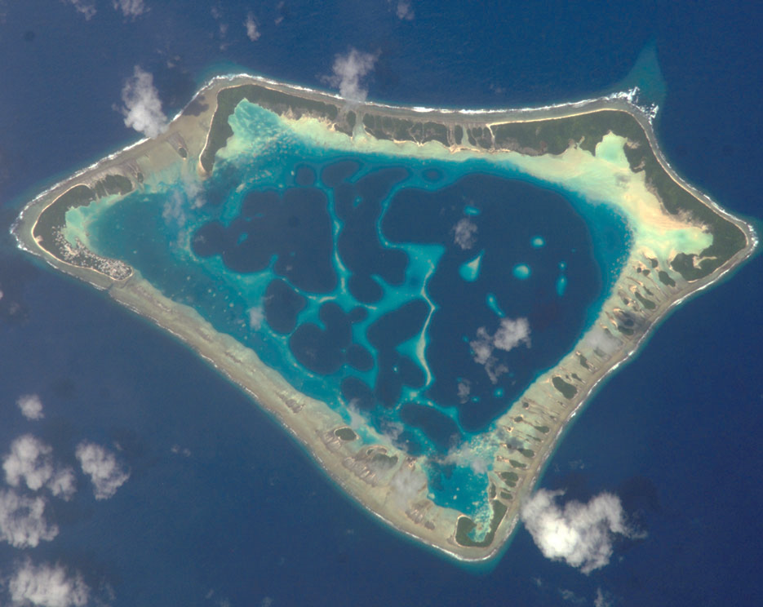
Lagoons
When coral reefs form off coasts, they create lagoons: shallow areas of water that are cut off from the ocean.
The tides carry sediment (silt, sand and small rocks) and deposit it around the reef, creating distinct sheltered areas.
atoll
lagoon
This image shows an atoll lagoon: an atoll with a lagoon in its center. Lagoons can also form when barrier reefs develop along coastlines.
Notes:
Photo credit: Atafu atoll near New Zealand image is in the public domain because it was solely created by NASA.

Slide 14
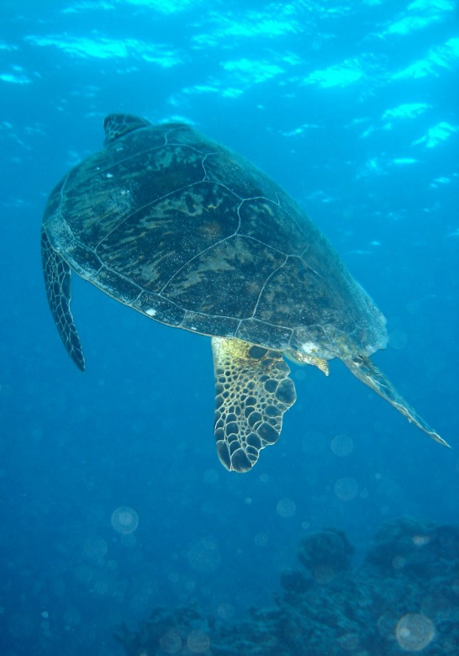
Coral reef habitats
Lagoons and coral reefs provide an important habitat for coastal lifeforms. The Great Barrier Reef off the east coast of Australia is an ecosystem with high biodiversity.
The Great Barrier Reef is home to thousands of animal species. Some of these include:
sea turtles
sea snakes
dugongs
saltwater crocodiles
clownfish
various seabirds.
The reef is also home to 2,195 known plant species and many others that we have not discovered yet. Some species are endemic, meaning that they are only found in this area.
Notes:
Teacher notes
As an extra task, students could be asked to pick a species found in the Great Barrier Reef and investigate how it has adapted to survive in this particular environment. Things to consider include:
what the species eats
the environmental conditions the species needs to survive
how the species protects itself from predators.
Photo credit: Green sea turtle © Nize, 2006, reproduced under the terms of the Creative Commons Attribution 2.5 Generic license.

Slide 15
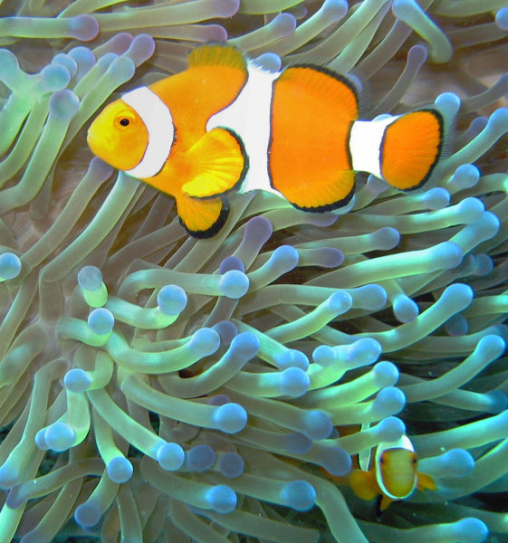
Clownfish
One example of a specifically evolved animal is the clownfish. Clownfish live in Pacific waters, including the Great Barrier Reef.
Clownfish are immune to the stings of sea anemones, so are able to live near them while being protected from predators. They also eat small organisms that could harm the anemones.
This is an example of a symbiotic relationship. Both clownfish and sea anemones live in the same environment and have co-evolved to benefit each other.
Notes:
Teacher notes
Students may need the term ‘symbiotic’ defining. A symbiotic relationship is one in which two different organisms (such as plants or animals) have a biological relationship. This relationship can be beneficial to one or both of the organisms, or harmful to one or both of the organisms. The relationship between clownfish and sea anemones is mutualistic, meaning that both organisms benefit.
Photo credit: Clownfish image has been released into the public domain by its author, janderk, and is reproduced free from any known copyright restrictions.

Slide 16
Summary
You have now learned about some of the ways that plants and animals interact with other elements of the biosphere.
Are there any other examples you can think of or want to investigate?
How might specifically evolved species be vulnerable to changes in their environment?
Can you think of any habitats that are experiencing rapid change?
Notes:
Teacher notes
These questions could be a useful basis for extension tasks. Ask students to consider environments that are experiencing rapid change, including:
the Amazon rainforest (experiencing high rates of deforestation)
the Great Barrier Reef (experiencing coral bleaching due to human activities)
the Sahel region (experiencing desertification and drought.)
This slide covers the Science and Engineering Practice:
Asking Questions and Defining Problems: Ask questions that can be investigated within the scope of the school laboratory, research facilities, or field (e.g., outdoor environment) with available resources and, when appropriate, frame a hypothesis based on a model or theory.

Slide 17
True or false?
Notes:
Teacher notes
This true-or-false activity could be used as a review, or at the start of class to gauge students’ existing knowledge of the subject matter. Colored traffic light cards (red = false, yellow = don’t know, green = true) could be used to make this a whole-class exercise.

