Slide 1
CFCs and the Environment

Slide 2
Information
Developing and Using Models
Constructing Explanations and Designing Solutions
2. Cause and Effect
7. Stability and Change

Slide 3
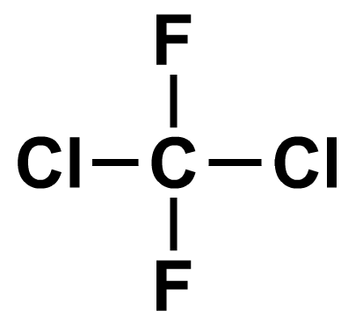
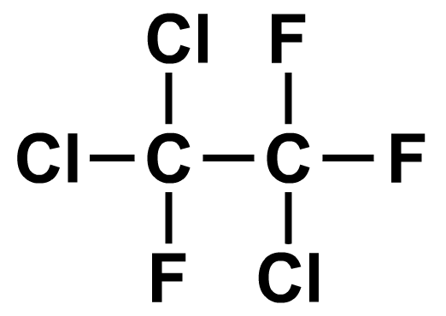
What are CFCs?
CFCs are a family of compounds that contain only chlorine, fluorine and carbon atoms.
CFC stands for chlorofluorocarbon.
There are many different varieties of CFC. Here are some examples:
CCl₂F₂
Cl₂FC-CClF₂
dichlorodifluoromethane
1,1,2-trichloro-1,2,2-
trifluoroethane
Notes:
Teacher notes
Students should be aware that CFCs are not naturally found in the environment. They are synthesized by people, using feedstocks such as alkanes.

Slide 4
Properties of CFCs
CFCs contain strong covalent bonds. This means that they are very inert (unreactive).
CFCs therefore last for a long time in the environment as they do not decompose or react with other substances easily.
They are also insoluble in water, and have low melting and boiling points.
boiling point: –30 °C
melting point: –158 °C
boiling point: 48 °C
melting point: –35 °C
What state are these CFCs at room temperature?

Slide 5
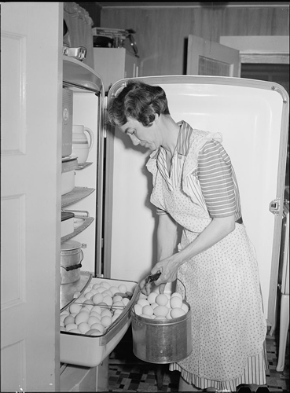
Development of CFCs
During the 1930s, an American engineer named Thomas Midgely was looking for substances that were suitable for use as coolants in refrigerators.
The refrigerants in use at that time were toxic compounds such as ammonia and sulfur dioxide.
Using what they knew about halogen compounds, Midgely and his team developed CFCs.
Their discovery was seen as a success and CFCs soon replaced the previously used refrigerants.
Notes:
Teacher notes
Ask students what they think the impact of this discovery was. They should be aware that the discovery of CFCs was initially seen as a great success. Refrigeration extends the shelf-life of food products and helps to control food-borne diseases. Prior to the use of CFCs, refrigeration gases led to many deaths. Early refrigeration gases were toxic and often leaked, causing deaths from the inhalation of the toxic fumes. Replacements were sought by Midgely’s employers, and his team was challenged to develop an alternative. Midgely and his team developed dichlorodifluoromethane, CCl₂F₂, which they named Freon. The team believed that the stability of the covalent bonds within the compound would prevent the release of toxic breakdown products. The gas proved to be non-toxic and non-flammable, and was lauded as a success. CFCs were soon found to have many other applications.
Photo credit: Lauderdale County, Alabama. Tennessee Valley Authority (TVA). An electric refrigerator helps Mrs. Case keep eggs fresh. By Arthur Rothstein, 1942. Source: Library of Congress, Prints & Photographs Division, FSA/OWI Collection, [LC-USW3-003911-D]. This image is in the public domain because it is a work of the U.S. Federal Government and is therefore not subject to copyright.

Slide 6
Uses of CFCs
Notes:
Teacher notes
This activity contains several discussion points relating to items that would once have contained CFCs. The first modern air freshener was developed in the 1940s using a CFC propellant. Expanded polystyrene foam is still used as a packaging material, however, CFCs have now been replaced with other gases, such as carbon dioxide.

Slide 7
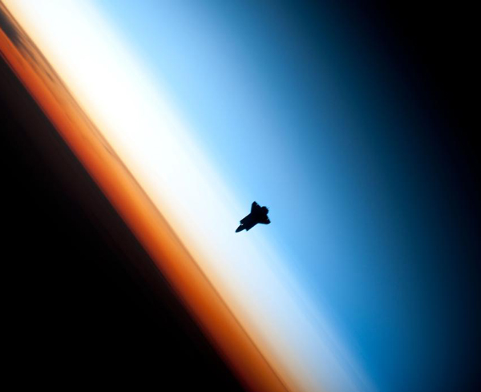
The ozone layer
Earth’s atmosphere is made of several different layers. The stratosphere is one of these layers, located between 10 km and 50 km from the surface.
The stratosphere contains the ozone layer, which is made of the gas ozone (O₃).
ozone layer
In the late 1970s and early 1980s, scientists noticed that the ozone layer was becoming damaged. They linked this problem to CFCs.
Notes:
Teacher notes
The image shows the space shuttle Endeavour silhouetted against Earth’s atmosphere. The image was taken in 2010 by a crew member of the International Space Station. The orange layer is the troposphere (0-10 km from the surface), where all of Earth’s weather and clouds are generated and contained. This orange layer gives way to the whitish stratosphere (10-50 km from the surface) and then into the mesosphere (50-80 km from the surface). Most ozone is contained within the stratosphere, forming a layer at about 25 km above Earth’s surface.
Photo credit: NASA

Slide 8
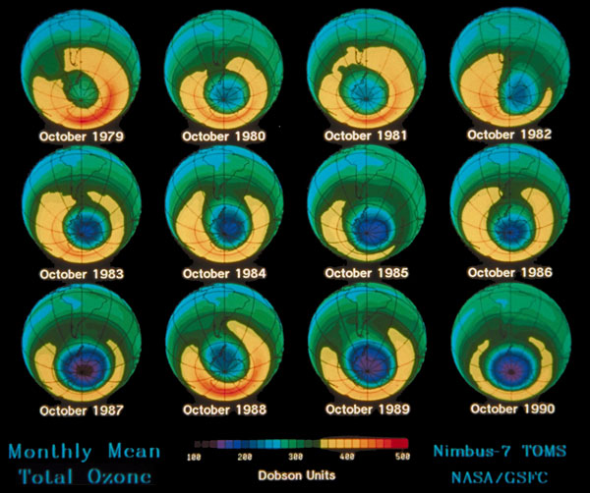
Damage to the ozone layer
The following image shows the amount of ozone over Antarctica between 1979 and 1990.
Dark blues and purples indicate low levels of ozone.
How did the ozone layer change between 1979 and 1990?
Notes:
Teacher notes
The images on this slide show ozone levels measured each October between 1979 and 1990. The measurements represented are in Dobson Units. The units were developed by Gordon Dobson, a British Scientist who invented a device for measuring ozone in the 1920s. Dobson Units are discussed further in slide 16.
Image credit: © Jupiterimages Corporation 2018

Slide 9
The function of ozone
Notes:
Teacher notes
This eight stage flash animation shows how ozone absorbs ultraviolet light in the stratosphere. The animation can be used to illustrate the function of the ozone layer in supporting life on Earth. The end of the animation asks students to consider the effect of decreasing the concentration of ozone in the ozone layer. The effect of lower ozone concentrations is a reduction in the absorption of UV radiation by the ozone layer. This would cause an increase in the amount of UV radiation reaching Earth’s surface. The effects of increased UV exposure are covered in the following slide.
The penultimate stage of the animation shows that most of the UV radiation is absorbed by the ozone layer. This most accurately depicts the absorption of UV-b radiation, as 95% of UV-b is absorbed by the ozone layer. UV-c radiation has a shorter wavelength than UV-b, and 100% of it is absorbed. UV-a has a longer wavelength than UV-b and only 5% of it is absorbed, however, UV-a is much less damaging to living organisms than UV-b radiation.
This slide covers the Science and Engineering Practices:
Developing and Using Models: Use a model to provide mechanistic accounts of phenomena.
Constructing Explanations and Designing Solutions: Apply scientific ideas, principles, and/or evidence to provide an explanation of phenomena and solve design problems, taking into account possible unanticipated effects.

Slide 10
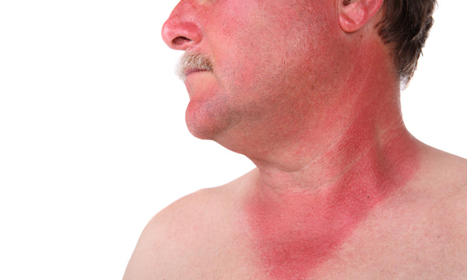
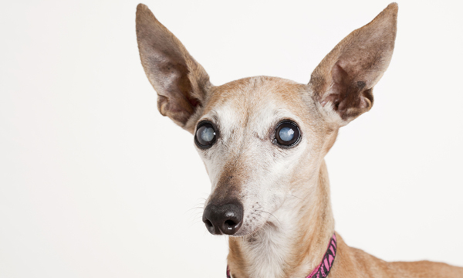
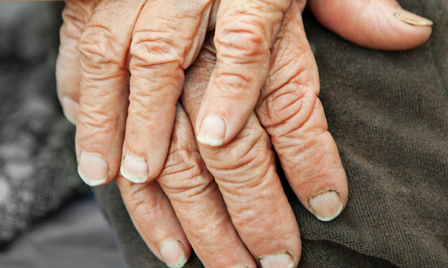
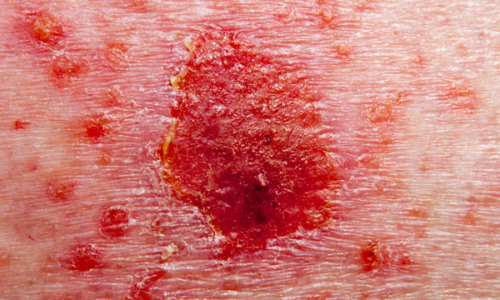
Effects of UV exposure
Increased levels of ultraviolet light can lead to medical problems such as:
increased risk of sunburn
increased risk of cataracts
accelerated ageing of skin
increased risk of skin cancer
Notes:
Photo credits: sunburn: © Suzanne Tucker, cataracts: © marekuliasz, aged skin: © Galushko Sergey, skin cancer: © R. Michael Ballard, all at Shutterstock.com 2018

Slide 11
The Montreal Protocol
Notes:
Teacher notes
The Montreal Protocol is viewed as one of the most successful international environmental agreements, and has been well adhered to by the international community. It is an important example of a situation in which scientific evidence has been acted upon by governments for the protection of the environment and human health. Students could research other international environmental agreements, such as the Kyoto Protocol, and discuss the relative success or failure of these agreements.

Slide 12
CFCs in the atmosphere
When CFCs are released into the environment they are dispersed by air currents and carried into the stratosphere.
Under most conditions CFC molecules are inert, however, the ultraviolet light in the stratosphere is strong enough to break the molecules apart.
CFC molecules are broken down in the stratosphere to give highly reactive chlorine atoms.
UV light
CCl₂F₂
CClF₂•
+
Cl•
Notes:
Teacher notes
The chemical stability of CFCs was initially seen as an advantage, since they did not break down to release toxic products into the environment. The disadvantages of this stability – that the molecules only break down at high altitudes – became clear long after their use became widespread. CFCs reach the environment through several routes. These include the use of aerosols and leakages from refrigeration equipment. Prior to 2001 there was no legislative requirement for EU member states to remove CFCs from refrigeration equipment before disposal.
This slide covers the Science and Engineering Practice:
Constructing Explanations and Designing Solutions: Apply scientific ideas, principles, and/or evidence to provide an explanation of phenomena and solve design problems, taking into account possible unanticipated effects.

Slide 13
Free radical formation
Notes:
Teacher notes
It may help to explain that the chlorine free radical is the same as a chlorine atom. It has seven outer electrons, which is one short of a full shell. This makes it extremely reactive.
This slide covers the Science and Engineering Practices:
Developing and Using Models: Use a model to provide mechanistic accounts of phenomena.
Constructing Explanations and Designing Solutions: Apply scientific ideas, principles, and/or evidence to provide an explanation of phenomena and solve design problems, taking into account possible unanticipated effects.

Slide 14
Reaction with ozone
Chlorine free radicals react with ozone. This produces another free radical species: ClO•.
Cl•
+
O₃
→
ClO•
+
O₂
ClO• can also react with ozone. This reaction regenerates a chlorine free radical.
ClO•
+
O₃
→
Cl•
+
2O₂
The formation of another chlorine radical allows the process to repeat in a chain reaction.
Notes:
Teacher notes
Chlorine radicals are eventually removed from the stratosphere by sinks such as methane. Chlorine radicals can react with methane to produce hydrogen chloride, which exists in the stratosphere as an undissociated molecule.
This slide covers the Science and Engineering Practice:
Constructing Explanations and Designing Solutions: Apply scientific ideas, principles, and/or evidence to provide an explanation of phenomena and solve design problems, taking into account possible unanticipated effects.

Slide 15
CFCs and chain reactions
Chlorine free radicals are regenerated in the second step of the chain reaction, therefore a single chlorine radical can destroy 100,000 ozone molecules.
This image shows the amount of ozone over Antarctica. Dark blues and purples indicate low levels of ozone.
How has the ozone layer changed?
Notes:
Teacher notes
The images on this slide show ozone levels measured each October between 1979 and 1990. The measurements represented are in Dobson Units. The units were developed by British scientist, Gordon Dobson, who invented a device for measuring ozone in the 1920s. See the notes on the next slide for more information.
This slide covers the Science and Engineering Practice:
Constructing Explanations and Designing Solutions: Apply scientific ideas, principles, and/or evidence to provide an explanation of phenomena and solve design problems, taking into account possible unanticipated effects.
Photo credit: © Jupiterimages Corporation 2018

Slide 16
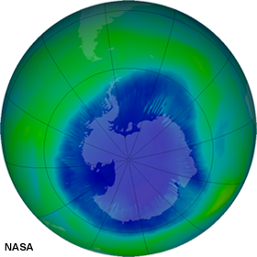
Is ozone depletion slowing?
The stability of CFC molecules means that they can only be broken down by UV radiation in the stratosphere, and it takes many years for CFCs to reach these high altitudes.
This means that CFCs will continue to deplete ozone for many years after their use has been banned.
However, recent scientific studies have shown that the hole in the ozone layer is not getting bigger.
If the Montreal Protocol continues to be followed, the ozone layer is expected to recover by 2050.
Notes:
Teacher notes
Despite the success of the Montreal Protocol in Europe, CFCs are still in use today. The Montreal Protocol did not ban production of CFCs with immediate effect; rather, production was to be decreased gradually, reaching zero by 2000. Refrigerators produced before this are still in use today.
This slide covers the Science and Engineering Practice:
Constructing Explanations and Designing Solutions: Apply scientific ideas, principles, and/or evidence to provide an explanation of phenomena and solve design problems, taking into account possible unanticipated effects.
Photo credit: NASA
The image shows levels of ozone above Antarctica, in the Southern Hemisphere, using data recorded on 26th August 2006. During the summer months, ozone levels are at their lowest, so data from this time is more likely to reveal ozone damage. Ozone levels are measured in Dobson Units. One Dobson Unit would form a layer 10 micrometres thick, if held at standard temperature and pressure. A measurement of less than 200 Dobson Units indicates a “hole” in the ozone layer. The dark blue areas of the image show ozone levels of 220 Dobson Units or below.
This image was reproduced from a NASA database, which includes data from 1979 to 2006. The database could be used by students to explore the changes to the ozone layer.

Slide 17
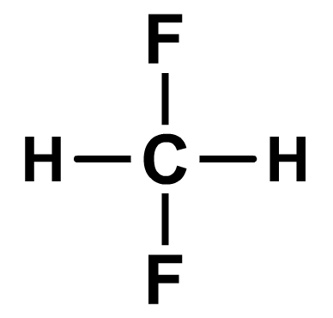
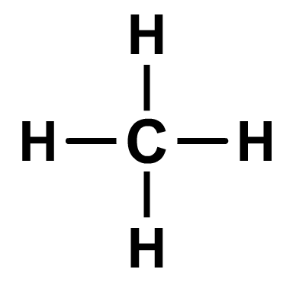
Alternatives to CFCs
Two families of compounds are now used in place of CFCs:
hydrofluorocarbons (HFCs)
alkanes.
These compounds do not contain chlorine atoms, so they cannot release chlorine free radicals into the atmosphere.
difluoromethane
methane
However, both these families of compounds are powerful greenhouse gases.
Notes:
Teacher notes
Over the course of 100 years, each alkane molecule has the same effect as 10 carbon dioxide molecules, while each HFC molecule has the same effect on the atmosphere as at least 1000 carbon dioxide molecules. HFCs were targeted in the Kyoto Protocol and wealthy countries are now seeking to reduce their production.
This slide covers the Science and Engineering Practice:
Constructing Explanations and Designing Solutions: Design, evaluate, and/or refine a solution to a complex real-world problem, based on scientific knowledge, student-generated sources of evidence, prioritized criteria, and trade-off considerations.

Slide 18
Evaluating the alternatives
Notes:
Teacher notes
This voting activity enables the individual opinions of the class to be represented graphically. It could be used as a precursor to a debate on the use of CFCs, HFCs and alkanes. The class could vote again after the debate to see if their opinions have changed.
This slide covers the Science and Engineering Practice:
Constructing Explanations and Designing Solutions: Design, evaluate, and/or refine a solution to a complex real-world problem, based on scientific knowledge, student-generated sources of evidence, prioritized criteria, and trade-off considerations.

Slide 19
CFC, HFC or alkane?

Slide 20
True or false?

