Slide 1
Carbon Footprints

Slide 2
Information
Constructing Explanations and Designing Solutions
2. Cause and Effect

Slide 3
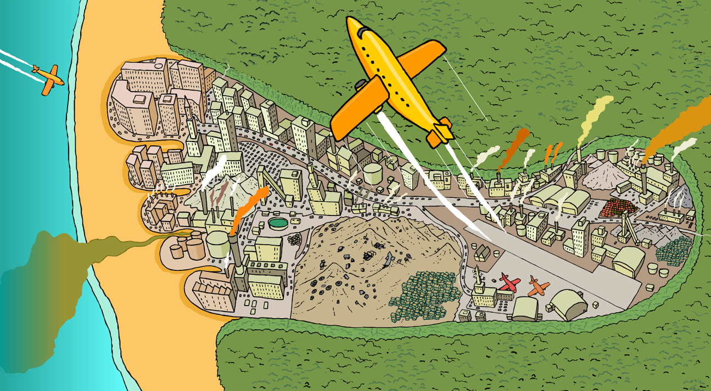
What is a carbon footprint?
As we go about our daily lives, we unknowingly contribute greenhouse gases to the atmosphere.
The total amount of greenhouse gases emitted over the life cycle of a product, service or event is the carbon footprint.

Slide 4
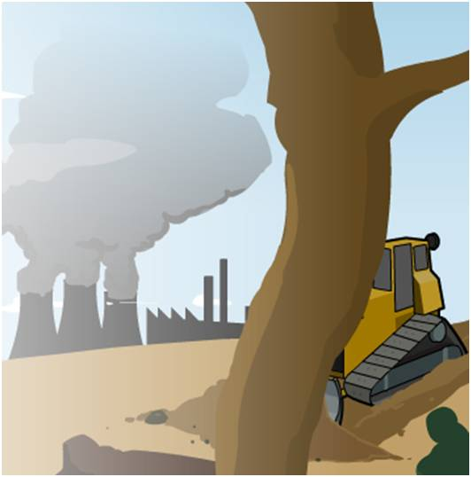
Carbon dioxide emissions
Decreasing the amount of greenhouse gas emissions will decrease the carbon footprint of human activities.
Carbon dioxide is perhaps the most well known greenhouse gas. It is produced naturally and from human activity.
Sources of carbon dioxide include:
burning of fossil fuels for heat, electricity and to power vehicles
deforestation
cement production
respiration.
Notes:
Teacher notes
For more information about carbon dioxide as a greenhouse gas please refer to The Greenhouse Effect presentation.

Slide 5
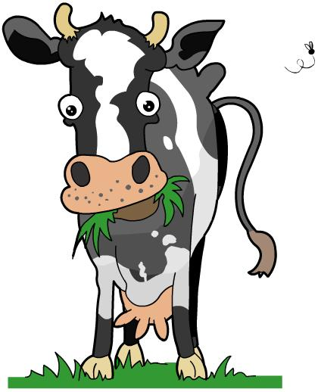
Methane emissions
Methane is a greenhouse gas commonly produced during the breakdown of organic matter.
It is a much stronger greenhouse gas than carbon dioxide, although there is much less of it in the atmosphere.
Sources of methane include:
fossil fuel production
agricultural waste
landfill sites.
Limiting methane emissions is an important step in reducing carbon footprints.

Slide 6
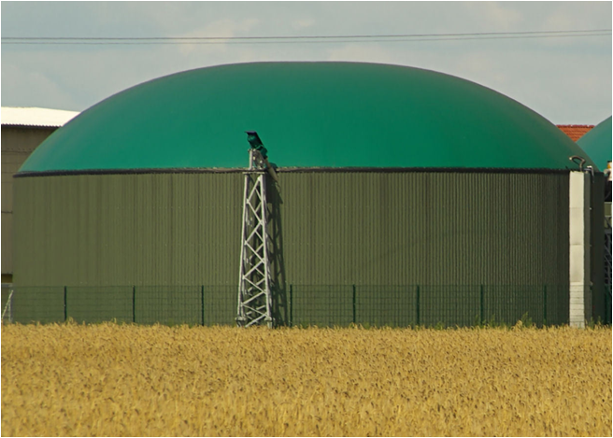
Reducing methane – anaerobic digesters
Many methods to decrease methane emission involve the capture of the gas before it is emitted into the environment.
Anaerobic bacteria grow in an airtight environment in the absence of oxygen. They “digest” cattle manure to produce biogas.
The biogas is composed largely of methane. It is used to generate electricity, or is processed further for use as a fuel.
This reduces the amount of methane emitted into the environment.
Notes:
Teacher notes
The methane gas produced is pumped into a processing facility where it can be used to generate electricity or heat. The electricity generated can be used to heat the digestion tanks or to supply the power grid.
Some discussion points for students to consider:
How do you know which farms use digesters?
Should people be more informed about farms that utilize digesters?
Should farmers have to change the type of food they feed their livestock in order to decrease methane emissions?
Should people reduce the amount of red meat they eat?
Photo credit: bacteria digestion tank © LianeM, Shutterstock.com 2018

Slide 7
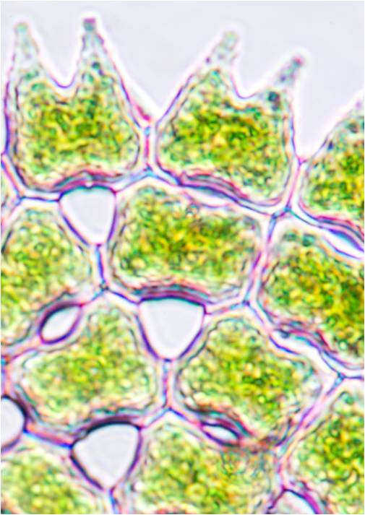
Removing carbon dioxide
Scientists are investigating ways in which the amount of carbon dioxide in the atmosphere can be reduced, including:
adding iron into the oceans to promote the growth of tiny marine organisms called phytoplankton. These organisms can photosynthesize, which means they would absorb carbon dioxide from the atmosphere.
converting carbon dioxide from power stations back into hydrocarbon fuel, using sunlight as the source of energy.
Notes:
Teacher notes
So far these methods have failed to work effectively.
This slide covers the Science and Engineering Practice:
Constructing Explanations and Designing Solutions: Design, evaluate, and/or refine a solution to a complex real-world problem, based on scientific knowledge, student-generated sources of evidence, prioritized criteria, and trade-off considerations.
Photo credit: diatoms under the microscope © PIYAPONG THONGDUMHYU, Shutterstock.com 2018

Slide 8
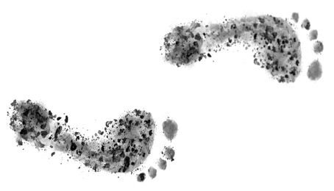
How can you reduce your carbon footprint?
Most daily activities have a carbon footprint, for example, taking the bus to school or spending time online.
How can individuals reduce their carbon footprint?
Reduce waste production.
Reuse materials instead of throwing them away.
Recycle materials.
Walking or cycling to school and work.
Limiting air travel.
Turning lights off when not in use.
Turning computers off when not in use.
Notes:
Teacher notes
Students could discuss current actions they are taking to reduce their carbon footprint, and ideas for future action they and their family could take. Ideas for discussion could include:
Reduce waste - buy less or purchase items you know can be reused or recycled.
Reusing materials, for example, using charity shops, and reusing plastic bottles and bags.
Walking or cycling and limiting air travel will reduce the amount of greenhouse gases released from the combustion of fuels.
Turning off all electrical supplies when not in use and limiting time spent using electrical items.
Eat locally produced food – this will reduce greenhouse gas emissions from the transport of food.
Cutting down the amount of meat and dairy products consumed, as these can have a larger carbon footprint than other foods.

Slide 9
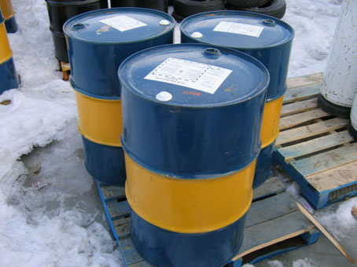
Alternative fuels
Most vehicles in the world are powered by petrol or diesel. These fuels are produced from crude oil.
Crude oil is a fossil fuel. It is non-renewable, which means it will one day run out.
Although fossil fuels are currently a convenient source of fuel, the greenhouse gases released when they are burned can be very damaging to the environment.
As a result, some people have already begun using alternative fuels such as biofuels and electricity.
Notes:
Photo credit: © Trevor MacInnis. This image is reproduced under the terms of the Creative Commons License. A copy of the license can be read at this address: http://creativecommons.org/licenses/by/3.0/

Slide 10
Alternative fuels: biofuels
Biofuels are renewable fuels produced from plant based material. Bioethanol and biodiesel are examples of biofuels used today.
Bioethanol is produced from the fermentation of crops. It is commonly added to petrol to reduce greenhouse gas emissions.
Biodiesel is produced from vegetable oils, such as rapeseed oil.
Although biofuels produce fewer greenhouse gases than normal fuels, fossil fuels are used during their production.
How will this affect their carbon footprint?
Notes:
Teacher notes
The production of biofuels is costly and requires large amounts of energy. In order for bioethanol to be used on its own, the engine must be modified which increases the cost of production. The use of bioethanol can also increase the cost of food as it is using land that would normally be used for food crops.
Biodiesel can be used in existing diesel engines without the need for modifications.
As biofuels are produced from plants, they could be described as carbon neutral. This is where the amount of carbon dioxide used up by the plant through photosynthesis balances out the amount of carbon dioxide produced during the use of the biofuel. However, as fossil fuels are burned during the production of the biofuel, the fuel has a higher carbon footprint.
This slide covers the Science and Engineering Practice:
Constructing Explanations and Designing Solutions: Design, evaluate, and/or refine a solution to a complex real-world problem, based on scientific knowledge, student-generated sources of evidence, prioritized criteria, and trade-off considerations.
Photo credit: rapeseed field © Creative Travel Projects, Shutterstock.com 2018

Slide 11
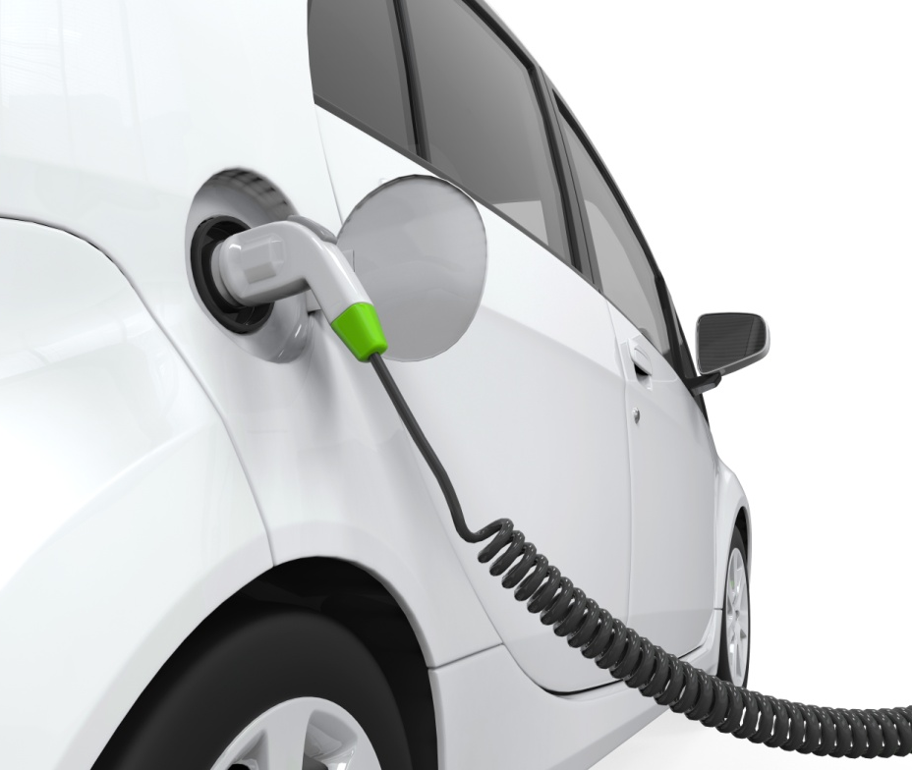
Alternative fuels: electricity
Electric cars are becoming increasingly popular. They are battery-powered vehicles that use electricity as an alternative to petrol and diesel.
This is highly efficient, and makes use of electricity by simply plugging the car into an electrical supply!
As coal and natural gas are used to produce the electricity for the national grid, battery-powered vehicles still have a carbon footprint.
How could you further decrease the carbon footprint?
Notes:
Teacher notes
Using solar panels to provide electricity for the electric car would further decrease the carbon footprint.
Photo credit: electric car © Nerthuz, Shutterstock.com 2018

Slide 12
Would you use alternative fuels?
Notes:
Teacher notes
This voting activity enables the individual opinions of the class to be represented graphically. It could be used as a precursor to a debate on the use of alternative fuels, such as how important the financial cost is.

Slide 13
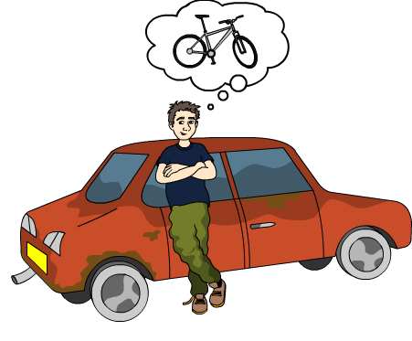
Reasons for limited action
Action by governments, individuals and businesses can all contribute towards significantly reducing greenhouse gas emissions. However, sometimes these actions may be limited.
Can you think of some reasons for this?
Lack of awareness.
Reluctance to change.
Costs involved in new equipment.
Public uncertainty about the causes of climate change.
Public uncertainty about the impact of individual actions.

Slide 14
How big is your carbon footprint?
Notes:
Teacher notes
This activity can be used to estimate how big a student or class carbon footprint is.
Further calculations can be made at the following website: http://footprint.wwf.org.uk/
This weblink was working at the time of publication. Boardworks is not responsible for the content of third party sites.

