Slide 1
Climate Systems

Slide 2
Information
Asking Questions and Defining Problems
Developing and Using Models
Analyzing and Interpreting Data
Constructing Explanations and Designing Solutions
1. Patterns
2. Cause and Effect
3. Scale, Proportion, and Quantity
4. Systems and System Models
5. Energy and Matter
7. Stability and Change

Slide 3
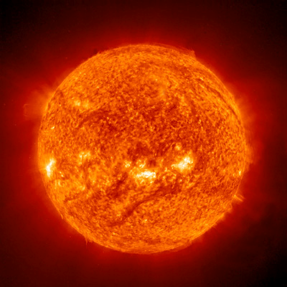
What is heat transfer?
The Sun is the external source of energy for Earth.
Energy reaching Earth drives global interaction between the atmosphere and the surface, creating wind and influencing ocean currents.
Heat is transferred by three main processes:
conduction
convection
radiation.
Notes:
Teacher notes
You might like to remind students that heat energy only flows when there is a temperature difference between a warmer area and a cooler area. For more information on heat transfer on Earth, please refer to the Understanding Earth’s Structure presentation.
Photo credit: © Ekaterina Starshaya, Shutterstock.com 2018

Slide 4
Differential heating
Radiation (solar energy) from the Sun does not hit Earth everywhere at the same time and in equal amounts.
This means that some places receive more heat while others receive less heat. This is known as differential heating.
Factors that affect the amount of energy reaching an area include:
altitude (the height of the land)
latitude (how far north or south of the Equator a place is).
Notes:
Photo credit: © kwest, Shutterstock.com 2018

Slide 5
Why is the South warmer than the North?
Notes:
This slide covers the Science and Engineering Practices:
Developing and Using Models: Use a model to provide mechanistic accounts of phenomena.
Constructing Explanations and Designing Solutions: Apply scientific ideas, principles, and/or evidence to provide an explanation of phenomena and solve design problems, taking into account possible unanticipated effects.

Slide 6
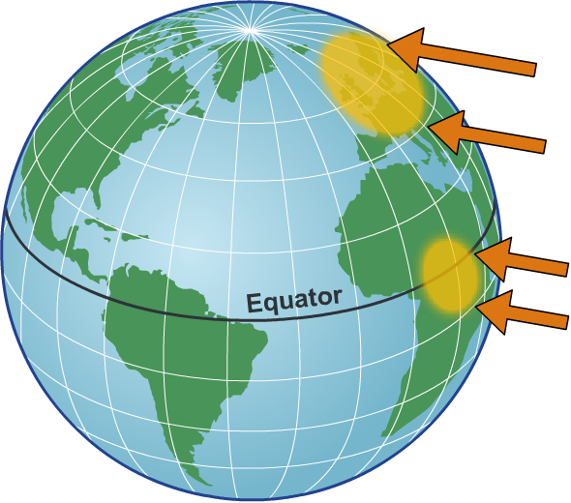
Insolation
This diagram illustrates the impact of latitude on the amount of solar energy received.
Solar energy at higher latitudes is spread out over a larger area, which means that it is less concentrated.
Lower latitudes are closer
to the Equator: the imaginary line that goes around the middle of the Earth.
Solar energy at lower latitudes is
more concentrated. The amount of solar energy received in different parts of the world is known as insolation.
Notes:
This slide covers the Science and Engineering Practices:
Developing and Using Models: Use a model to provide mechanistic accounts of phenomena.
Constructing Explanations and Designing Solutions: Apply scientific ideas, principles, and/or evidence to provide an explanation of phenomena and solve design problems, taking into account possible unanticipated effects.

Slide 7
What is climate?
The amount of solar energy received is one of the factors that influences an area’s climate. Climate is the average rainfall and temperature conditions in an area.
The Earth is divided into climate zones, which help scientists to characterize areas. They include:
arid (a hot, dry climate)
tropical (a warm climate with a distinct rainy season)
polar (a cold, dry climate).
What climate zones can be
found in the US?
Notes:
Teacher notes
Encourage students to examine the image to find the answers to this question. National borders are not shown, but all the listed climates can be found in the US, including a polar climate in Alaska and a tropical climate in southern Florida. This could be an interesting starting point for a class discussion about the variation in climate across the country. Ask students to describe the climate in other states or places they may have visited. How were they different?

Slide 8
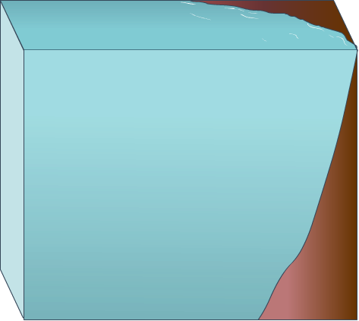
Ocean circulation
Solar radiation heating the Earth's surface also drives convection within the oceans, producing ocean currents.
There are two circulation systems in the ocean:
surface currents – these involve the top 10% of water in the ocean.
surface currents
400 m
deep currents – these occur below 400 meter depth.
deep currents
Ocean currents are called gyres. They spin clockwise in the northern hemisphere and counter-clockwise in the southern hemisphere.

Slide 9
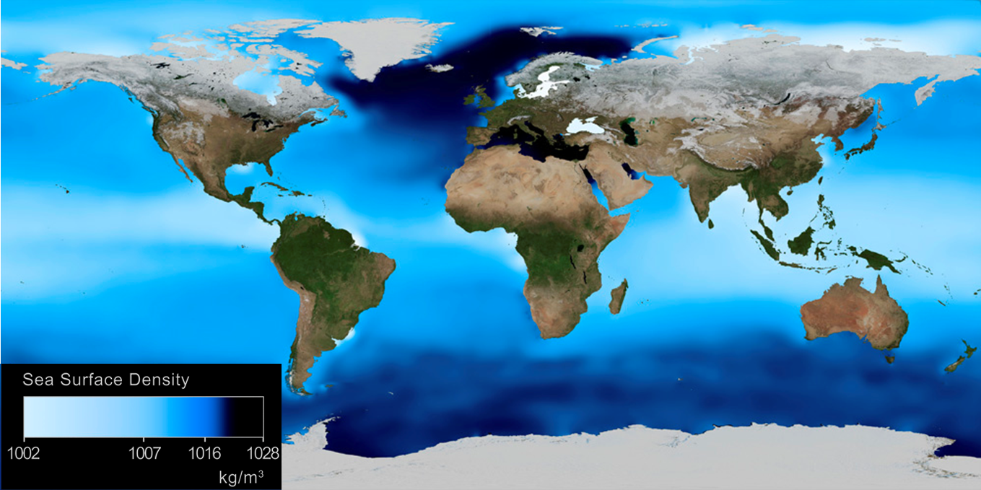
Ocean water density
The density of ocean water varies due to differences in temperature and salinity (saltiness.) Dark blue areas show regions of higher density.
What might you conclude about the link between temperature and density in ocean water?
Notes:
Teacher notes
Encourage students to use what they know about the temperature at the poles to work out that areas of high density ocean water are usually colder.
This slide covers the Science and Engineering Practice:
Asking Questions and Defining Problems: Ask questions that arise from careful observation of phenomena, or unexpected results, to clarify and/or seek additional information.
Photo credit: NASA / GSFC-SVS / SCIENCE PHOTO LIBRARY Sea surface density, global map. The density of the surface water of the world's oceans is calculated from measurements of temperature and salinity. Here, light blue regions are of low density, with darker blue being regions of high density. The results show that while the variation is relatively small, there are three stable regions of denser water, one in the north around Iceland, and the other two in the south, associated with Antarctic ice shelves. These masses of water sink, driving the Thermohaline Circulation and the world's deep ocean currents. This has a major effect on the world's climate. The data used in this map is from the World Ocean Atlas.

Slide 10
Ocean salinity
Ocean water at the poles is colder due to the effect of insolation on the Earth’s surface temperatures. However, polar ocean water is also saltier.
When water freezes, it forms ice crystals that have little room for salt molecules. The salt is left in the liquid seawater, resulting in areas with high salinity.
Salty water is denser than less salty water.
This dense water sinks and warmer water
from near the Equator moves to fill the gap.
The resulting deep current moves
water around the world’s oceans,
and is often called the global
ocean conveyor belt.

Slide 11
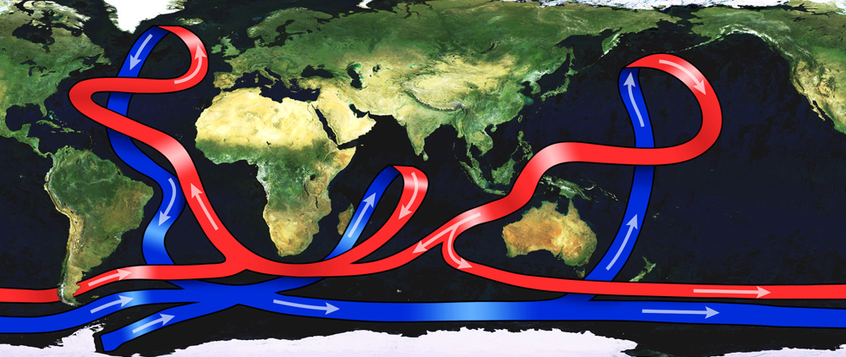
Thermohaline circulation
This image shows the major warm and cold currents of the global ocean conveyor belt. This process can be called thermohaline circulation.
Notes:
Teacher notes
As polar sea ice forms, the salt is left behind, increasing the concentration of salt in the ocean. The salty cold water is more dense than warm, fresh water and sinks to the ocean floor, pushing water through the world’s ocean like a plunger.
The global conveyor belt is thought to play a fundamental part in regulating the Earth’s climate, as it transfers heat and moisture around the planet. Some scientists predict that if this global circulation was to stop, temperatures in certain regions (including Europe) could decrease rapidly. It is thought to have stopped or changed direction in the past, causing significant changes in global temperatures.
Photo credit: Science Photo Library Satellite image of the Earth from space with a map of ocean circulation.

Slide 12
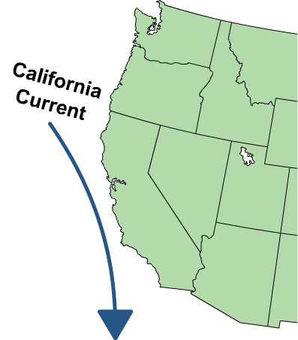
Ocean currents
Ocean currents have a big effect on climate: warm currents keep coastal areas and islands temperate, whereas cold currents do the opposite.
The California Current is an example of a major oceanic current. It brings water from the north coast of Alaska south towards the west coast.
What effect do you think this has on California’s climate?
What would happen if the California Current were to change course?
Notes:
Teacher notes
The California Current brings cold ocean water to California’s coast. Temperatures on the west coast are often several degrees cooler than the east coast during the same months.
Encourage students to consider the different ways in which the California Current could change course. For example, if it began flowing from south to north, temperatures along the west coast could significantly rise.
This slide covers the Science and Engineering Practice:
Asking Questions and Defining Problems: Ask questions that arise from examining models or a theory, to clarify and/or seek additional information and relationships.

Slide 13
What processes can affect the climate?
So far we have learned about the processes that have created habitable climates on Earth. However, climates are constantly changing, and there are a number of factors that can affect them, including:
El Niño Southern Oscillation
volcanic eruptions
human activity
solar output
changes to the Earth’s orbit or axis tilt.
What do you already know about
these processes?

Slide 14
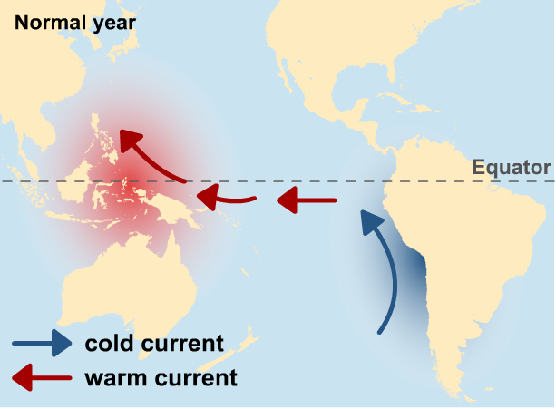
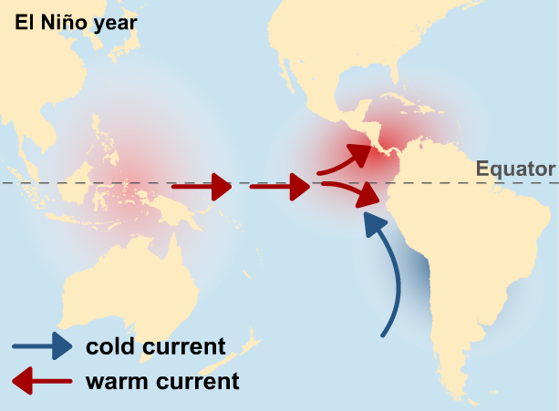
ENSO (El Niño-Southern Oscillation)
El Niño-Southern Oscillation (ENSO) refers to fluctuation in ocean temperatures in the equatorial Pacific Ocean.
ENSO has two distinct patterns:
El Niño, which leads to warmer than average Pacific sea temperatures during the winter months
La Niña, which leads to colder than average Pacific sea temperatures.
Notes:
Teacher notes
For more information about ENSO, please refer to the ENSO presentation.

Slide 15
How does ENSO affect the climate?
El Niño and La Niña climate variations occur about every two to seven years, but El Niño is more likely to happen.
Climate changes linked to El Niño include:
dry conditions in the Philippines, Australia and Indonesia
heavy rainfall in Peru, Brazil and Ecuador
tropical storms (or hurricanes) in Japan, Korea and the US.
When do you think the
last El Niño event was?
Notes:
Teacher notes
The El Niño event in 2014–2016 was named as one of the causes of the blizzards experienced by North America in the winter of 2016.

Slide 16
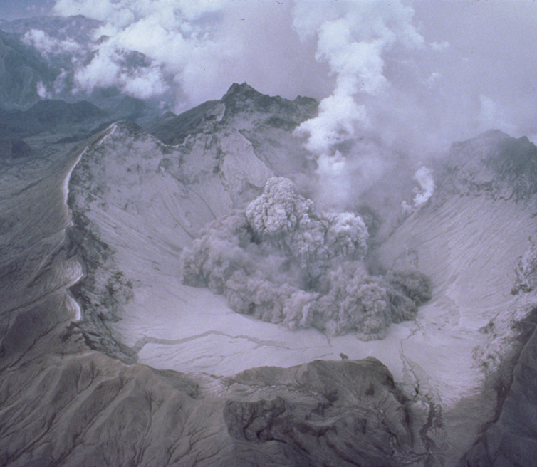
How do volcanoes affect climate?
Volcanic eruptions eject thousands of tons of dust, ash and gas into the atmosphere. This leads to an increase in the amount of solar energy reflected from the Earth (albedo), resulting in a cooling effect.
Mount Pinatubo, a volcano in the Philippines, experienced a huge eruption in 1991. The volcano ejected about 19 million tons of sulfur dioxide (SO₂) into the atmosphere, as well as clouds of ash and dust.
The eruption caused a 10% reduction in the amount of sunlight that reached the Earth’s surface in 1991.
Notes:
Photo credit: This Pinatubo caldera image is in the public domain because it was solely created by the USGS, and is reproduced free from any known copyright restrictions.

Slide 17
What is the greenhouse effect?
Notes:
Teacher notes
This animation can be used to illustrate the principles of the greenhouse effect. Students could be asked to consider the impact of rising greenhouse gases on the natural phenomenon of the greenhouse effect.
This slide covers the Science and Engineering Practice:
Developing and Using Models: Use a model to provide mechanistic accounts of phenomena.

Slide 18
What are the greenhouse gases?
Notes:
Teacher notes
This activity can be used to investigate which atmospheric gases are greenhouse gases. Traffic light colored voting cards could be used to engage the whole class in discussing which gases absorb infrared radiation before showing the animations for each gas.

Slide 19
The greenhouse effect: summary
Notes:
Teacher notes
This ordering activity can be used as an introductory or summary activity.
This slide covers the Science and Engineering Practice:
Developing and Using Models: Use a model to provide mechanistic accounts of phenomena.

Slide 20
Human activity and the greenhouse effect
The greenhouse effect is important in allowing the Earth to sustain life as we know it. Without it, the Earth would lose heat too quickly and would become too cold.
However, many human activities release large amounts of greenhouse gases into the atmosphere. These gases contribute to a process known as the enhanced greenhouse effect.
The enhanced greenhouse effect means that more solar radiation is trapped by the Earth’s atmosphere, gradually making the planet warmer.
What future problems might this lead to?
Notes:
Teacher notes
For more information about short- and long-term climate change, please refer to the Climate Change presentation.
This slide covers the Science and Engineering Practice:
Asking Questions and Defining Problems: Ask questions that arise from examining models or a theory, to clarify and/or seek additional information and relationships.

Slide 21
What activities increase greenhouse gases?
Human activities that increase greenhouse gases include:
large-scale agriculture and meat-based food production, which involves releasing large amounts of carbon dioxide (CO₂) and methane (CH₄) into the atmosphere
the burning of fossil fuels such as coal, oil and gas, which releases CO₂ and sulfur dioxide (SO₂)
deforestation: the removal of trees from an area.
Trees absorb CO₂ as part of the photosynthesis process. Cutting down trees reduces the amount of CO₂ absorbed.

Slide 22
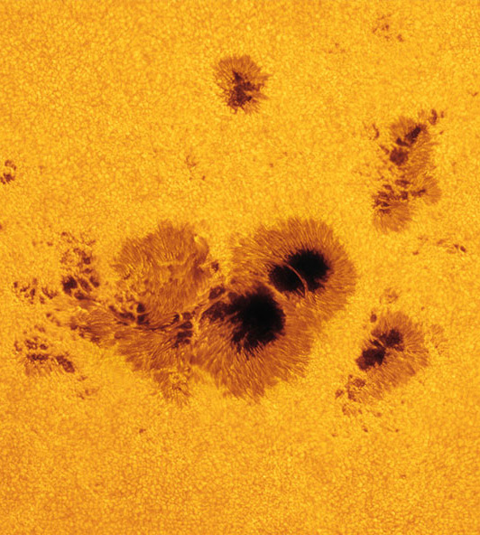
Solar output
Solar output refers to variations in the amount of energy received from the Sun due to more or less solar activity.
Scientists monitor dark patches on the Sun’s surface, called sunspots.
When there are more frequent sunspots, this can indicate increased intense solar activity.
Some scientists theorize that more sunspots could lead to changes in global climate.
However, sunspot activity
has decreased slightly in recent years.
Notes:
Photo credit: © NASA

Slide 23
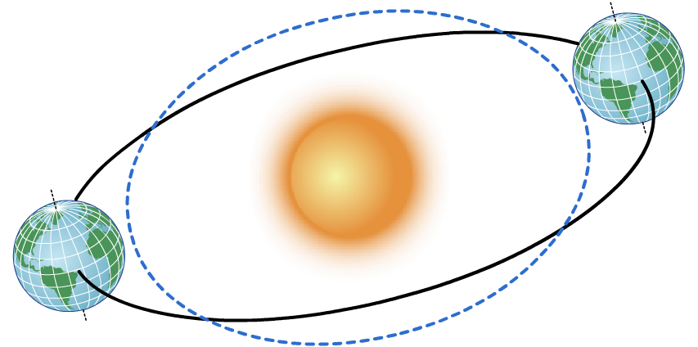
Orbital change
The Earth’s orbit around the Sun is elliptical, meaning that it is an oval rather than a circle.
Over time, this orbit adjusts slightly. This means that the distance between the Earth and the Sun varies. When the Earth is closer to the Sun, it receives more solar energy.
This process of orbital change
happens very slowly, over
a cycle of about
100,000 years.

Slide 24
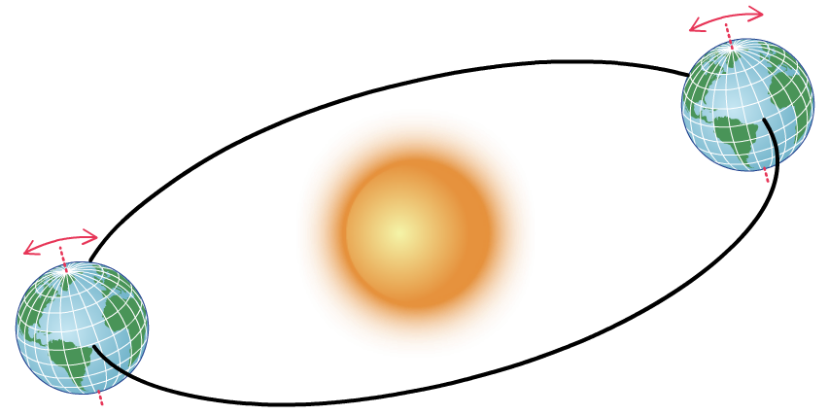
Axis tilt
Every 41,000 years, the Earth repeats a cycle of tilting back and forth on its axis.
This is a very small change: its angle tilts between about 24.5° and 21.1°. However, it is likely to affect insolation levels on different parts of the planet.
For example, a location 43° north of the Equator
might be tilted towards the Sun,
receiving more solar
radiation than usual.

Slide 25
The history of the atmosphere
Notes:
Teacher notes
For more detailed information on the composition and history of the Earth’s atmosphere, please refer to the Earth’s Atmosphere presentation.

Slide 26
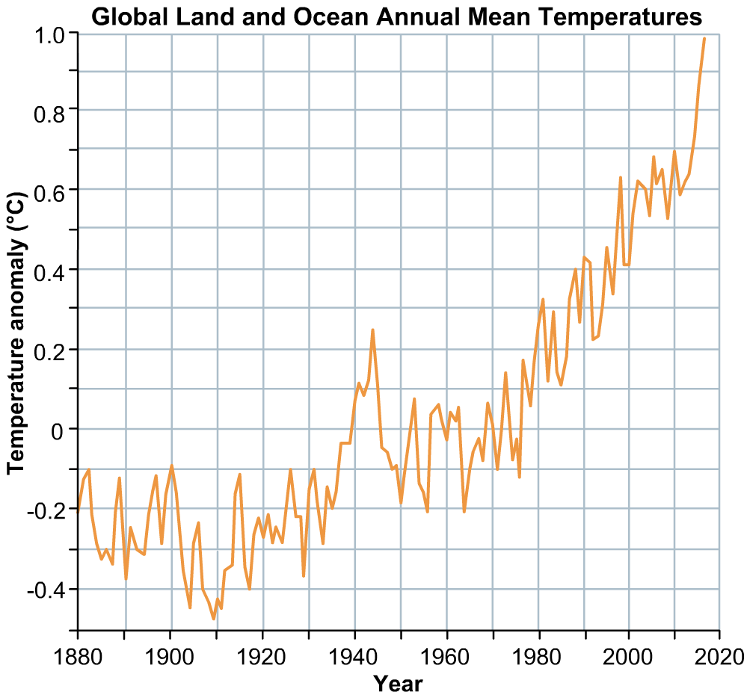
How have surface temperatures changed?
This graph shows the average global land and ocean surface temperature change between 1880 and 2018.
What general trends do you notice?
Think about some of the short-term influences on global climate you have learned about in this presentation.
Can you relate any of them to the data shown?
Notes:
Teacher notes
Students could be asked to hold up a ruler or pen to show the general upward trend of this graph. The most noticeable feature on this graph is the leap in temperatures around 1943, which could correlate with human activities during the Second World War (1939–1945).
For more information about increasing global temperatures, please refer to the Climate Change presentation.
This slide covers the Science and Engineering Practice:
Analyzing and Interpreting Data: Analyze data using tools, technologies, and/or models (e.g., computational, mathematical) in order to make valid and reliable scientific claims or determine an optimal design solution.
Data credit: NASA (Public domain data adapted and reproduced free from any known copyright restrictions.)

Slide 27
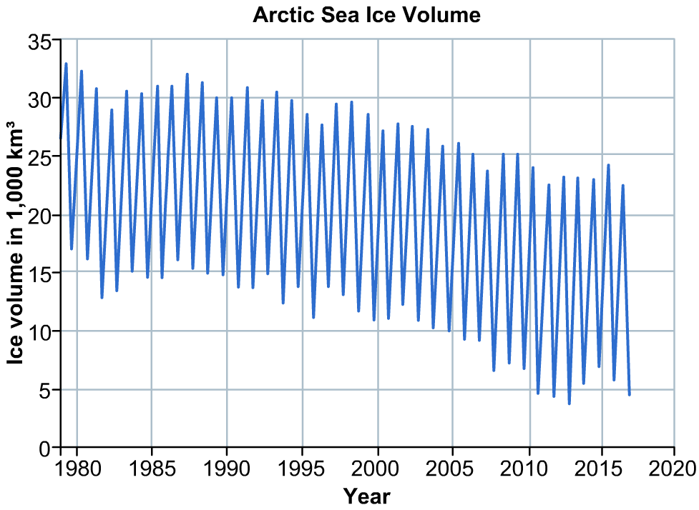
How has the volume of polar ice changed?
This graph shows the change in the volume of Arctic sea ice between 1980 and 2017.
What general trends do you notice?
When glacial and sea ice melts, it leads to rising sea levels.
What problems
might this cause for future generations?
Notes:
Teacher notes
Students could be asked to hold up a ruler or pen to show the general downward trend of this graph.
Problems associated with melting ice and sea level rise include:
increased ocean salinity and acidity
increased erosion and slumping in coastal areas
saltwater encroaching into freshwater reservoirs.
For more information about how polar ice levels and climate change can lead to feedback loops that cause further change, see the Feedback Systems presentation.
This slide covers the Science and Engineering Practice:
Analyzing and Interpreting Data: Analyze data using tools, technologies, and/or models (e.g., computational, mathematical) in order to make valid and reliable scientific claims or determine an optimal design solution.
Data credit: NOAA (Public domain data adapted and reproduced free from any known copyright restrictions.)

Slide 28
True or false?
Notes:
Teacher notes
This true-or-false activity could be used as a review, or at the start of class to gauge students’ existing knowledge of the subject matter. Colored traffic light cards (red = false, yellow = don’t know, green = true) could be used to make this a whole-class exercise.

