Slide 1
ENSO

Slide 2
Information
Developing and Using Models
1. Patterns
4. Systems and System Models
7. Stability and Change

Slide 3
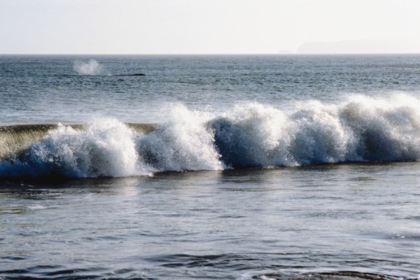
What is ENSO?
ENSO stands for El Niño Southern Oscillation. It refers to all changes in water temperature and sea level air pressure in the Pacific Ocean.
Temperatures in the Pacific Ocean “oscillate,” or swing, between extremes. This cycle is the Earth’s way of maintaining a natural equilibrium, or balance, between these extremes.
Changes in ocean surface temperature disrupt air currents and pressure systems, which can affect weather patterns around the world.
Notes:
Photo credit: Jupiterimages Corporation

Slide 4
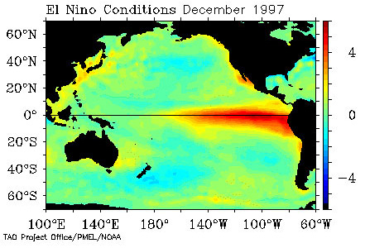
El Niño and La Niña
Normally, the Pacific is warm in the west and cool in the east. The ENSO cycle includes both warming and cooling events.
El Niño occurs when warm water built up in the west moves east, warming the surface waters of the Pacific.
La Niña occurs when cool water from the east moves west, cooling the surface waters of the Pacific.
El Niño and La Niña are part of the Earth’s way of maintaining temperature and pressure equilibrium in the Pacific Ocean.
Notes:
Teacher notes
El Niño, meaning “the Christ child” was so named by the Peruvian fishermen who first noticed the phenomenon. The fishermen used this name because El Niño occurs during the winter months, around Christmas. It occurs about every 2–7 years.
Photo credit: National Oceanic and Atmospheric Administration

Slide 5
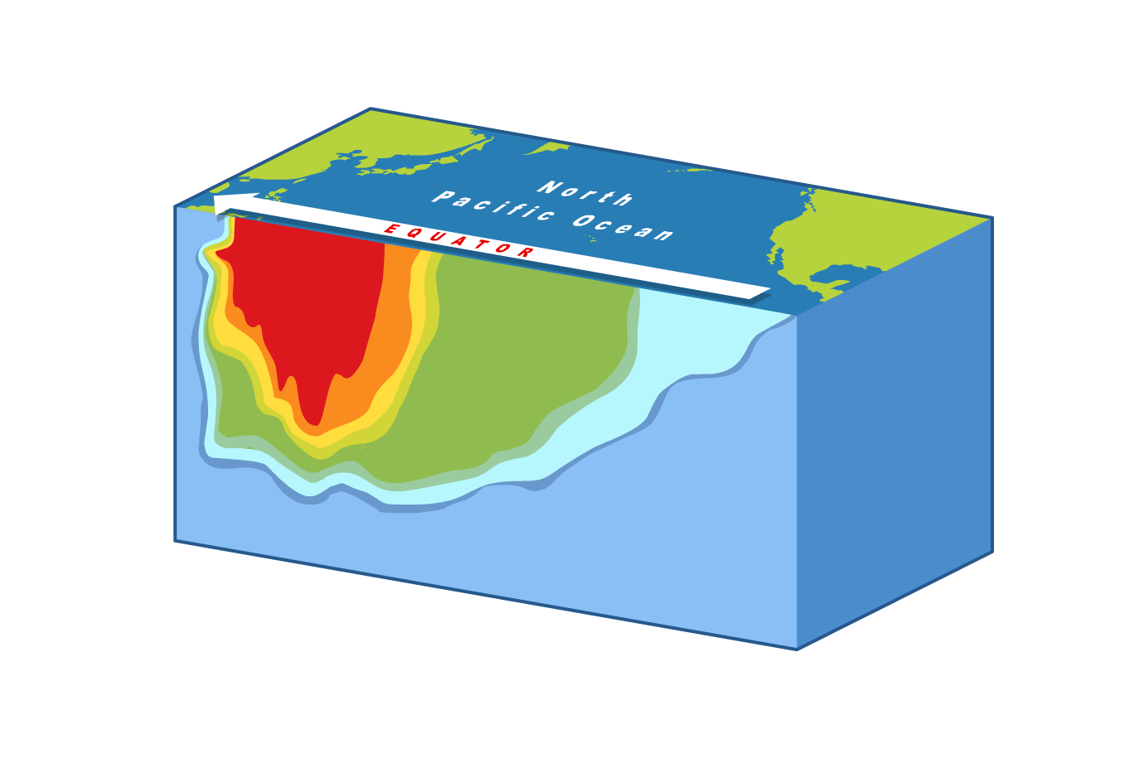
Normal conditions
Normally, strong Pacific winds move cool water from eastern equatorial regions to the west, where the water is warmer.
Because warm water takes up more space than cold, the western Pacific is usually about half a meter higher and 8 °C warmer than it is in the east.
Scientists define ocean temperature differences with an imaginary line called a thermocline, which marks the divide between warm upper ocean layers and the cold, deeper water below.
Under normal conditions, the thermocline is deep in the western Pacific and shallow in the east.
Notes:
Teacher notes
The thermocline concept can be a difficult one to grasp. It is worth explaining to students that the thermocline is used to define the difference between two distinct layers of ocean water. The upper, mixed layers are warmer, and generally maintain a similar temperature to the surface water above. Below this, the deep ocean layer is much colder. In both these regions, temperatures are relatively homogenous. Between these two regions is the thermocline: a transition layer that separates the warm and cold layers.
Therefore, a shallow thermocline means that cold water is close to the surface, while a deep thermocline means that the upper, mixed layer of warmer water is very deep.
Students might need to be reminded that warm water takes up more space than cold because its particles are moving faster and are further apart, making it less dense.
It should be made clear to students that Pacific winds are not the only factor affecting ocean movement and temperature. The Coriolis effect, the movement of polar ocean currents, and upwelling all play integral parts in temperature distribution in the Pacific Ocean.

Slide 6
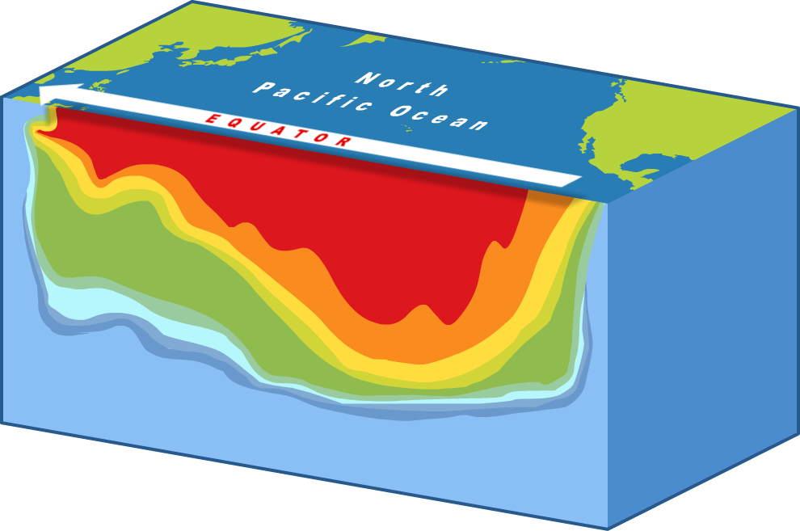
El Niño conditions
During an El Niño event, the westerly winds weaken, allowing warm water to move east, heating the surface waters off the coast of the Americas.
The thermocline flattens as surface temperatures grow warmer across the Pacific. Upwelling no longer brings cold water to the surface. These temperature changes disrupt normal air and ocean currents.
El Niño ends when the Earth’s rotation naturally moves water away from the equator, bringing cold water closer to the surface and strengthening westerly winds once more.
Notes:
Teacher notes
Ocean water naturally moves away from the equator due to the rotation of the Earth. As surface water moves away from the equator and into the Northern and Southern Hemispheres, colder water is brought to the surface. This process is called equatorial upwelling.
Coastal upwelling occurs at certain coasts, such as the Pacific Coast of the U.S. Here, surface water is pushed away by coastal winds and deeper water is forced to the surface. This process contributes to the cooler waters in the Eastern Pacific.

Slide 7
Formation of El Niño
Notes:
This slide covers the Science and Engineering Practice:
Developing and Using Models: Use a model to provide mechanistic accounts of phenomena.

Slide 8
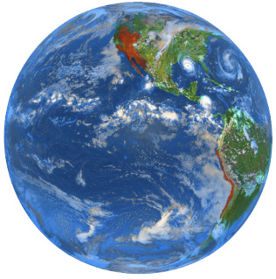
Changes in weather patterns
Warm ocean surface water adds heat and moisture to the air above it. This warm, moist air rises, producing areas of low pressure and thunderstorm activity.
Cold water cools the air above it. This cool, dry air sinks, creating high-pressure areas with no precipitation.
An El Niño event changes the distribution of warm and cold water in the Pacific, thereby changing the high and low pressure areas in the atmosphere. These changes influence the wind patterns, or jet streams, that affect the weather around the world.
Notes:
Photo credit: Jupiterimages Corporation

Slide 9
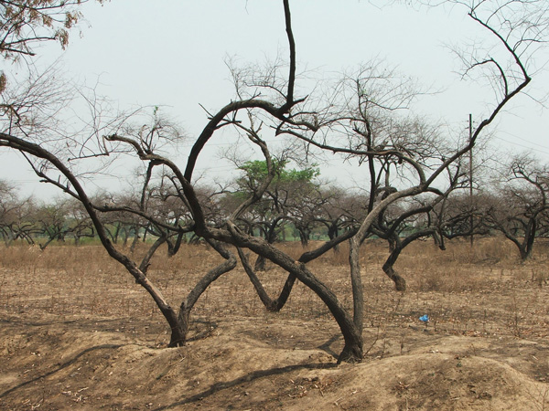
Impacts on weather
The redistribution of high and low pressure systems caused by an El Niño event can cause major changes in global weather.
In general, El Niño causes increased precipitation in western South America, Central America, and the southern United States.
Temperatures are higher and precipitation is lower in the northern United States and Canada.
There is below average precipitation in Africa, Asia and Australia, which can result in serious droughts.
Notes:
Photo credit: © saleem taqvi, FreeImages.com 2018

Slide 10
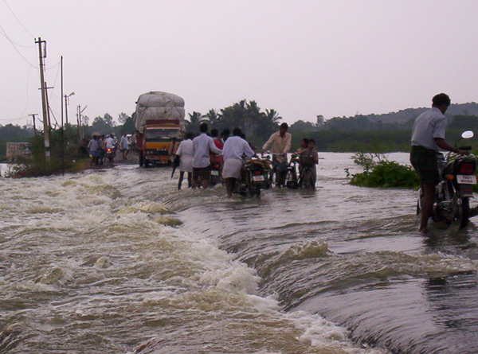
Impacts on societies
Peru and its neighbors often receive the first and worst effects of El Niño. Increased precipitation causes flooding and landslides, which can destroy entire villages. Disruptions in the upwelling of deep, nutrient-rich water kills the anchovies that are a major staple of the Peruvian economy.
1982–3 saw one of the worst El Niños on record. Major floods and landslides swept the western coast of the Americas, while droughts led to loss of crops and even famine in Africa, India, Asia and Australia.
Notes:
Teacher notes
The other major El Niño event of the twentieth century occurred in 1997–8. Like the 1982–3 event, it caused droughts and floods around the world, resulting in widespread famine, mudflows, landslides and even wildfires. Both of these El Niño events left thousands dead and many more homeless.
Photo credit: © guru thilak, FreeImages.com 2018

Slide 11
Fill in the blanks

Slide 12
Stages of El Niño

