Slide 1
Earthquakes

Slide 2
Information
Asking Questions and Defining Problems
Developing and Using Models
Analyzing and Interpreting Data
Constructing Explanations and Designing Solutions
1. Patterns
2. Cause and Effect
4. Systems and System Models

Slide 3
What are earthquakes?

Slide 4
Where do earthquakes occur?
Notes:
Teacher notes
Students should be encouraged to describe the patterns of earthquake activity on a global scale as shown on the map. Most earthquakes are felt on or near plate boundaries. This could be extended through discussion of the movement of the world’s major tectonic plates. Students could be encouraged to ‘build’ maps similar to the one shown here. Students could mark ‘active zones’ on a world map showing population distribution, and label where densely settled populations overlap with earthquake zones.
This slide covers the Science and Engineering Practice:
Asking Questions and Defining Problems: Ask questions that arise from careful observation of phenomena, or unexpected results, to clarify and/or seek additional information.

Slide 5
Seismic waves
Notes:
Teacher notes
Love waves are surface seismic waves that cause horizontal shearing of the earth. They are named after the mathematician A.E.H. Love, who proved their existence.

Slide 6
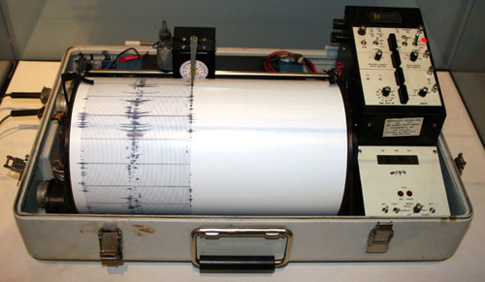
How are earthquakes measured?
The Richter scale can be used to measure the magnitude (power) of an earthquake’s tremor using an instrument called a seismograph. The Richter scale classifies earthquakes by magnitude from 1–10.
It is a logarithmic scale, which means that a scale 6 earthquake on the Richter scale is 10 times larger than a scale 5 and 100 times larger than a scale 4.
Do you know what the results and impacts of earthquakes of different scales are?
Notes:
Teacher notes
The Richter scale highlights the following effects at these magnitudes:
1–3: normally only detected by instruments
4: faint tremor causing little damage
5: noticeable shaking and rattling, some structural damage to poorly-constructed buildings
6: poorly constructed buildings can collapse
7: can cause damage over an area of at least 100 miles
8: large buildings collapse, can cause serious damage over several hundred miles
9: ground seen to shake, can cause devastation over an area of at least 1000 miles
10: total devastation
The Moment Magnitude scale was developed in the 1970s as a successor to the Richter scale. However, opinion is divided over which to use. They are both logarithmic scales, but the Moment Magnitude scale doesn’t end at 10.
As an extension activity, you may wish to ask students to research some of the world’s most devastating earthquakes. This will give them a better sense of how much damage earthquakes of different magnitudes cause and get them to start thinking about the death toll and other consequences of earthquakes.
A list of the largest recorded earthquakes can be found at this address: http://earthquake.usgs.gov/regional/world/10_largest_world.php
This weblink was working correctly at the time of publication. Boardworks takes no responsibility for the content of external sites.
Photo credit: © Yamguchi. This image is reproduced under the terms of the GNU Free Documentation License. A copy of the license can be read at this address: http://commons.wikimedia.org/wiki/Commons:GNU_Free_Documentation_License

Slide 7
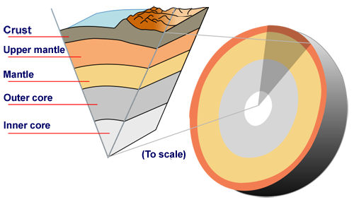
The causes of earthquakes
Earthquakes occur when rocks in the Earth’s crust move suddenly. There are two main types of crust:
oceanic crust: mostly made of basalt, it is found under the oceans and continents
continental crust: mostly made of granite, it is found on the top layer of continents.
The crust is the outermost layer of the Earth. Continental crust is less dense than oceanic crust and as a result it rises above it where they meet.
Notes:
Image credit: © Surachit. This image is reproduced under the terms of the Creative Commons License. A copy of the license can be read at this address: http://creativecommons.org/licenses/by-sa/3.0/

Slide 8
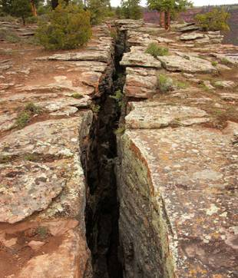
Plate movements
The plates that make up the Earth’s crust are moving towards or away from each other at a rate of a few millimeters a year.
It is believed convection currents in the Earth’s mantle cause the plates to move. The movement is not smooth, and sudden movements cause earthquakes.
There are four types of plate boundary:
convergent boundary (subduction)
convergent boundary (collision)
divergent boundary
conservative boundary.
Notes:
Teacher notes
Convergent boundaries are also known as destructive boundaries, divergent boundaries are also known as constructive boundaries and conservative boundaries are also known as transform boundaries.
For more information about plate movements, please refer to the Plate Tectonics presentation.
Photo credit: © Lee Prince, shutterstock.com 2018

Slide 9
Convergent subduction boundaries
Notes:
This slide covers the Science and Engineering Practice:
Developing and Using Models: Develop, revise, and/or use a model based on evidence to illustrate and/or predict the relationships between systems or between components of a system.

Slide 10
Convergent collision boundaries
Notes:
This slide covers the Science and Engineering Practice:
Developing and Using Models: Develop, revise, and/or use a model based on evidence to illustrate and/or predict the relationships between systems or between components of a system.

Slide 11
Divergent boundaries
Notes:
This slide covers the Science and Engineering Practice:
Developing and Using Models: Develop, revise, and/or use a model based on evidence to illustrate and/or predict the relationships between systems or between components of a system.

Slide 12
Conservative boundaries
Notes:
This slide covers the Science and Engineering Practice:
Developing and Using Models: Develop, revise, and/or use a model based on evidence to illustrate and/or predict the relationships between systems or between components of a system.

Slide 13
Identifying earthquake effects
Notes:
Teacher notes
The primary effects in the picture are the collapsed buildings, broken bridge and damaged power lines, because all of these resulted from the immediate impact of the earthquake. The secondary effects are the fire, due to a broken gas pipe, landslide and tsunami. Most of the injuries and deaths that occur during and after an earthquake area are a result of primary effects, such as people being hit by falling roofs or being trapped in collapsed buildings. Secondary effects are not always instant but they can add significantly to the death toll.

Slide 14
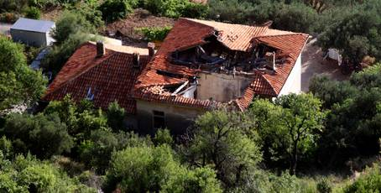
The impact of earthquakes
The impacts caused by earthquakes can often be split into three categories:
physical
social
economic.
Does an earthquake’s magnitude affect its impact?
The higher the magnitude of an earthquake, the greater the physical, social and economic impacts.
Physical and human factors will also have an effect on the scale of the damage caused by the earthquake.
Notes:
Photo credit: © Petr Nad, Shutterstock.com 2018

Slide 15
Physical and human factors
Notes:
Teacher notes
This drag and drop activity is printable either as a solved answer sheet (when the print button is pressed after the activity has been solved) or as an unsolved worksheet at any other time.

Slide 16
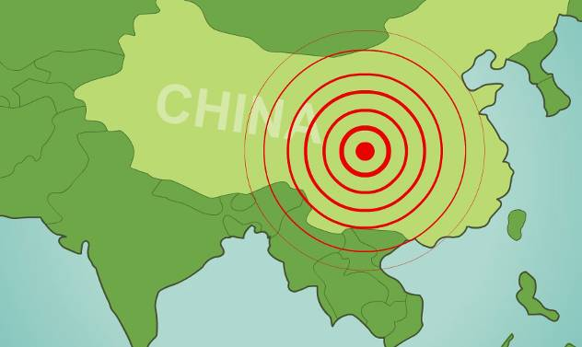
Sichuan earthquake, China 2008
Earthquake Fact File
Location: northwest of Chengdu, the capital of Sichuan Province, China
Date: May 12th 2008
Magnitude: 7.9 magnitude
Time: 2:28pm (local time)
Deaths: 68,712 people (18,000 still listed as missing)

Slide 17
Impacts of the Sichuan earthquake
Notes:
Photo credits: destroyed house © Miniwiki. This image is reproduced under the terms of the Creative Commons License. A copy of the license can be read at this address: http://creativecommons.org/licenses/by/3.0/; Tiananmen Square memorial service © Neo-Jay. This image is reproduced under the terms of the GNU Free Documentation License. A copy of the license can be read at this address: http://commons.wikimedia.org/wiki/Commons:GNU_Free_Documentation_License; destroyed school © Archey Firefly. This image is reproduced under the terms of the Creative Commons License. A copy of the license can be read at this address: http://creativecommons.org/licenses/by/2.0/

Slide 18
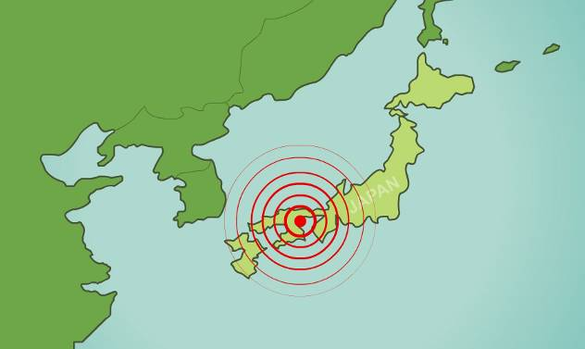
Kobe earthquake, Japan 1995
Earthquake Fact File
Location: 20 km from Kobe, the capital of Hyōgo Prefecture, Japan
Date: January 17th 1995
Magnitude: 7.2 magnitude
Time: 5:46am (local time)
Deaths: 6,434 people (36,000–40,000 injured).

Slide 19
Impacts of the Kobe earthquake
Notes:
Photo credits: Kashiwai building just before its collapse © BetacommandBot. This image is reproduced under the terms of the Creative Commons License. A copy of the license can be read at this address: http://creativecommons.org/licenses/by-sa/2.5/; ten year memorial ceremony © Aphaia. This image is reproduced under the terms of the GNU Free Documentation License. A copy of the license can be read at this address: http://commons.wikimedia.org/wiki/Commons:GNU_Free_Documentation_License; city centre street damage © BetacommandBot. This image is reproduced under the terms of the Creative Commons License. A copy of the license can be read at this address: http://creativecommons.org/licenses/by-sa/2.5/

Slide 20
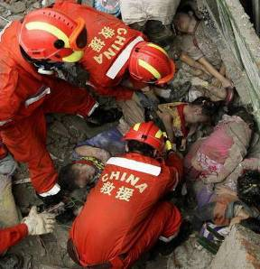
Comparing impacts: China and Japan
The Sichuan earthquake had such a severe impact due primarily to the magnitude of the earthquake. The Chinese government’s rapid response was widely praised, but experts blamed poor quality design and construction of buildings.
The Kobe earthquake had such severe impacts because the focus was only
30 km below the Earth’s surface and situated close to Kobe, a very densely populated city. The devastation occurred in spite of high quality building design, seen by Japan as a necessity due to its location near three plate boundaries.
How might earthquakes be better managed?
Notes:
Teacher notes
The question aims to get students to think about how earthquakes can be managed. Building design and construction is important as the ability to withstand impact is important. Management and reactions to the situation can be handled well, but expect students to point out that better planning and preparation for earthquakes will reduce the scale of the problem in the first place. Positive cooperation between the different groups involved, such as governments, scientists and earthquake experts, emergency services, charities and aid agencies can also improve the way in which earthquakes are managed.
Photo: © Divine Rapier. This image is reproduced under the terms of the Creative Commons License. A copy of the license can be read at this address: http://creativecommons.org/licenses/by/2.0/

Slide 21
Tsunamis
Notes:
This slide covers the Science and Engineering Practice:
Developing and Using Models: Develop, revise, and/or use a model based on evidence to illustrate and/or predict the relationships between systems or between components of a system.

Slide 22
Indian Ocean tsunami 2004

Slide 23
Physical impact
Notes:
Photo credits: satellite photos of Lhoknga, Indonesia. These images are in the public domain because they were created by NASA and Ikonos Images, Centre for Remote Imaging, Sensing and Processing, National University of Singapore and Space Imaging

Slide 24
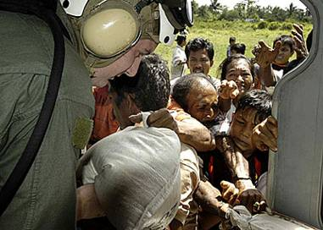
Social and economic impact
The tsunami caused devastation all across the Indian Ocean, destroying homes, businesses, schools, hospitals and other infrastructure. Local industries, particularly fishing, plantation farms and tourism were badly hit, damaging economies. Roads were destroyed and the coastal railway in Sri Lanka was wrecked.
The World Bank estimated that Sri Lanka alone would need
$1.5 billion to rebuild housing, transport links and local industries and infrastructure.
What other impacts did the tsunami have? How was the tsunami managed?
Notes:
Teacher notes
The tsunami had a huge environmental impact and the affected areas took many years to recover. Ecosystems such as mangroves, coral reefs and forests were affected by both physical damage and the large amount of saltwater that has infiltrated them. The salination of freshwater also damaged the infrastructure by affecting drinking water supplies. The high salt content added to the soil also reduced its fertility, damaging its agricultural value.
A large amount of humanitarian aid was provided from all over the world to rebuild the infrastructure and provide fresh food and water. Sanitation had to be provided in order control the spread of diseases, but this was successfully managed due to the quick response. An estimated $13.5 billion was given internationally, making it the most generous international humanitarian response ever. However, funds were not always directed to the people who needed them most. Long term recovery and reconstruction was the most pressing need, but large amounts were diverted into short term emergency needs. This has been blamed on poor communications between different organizations and the affected governments and a desire by many groups to show that the donations they made were having a visible effect.
There were no tsunami detection systems in the Indian Ocean so there was no advance warning of it, which caused a high death toll because there was no time to evacuate. Tsunamis are difficult to detect due to the fact that in deep water their wave height is not that great. In the aftermath of the tsunami the United Nations began work on an Indian Ocean tsunami detection system in order to better manage future disasters.
A report into the development of a tsunami detection system can be found at this address: www.esri.com/library/whitepapers/pdfs/gis-and-emergency-mgmt.pdf
A variety of articles on the impacts of the Indian Ocean tsunami can be found at this address: www.wiley.com/bw/vi.asp?ref=0361-3666&site=1
These weblinks were working correctly at the time of publication. Boardworks takes no responsibility for the content of external sites.
Photo: © simminch. This image is reproduced under the terms of the Creative Commons License. A copy of the license can be read at this address: http://creativecommons.org/licenses/by/2.0/

Slide 25
Managing earthquakes
There are four main ways of managing earthquakes:
technology: in the 1970s it was hoped that technology and engineering skills could control earthquakes, but seismic activity still proves impossible to control
reduce vulnerability: this can be done by building expensive earthquake-proof buildings and infrastructure
improved prediction: heavy investment in research, e.g. remote sensing by satellites, is used to view small crust movements
modify the loss: seismologists work with insurance companies to calculate risk and cost premiums.
Notes:
Photo credit: © Supri Suharjoto, Shutterstock.com 2018

Slide 26
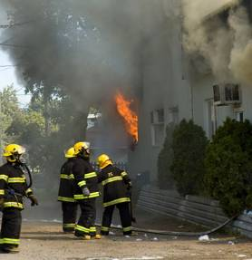
Being prepared
Being prepared means detailed planning and testing of short- and long-term responses.
Short-term responses:
storage of emergency supplies
emergency action plans.
Long-term responses:
education about how to react
safer building design and construction
development plans in vulnerable areas.
Involving the local community is important for all responses. This could include training them in skills such as first aid and firefighting and making them aware of emergency plans.
Notes:
Teacher notes
An example of a good preparation scheme is that of the California Earthquake Program. It was founded in 1993 to provide planning and technical assistance for hazards. California has a large fault - the San Andreas Fault - running through the state, through San Francisco and close to Los Angeles. The Program concentrates its efforts in the most vulnerable areas of the state. Members of the Program work with a variety of local and regional organizations, including governments, businesses, hospitals, schools, local community organizations and individuals. They address tasks such as preparation and emergency action plans, emergency response, hazard reduction, temporary shelter and housing and post-disaster recovery.
Photo credit: © Pierdelune, Shutterstock.com 2018

Slide 27
Building safer structures
Earthquakes continue to damage or destroy buildings, bridges, roads and other structures.
The United States Geological Survey (USGS) monitors how structures respond to earthquakes and applies the knowledge gained to improve the ability of structures to survive major earthquakes.
San Francisco’s Transamerica Pyramid was built to withstand earthquakes. It swayed but was not damaged by the 1989 earthquake in Loma Prieta, California.
What makes a building strong? Why is a pyramid the best shape to withstand earthquakes?
Notes:
Teacher notes
Properties which make a building strong include deep foundations, strong lintels and overlapping bricks. Shorter buildings are stronger because shock waves increase as they travel up buildings, making tall buildings more vulnerable. Pyramid-shaped buildings have a wide base, which lowers the center of gravity and increases its stability, making it the best shape to withstand earthquakes.
In developed countries like Japan, buildings are designed and engineered to withstand the vibrations of an earthquake. In developing countries like China, buildings are often less rigidly constructed and made from cheap, readily available materials, such as mud or stone. They are therefore prone to collapsing easily.
This slide covers the Science and Engineering Practice:
Constructing Explanations and Designing Solutions: Design, evaluate, and/or refine a solution to a complex real-world problem, based on scientific knowledge, student-generated sources of evidence, prioritized criteria, and trade-off considerations.
Analyzing and Interpreting Data: Analyze data to identify design features or characteristics of the components of a proposed process or system to optimize it relative to criteria for success.
Photo credit: © Mfield. This image is reproduced under the terms of the GNU Free Documentation License. A copy of the license can be read at this address: http://commons.wikimedia.org/wiki/Commons:GNU_Free_Documentation_License

Slide 28
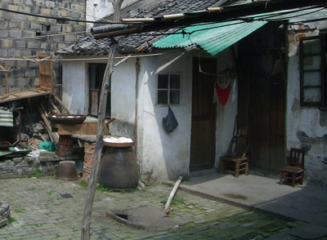
Comparing earthquake management
Developed countries have been able to employ advanced building techniques to minimize the devastation caused by earthquakes. These techniques are very expensive.
High demand for housing in developing countries and poor economic conditions mean that many buildings are poorly constructed. People cannot afford the expensive building techniques that are employed in developed countries.
Can you think of other reasons why developing countries do not manage earthquakes as well?
Notes:
Teacher notes
As well as safer buildings being more expensive, the building standards are more difficult to enforce, particularly in remote areas. Developing countries are also less likely to be able to afford the technologies required to predict and cope with the aftermath of an earthquake. Many developing countries in earthquake zones have other priorities that are in need of both financial and political attention, such as HIV/AIDS, disease, famine, infant mortality and malnutrition. Therefore planning and implementing earthquake management strategies are often lower down on the list of priorities. The infrastructure in developing countries is not as strong, so communication between different groups, such as the government, emergency services and aid agencies may not be as effective.
Photo credit: © Augapfel. This image is reproduced under the terms of the Creative Commons License. A copy of the license can be read at this address: http://creativecommons.org/licenses/by/2.0/

Slide 29
Stakeholders
Notes:
Teacher notes
There are no correct answers for this activity, but students should be able to justify their answers and explain why they think different stakeholders would complement or come into conflict with each other. It might also be worth asking students if they think the country that the stakeholders are in will make a difference. For example, a strict government such as China’s might be more likely to come into conflict with either the UN or aid agencies.
Image credits: © Nicemonkey, Shutterstock.com 2018

