Slide 1
Earth’s Atmosphere

Slide 2
Information
Developing and Using Models
Constructing Explanations and Designing Solutions
Engaging in Argument from Evidence
2. Cause and Effect
5. Energy and Matter
7. Stability and Change

Slide 3
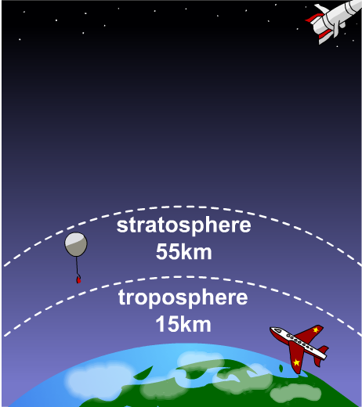
What is the atmosphere?
The Earth is different to the other planets in our solar system because it has an atmosphere that can support life.
The atmosphere is an envelope of different gases (air) surrounding Earth.
80% of atmospheric gases are within 15 km of Earth. This is a very thin layer compared to the Earth’s diameter, which is approximately 12,756 km.

Slide 4
What is air made from?
The air is made up of a mixture of gases. These gases are small molecules, which have large spaces between them.
The gases which make up the air are:
oxygen, O₂
nitrogen, N₂
argon, Ar
small proportions of carbon dioxide, water vapor and other gases.
The proportions of these gases in the atmosphere have remained roughly the same for the last 200 million years.

Slide 5
What is the atmosphere made of?
The gases that make up the atmosphere are present in the following amounts:
the remaining 1% is mostly argon (0.93%) with some carbon dioxide (0.04%), varying amounts of water vapor and trace amounts
of other gases
about 21% is oxygen
about 78% is nitrogen

Slide 6
Atmosphere – true or false?
Notes:
Teacher notes
This true-or-false activity could be used as an introductory or summary activity on the composition of the atmosphere, or at the start of the lesson to gauge students’ existing knowledge of the subject matter. Colored traffic light cards (red = false, yellow = don’t know, green = true) could be used to make this a whole-class exercise.

Slide 7
The early atmosphere
As there were no humans to measure the Earth’s atmosphere 4 billion years ago, scientists must use indirect methods to determine how the atmosphere originally formed.
Based on different evidence, there are several theories about how the atmosphere was formed.
One theory suggests that intense volcanic activity, during the first billion years of Earth’s existence, released gases which formed the early atmosphere.
Notes:
This slide covers the Science and Engineering Practice:
Developing and Using Models: Develop, revise, and/or use a model based on evidence to illustrate and/or predict the relationships between systems or between components of a system.

Slide 8
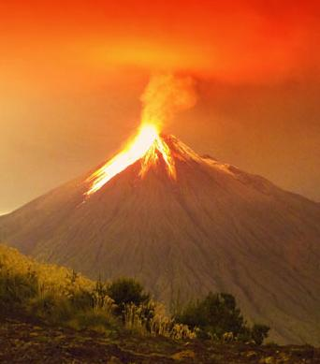
The volcano theory
Present day volcanoes release vast amounts of gases, including: water vapor, carbon monoxide, carbon dioxide, methane, nitrogen, ammonia and sulfur gases.
It is believed that volcanoes present billions of years ago also released these gases.
The nitrogen gradually built up in the atmosphere, and the water vapor condensed to form the oceans as the Earth cooled.
Little or no oxygen was present in the Earth’s early atmosphere!
Notes:
This slide covers the Science and Engineering Practice:
Developing and Using Models: Develop, revise, and/or use a model based on evidence to illustrate and/or predict the relationships between systems or between components of a system.
Photo credit: Ammit Jack, Shutterstock.com 2018

Slide 9
The history of the atmosphere
Notes:
Teacher notes
This timeline can be used to introduce work on the Earth’s atmosphere and to help convey a sense of the timescale involved.
This slide covers the Science and Engineering Practices:
Developing and Using Models: Develop, revise, and/or use a model based on evidence to illustrate and/or predict the relationships between systems or between components of a system.
Engaging in Argument from Evidence: Construct, use, and/or present an oral and written argument or counter-arguments based on data and evidence.

Slide 10
Evolving atmosphere
Notes:
Teacher notes
This ordering activity could be used as an introductory or summary activity to assess students’ understanding of the evolution of the atmosphere. Students could work individually or in small groups. Mini-whiteboards could be used to convey answers.
This slide covers the Science and Engineering Practice:
Engaging in Argument from Evidence: Construct, use, and/or present an oral and written argument or counter-arguments based on data and evidence.

Slide 11
Evidence for Earth’s early atmosphere
Notes:
Teacher notes
Different types of evidence have been used to gain an understanding of how the Earth’s atmosphere originally formed and has developed over time. Use this mind map to find out more about the different types of evidence used.
It is believed that when the oceanic dissolved iron stores were exhausted, oxygen was released into the atmosphere.
This slide covers the Science and Engineering Practice:
Engaging in Argument from Evidence: Construct, use, and/or present an oral and written argument or counter-arguments based on data and evidence.
Photo credit: stromatolite fossil © Bildagentur Zoonar GmbH, banded iron formation © Sementer, mars © Michael Rosskothen, all at shutterstock.com 2018

Slide 12
Predicting Earth’s early atmosphere
Earth’s early atmosphere is thought to have been similar to that of Mars and Venus today.
Atmosphere
Venus
From the data, how much carbon dioxide and argon would you expect Earth’s early atmosphere to have?
temperature
462 °C
% oxygen
low
% nitrogen
3%
% carbon dioxide
96%
% argon
<1%
Why does Venus have no ocean?
% water vapor
<1%
Notes:
Teacher notes
It is expected that Earth’s early atmosphere was similar to that on Venus, for example with a high percentage of carbon dioxide and low percentage of oxygen.
Argon is a noble gas, and is therefore very unreactive. It would be expected that levels of argon in the atmosphere remain fairly constant over time.
The oceans seen on Earth are formed by the condensation of water vapor. The surface temperature of Venus is around 462º C, this is too hot for water vapor to condense, and so surface water is unable to form.
The data for Venus’s atmosphere is based on content from Windows to the Universe® (http://windows2universe.org), © National Earth Science Teachers Association 2018. The data is reproduced under the terms of the Creative Commons Attribution ShareAlike 3.0 Unported License. A copy of the license can be read at this address: https://creativecommons.org/licenses/by-nc-sa/3.0/.
For more information about the atmosphere on Venus see: http://www.windows2universe.org/venus/atmosphere.html.
This weblink was working at the time of publication. Boardworks is not responsible for the content of third party sites
This slide covers the Science and Engineering Practice:
Engaging in Argument from Evidence: Construct, use, and/or present an oral and written argument or counter-arguments based on data and evidence.

Slide 13
What questions does the evidence answer?
Think about what the evidence for Earth’s early atmosphere tells you, as well as what it does not tell you.
How similar will Earth’s atmosphere be to other planets?
What effect does the formation of calcium carbonate rocks and fossils have on the composition of the atmosphere?
When oxygen reserves such as banded iron formations and red beds were exhausted, where did the oxygen go?
Notes:
Teacher notes
Students could discuss the different questions, and whether the questions can be answered based on the current evidence.
The formation of calcium carbonate rocks and fossils decreased the amount of carbon dioxide in the atmosphere. The algae that produced oxygen via photosynthesis used carbon dioxide from the ocean, which also decreased the carbon dioxide supply.
When the dissolved iron supply in the ocean was exhausted, the oxygen was released into the atmosphere. This allowed the evolution of land-based organisms such as plants, which further increased the amount of oxygen in the atmosphere.
Oxygen accumulated in the atmosphere around 1.5 billion years ago, which coincides with a decrease in the formation of red beds. Red beds, however, can still be produced today as oxygen in the atmosphere reacts with reduced iron in the land.
This slide covers the Science and Engineering Practice:
Engaging in Argument from Evidence: Construct, use, and/or present an oral and written argument or counter-arguments based on data and evidence.

Slide 14
Where does oxygen come from?
Notes:
This slide covers the Science and Engineering Practice:
Developing and Using Models: Develop, revise, and/or use a model based on evidence to illustrate and/or predict the relationships between systems or between components of a system.

Slide 15
Algae and oxygen
Algae first produced oxygen about 2.7 billion years ago and, soon after this, oxygen appeared in the atmosphere.
Algae and plants use carbon dioxide in the air to produce glucose and oxygen. This is called photosynthesis, and is represented by the equation:
carbon dioxide + water → oxygen + glucose
6CO₂ + 6H₂O → 6O₂ + C₆H₁₂O₆
As plants evolved over the next billion years, the percentage of carbon dioxide decreased and, with it, the percentage of oxygen increased.
This allowed the evolution of organisms that need oxygen to grow and survive.
Notes:
This slide covers the Science and Engineering Practices:
Constructing Explanations and Designing Solutions: Apply scientific ideas, principles, and/or evidence to provide an explanation of phenomena and solve design problems, taking into account possible unanticipated effects.
Engaging in Argument from Evidence: Construct, use, and/or present an oral and written argument or counter-arguments based on data and evidence.

Slide 16
Why is carbon dioxide so important?
Carbon is present in all living things and moves through the environment in a chain of reactions called the carbon cycle.
The carbon is present in the atmosphere and oceans as carbon dioxide, CO₂.
The amount of carbon dioxide in the atmosphere has remained roughly constant for the last 200 million years.
Any process producing carbon dioxide today could affect the climate for hundreds of years. For example, the combustion of fuels releases carbon dioxide.
Notes:
Teacher notes
In the past, the amount of carbon dioxide in the atmosphere has remained constant as carbon dioxide have been made and used up in roughly equal amounts. However, significant increases in the amount of carbon dioxide has been observed over the last 100 years.

Slide 17
What is the carbon cycle?
Notes:
This slide covers the Science and Engineering Practices:
Developing and Using Models: Develop, revise, and/or use a model based on evidence to illustrate and/or predict the relationships between systems or between components of a system.
Developing and Using Models: Use a model to provide mechanistic accounts of phenomena.

Slide 18
Decreasing carbon dioxide
It is believed that the Earth’s atmosphere was originally composed of a large amount of carbon dioxide.
This contrasts to the current atmosphere of just 0.04% CO₂.
So where has all the carbon dioxide gone?
As well as the action of photosynthesis, sedimentation also decreased the amount of carbon dioxide in the atmosphere.

Slide 19
Carbon dioxide and the oceans
Notes:
This slide covers the Science and Engineering Practices:
Developing and Using Models: Use a model to provide mechanistic accounts of phenomena.
Constructing Explanations and Designing Solutions: Apply scientific ideas, principles, and/or evidence to provide an explanation of phenomena and solve design problems, taking into account possible unanticipated effects.
Engaging in Argument from Evidence: Construct, use, and/or present an oral and written argument or counter-arguments based on data and evidence.

Slide 20
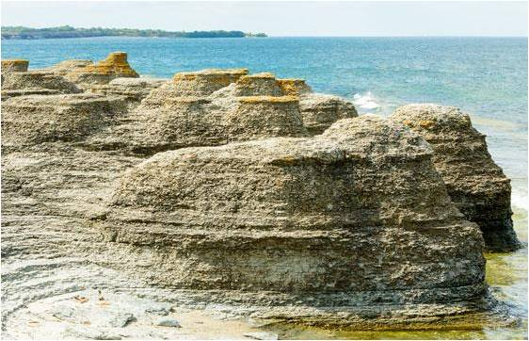
Limestone formation
Limestone is formed from the sedimentation of marine organisms that use calcium carbonate (CaCO₃) from the ocean to make their shells.
When these organisms died, they accumulated as sediment on the ocean floor. The sedimentary rock produced is limestone.
Alternatively, limestone can form from the buildup of calcium carbonate on ocean floors.
Notes:
Teacher notes
The layers of sediment are compacted and form sedimentary rock. The distinct layers in this rock are related to the time intervals at which sedimentation occurred.
Photo credit: limestone sea stacks © Imfoto, shutterstock.com 2018

Slide 21
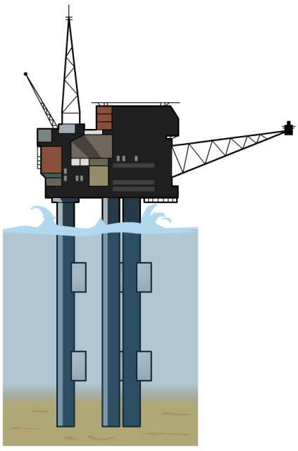
Sedimentation and fossil fuels
Compression of ocean floor sedimentary rock by overlying sediments produces great pressures and heat that can result in the formation of fossil fuels.
Crude oil and natural gas are fossil fuels produced by the sedimentation of dead marine organisms.
Coal is another type of fossil fuel that is formed from the sedimentation of dead plant material.
Fossil fuels can be found in limestone, sandstone and clay sediments.
Notes:
Teacher notes
The level of heat and pressure produced determines the type of fossil fuel formed.
Following formation, the fossil fuels migrate into the surrounding pores in the rock. Some of the fossil fuels became trapped by impervious rock. These are the reserves that humans obtain fossil fuels from today.
Human activity is increasing the amount of CO₂ through the burning of fossil fuels.

Slide 22
Formation of coal
Notes:
This slide covers the Science and Engineering Practices:
Developing and Using Models: Use a model to provide mechanistic accounts of phenomena.
Constructing Explanations and Designing Solutions: Apply scientific ideas, principles, and/or evidence to provide an explanation of phenomena and solve design problems, taking into account possible unanticipated effects.

Slide 23
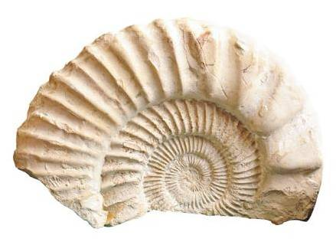
Summary of major changes in the atmosphere
Different factors have affected Earth’s atmosphere since its formation.
Causes of decreased carbon dioxide:
atmospheric change
increased levels of photosynthesis
dissolved CO₂ in the ocean
sedimentation of calcium carbonate- based organic matter.
Causes of increased oxygen:
increased oxygen production by photosynthesis.

