Slide 1
Extracting Metals by Alternative Methods

Slide 2
Information
Constructing Explanations and Designing Solutions
Engaging in Argument from Evidence
7. Stability and Change

Slide 3
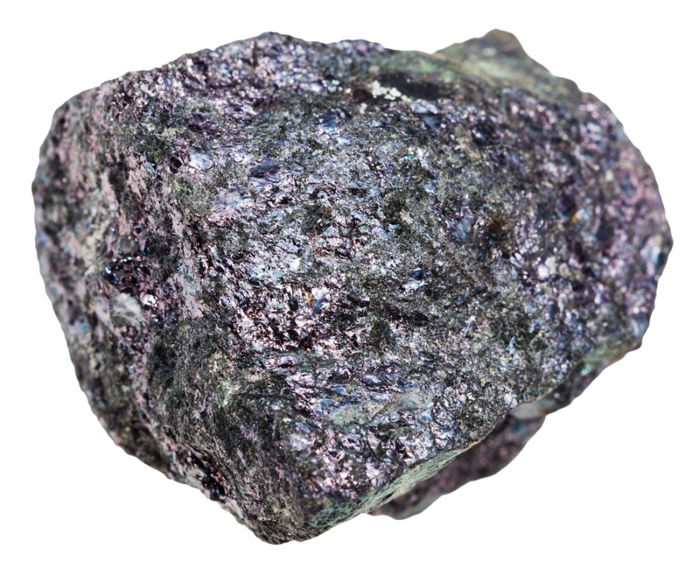
Extracting metals
Some unreactive metals, like gold and silver, are found in the Earth’s crust as pure substances.
Most metals are actually found combined with other elements, as compounds in ores. These metals must be extracted from their ores before they can be made useful.
The extraction of metals and minerals is the fifth-largest industry in the world, but mining for ores is expensive and can cause damage to the environment.
Notes:
Photo credit: bornite (peacock copper) © vvoe, Shutterstock.com 2018

Slide 4
Impacts of extraction
Notes:
Teacher notes
This click-and-reveal activity could be used to introduce the main social, economic and environmental impacts of metal extraction. The activity could be extended by asking students to think of other impacts, for example, mine workers may be exposed to health and safety risks.

Slide 5
Cast your vote
Notes:
Teacher notes
This voting activity enables the individual opinions of the class to be represented graphically. It could be used as a precursor to a debate on the impacts of metal extraction.

Slide 6
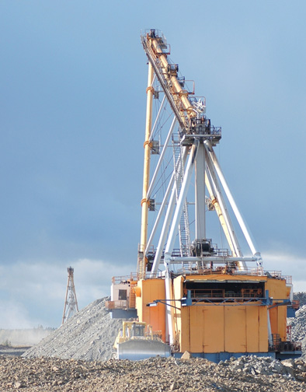
Mining for ores
As mining for ores is expensive, it is only carried out where minerals are abundant enough for this to be profitable.
In industry, an ore must contain enough metal to make mining and extraction economical.
The value of ores changes over time due to society and technology.
For example, rocks containing only 5% copper would have been considered unprofitable in the 19th century, but today, most copper comes from ores containing 0.4 to 1% copper.
Notes:
Photo credit: © Dmitri Melnik, Shutterstock.com 2018

Slide 7
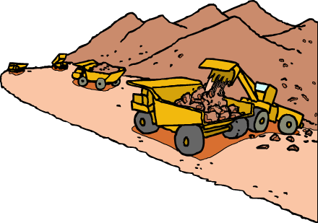
Finding alternatives
The Earth’s natural sources of ore are becoming scarce, and so new ways of extracting metals from low-grade ores are being developed.
A low grade ore has a low concentration of metal.
Phytomining and bioleaching are used to extract copper from metal-contaminated land and low grade ores.
They avoid the more traditional method of digging, moving and disposing of large amounts of rock.

Slide 8
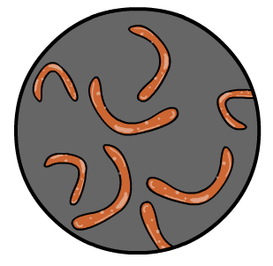
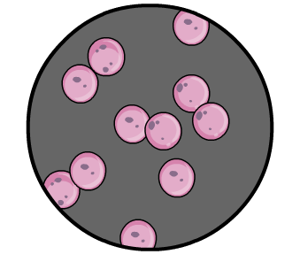
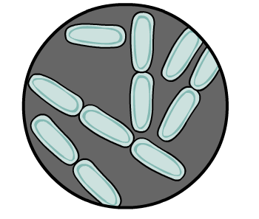
Bioleaching
New mining techniques can decrease the impact of metal extraction on the environment.
In bioleaching, metal ores are dissolved in a solution then mixed with certain bacteria. Depending on the type of bacteria, different metals will be “leached” from the ores into the solution, ready for electrolysis or a displacement reaction.
Bioleaching uses less fuel than traditional extraction, and does not produce waste gases.
Notes:
This slide covers the Science and Engineering Practice:
Constructing Explanations and Designing Solutions: Design, evaluate, and/or refine a solution to a complex real-world problem, based on scientific knowledge, student-generated sources of evidence, prioritized criteria, and trade-off considerations.

Slide 9
Phytomining
Notes:
Teacher notes
Phytomining can be recreated in the classroom in the following experiment:
Plants of the Brassica genus, such as Indian Mustard, cabbages or broccoli, should be grown in compost which has had copper sulfate added to it (alternatively, the leaves of Brassica plants can be sprayed with copper sulfate solution). Once grown, the plants should be turned to ash in a fume cupboard and sulfuric acid added to the ash. This can then be filtered and the metal obtained from the solution by displacement or electrolysis.
This slide covers the Science and Engineering Practice:
Constructing Explanations and Designing Solutions: Design, evaluate, and/or refine a solution to a complex real-world problem, based on scientific knowledge, student-generated sources of evidence, prioritized criteria, and trade-off considerations.

Slide 10
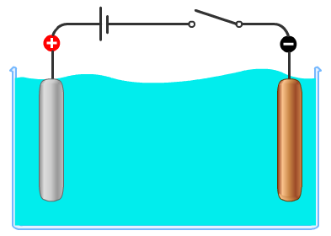
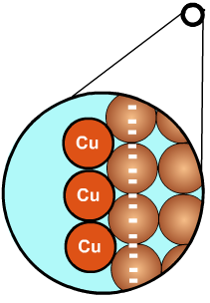
Purifying copper
Copper extracted from its ore by bioleaching or phytomining is impure. In order to purify the copper, it must be dissolved in an acid, such as sulfuric acid, then electrolysis is carried out.
The impure copper from the copper sulfate solution is attracted to the pure copper negative electrode. Titanium is used for the positive electrode.
Copper can also be extracted from solutions of copper sulfate by carrying out a displacement reaction using scrap iron.
Notes:
Teacher notes
For more information about extracting metals by electrolysis please refer to the Physical Science: Electrolysis and Extracting Metals presentations.
This slide covers the Science and Engineering Practice:
Constructing Explanations and Designing Solutions: Design, evaluate, and/or refine a solution to a complex real-world problem, based on scientific knowledge, student-generated sources of evidence, prioritized criteria, and trade-off considerations.

Slide 11
Phytomining or bioleaching?
The table below compares bioleaching and phytomining.
phytomining
bioleaching
carbon dioxide is released when the plants are burnt
no waste gases are produced
90% of metal in the low-grade ore is extracted
plants take up land and may alter the ecology
uses less than 50% of the energy of traditional
extraction methods
non-continuous process as it requires a long time for plants to grow and be harvested
a very slow process that can take years
Which method would you use?
Notes:
Teacher notes
Students could discuss as a class which method they think is better.
The main points are:
Phytomining releases CO₂ and therefore contributes to global climate change, however this may be balanced out by the CO₂ the plants use when they grow.
Bioleaching takes a longer time to extract the metal.
Bioleaching can extract up to 90% of the metal in the ore, compared to traditional methods that extract around 60%.
Both methods will require energy to extract the copper using electrolysis.
This slide covers the Science and Engineering Practice:
Engaging in Argument from Evidence: Evaluate competing design solutions to a real-world problem based on scientific ideas and principles, empirical evidence, and logical arguments regarding relevant factors (e.g. economic, societal, environmental, ethical considerations).

