Slide 1
Feedback Systems

Slide 2
Information
Asking Questions and Defining Problems
Developing and Using Models
Constructing Explanations and Designing Solutions
1. Patterns
2. Cause and Effect
4. Systems and System Models
7. Stability and Change

Slide 3
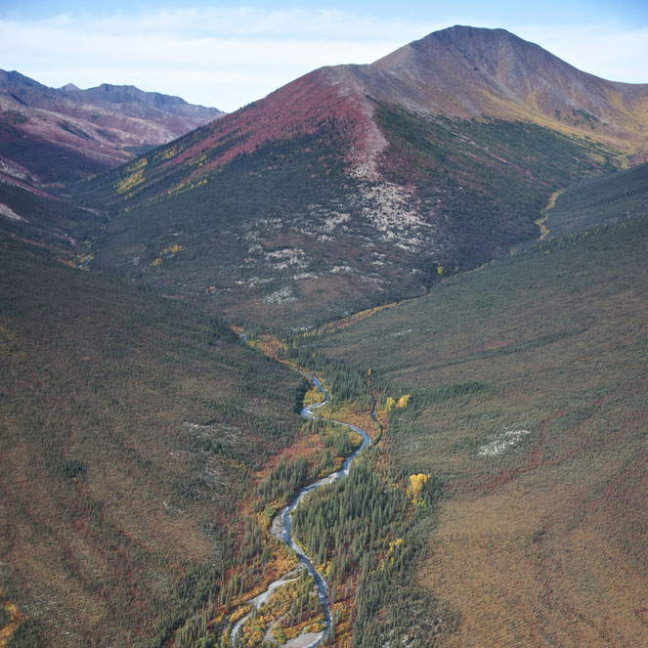
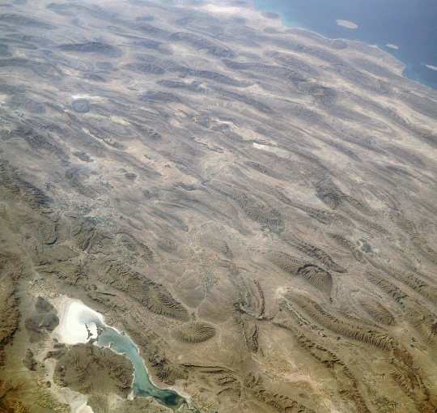
Constructive forces
Constructive forces can lead to the creation of recognizable features on Earth such as mountains and valleys.
What constructive forces made these land features?
Notes:
This slide covers the Science and Engineering Practice:
Asking Questions and Defining Problems: Ask questions that arise from careful observation of phenomena, or unexpected results, to clarify and/or seek additional information.
Photo credits: valley © Josh Anon, Shutterstock.com 2018; image of the Zagros Mountains, Iran was solely created by NASA and is reproduced free from any known copyright restrictions.

Slide 4
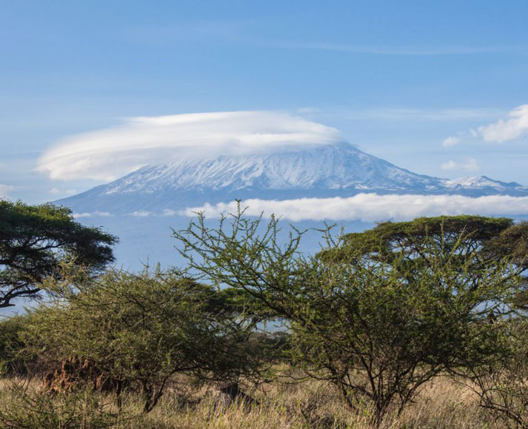
Volcanism
Volcanism is when lava erupts from the mantle onto the Earth’s surface. This process creates distinct land features.
Lava is molten rock that has reached the Earth’s surface through a gap in the crust, called a vent. When it cools, it solidifies back into rock.
A notable example of volcanism is the creation
of volcanoes.
This image shows Mount Kilimanjaro in Tanzania.
What volcanic processes took place to form it?
Notes:
Teacher notes
Encourage students to consider:
the height of the peak (Kilimanjaro’s peak is 5,895 m above sea level)
the steepness of the sides (fast- or slow-flowing lava?)
the fact that lava erupts due to a build-up of pressure under the crust.
Photo credit: Mount Kilimanjaro, Tanzania © Ninara, 2012, reproduced under the terms of the Creative Commons Attribution 2.0 Generic license.

Slide 5
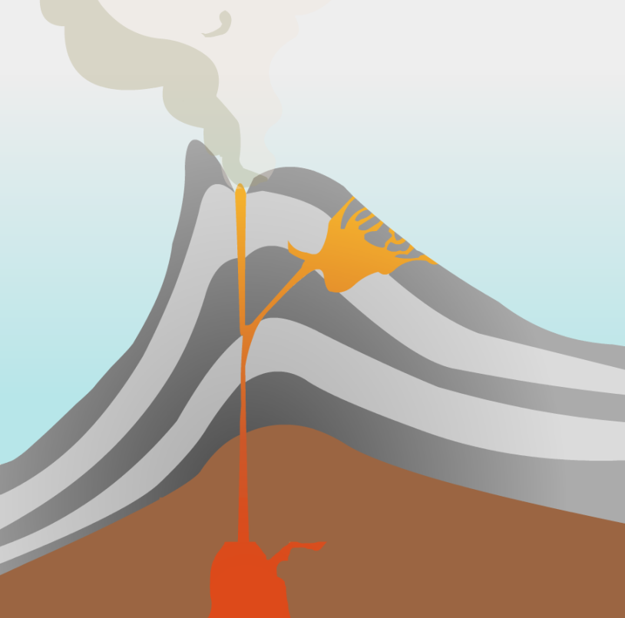
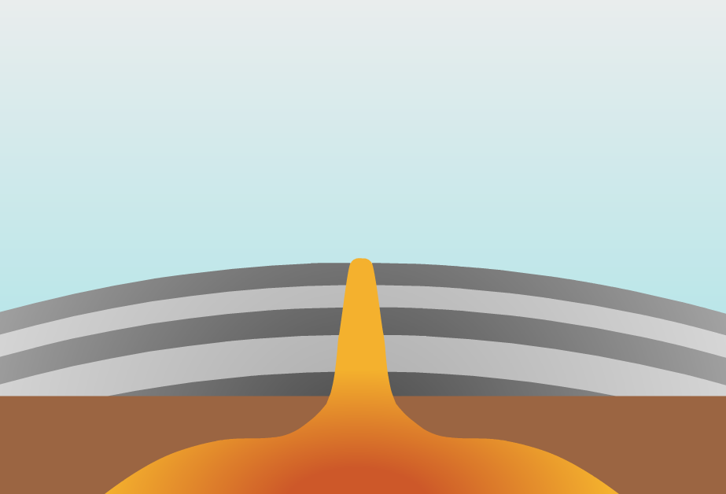
Volcanoes
When volcanoes stop erupting frequently, they are dormant. Volcanoes that no longer contain molten rock are extinct. Extinct volcanoes can form mountainous land features.
What are the differences between these two volcanoes?
Notes:
This slide covers the Science and Engineering Practice:
Asking Questions and Defining Problems: Ask questions that arise from careful observation of phenomena, or unexpected results, to clarify and/or seek additional information.

Slide 6
How do volcanoes form mountains?
Volcanoes that erupt due to high
pressure form tall mountains
with steep sides. These are
known as stratovolcanoes.
Mount Kilimanjaro is made up of three stratovolcanoes.
Volcanoes that erupt more frequently and with less pressure form mountains with gentle sides. These are known as shield volcanoes.

Slide 7
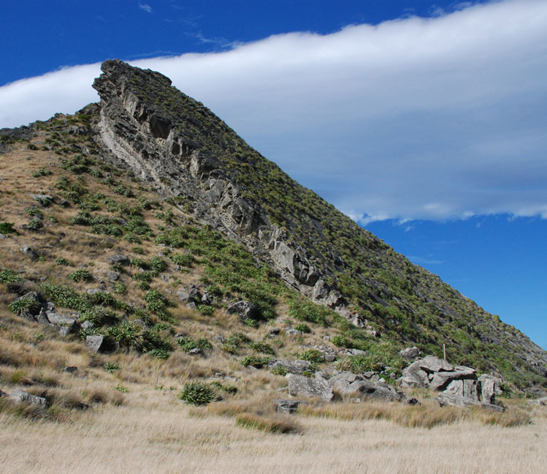
Tectonic uplift
Tectonic uplift occurs when tectonic plate movement forces rocks upwards, creating land features. It occurs in different ways, but usually involves two tectonic plates colliding.
What has happened to create the land feature in this photo?
Think about the direction of the forces, and what has happened to the flat part of the land.
Can you explain it using the tectonic uplift theory?
Notes:
Teacher notes
This could be used as a discussion activity to introduce the idea of uplift. Ask students to draw arrows to represent the direction of the forces that have resulted in the land feature shown here.
For more information about tectonic plates, please refer to the Plate Tectonics presentation.
This slide covers the Science and Engineering Practice:
Asking Questions and Defining Problems: Ask questions that arise from careful observation of phenomena, or unexpected results, to clarify and/or seek additional information.
Photo credit: Kupe's Sail, New Zealand image has been released into the public domain by its author, Karora, and is reproduced free from any known copyright restrictions.

Slide 8
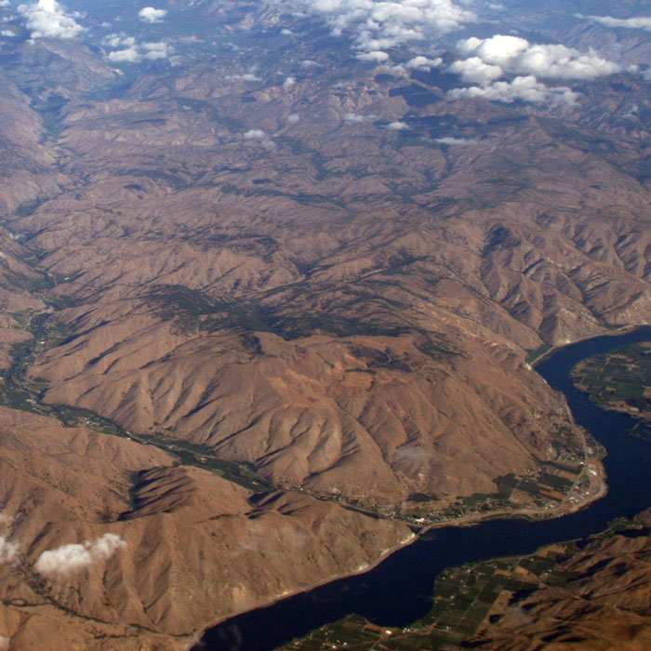
How can tectonic uplift create plateaus?
A plateau is like a mountain. However, unlike mountains, plateaus have flat tops. They can form in two ways:
through upwelling magma, when molten rock underneath the crust cannot break through and pushes land upwards
through erosion, when an existing mountain peak is worn down by a glacier.
Glaciers are huge pieces of ice that form on mountains and slide down over thousands of years. The glaciers that created plateaus melted long ago but they have left distinct land features behind.
Notes:
Photo credit: Columbia River Plateau, Washington © Doc Searls, 2010, reproduced under the terms of the Creative Commons Attribution 2.0 Generic license.

Slide 9
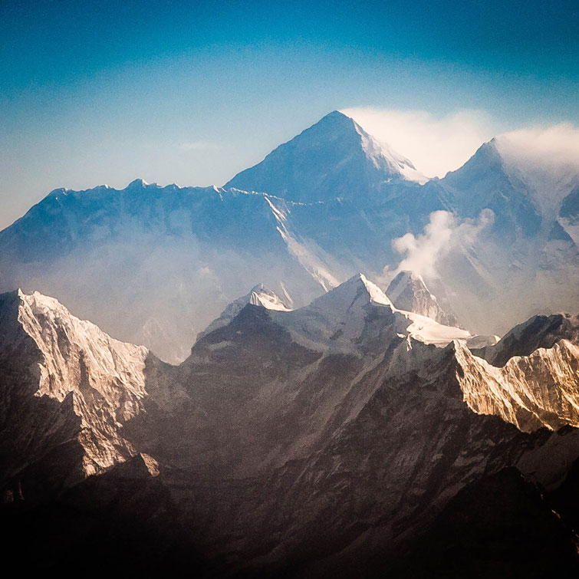
Orogeny
Orogeny is when two sections of crust are pushed together, forcing the rocks to crumple into fold mountains.
The Himalayan mountains in Asia are fold mountains, formed by the Indian and Eurasian tectonic plates coming together.
The Himalayas are still growing at around 6 cm per year! What does this tell us about the tectonic plates below them?
What other land feature can you see in this photo?
Notes:
Teacher notes
Point out the valleys between the mountain peaks, which were also formed through the process of tectonic uplift.
This slide covers the Science and Engineering Practice:
Asking Questions and Defining Problems: Ask questions that arise from careful observation of phenomena, or unexpected results, to clarify and/or seek additional information.
Photo credit: Mount Everest © Ralf Kayser, 2012, reproduced under the terms of the Creative Commons Attribution 2.0 Generic license.

Slide 10
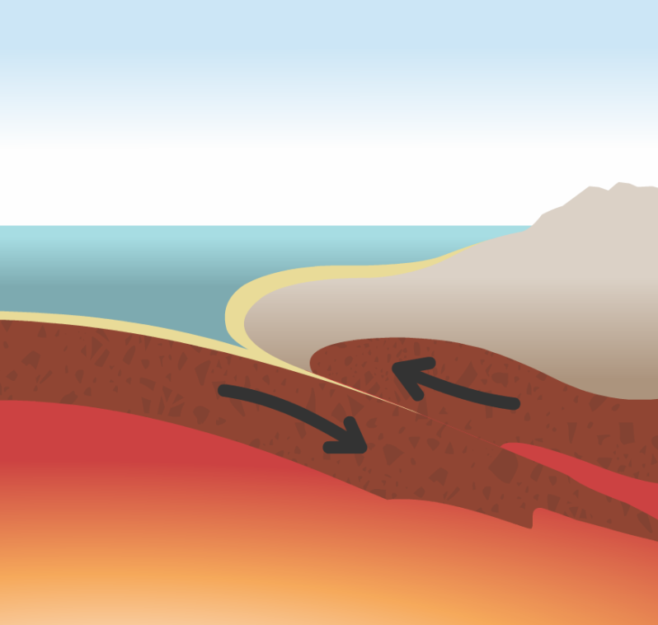
Submarine features
The ocean floor is not flat. It includes underwater mountains, valleys and tectonic features. These submarine features exist at the bottom of the ocean.
Ocean trenches are formed when one tectonic plate is subducted (pushed down) under another.
A good example of an ocean trench is the Mariana Trench in the Pacific Ocean. This trench has a known depth of almost 11,000 m!
trench
Which plate is being subducted in this diagram? What other destructive forces are at work?
Notes:
This slide covers the Science and Engineering Practice:
Asking Questions and Defining Problems: Ask questions that arise from careful observation of phenomena, or unexpected results, to clarify and/or seek additional information.

Slide 11
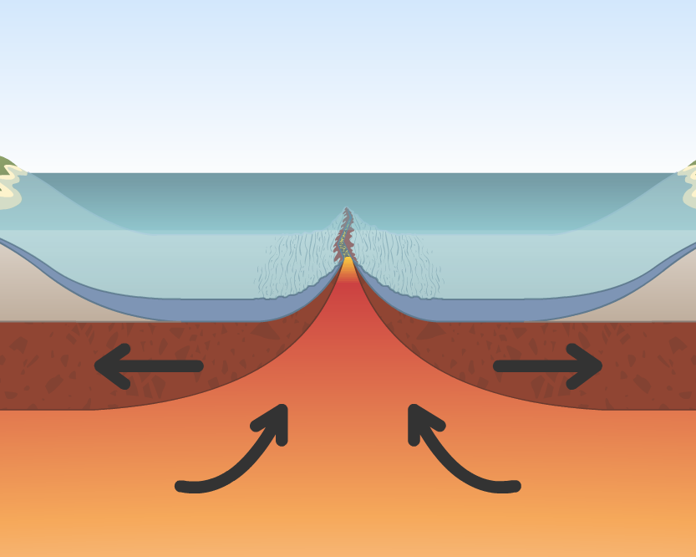
Ridges and seamounts
Where two oceanic plates move away from each other, lava rises to the surface, creating new crust. This process is known as seafloor spreading.
mid-ocean ridge
A mid-ocean ridge is an underwater mountain range created by seafloor spreading.
Some mid-ocean ridges form underwater volcanoes, called seamounts. After thousands of years, these volcanoes stop erupting and become extinct, leaving behind an isolated underwater mountain.

Slide 12
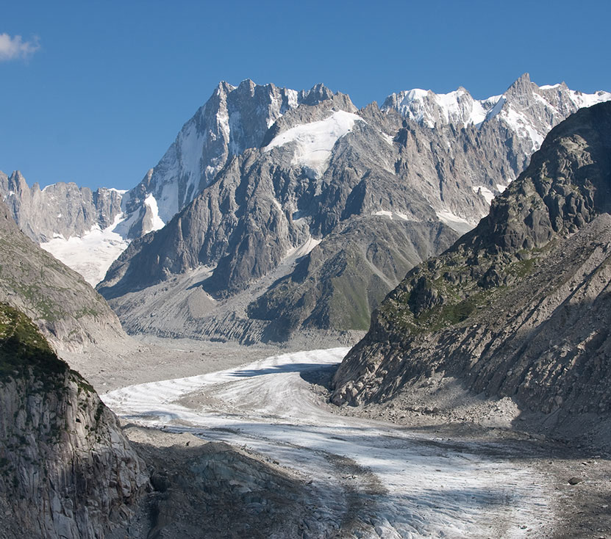
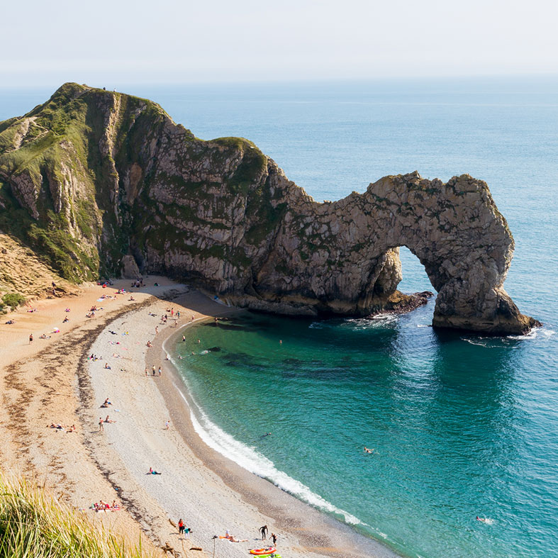
Destructive forces
Destructive forces also create features, but they do so through processes that destroy or erode rocks.
What destructive forces are at work in these images?
Notes:
This slide covers the Science and Engineering Practice:
Asking Questions and Defining Problems: Ask questions that arise from careful observation of phenomena, or unexpected results, to clarify and/or seek additional information.
Photo credits: Mer de Glace glacier, France © Theo Snijder; Durdle Door, UK © ian woolcock, both at Shutterstock.com 2018

Slide 13
Weathering
Weathering is the breakdown of rocks into smaller fragments due to processes taking place in the environment.
Eventually the fragments of rock become soil or sand.
Physical weathering processes include:
exfoliation, sometimes called “onion-skin” weathering, caused by very hot temperatures
freeze-thaw weathering, caused by water repeatedly freezing and melting.
Exfoliation and freeze-thaw weathering tend to occur in very different types of landscapes.
Where might each type of weathering occur?
Notes:
Teacher notes
Encourage students to think about the effect of the local climate. Exfoliation requires high temperatures, so it occurs in places with hot climates. Freeze-thaw weathering occurs in places where the temperature is above freezing during the day but drops below freezing overnight.
The next two slides contain animations of both exfoliation and freeze-thaw weathering, but for more information on the different types of weathering, including biological and chemical, please refer to the Weathering presentation.

Slide 14
Exfoliation in action
Notes:
This slide covers the Science and Engineering Practice:
Constructing Explanations and Designing Solutions: Apply scientific ideas, principles, and/or evidence to provide an explanation of phenomena and solve design problems, taking into account possible unanticipated effects.

Slide 15
Freeze-thaw weathering in action
Notes:
This slide covers the Science and Engineering Practice:
Constructing Explanations and Designing Solutions: Apply scientific ideas, principles, and/or evidence to provide an explanation of phenomena and solve design problems, taking into account possible unanticipated effects.

Slide 16
Mass wasting
As a stratovolcano forms, it builds up layers of ash and rock around it.
Eventually, its sides become too steep to support: they collapse and slide down the mountain. This process is called mass wasting.
Mass wasting does not only happen at volcanoes. It can happen anywhere there are steep slopes.
Can you think of any other examples of mass wasting?
What might trigger a large amount of mass wasting?
Notes:
Teacher notes
Other examples of mass wasting include:
rockfalls
landslides
mudslides
avalanches.
Factors affecting the rate of mass wasting include:
severe weather, e.g. rain or wind
tectonic activity, e.g. earthquakes
changes in plants and vegetation, e.g. deforestation.

Slide 17
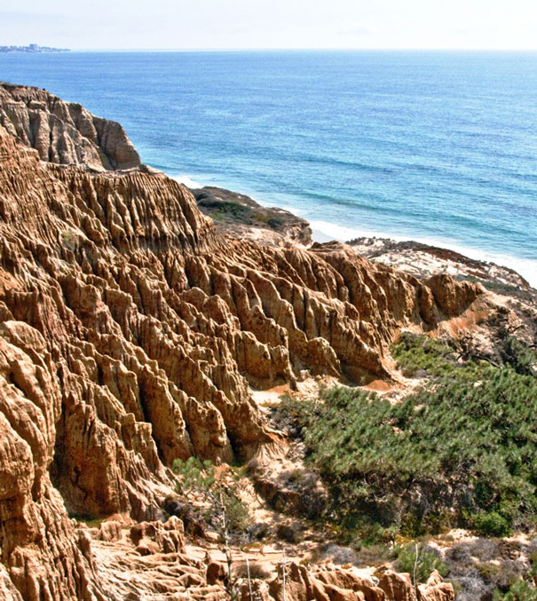
Coastal erosion
Another destructive force that shapes Earth’s land features is erosion. This is the wearing away of rock and other material due to other processes.
One of the key contributors to erosion is the tide. Waves can break on the shore with a large amount of force, resulting in damage and coastal erosion.
How has coastal erosion affected the cliffs in this photo?
Can you think of any problems or dangers of coastal erosion?
Notes:
Teacher notes
Encourage students to examine the shape of the rocks. How were the holes and crevasses made? What can they tell about the hardness or softness of the rocks?
Dangers of coastal erosion include:
falling rocks and landslides
houses and paths collapsing.
This slide covers the Science and Engineering Practice:
Asking Questions and Defining Problems: Ask questions that arise from careful observation of phenomena, or unexpected results, to clarify and/or seek additional information.
Photo credit: Cliff erosion image has been released into the public domain by its author, Athene cunicularia, and is reproduced free from any known copyright restrictions.

Slide 18
What are feedback loops?
Over thousands – or even millions – of years, Earth has developed different feedback systems. These systems are:
dynamic: they change or adapt over long periods of time
interacting: they are part of a larger network of connected systems.
Sometimes, external changes can have an impact on these feedback systems.
When one change causes further changes, this is known as a feedback loop.
Feedback loops can be positive or negative.
Can you think of any examples of positive or negative feedback loops?
Notes:
Teacher notes
Students are perhaps most likely to think of the global warming phenomenon and the various ways in which a warmer planet brings about further changes.

Slide 19
What is climate feedback?
Feedback loops often take place in climate systems. Climate refers to the average temperature and rainfall of a specific area. It is different to weather, which refers to the conditions on a particular day.
Do these sentences refer to weather or climate?
It is going to rain this afternoon.
Oregon receives more rain per year than Texas.
January tends to be colder than March.
When climates change, they can create a feedback loop that results in further change. One example of this is the enhanced greenhouse effect.
Notes:
Teacher notes
The next slide contains an animation of the greenhouse effect.

Slide 20
What is the greenhouse effect?
Notes:
Teacher notes
This animation can be used to illustrate the principles of the greenhouse effect. Students could be asked to consider the impact of rising greenhouse gases on the natural phenomenon of the greenhouse effect. How does this form a feedback loop? What would need to happen before the feedback loop was broken?
For more information on the greenhouse effect, please refer to the Climate Systems presentation.
This slide covers the Science and Engineering Practices:
Developing and Using Models: Use a model to provide mechanistic accounts of phenomena.
Constructing Explanations and Designing Solutions: Apply scientific ideas, principles, and/or evidence to provide an explanation of phenomena and solve design problems, taking into account possible unanticipated effects.

Slide 21
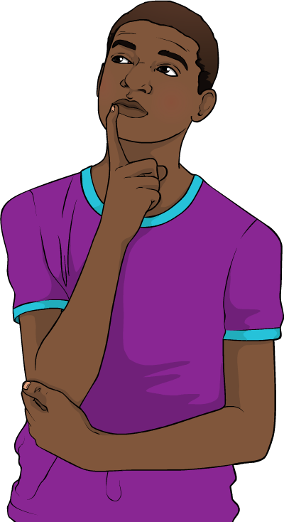
The greenhouse effect
The greenhouse effect is an important reason why life is able to survive on Earth. However, as more greenhouse gases are released into the atmosphere, the process has sped up.
The enhanced greenhouse effect is linked to:
rising average surface temperatures
unpredictable or severe weather patterns
the loss of polar ice caps.
Each of these effects has the potential to impact other systems and create a feedback loop.
Can you think of any feedback loops
that could be affected?
Notes:
Teacher notes
Encourage students to consider:
the effect of rising temperatures on global biomes
the impact of severe weather on human settlements
the impact of melting ice caps on global sea levels.

Slide 22
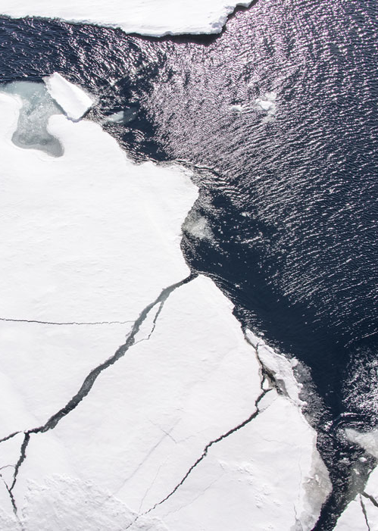
The albedo feedback loop
One of the consequences of the Earth heating up is a reduction of ice albedo due to melting polar ice caps. Albedo is the amount of solar radiation reflected by a surface.
Ice caps are huge pieces of ice at the North and South poles. The Earth’s rising temperatures mean that more ice is melting each year.
The ocean surface has a low albedo, as it only reflects about 6% of the solar radiation it receives. In contrast, ice reflects 50–70%: it has a high albedo.
What do you think will happen as more
and more ice melts into the ocean?
Notes:
Teacher notes
Encourage students to consider albedo as part of a wider feedback loop. Likely consequences of polar ice melt include:
further reduction of the albedo effect
resulting temperature increases, leading to further ice melt
sea level rise.
This slide covers the Science and Engineering Practice:
Asking Questions and Defining Problems: Ask questions that arise from examining models or a theory, to clarify and/or seek additional information and relationships.
Photo credit: Sea ice at the North Pole © Christopher Michel, 2015, reproduced under the terms of the Creative Commons Attribution 2.0 Generic license.

Slide 23
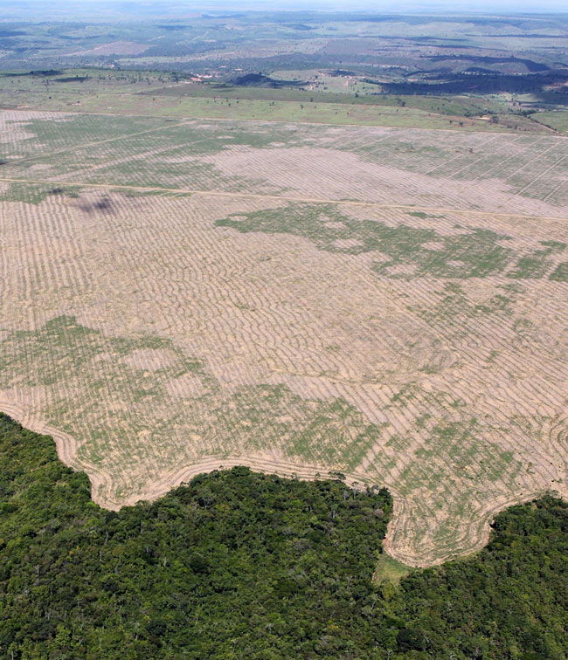
The deforestation feedback loop
Human activities can also create or impact feedback loops.
For example, in the Amazon rainforest, large-scale deforestation is taking place. This is the cutting down of trees, either to acquire the wood or
to clear the land for other uses.
In the Amazon, soil quality is poor and nutrients wash away quickly unless they are protected by trees.
When trees are cut down, rainfall can result in high surface runoff (water flowing over land) and soil erosion (soil being washed away.)
Notes:
Photo credit: Deforestation in the Amazon © Ibama, 2016, reproduced under the terms of the Creative Commons Attribution 2.0 Generic license.

Slide 24
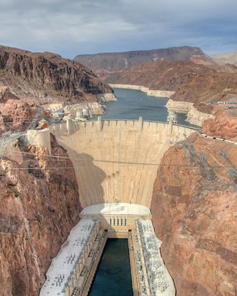
River damming
A dam is an artificial barrier that prevents water from flowing along a river the way it would naturally. There are around 84,000 dams in the United States.
Rivers play an important part of a process called groundwater recharge, which is when surface water (such as rainfall) drains underground.
Rivers also transport sediment (tiny pieces of rock and silt) downstream. Over time, sediment is deposited at the river mouth, providing the coast with some protection from erosion.
What impact do you think dams have on these processes?
Notes:
Teacher notes
Where water builds up behind a dam, groundwater recharge increases in that area. However, it dramatically decreases downstream of the river due to the restriction of the water flow. The higher water levels behind the dam can lead to increasing amounts of soil erosion, and can prevent rivers from reaching the ocean. This can lead to further impacts at a coastal level, including coastal erosion.
This slide covers the Science and Engineering Practice:
Asking Questions and Defining Problems: Ask questions that arise from examining models or a theory, to clarify and/or seek additional information and relationships.
Photo credit: Hoover Dam © Ralph Arvesen, 2011, reproduced under the terms of the Creative Commons Attribution 2.0 Generic license.

Slide 25
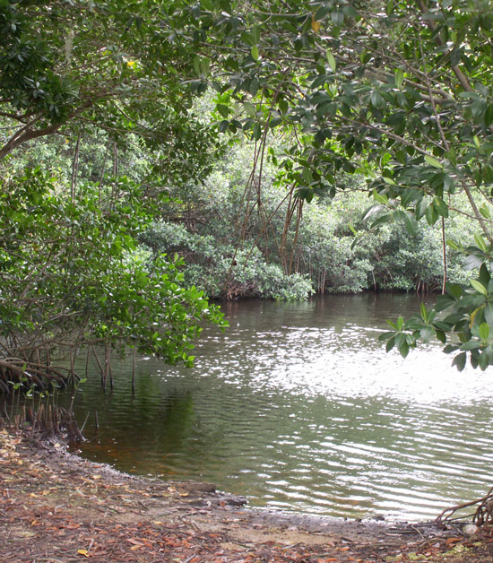
Wetlands
Wetlands are areas where the ground is usually saturated (soaked) with water. Types of wetland include mangroves, marshes and swamps, and they are home to animals such as frogs, fish, alligators and turtles.
Areas near wetlands tend to have higher humidity, which is the amount of water vapor in the air.
When wetlands are cleared or drained by humans, local humidity decreases. Wetlands depend on humid conditions for their survival, so the decreasing humidity leads to further loss of wetland areas.
Notes:
Photo credit: Mangrove wetlands in Florida image has been released into the public domain by its author, Moni3, and is reproduced free from any known copyright restrictions.

Slide 26
Summary
In this presentation, you have studied how one change to the Earth’s surface can create a feedback loop that can cause further changes.
As a summary activity, can you explain how human activities cause changes
to the following feedback loops:
the greenhouse effect
soil surface runoff
river groundwater recharge
loss of wetlands?
Notes:
This slide covers the Science and Engineering Practice:
Constructing Explanations and Designing Solutions: Apply scientific ideas, principles, and/or evidence to provide an explanation of phenomena and solve design problems, taking into account possible unanticipated effects.

