Slide 1
Fossils

Slide 2
Information
Developing and Using Models
7. Stability and Change

Slide 3
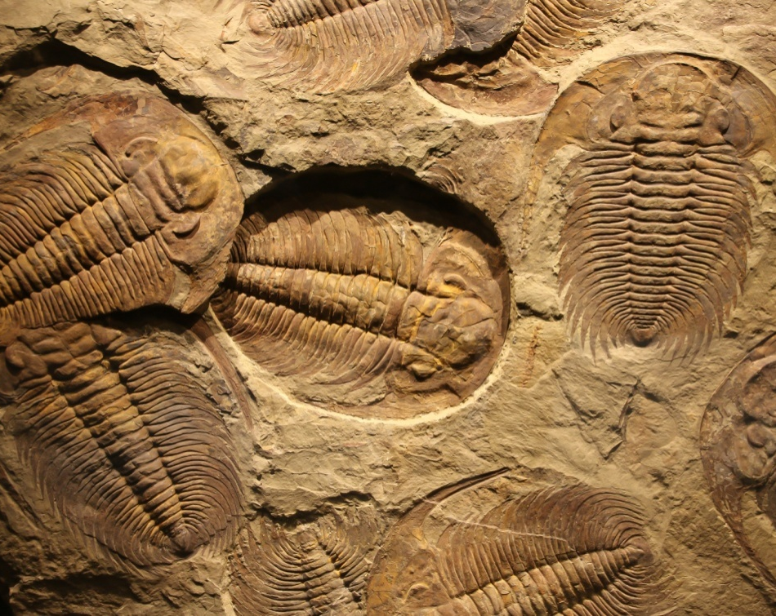
What are fossils?
Simple life forms first appeared on Earth approximately 3 billion years ago.
All life we see on Earth today has evolved from these early organisms.
We can learn about how life on Earth has changed over time by studying fossils.
Fossils are the preserved remains of animals, plants and other organisms that lived in the past – up to millions of years ago.
Notes:
Photo credit: Trilobite fossils © Merlin74, Shutterstock.com 2018

Slide 4
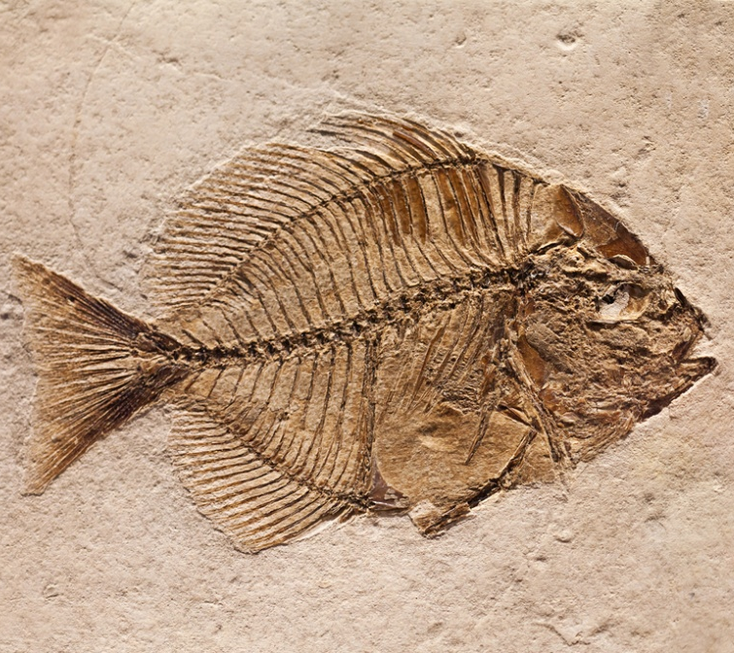
How do fossils form? (1)
Fossils are found in rocks and can be formed in several ways.
Microbes require a source of food, oxygen, water and warmth to carry out the process of decay.
Some fossils are formed from parts of an organism that have not decayed. This can happen if one or more conditions needed for decay to occur are absent.
Can you think of some environments where decay might be prevented?
Notes:
Teacher notes
Environments that may be unable to support the process of decay include:
deserts – lack of water
polar regions – lack of warmth
peat bogs – lack of oxygen.
Photo credit: © Marcio Jose Bastos Silva, Shutterstock.com 2018

Slide 5
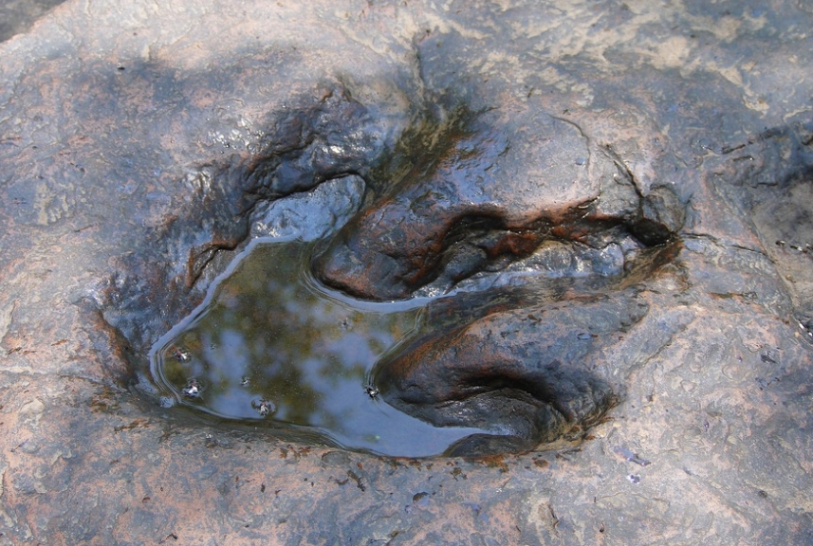
How do fossils form? (2)
Fossils can also be formed when parts of the organism are replaced by other materials as they decay.
Sometimes hard body parts of organisms, such as bone and shell, can become covered by layers of sediments. Over time they are slowly replaced by minerals to form a cast of the original organism.
Other fossils are only the preserved traces of organisms, such as footprints, rootlet traces and burrows.
Notes:
Teacher notes
Rootlet traces are the preserved pattern of roots from plants that lived in the distant past.
Photo credit: © Rattana, Shutterstock.com 2018

Slide 6
How are animal fossils formed?
Notes:
Teacher notes
This six-stage interactive animation shows how animal fossils can be formed at sea, and how they are found within sedimentary rock formations on land. Suitable prompts could include:
Fossils are only found in sedimentary rocks. How do these form?
Could a whole fish get fossilized?
Are fossils made from bone?
How can you tell that some fossils are older than others?
How do fossils formed deep under water end up on the side of cliffs?
Why are new fossils still being discovered?
This slide covers the Science and Engineering Practice:
Developing and Using Models: Use a model to provide mechanistic accounts of phenomena.

Slide 7
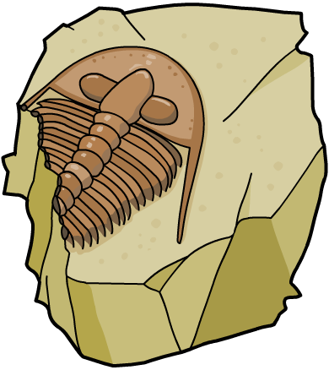
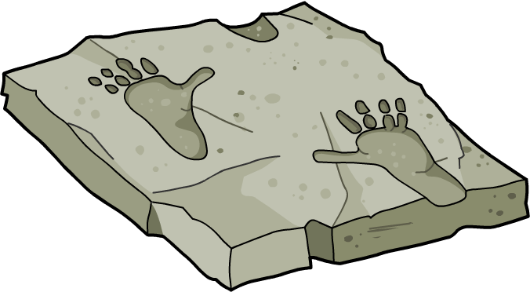
Why are fossils rare?
Because the conditions for fossilization are so specific, fossils are relatively rare. However, there are other reasons that explain why fossils are so uncommon:
Many early life forms were soft-bodied and decayed to leave no trace.
Most fossils have likely been destroyed by geological activity.
Some fossils have yet to be found.
The rarity of fossils is one reason why scientists cannot be certain about how life began on Earth.

Slide 8
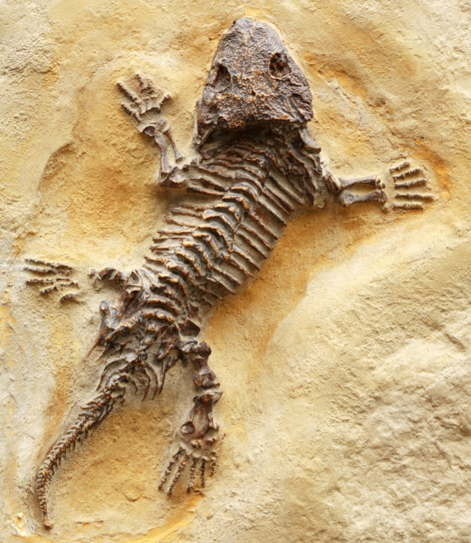
Fossils show change
The history of life on Earth shown by fossils is called the fossil record. Fossils can help us learn about how much, or how little, organisms changed as life developed on Earth.
Although there are gaps in the fossil record, it can be used to provide evidence about how organisms have changed gradually over time.
As a result, the fossil record can be used to show the process of evolution.
The fossil record can also show how different species evolved from common ancestors.
Notes:
Teacher notes
For example, modern humans and chimpanzees both evolved from a common ancestor that existed millions of years ago.
Photo credit: Ancient lizard, Seymouria © cosma, Shutterstock.com 2018

Slide 9
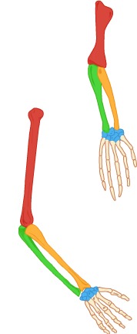
Pentadactyl limb
Fossils have revealed many structural similarities between living and extinct organisms.
As a result, fossils can be used to indicate whether certain organisms could share a common ancestor.
lizard
For example, many vertebrates share a pentadactyl limb:
a limb with five digits, a lower section containing two bones, and an upper section containing one bone.
human
Notes:
Teacher notes
The modern bird only has a pentadactyl limb with only three digits. This is because the pentadactyl limb of some vertebrates has evolved to have fewer than five digits.

Slide 10
Fossil record: horse
Notes:
Teacher notes
This timeline can be used to introduce work on the evolution of the horse as an example of the usefulness of the fossil record. Students could be asked about how changes in the size of horses, the structure of their feet and teeth provide evidence for their changing habitat and diet.
This slide covers the Science and Engineering Practice:
Developing and Using Models: Develop, revise, and/or use a model based on evidence to illustrate and/or predict the relationships between systems or between components of a system.

Slide 11
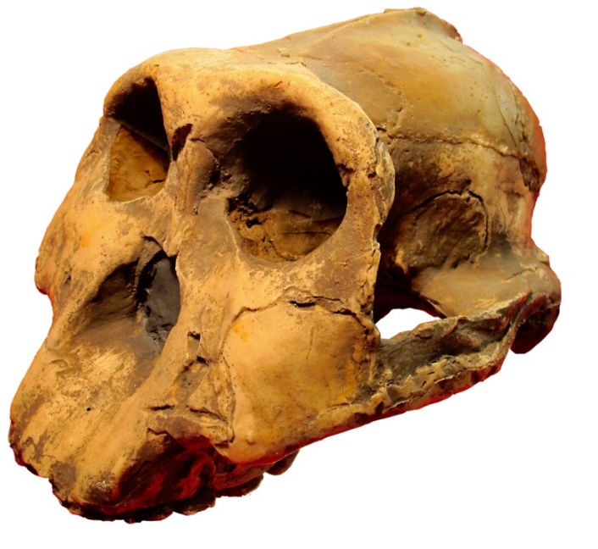
Fossils and human evolution
Fossils have provided information on how modern humans have evolved.
Early humans are called hominids. Fossilized remains of our ancestors have been dated back to over 4 million years ago.
Looking at these fossils enables us to learn about the similarities and differences between ourselves and our evolutionary ancestors.
For example, fossils can be used to show how humans evolved to adapt to changing environmental conditions and food supplies.
Notes:
Photo credit: skull of Australopithecus boisei © Dinoton, Shutterstock.com 2018

Slide 12
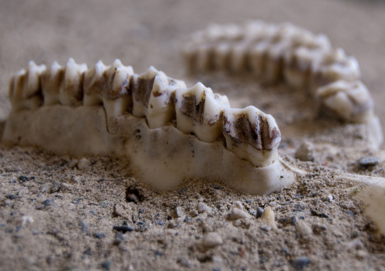
Using fossils to learn about our past
By comparing features found in fossils of different ages, scientists can follow the course of human evolution.
Fossils can suggest when certain features developed, and provide information about the lifestyles of our ancestors.
They can also be used to see how the evolution of structural features may be linked to changes in habitat or behavior.
For example, changes in the jaw and teeth of our ancestors might be linked to a change in diet.
Notes:
Photo credit: © cla78, Shutterstock.com 2018

Slide 13
Fossil evidence for human evolution
Notes:
Photo credits: fossil of Lucy © Wellcome Trust; skeleton © topal, Shutterstock.com, 2018

Slide 14
Ardi: evidence for human evolution
Notes:
Teacher notes
Ardi’s pelvis was constructed from crushed remains, so can the hypothesis of her really being bipedal be supported? Some scientists argue not.

Slide 15
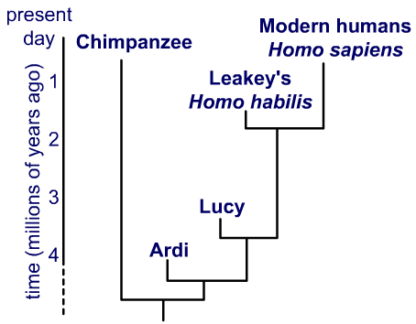
Evolutionary trees
Fossils can be used to work out the relationship between different types of organisms. This information can be shown using a diagram called an evolutionary tree.
With which early human do modern humans most recently share a common ancestor?
What does the tree tell you about the relationship between humans and chimpanzees?
Notes:
Teacher notes
Where branches join indicates the existence of a common ancestor.
Answers to questions:
The most recent relative to modern humans shown on this tree is Homo habilis. This is the early human with which modern humans most recently shared a common ancestor.
All humans (modern and early forms) shared a common ancestor with chimpanzee over 4 million years ago. There is huge variation in estimates of when this common ancestor existed, ranging from 4.4 to 13 million years ago.
This slide covers the Science and Engineering Practice:
Developing and Using Models: Develop, revise, and/or use a model based on evidence to illustrate and/or predict the relationships between systems or between components of a system.

