Slide 1
History of Earth

Slide 2
Information
Asking Questions and Defining Problems
Developing and Using Models
1. Patterns
2. Cause and Effect
6. Structure and Function
7. Stability and Change

Slide 3
Old and new rocks
Tectonic plate theory hypothesizes that new oceanic crust is constantly being created due to seafloor spreading.
At divergent plate boundaries like the Mid-Atlantic Ridge, the oceanic crust is much younger than it is in the middle of the plate, because it has been created more recently.
Similarly, the North American plate (an example of continental crust) has an older central core. It is younger towards the edges, where it has interacted with other plates to create convergent or transform boundaries.
Why might scientists study ancient Earth rocks to find out more about early Earth?
Mid-Atlantic Ridge
Notes:
Teacher notes
This question is answered in more depth on the next two slides. For more information on plate tectonics, seafloor spreading and mantle convection, please refer to the Plate Tectonics presentation.

Slide 4
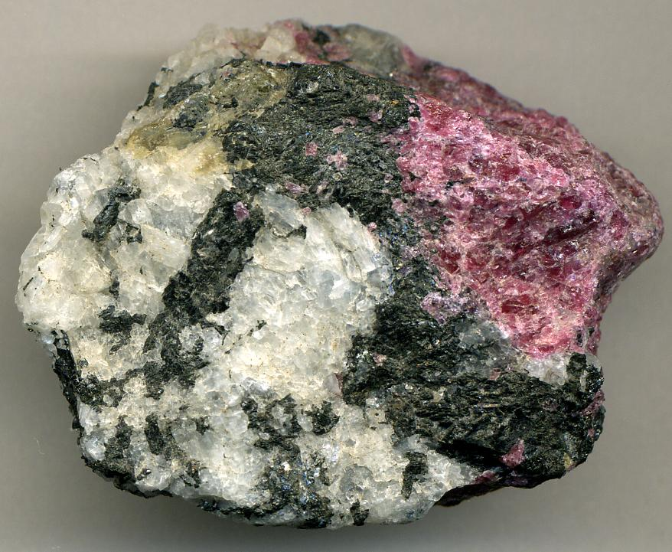
Rocks on Earth
Scientists can study rocks on Earth to find out more about its formation and early history. They are broadly divided into two types:
continental rocks are less dense and make up major land masses like North America and Asia
oceanic rocks are more dense and lie under the Earth’s oceans.
Which of these two would be more useful to study to find out about the early history of Earth?
Notes:
Teacher notes
Since continental rocks are older, they are more useful to study in this context. An explanation of this can be found on the next slide.
This slide covers the Science and Engineering Practice:
Asking Questions and Defining Problems: Ask questions to clarify and refine a model, an explanation, or an engineering problem.
Photo credit: Rock containing zircon © James St. John, 2014, reproduced under the terms of the Creative Commons Attribution 2.0 Generic licence, https://creativecommons.org/licenses/by/2.0/

Slide 5
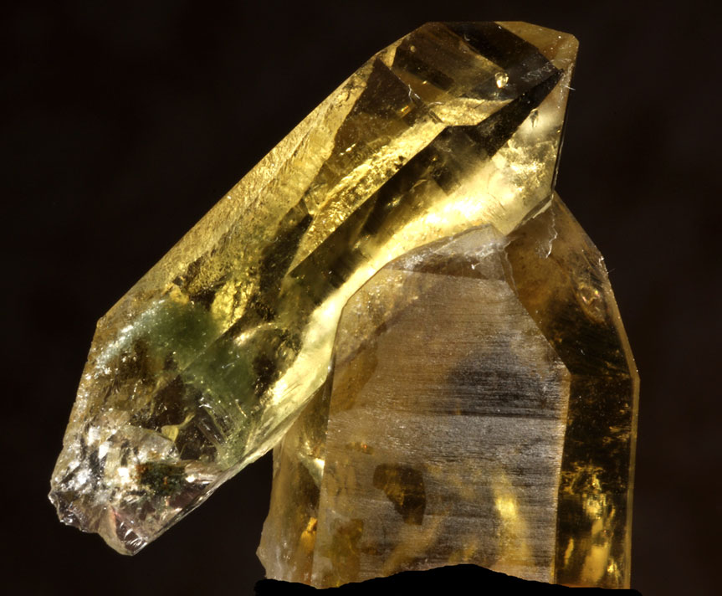
Ancient rocks
The theory of plate tectonics explains how Earth’s tectonic plates float on the mantle’s surface. Oceanic rocks are denser and can be subducted under the lighter continental plates. They are then recycled in the mantle.
Since continental rocks are less likely to be subducted, they are generally older. Continental rocks can therefore contain information about what the Earth was like millions, or even billions, of years ago.
The Earth’s crust is largely made up of silicon compounds, called silicates. Pure silicon oxide forms a clear mineral called quartz, which makes up about 12% of the crust.
Notes:
Teacher notes
For more information about plate tectonics, please refer to the Plate Tectonics presentation.
Photo credit: Citrine quartz crystal image has been released into the public domain by its author, Parent Géry, and is reproduced free from any known copyright restrictions.

Slide 6
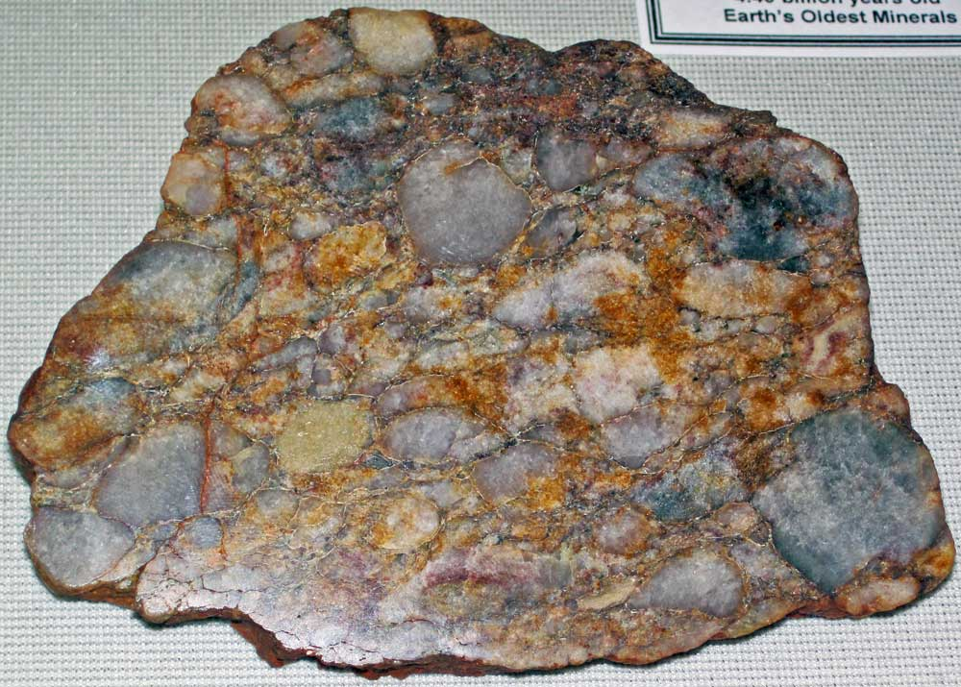
What is zircon?
Some of the Earth’s crust contains a type of rock called zircon, which is among the oldest minerals found on Earth.
Zircon is found in ancient continental rocks, and can be over 4 billion years old. Compare this to oceanic rocks, which are much younger in geological terms: less than 200 million years old.
Some zircon crystals found in the Jack Hills in Australia are 4.39 billion years old: almost as old as the Earth itself.
Notes:
Teacher notes
Students may be interested to know that the rock pictured is approximately 3 billion years old. The oldest zircon crystals are known as Hadean zircon, named after the eon during which they formed. These are very rare and have only been found in a handful of places worldwide.
Photo credit: Zircon and quartz rock © James St. John, 2016, reproduced under the terms of the Creative Commons Attribution 2.0 Generic licence, https://creativecommons.org/licenses/by/2.0/

Slide 7
How was the Earth formed?
About 4.6 billion years ago, a cloud of dust and gas accumulated enough mass to stick together and form the early Earth. This is known as accretion theory.
At this point, there were many rocks and other debris orbiting the Sun. Some of these meteorites hit the Earth, which gradually heated until its surface was molten.
Today, very little evidence still exists on Earth to show how the planet was formed. Why do you think this is?
Notes:
Teacher notes
Encourage students to explore what might happen when a meteorite hit the early Earth. Considerations might include:
the molten surface of the Earth
the density of elements in meteorites
subsequent tectonic formations and movement.
This slide covers the Science and Engineering Practice:
Asking Questions and Defining Problems: Ask questions that arise from examining models or a theory, to clarify and/or seek additional information and relationships.

Slide 8
Formation of the Earth
Notes:
This slide covers the Science and Engineering Practice:
Developing and Using Models: Develop, revise, and/or use a model based on evidence to illustrate and/or predict the relationships between systems or between components of a system.

Slide 9
How was the Moon formed?
About 4.51 billion years ago, a Mars-sized mass of rock called Theia collided with the Earth.
The impact partly liquefied (melted) the Earth’s surface, and scientists believe that Theia’s mantle and core combined with Earth’s.
Dust and rock fragments were thrown out into space. These fragments began to orbit the Earth, pulled in by Earth’s gravity. Eventually they joined together to form the Moon.

Slide 10
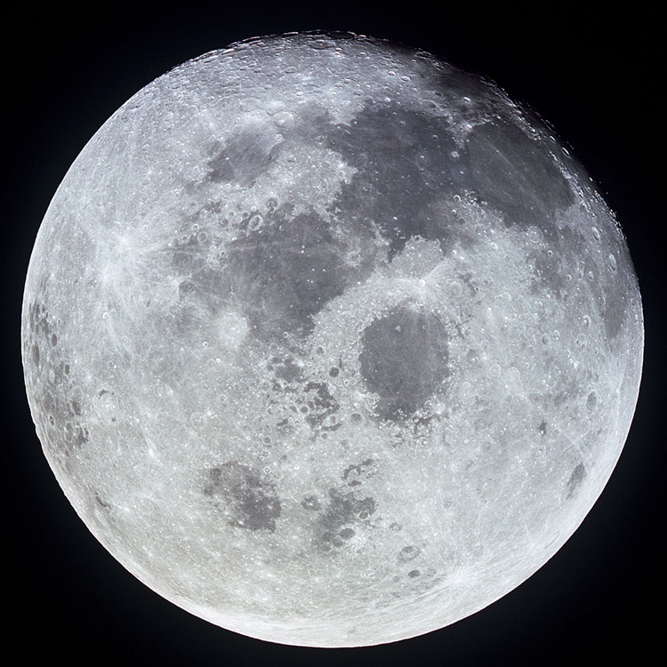
The Moon
This is a photograph of the Moon, taken by NASA.
What do you notice about its surface?
What might these marks tell us about the Moon’s history?
Why can’t we see similar craters on the Earth’s surface?
Notes:
Teacher notes
Students may point out the Moon’s pockmarked, cratered surface. A useful starting point for discussion could be the differences in atmosphere and surface conditions between the Earth and the Moon, developing into a more in-depth explanation of why Earth’s tectonic and atmospheric processes have resulted in the destruction over time of many of the Earth’s older craters and rock record.
More detail on this can be found on the following slide.
This slide covers the Science and Engineering Practice:
Asking Questions and Defining Problems: Ask questions that arise from careful observation of phenomena, or unexpected results, to clarify and/or seek additional information.
Photo credit: Moon image from Apollo 11 © NASA

Slide 11
What can the Moon tell us about Earth?
Billions of years ago, Earth was also covered in craters. However, over time, geologic processes such as tectonic activity and rainfall have gradually eroded these craters. This means that Earth’s early rock record is very sparse.
If the Moon did form from dust and rock fragments from the early Earth, some of these samples could still survive on its surface. These could provide clues about what Earth was like millions of
years ago.
Scientists may look for:
the proportions of minerals on the early Earth
evidence of fossilized microorganisms.

Slide 12
Ages of lunar rocks
To find out the age of the Moon, scientists study lunar rocks that have been brought back to Earth. They date them using a process called radiometric dating.
Radiometric dating uses isotopes (radioactive forms of elements) to determine how long a rock has been in a state of radioactive decay. This is used to figure out how long ago the rock was formed: its absolute age.
By analyzing crustal rocks from the Moon, scientists can come up with a geological timeline for its formation.
Notes:
Teacher notes
For more information about radioactive decay, please refer to the Physical Science: Half-life presentation.

Slide 13
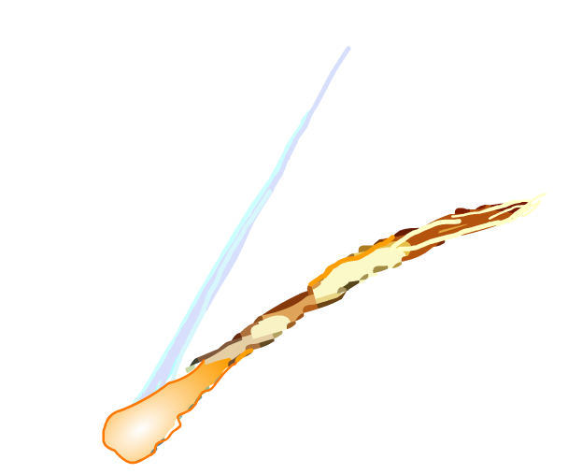
Meteorites on Earth
The period from Earth’s formation to about 4 billion years ago is known as the Hadean eon. During this period, the planet was hit by many meteorites.
Some of these rocks may have melted and sunk under the surface to form part of the Earth’s inner core.
Scientists have also theorized that these meteorite impacts could have helped to create Earth’s tectonic plates.
Meteorites found in Australia have been dated to 2.7 billion years ago and can provide data about Earth’s early atmosphere.

Slide 14
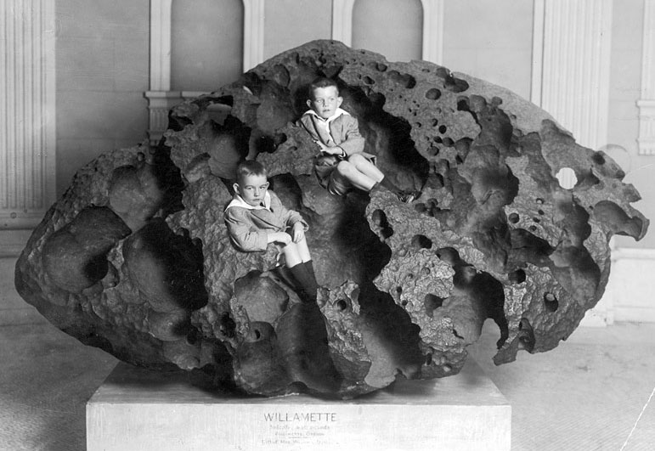
Meteorite weathering
Meteorites in space or on planets without oxygenated atmospheres can remain unchanged for millions of years.
Meteorites that land on Earth are subject to:
oxidation from the atmosphere
chemical erosion
rain and wind.
These are all forms of weathering.
Why does the meteorite on the right look the way
it does?
Notes:
Teacher notes
The image here is the Willamette Meteorite, photographed in 1911. The visible crevasses are there for two reasons:
the combination of speed, heat and pressure when the meteorite entered the Earth’s atmosphere
thousands of years of weathering.
Rainwater reacted with minerals in the rock, producing sulfuric acid. The acid then dissolved the softer parts of the meteorite.
This slide covers the Science and Engineering Practice:
Asking Questions and Defining Problems: Ask questions that arise from careful observation of phenomena, or unexpected results, to clarify and/or seek additional information.
Photo credit: This image is in the public domain in the USA.

Slide 15
Earth’s history – true or false?
Notes:
Teacher notes
This true-or-false activity could be used as a review of Earth’s history, or at the start of class to gauge students’ existing knowledge of the subject matter. Colored traffic light cards (red = false, yellow = don’t know, green = true) could be used to make this a whole-class exercise.

