Slide 1
Natural Hazards

Slide 2
Information
Asking Questions and Defining Problems
Developing and Using Models
Analyzing and Interpreting Data
Constructing Explanations and Designing Solutions
1. Patterns
2. Cause and Effect
3. Scale, Proportion, and Quantity
7. Stability and Change

Slide 3
What are natural hazards?
A natural hazard is any naturally occurring event that has the potential to cause harm to people in the area.
Natural hazards can be due to:
tectonic processes
processes on the Earth’s surface
severe weather.
Some examples of natural hazards include:
volcanoes
tsunamis
floods
hurricanes
landslides
droughts.
Do you know what processes cause these natural hazards?
Notes:
Teacher notes
These natural hazard events will be covered in more detail on the next slides, but for clarification: volcanoes and tsunamis are tectonic hazards; floods, hurricanes and droughts are weather hazards; and landslides are surface hazards.

Slide 4
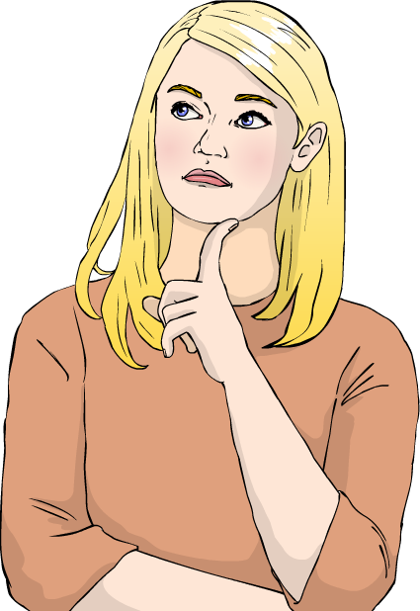
Earthquakes
The Earth’s crust is made up of huge pieces of rock, called tectonic plates. When these plates shift, they can cause natural hazard events on the surface.
Earthquakes are caused when two
tectonic plates are forced past each other. Pressure builds up between them until they suddenly shift, releasing the pressure and causing seismic waves (tremors).
The point at which an earthquake begins is known as its epicenter.
How might the location of an earthquake’s epicenter affect its impact on people?
Notes:
Teacher notes
For more detail about how tectonic processes cause tectonic events and landforms, please refer to the Plate Tectonics presentation, and for more information about earthquake vibrations, please refer to the Seismic Waves presentation.

Slide 5
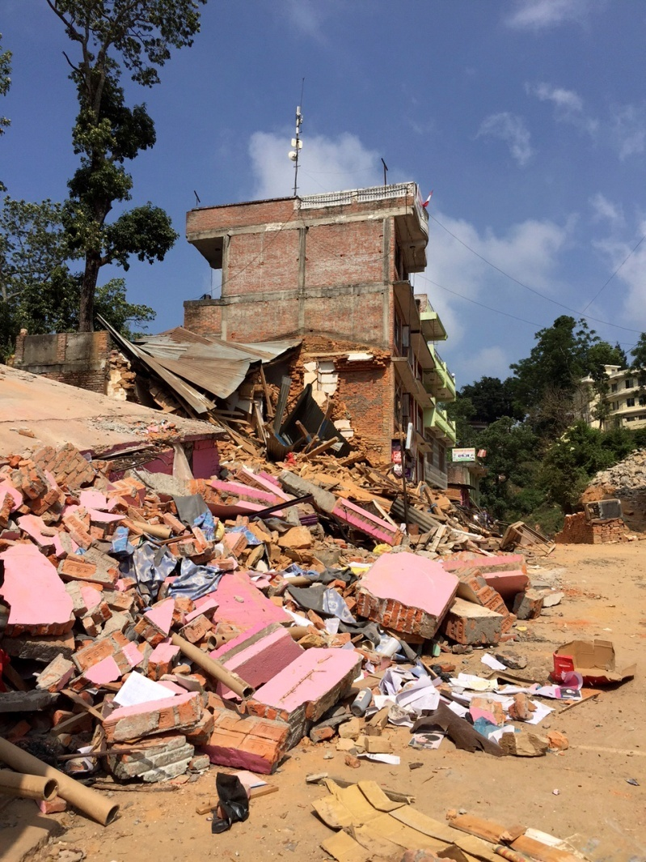
Earthquake hazards
When earthquakes occur, the tremors they release can cause danger to people living near the epicenter.
Seismic waves can cause buildings to sway and sometimes collapse. This image shows the impact of an earthquake in Nepal in 2015.
Collapsing buildings are an example of a primary impact: they occur as a direct result of the hazard event.
Secondary impacts occur as a result of primary impacts.
What secondary impacts might occur due to the damage shown here?
Notes:
Teacher notes
Correct answers include:
risk of injury due to falling masonry or unsafe structures
fire risk due to damaged gas pipes or electricity cables.
Photo credit: Damage after the 2015 Nepal earthquake © Zoe Paxton/DFID, 2015, reproduced under the terms of the Creative Commons Attribution 2.0 Generic licence.

Slide 6
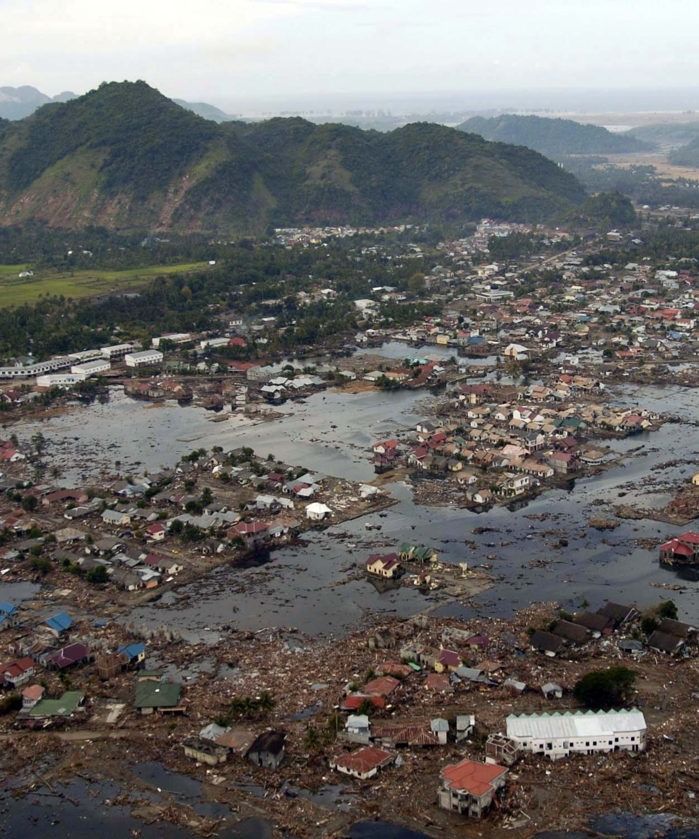
Tsunamis
Tsunamis are a secondary impact of earthquakes. When an earthquake occurs under the sea, it can trigger a huge tidal wave that can cause severe damage to coastal areas.
On December 26th 2004, there was a huge earthquake under the Indian Ocean. This triggered several tsunami waves that led to the death of around 230,000–280,000 people.
As well as the loss of life, the tsunamis caused approximately $19.9 billion of damage in some of the world’s most deprived countries.
Notes:
Photo credit: Sumatra tsunami devastation image is a work of the US federal government and as such is in the public domain.

Slide 7
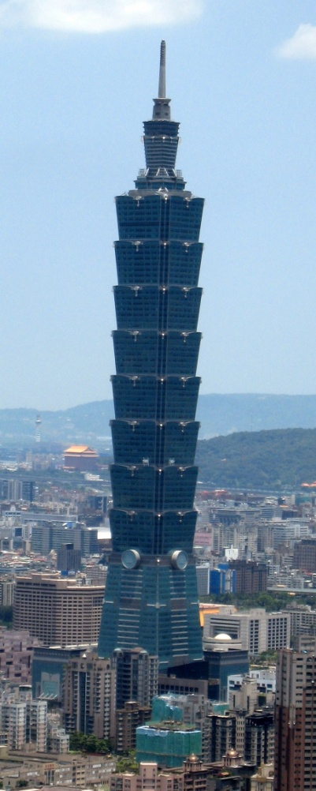
Earthquakes and human activity
Earthquakes are difficult to predict, since scientists cannot accurately tell when two tectonic plates will shift. However, people can prepare for earthquakes in other ways.
One method is to build earthquake-proof buildings in areas particularly prone to earthquakes. These buildings are designed to reduce the amount of damage caused.
Taipei 101 (right) is an example of an earthquake-resistant building. It has a flexible steel frame and reinforced foundations so that it absorbs vibrations, rather than collapsing.
Can you think of any problems with using earthquake-proof buildings?
Notes:
Teacher notes
Encourage students to think about potential barriers to this solution, such as:
earthquake-proofing technology being expensive
nearby existing buildings still being liable to collapse.
Photo credit: Taipei 101, Taiwan © Daymin, 2008, reproduced under the terms of the Creative Commons Attribution 2.0 Generic licence.

Slide 8
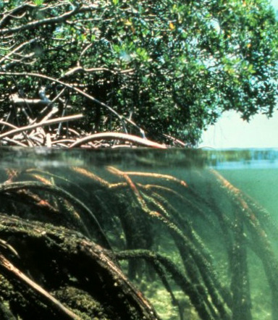
Tsunamis and human activity
In Hawaii, the Pacific Tsunami Warning System monitors seismic activity in the Pacific Ocean. If an earthquake occurs, warnings are sent to nearby beaches so that people can evacuate to a safe place.
Tsunami waves cause less damage if they are interrupted. Interruption can occur through artificial barriers or natural vegetation.
Mangrove forests form a natural barrier to tsunami waves. However, when these are cleared by humans in order to use coastal land, the protection they give is removed.
Notes:
Photo credit: Mangrove forest image is in the public domain in the US because it is a work of the NOAA.

Slide 9
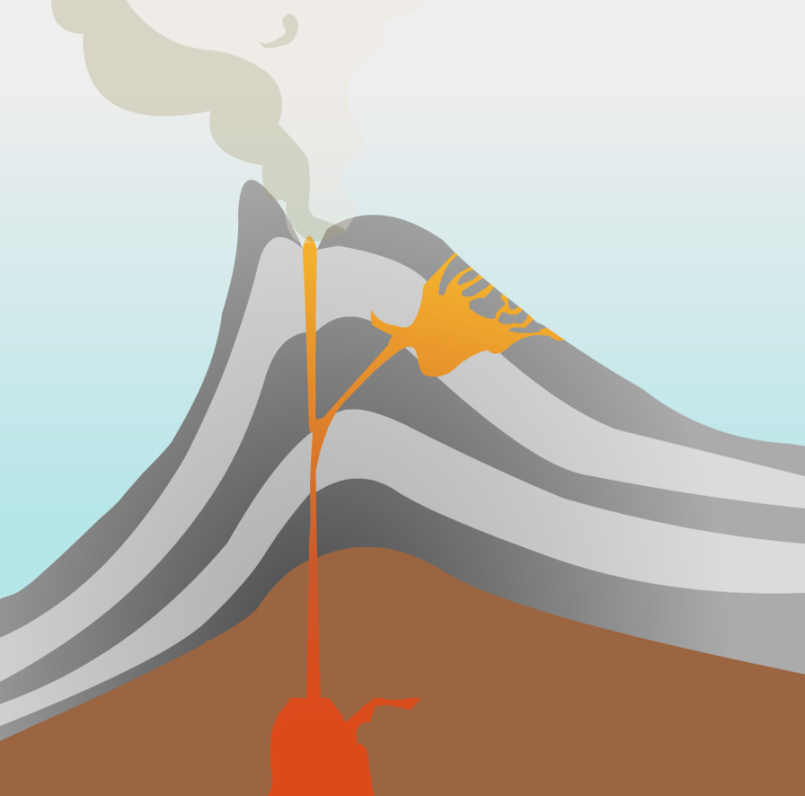
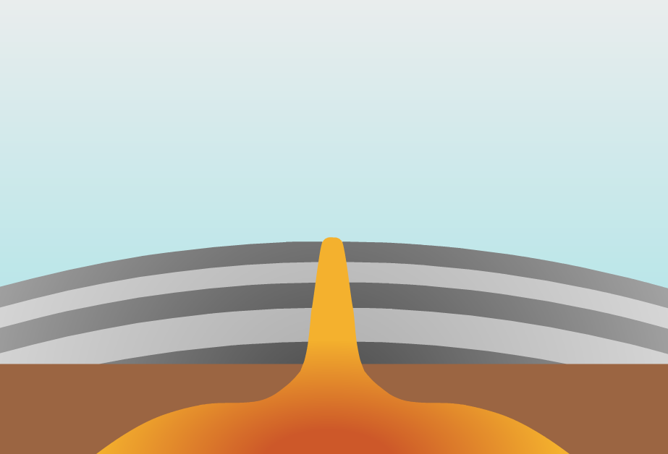
Volcanoes
When volcanoes stop erupting frequently, they are dormant. Volcanoes that no longer contain molten rock are extinct. Extinct volcanoes can form mountainous land features.
What are the differences between these two volcanoes?

Slide 10
How do volcanoes form mountains?
Volcanoes that erupt due to high
pressure form tall mountains
with steep sides. These are
known as stratovolcanoes.
Mount Kilimanjaro is made up of three stratovolcanoes.
Volcanoes that erupt more frequently and with less pressure form mountains with gentle sides. These are known as shield volcanoes.

Slide 11
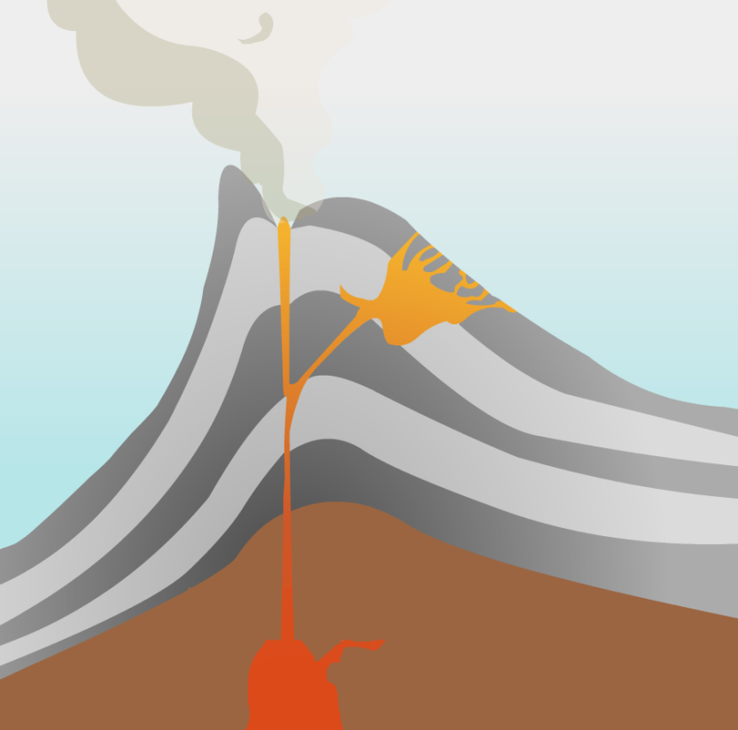
Mass wasting
As a stratovolcano forms, it builds up layers of ash and rock around it.
Eventually, its sides become too steep to support: they collapse and slide down the mountain. This process is called mass wasting.
Mass wasting does not only happen at volcanoes. It can happen anywhere there are steep slopes.
Can you think of any other examples of mass wasting?
What might trigger a large amount of mass wasting?
Notes:
Teacher notes
Other examples of mass wasting include:
rockfalls
landslides
mudslides
avalanches.
Factors affecting the rate of mass wasting include:
severe weather, e.g. rain or wind
tectonic activity, e.g. earthquakes
changes in plants and vegetation, e.g. deforestation.

Slide 12
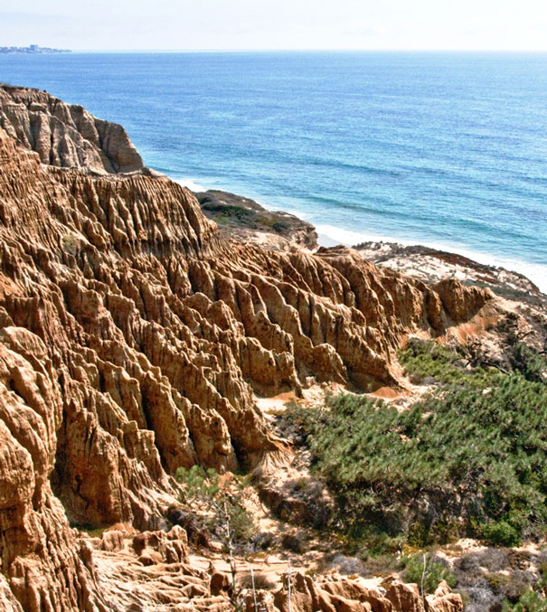
Coastal erosion
Another destructive force that shapes Earth’s land features is erosion. This is the wearing away of rock and other material due to other processes.
One of the key contributors to erosion is the tide. Waves can break on the shore with a large amount of force, resulting in damage and coastal erosion.
How has coastal erosion affected the cliffs in this photo?
Can you think of any problems or dangers of coastal erosion?
Notes:
Teacher notes
Encourage students to examine the shape of the rocks. How were the holes and crevasses made? What can they tell you about the hardness or softness of the rocks?
Dangers of coastal erosion include:
falling rocks and landslides
houses and paths collapsing
This slide covers the Science and Engineering Practice:
Asking Questions and Defining Problems: Ask questions that arise from careful observation of phenomena, or unexpected results, to clarify and/or seek additional information.
Photo credit: Cliff erosion image has been released into the public domain by its author, Athene cunicularia, and is reproduced free from any known copyright restrictions.

Slide 13
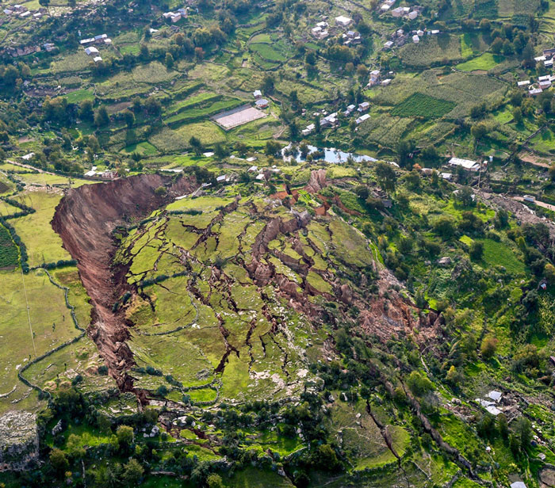
Mass wasting, erosion and human activity
Erosion and mass wasting can both cause damage to buildings due to surface movement. Coastal homes are at risk if erosion wears away the ground on which they are built.
Mass wasting events such as landslides can cause huge sections of terrain to move downhill.
What do you think might
happen to houses on the
moving land in this photo?
What are the dangers to nearby buildings or settlements?
Notes:
This slide covers the Science and Engineering Practice:
Asking Questions and Defining Problems: Ask questions that arise from careful observation of phenomena, or unexpected results, to clarify and/or seek additional information.
Photo credit: Landslide in Peru © Galeria del Ministerio de Defensa del Perú, 2018, reproduced under the terms of the Creative Commons Attribution 2.0 Generic licence.

Slide 14
How do hurricanes form?
Notes:
This slide covers the Science and Engineering Practice:
Constructing Explanations and Designing Solutions: Apply scientific ideas, principles, and/or evidence to provide an explanation of phenomena and solve design problems, taking into account possible unanticipated effects.

Slide 15
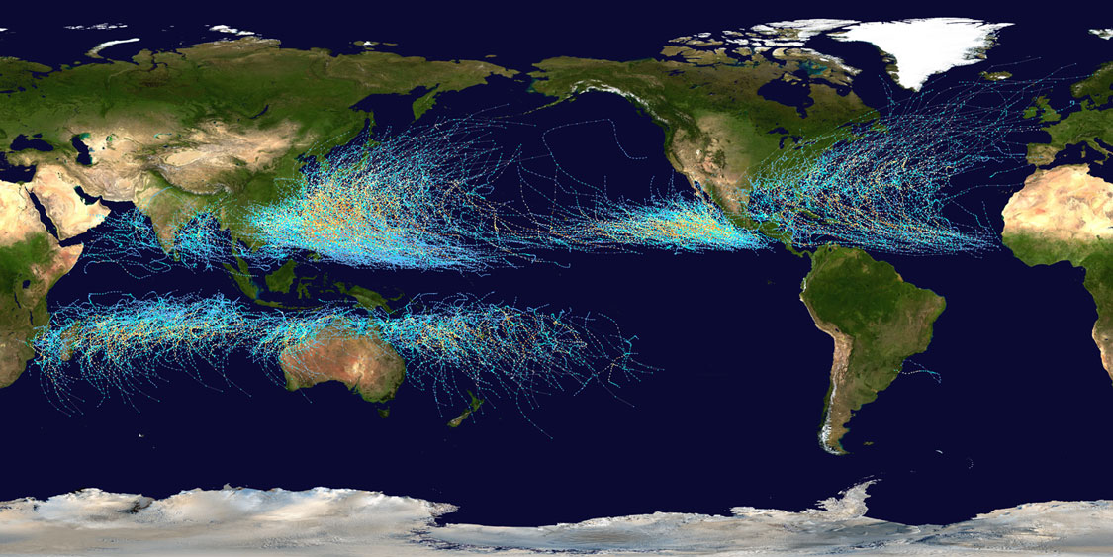
Where do hurricanes form?
Hurricanes occur in two distinct bands north and south of the Equator, but not over the Equator itself. This image shows the tracks (paths) of hurricanes between 1985–2005.
Notes:
Photo credit: Storm tracks 1985-2005 image has been released into the public domain by its author, Nilfanion, and is reproduced free from any known copyright restrictions.

Slide 16
Hurricanes and human activity
When hurricanes make landfall (reach land), they become a hazard to people living nearby. Hurricanes can damage or destroy buildings and flood low-lying coastal areas.
People living in vulnerable places might prepare for a hurricane by reinforcing their homes against strong winds and installing backup generators in case of a power outage.
In the US, the National Hurricane Center issues warnings and recommendations when necessary. Flights may be canceled and some people may evacuate (leave town).

Slide 17
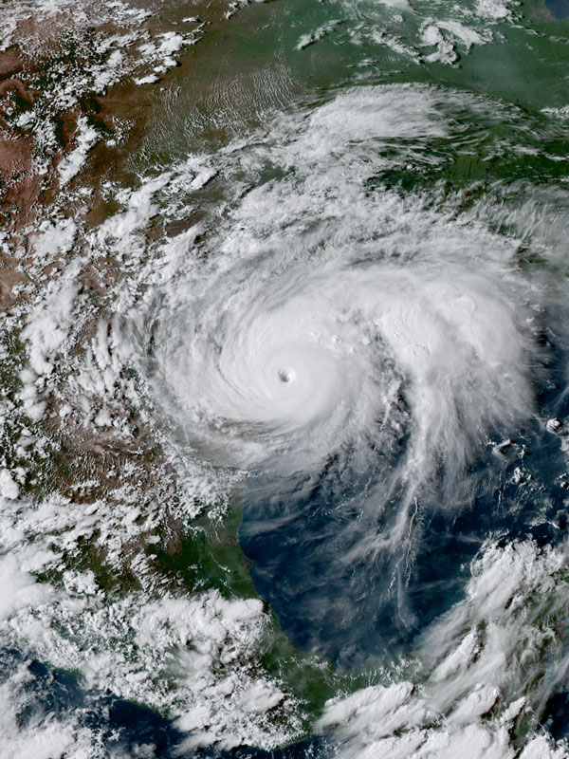
Preparing for a hurricane
Governments and scientists might prepare for hurricanes by:
monitoring cloud patterns to spot developing storms
using past storm data to predict likely paths of current storms as they develop.
Once a storm has been identified, its development is monitored. If it is large enough, it might be given a name.
Have you ever heard about a named hurricane on the news?
How might the actions above help people prepare for a hurricane?
Notes:
Teacher notes
Students may name any number of recent hurricanes. Some of the largest that have hit the USA include:
Hurricane Harvey (2017)
Hurricane Matthew (2016)
Hurricane Sandy (2012)
Hurricane Katrina (2005).
If a hurricane is likely to hit a populated area, inhabitants can be advised to prepare themselves, stock up on food and warm clothes, or even evacuate in severe cases.
Photo credit: Hurricane Harvey satellite image is in the public domain in the US because it is a work of the NOAA.

Slide 18
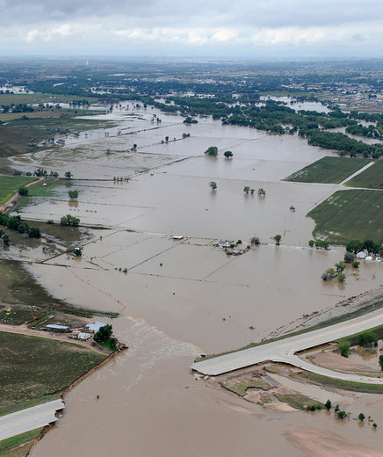
Floods
During rainfall, water is absorbed into the ground. Floods occur when the ground becomes saturated (soaked) and cannot absorb any more. Floods can be a secondary effect of hurricanes or occur separately as a result of heavy rain.
Floods are more likely to happen in cities near rivers. Sidewalks and roads are usually made of non-porous materials (such as concrete) that do not allow water to drain through.
Floods can be difficult to predict. Some floods may happen as a result of intense, sudden rainfall: these are known as flash floods.
Notes:
Photo credit: 2013 Colorado flooding image is a work of the Environmental Protection Agency and as such is in the public domain.

Slide 19
Floods and human activity
Floods can lead to loss of life as well as damage to buildings and infrastructure (roads and power supplies). Children and the elderly are the most at risk from rising water levels.
Floodwater can quickly cause sewerage systems to overflow. This can contaminate drinking water, leading to shortages. It can also spread waterborne diseases like cholera.
Flood damage takes a long time to rebuild and repair. Not only is it expensive, but it can also result in a loss of earnings for residents.
For example, a flooded office building could put many people out of work for months.
This is an example of a long-term effect.

Slide 20
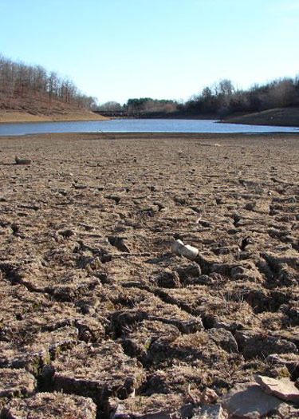
Droughts
A drought is a long period during which an area receives lower than average rainfall. Droughts cause water shortages, which in turn can lead to crop failures and food shortages.
California experienced a severe drought from 2011–2017. Residents were asked to reduce their
usage by 25% in order to save water.
California’s agricultural industry accounts for 80% of the state’s total water use, and was badly affected by the drought. Many trees and plants died throughout the area.
What difference might there be between these impacts of drought and the impacts in a poorer area like rural Chad, in Africa?
Notes:
Teacher notes
The answer to this question will be covered in more detail on the next slide.
Photo credit: Dry California riverbed image is in the public domain in the US because it is a work of the NOAA.

Slide 21
Droughts and human activity
Lake Chad in northern Africa borders four countries: Chad, Niger, Nigeria and Cameroon. The water levels have been dropping since the 1960s and this is a problem for the many people who depend on the lake as their only source of water.
Agriculture around Lake Chad is often subsistence farming: people growing crops to feed themselves and their families, rather than to sell for profit.
Water shortages have forced many people to move away from the area. Over 2.5 million people have already been displaced, and this mass migration is predicted to continue in the future.

Slide 22
What is the greenhouse effect?
Notes:
Teacher notes
This animation can be used to illustrate the principles of the greenhouse effect. Students could be asked to consider the impact of rising greenhouse gases on the natural phenomenon of the greenhouse effect. How does this form a feedback loop? What would need to happen before the feedback loop was broken?
For more information on the greenhouse effect, please refer to the Climate Systems presentation.
This slide covers the Science and Engineering Practice:
Developing and Using Models: Use a model to provide mechanistic accounts of phenomena.

Slide 23
The greenhouse effect
The greenhouse effect is an important reason why life is able to survive on Earth. However, as more greenhouse gases are released into the atmosphere, the process has sped up.
The enhanced greenhouse effect is linked to:
rising average surface temperatures
unpredictable or severe weather patterns
the loss of polar ice caps
rising global sea levels.
What problems might be caused or intensified by these impacts?
Notes:
Teacher notes
Encourage students to consider:
the effect of rising temperatures on global biomes
the impact of severe weather on human settlements
the impact of melting ice caps on global sea levels.

Slide 24
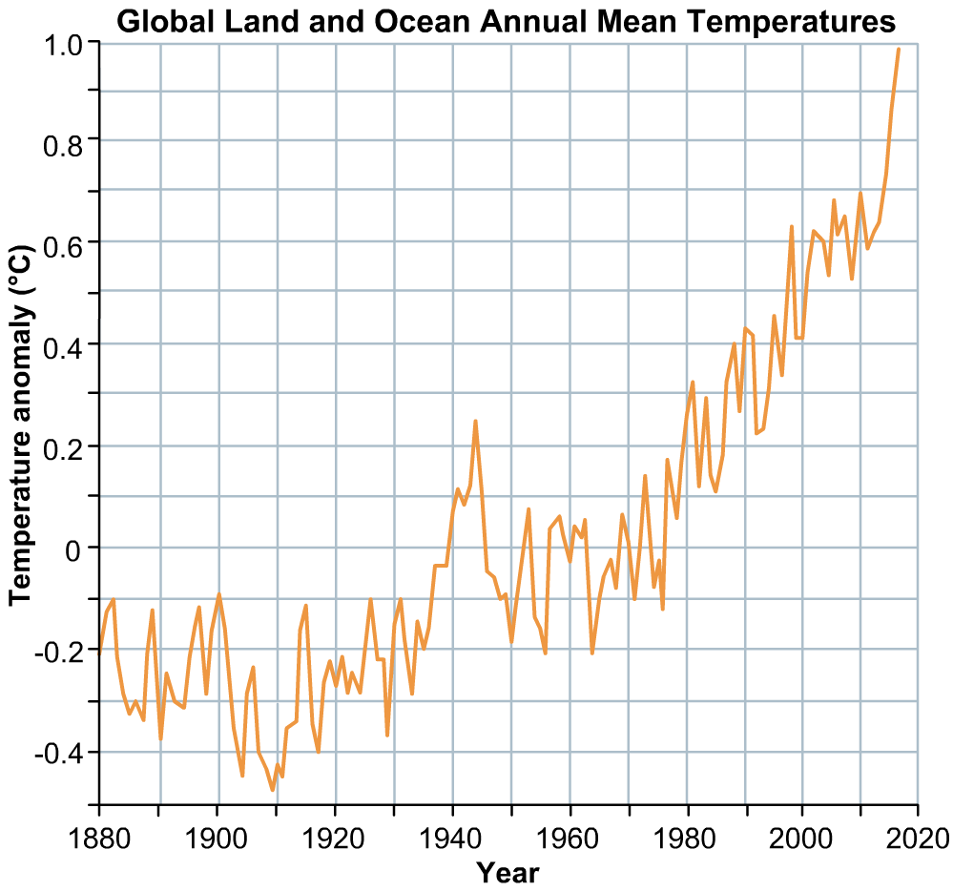
How have surface temperatures changed?
This graph shows the average global land and ocean surface temperature change between 1880 and 2018.
What general trends do you notice?
Can you think of any problems that might be caused by these trends?
Based on the pattern shown on this graph, what might happen to global temperatures in the future?
Notes:
Teacher notes
Students could be asked to hold up a ruler or pen to show the general upward trend of this graph. The most noticeable feature on this graph is the leap in temperatures around 1943, which could correlate with human activities during the Second World War (1939–1945). Encourage students to think about problems they have already learned about in this presentation, such as the shrinking of Lake Chad, and how rising temperatures could affect it.
For more information about increasing global temperatures and related climate effects, please refer to the Climate Change and Climate Systems presentations.
This slide covers the Science and Engineering Practice:
Analyzing and Interpreting Data: Analyze data using tools, technologies, and/or models (e.g., computational, mathematical) in order to make valid and reliable scientific claims or determine an optimal design solution.
Data credit: NASA (Public domain data adapted and reproduced free from any known copyright restrictions.)

Slide 25
Climate change
The greenhouse effect is just one example of how climates can change over time. When climate changes, it can cause mass food shortages or displace entire populations.
The UN Food and Agriculture Organization estimates that between 2008 and 2015, about 26 million people each year were forced to migrate due to climate or weather disasters.
Often the people forced to migrate are people who live in poverty in rural areas. They are also subsistence farmers who depend on regular rainfall for their crops to survive.

Slide 26
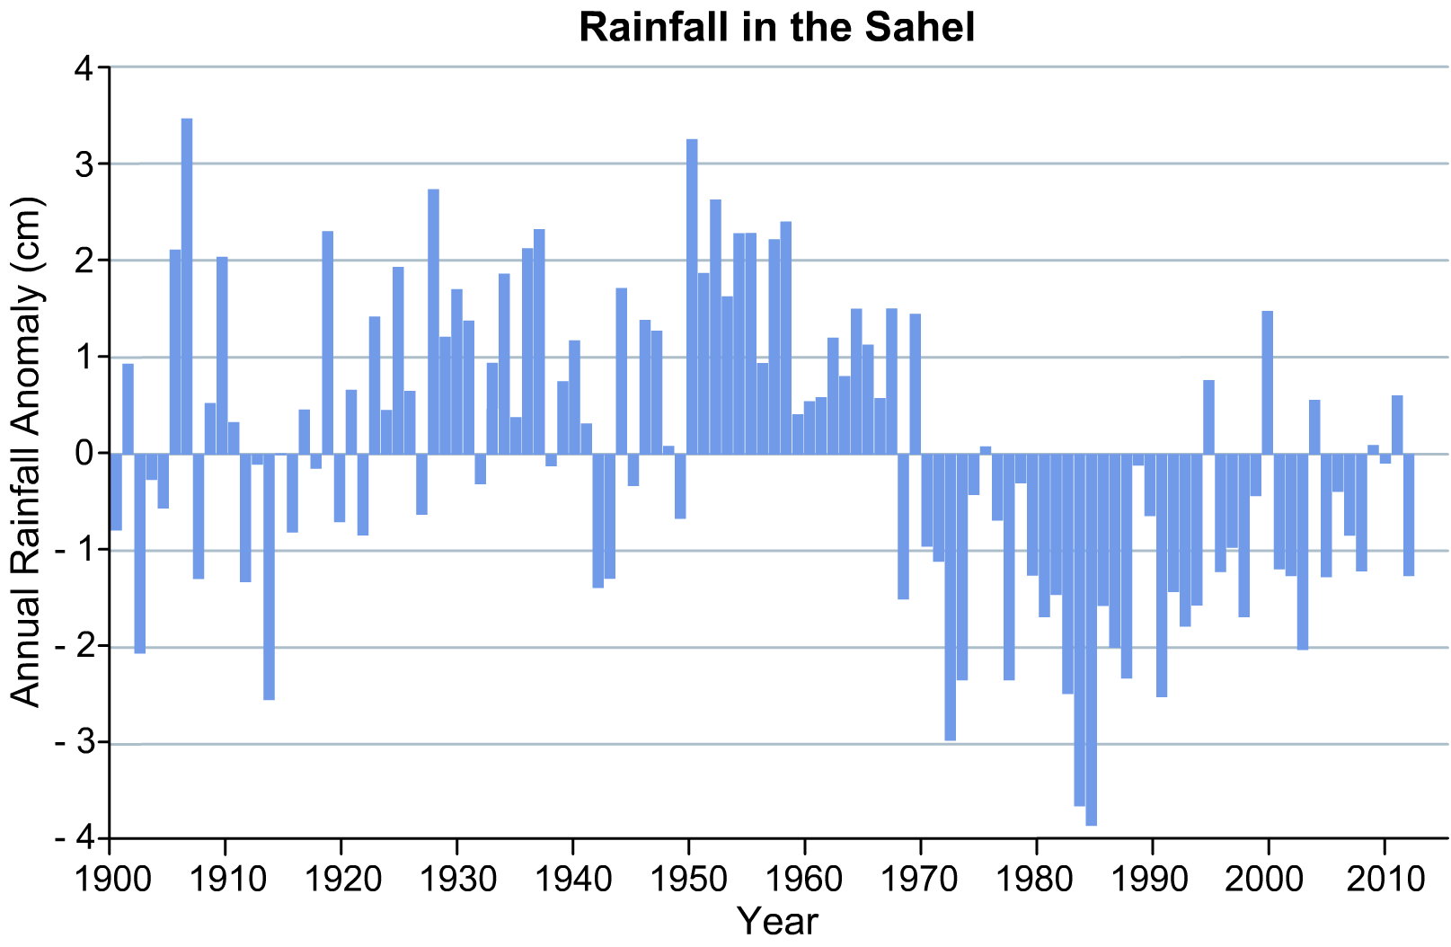
Climate change in the Sahel
The Sahel is a region in Africa, just south of the Sahara Desert. It is a semi-arid area, which means that it is hot all year round, with very low levels of rainfall.
When it does rain, the water is very important to the plants and crops that grow in this region.
This graph shows the average rainfall in the Sahel over the past 100 years.
What trends can you see? How might they impact farmers living in the Sahel?
Notes:
Teacher notes
Bear in mind that this graph shows rainfall anomalies: whether the rainfall levels were higher or lower than average, and by how much. Students may note that the period between 1950 and 1970 saw higher than average rainfall, but the period since 1970 has been much lower.
This slide covers the Science and Engineering Practice:
Analyzing and Interpreting Data: Analyze data using tools, technologies, and/or models (e.g., computational, mathematical) in order to make valid and reliable scientific claims or determine an optimal design solution.

Slide 27
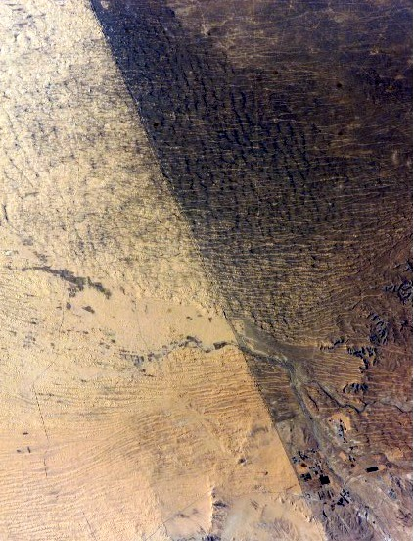
Livestock farming
People living in the Sahel are often nomadic livestock farmers: they move from place to place to find fresh areas for their animals to graze.
However, overgrazing is now a problem in the Sahel. This is when too many animals feed from one patch of land, causing the vegetation there to die.
Soil in the Sahel is typically thin and vulnerable to erosion. Without plants’ roots to hold it together, it can wash away during the rainy season, preventing them from growing back.
Notes:
Teacher notes
This image shows the border between Egypt, left, and Israel, right. The land on the Egyptian side has been overgrazed.
Photo credit: Satellite image of the border between Israel and Egypt is in the public domain because it was solely created by NASA.

Slide 28
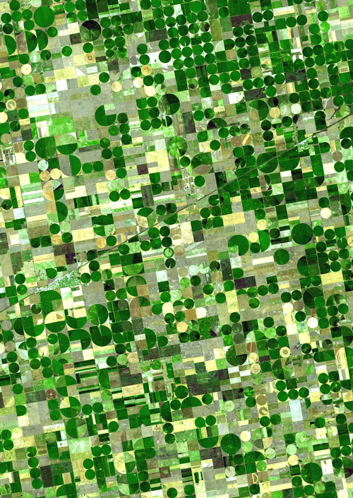
Changes to crops
Rain in the Sahel usually only falls during two or three summer months. For the rest of the year, the area is extremely dry.
Crops grown in these areas need to be drought-resistant, meaning that they are better able to survive with less water.
In some areas of the Sahara, pumped water is supplied to farmland through rotating sprinkler systems, resulting in circular fields. This is known as pivot farming, and is also used in drier parts of the US.
Notes:
Photo credit: Pivot farming in Kansas image is in the public domain because it was solely created by NASA.

Slide 29
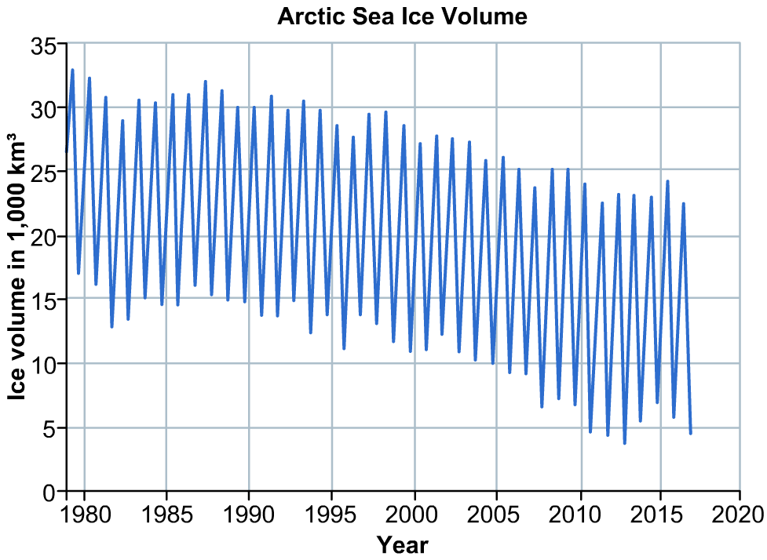
How has the volume of polar ice changed?
This graph shows the change in the volume of Arctic sea ice between 1980 and 2017.
What general trends do you notice?
When glacial and sea ice melts, it leads to rising sea levels.
What problems
might this cause for future generations?
Notes:
Teacher notes
Students could be asked to hold up a ruler or pen to show the general downward trend of this graph.
Problems associated with melting ice and sea level rise include:
increased ocean salinity and acidity
increased erosion and slumping in coastal areas
saltwater encroaching into freshwater reservoirs.
For more information about how polar ice levels and climate change can lead to feedback loops that cause further change, see the Feedback Systems presentation.
This slide covers the Science and Engineering Practice:
Analyzing and Interpreting Data: Analyze data using tools, technologies, and/or models (e.g., computational, mathematical) in order to make valid and reliable scientific claims or determine an optimal design solution.
Data credit: NOAA (Public domain data adapted and reproduced free from any known copyright restrictions.)

Slide 30
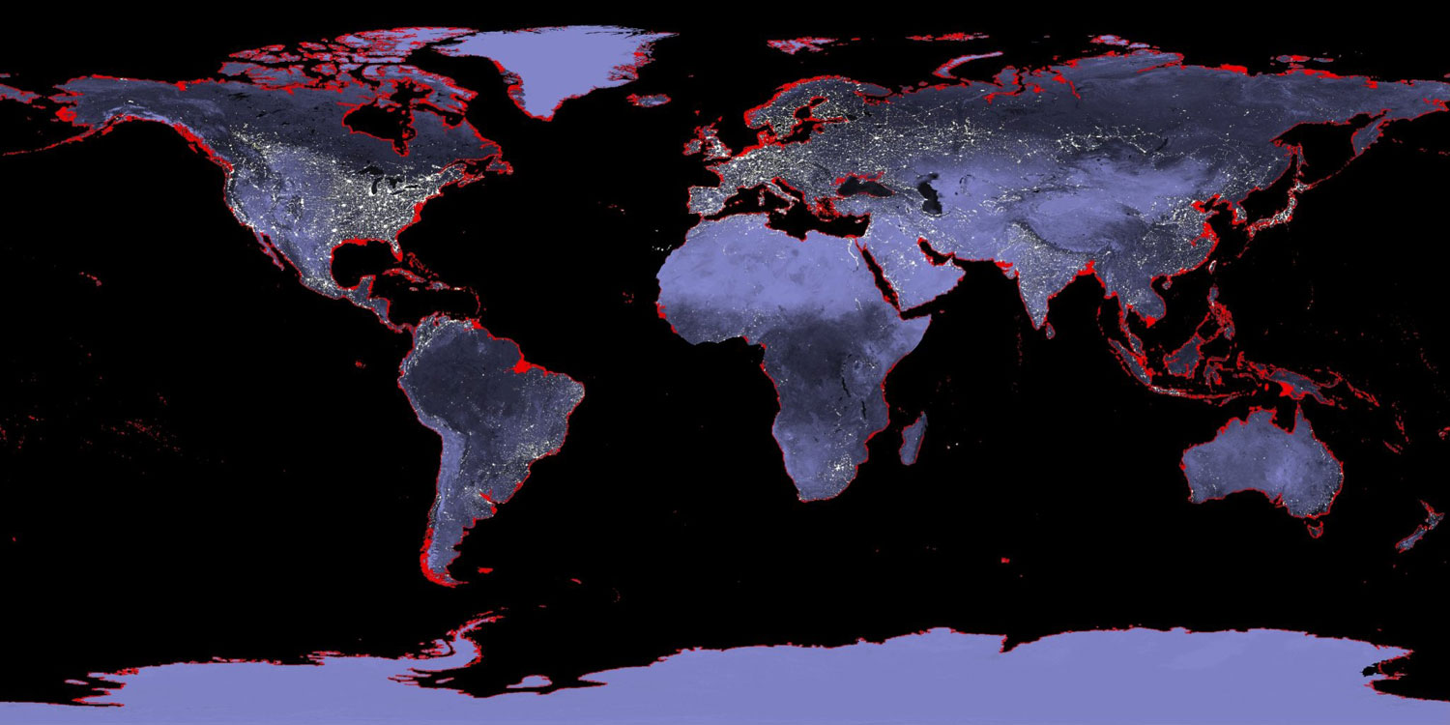
Sea level rise
On this map, areas in red show land that would be underwater if sea levels rose by 6 meters.
Notes:
Photo credit: Sea level rise image is in the public domain because it was solely created by NASA.

Slide 31
A closer look
Here is a closer look at that sea level rise map.
The east coast of the US is particularly vulnerable to sea level rise as much of the land is low-lying.
How might this affect people living in or near these coastal areas?
What would you do if you lived in an area at risk from rising sea levels?
Notes:
Teacher notes
Possible answers include:
move away from the area
try to protect your home.

Slide 32
Sea level rise in Kiribati
Kiribati is a group of 32 islands in the central Pacific Ocean. It has a population of approximately 108,000 people.
The islands are low-lying and extremely vulnerable to sea level rise. Within the next 100 years, the ground is likely to become saturated with saltwater and unable to support the growth of crops. This will also cause fresh water shortages.
President Tong stated in 2013 that, in order for his people to survive, they would need to migrate.
Can you think of any impacts of this mass migration?
Notes:
Teacher notes
The impacts could be positive or negative. Positive impacts include:
media attention, increased awareness and a subsequent global drive towards green solutions to combat sea level rise
rich cultural mix brought to the countries to which Kiribati natives migrate.
Negative impacts include:
loss of culture, land and heritage for Kiribati people
cost of rehousing thousands of climate refugees
legal issues and disputes due to loss of property and income.

Slide 33
True or false?
Notes:
Teacher notes
This true-or-false activity could be used as a review, or at the start of class to gauge students’ existing knowledge of the subject matter. Colored traffic light cards (red = false, yellow = don’t know, green = true) could be used to make this a whole-class exercise.

