Slide 1
Plate Tectonics

Slide 2
Information
Asking Questions and Defining Problems
Developing and Using Models
Constructing Explanations and Designing Solutions
1. Patterns
2. Cause and Effect
3. Scale, Proportion, and Quantity
6. Structure and Function

Slide 3
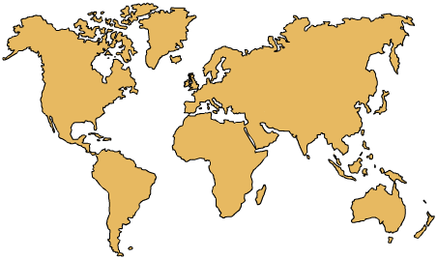
How does the Earth’s surface change?
The shapes and positions of the continents form a familiar image, but they have not always looked like this.
The Earth’s surface is dynamic.
Earthquakes, volcanic activity
and other geologic processes have been gradually changing it over millions of years.
The key geologic theory that explains how the Earth’s surface changes now and has changed in the past is called plate tectonics.
So what exactly is the theory of plate tectonics and how was it developed?

Slide 4
Introducing plate tectonics
Notes:
Teacher notes
This four-stage interactive animation about plate tectonics uses the metaphor of boiling soup to help enable students to visualize this concept. Suitable prompts could include:
Stage 1: Why aren’t we normally aware of the movement of the Earth’s crust?
Stage 2: What is the effect of the crusts moving apart?
Stage 3: What is the effect of the crusts moving towards each other?
Stage 4: How do the plate boundaries relate to areas of volcanic activity and earthquakes?
This slide covers the Science and Engineering Practice:
Developing and Using Models: Use a model to provide mechanistic accounts of phenomena.

Slide 5
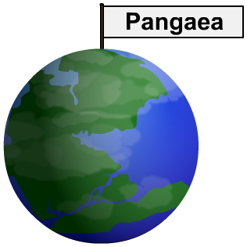
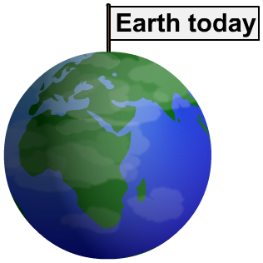
Have the continents moved?
Alfred Wegener was a key figure in changing ideas about the Earth’s surface. In 1912, he proposed that all the continents were once joined in a single supercontinent, called Pangaea.
Wegener suggested that Pangaea began to break up about 200 million years ago and that the pieces drifted apart to form the present day continents.
At the time, Wegener’s theory of “continental drift” was dismissed by geologists because he could not give a convincing explanation for how the continents were able to move.

Slide 6
How was Wegener’s theory developed?
Notes:
Teacher notes
This historical sequence could be used to explore how science works. While viewing the sequence, it could be highlighted that it can take time for new theories to be absorbed into body of scientific knowledge and this is often reliant on gathering more evidence to support the theory.
In this example, although Wegener’s theory initially met with skepticism, later research using new submarine technology provided further evidence to support his theory.
This slide covers the Science and Engineering Practice:
Constructing Explanations and Designing Solutions: Apply scientific ideas, principles, and/or evidence to provide an explanation of phenomena and solve design problems, taking into account possible unanticipated effects.

Slide 7
How have the continents changed?
Notes:
Teacher notes
This interactive activity enables students to explore how the continents have changed. While viewing the sequence, the jigsaw fit of the continents could be highlighted.

Slide 8
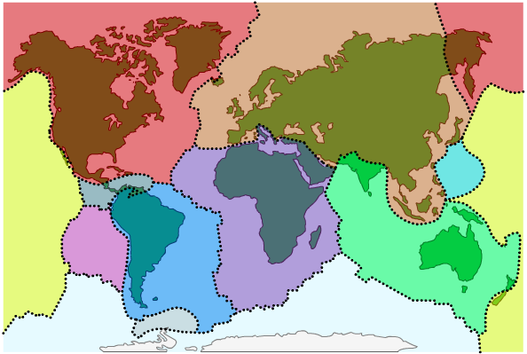
What is the theory of plate tectonics?
Geologists observe seafloor spreading and other effects to develop ideas about how the continents move. In 1967, these ideas were linked in the theory of plate tectonics.
According to this theory, the Earth’s crust is like a jigsaw puzzle made up of giant sections called tectonic plates.
These plates “float” on top of the mantle and so can move around the Earth’s surface.
There are 8 major tectonic plates and several minor plates.

Slide 9
How old are tectonic plates?
Tectonic plates are divided into two different types:
continental plates, which are less dense and make up the major land masses like North America and Asia
oceanic plates, which are more dense and lie under the planet’s oceans.
continental plate
oceanic plate
The oldest continental crust is about 4 billion years old. In comparison, the oldest oceanic crust is about 200 million years old.

Slide 10
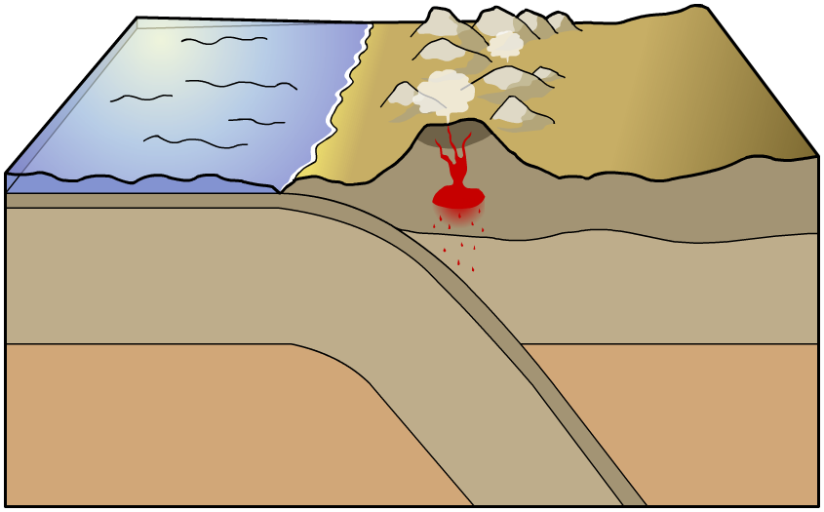
What is a plate boundary?
The area where two tectonic plates meet is called a plate boundary. Mountains, volcanoes and oceanic trenches are formed at plate boundaries, and earthquakes are more likely to occur here.
continental crust
trench
There are three types of plate boundary: divergent, convergent and transform.

Slide 11
Identifying plate boundaries
Notes:
Teacher notes
This three-stage interactive sequence uses animated arrow diagrams to illustrate the movement that occurs at different plate boundaries. It could be used as an introductory topic or for review. While using the activity, the link between geological hazards and certain movements could be highlighted. Students could be asked to produce similar illustrations in their notebooks.
The animated sequence on the next slide provides a more in-depth look at plate boundaries.
This slide covers the Science and Engineering Practice:
Developing and Using Models: Use a model to provide mechanistic accounts of phenomena.

Slide 12
Effects of tectonic plate movements
Notes:
Teacher notes
This three-stage interactive animated sequence provides a more detailed look at the three types of plate boundaries and introduces some new terminology. While viewing the convergent plate boundary animation, the difference in density between oceanic and continental plates should be stressed. The cyclic nature of the destruction and formation of plate material could also be highlighted.
It is important to stress that although no new plate material is formed at a transform boundary, this does not mean these boundaries are geologically stable, but are in fact very prone to earthquakes.
This slide covers the Science and Engineering Practice:
Developing and Using Models: Use a model to provide mechanistic accounts of phenomena.

Slide 13
What is seafloor spreading?
Notes:
Teacher notes
This interactive sequence explores the theory of seafloor spreading, as proposed by Harry Hess. When viewing the animation, the importance of convection currents and the use of GPS to indirectly observe seafloor spreading could be highlighted.
This slide covers the Science and Engineering Practice:
Constructing Explanations and Designing Solutions: Apply scientific ideas, principles, and/or evidence to provide an explanation of phenomena and solve design problems, taking into account possible unanticipated effects.

Slide 14
What evidence is there for plate tectonics?
Tectonic plate theory hypothesizes that new oceanic crust is constantly being created due to seafloor spreading.
At divergent plate boundaries like the Mid-Atlantic Ridge, the oceanic crust is much younger than it is in the middle of the plate, because it has been created more recently.
Similarly, the North American plate (an example of continental crust) has an older central core. It is younger towards the edges, where it has interacted with other plates to create convergent or transform boundaries.
How can these observations help to prove the theory of plate tectonics?
Mid-Atlantic Ridge
Notes:
Teacher notes
Encourage students to discuss the merits of plate tectonics and how the evidence presented on this slide helps to strengthen the theory.
This slide covers the Science and Engineering Practice:
Asking Questions and Defining Problems: Ask questions that arise from careful observation of phenomena, or unexpected results, to clarify and/or seek additional information.

Slide 15
How do tectonic plates move?
Notes:
Teacher notes
This three-stage interactive animation illustrates how convection currents cause the movement of tectonic plates. Suitable prompts could include:
Stage 1: What type of chemical reaction causes the lower mantle to heat up?
Stage 2: Where else do convection currents occur? Suitable examples include boiling water or coastal breezes.
Stage 3: What happens when the two plates collide?
This slide covers the Science and Engineering Practice:
Constructing Explanations and Designing Solutions: Apply scientific ideas, principles, and/or evidence to provide an explanation of phenomena and solve design problems, taking into account possible unanticipated effects.

Slide 16
How does the Earth’s core generate heat?
We now know that convection currents in the Earth’s mantle are what drive the movement of tectonic plates.
So where does all this heat come from?
In 2011, a seven-year research study found that around 50% of the heat emitted by the Earth is generated from the radioactive decay of unstable isotopes.
Isotopes are the radioactive forms of elements. Over time, unstable isotopes decay, releasing different forms of radiation, including heat.
Radioactive thorium, uranium and potassium in the Earth’s mantle are constantly in a state of radioactive decay.
Notes:
Teacher notes
For more information about isotopes and radioactive decay, please refer to the Half-life presentation.
This slide covers the Science and Engineering Practice:
Constructing Explanations and Designing Solutions: Apply scientific ideas, principles, and/or evidence to provide an explanation of phenomena and solve design problems, taking into account possible unanticipated effects.

Slide 17
Plate tectonics – true or false?
Notes:
Teacher notes
This true-or-false activity could be used as a review of plate tectonics, or at the start of class to gauge students’ existing knowledge of the subject matter. Colored traffic light cards (red = false, yellow = don’t know, green = true) could be used to make this a whole-class exercise.

