Slide 1
Relief

Slide 2
Information
Developing and Using Models
1. Patterns

Slide 3
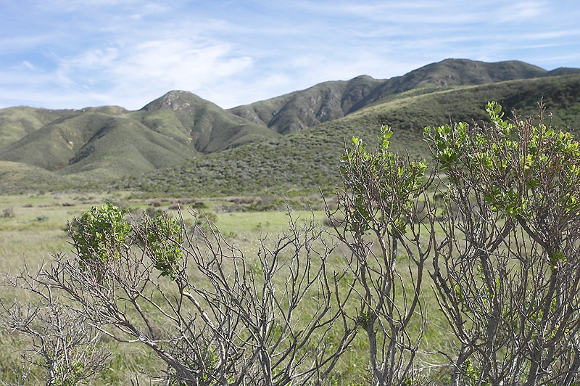
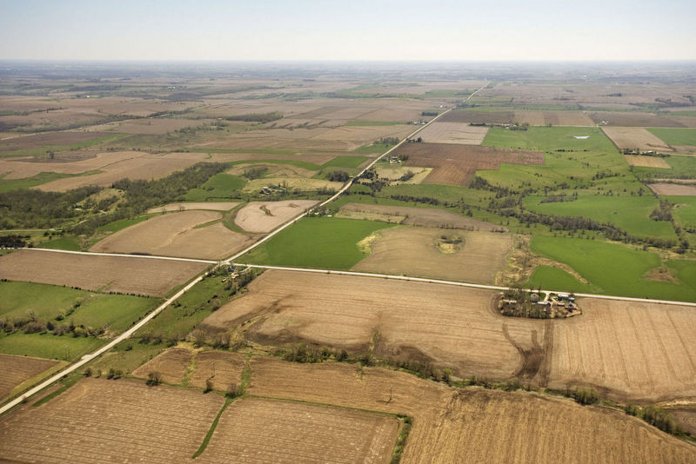
Relief
Relief is the term geographers use to refer to the height and shape of the land.
How would you show the relief of these landscapes on a map?
How many different ways can you think of to show relief?
Notes:
Photo credits: both © 2018 JupiterImages Corporation

Slide 4
How is relief shown on a map?
Relief is shown on maps in three main ways:
contour lines
spot heights
19
32
37
31
40
21
46
14
30
20
12
10
color shading.
10-20 m
21-30 m
31-40 m
41-50 m
Notes:
This slide covers the Science and Engineering Practice:
Developing and Using Models: Develop, revise, and/or use a model based on evidence to illustrate and/or predict the relationships between systems or between components of a system.

Slide 5
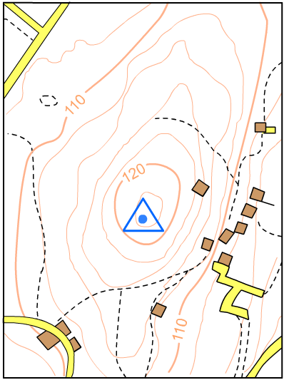
Ways to show relief
height in meters above sea level.
contour line – joins points of equal height.
115
spot height – represents the height of the land at a given point.
triangulation pillar – concrete post used by surveyors.
Notes:
This slide covers the Science and Engineering Practice:
Developing and Using Models: Develop, revise, and/or use a model based on evidence to illustrate and/or predict the relationships between systems or between components of a system.

Slide 6
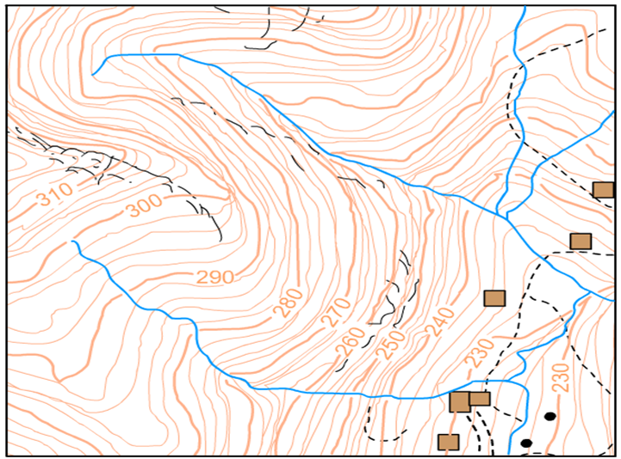
Contours
Relief is often shown on maps by light brown/orange lines known as contour lines.
Contours are lines that join points of equal height.
Contour lines usually have a number attached to them. This number indicates height above sea level.

Slide 7
Drawing contours
Notes:
This slide covers the Science and Engineering Practice:
Developing and Using Models: Develop, revise, and/or use a model based on evidence to illustrate and/or predict the relationships between systems or between components of a system.

Slide 8
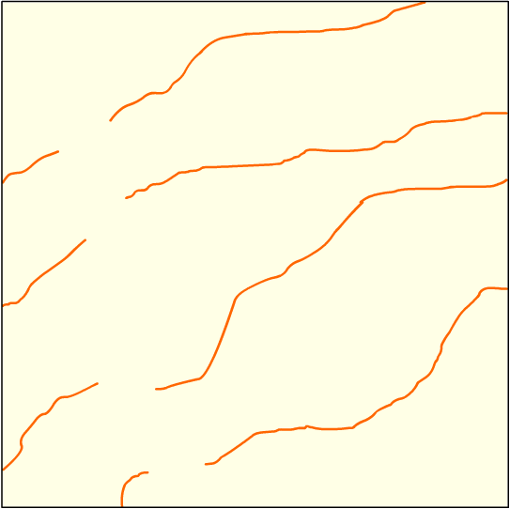
Intervals
Contours are equally spaced in a vertical direction. The equal distances between the contours are called intervals.
The intervals on this diagram are 10 m.
C
B
How can you find out the height of a point between contours?
A
Which point is 15 m high? A, B or C?
20
10
A could be at a height of 15 m.
What height would points B and C be?
Notes:
Teacher notes
In response to the questions, encourage students to estimate heights between contours.
There are no exact answers to the questions but you could discuss with the class what sensible estimates might be.

Slide 9
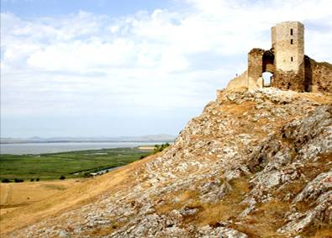
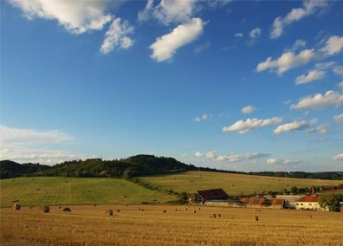
Steep slopes and gentle slopes
Contours are useful. They tells us about the shape of the land without needing to see it.
20
30
40
50
60
When contours are close, the land is steep.
10
When contours are far apart, the slope is gentle.
0
10
Notes:
Photo credits: both © FreeImages.com 2018

Slide 10
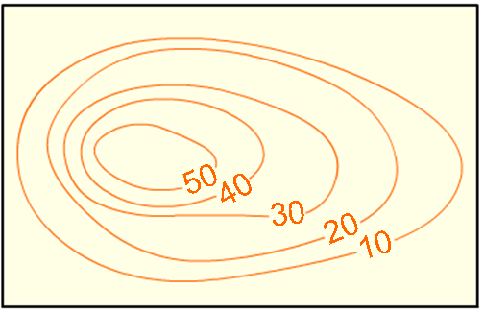
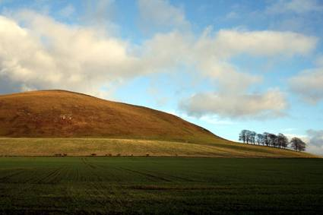
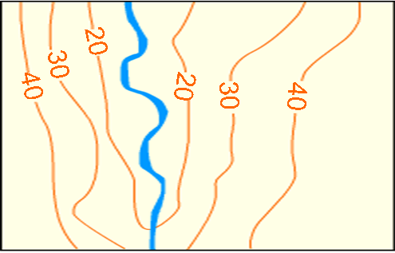
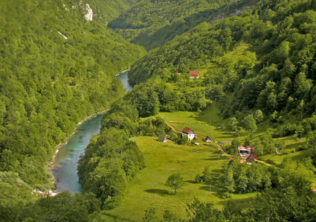
Hills and valleys
A map’s contour lines produce patterns that indicate particular landscape features:
Contours in this formation indicate a hill.
Contours in this formation indicate a river valley.
Notes:
Photo credits: both © FreeImages.com 2018

Slide 11
Labeling landscapes
Notes:
This slide covers the Science and Engineering Practice:
Developing and Using Models: Develop, revise, and/or use a model based on evidence to illustrate and/or predict the relationships between systems or between components of a system.

Slide 12
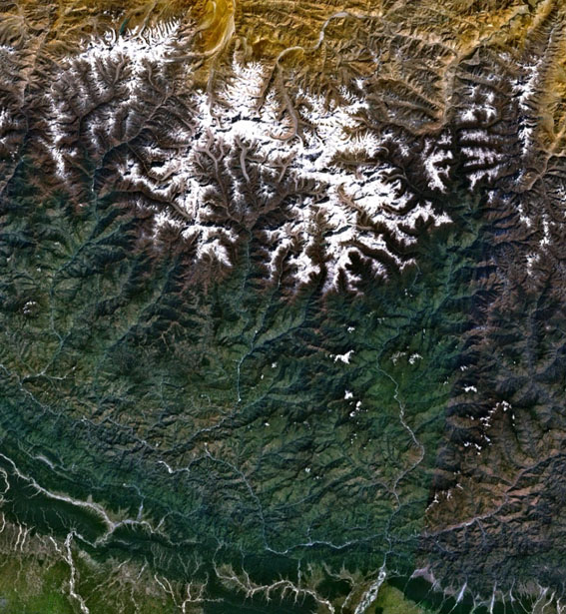
Using color to show relief
Examine this satellite image of Mount Everest.
snow line
How can you tell which areas are higher than other areas?
barren rock
The colors of the landscape produce a distinct pattern which helps us to understand the relief of the area.
green vegetation
river valley
Notes:
Photo credit: Courtesy of NASA

Slide 13
Using color to show height on a map
Notes:
This slide covers the Science and Engineering Practice:
Developing and Using Models: Develop, revise, and/or use a model based on evidence to illustrate and/or predict the relationships between systems or between components of a system.

